Slide 1

UNIVERSITY OF COMPUTER STUDIES (MONYWA)
QUIZ FOR GENIUS
Group Presentation Date: 28.8.2023 (Monday)

Slide 2
Supervised By Daw Phwe Sandi Kyaw
MEMBER LIST
3CS-3: Mg Hein Htet Aung
3CS-4: Mg Hmue Set San
3CS-5: Mg Thet Aung Zin
3CS-1: Ma Phyo Thiri Kyaw
3CS-2: Ma Ingyin San

Slide 3
Outlines
Abstract
Introduction
Objectives
Implementation of the Project
Conclusion
References

Slide 4
Abstract
This is a collection of different types of quizzes for Mathematics, Science, Riddle, Burmese Riddle, Sports, Nature, and so on.
Users can answer with the desired category.
This is intended to the people who want to get knowledge and pleasure by answering knowledgeable questions.
By this system, the user can learn additional knowledge.

Slide 5
Introduction
“Quiz for Genius” is a web-based system.
In this system, user can choose the desired one of the categories, pick out the appropriate level (Easy to Hard) from the chosen category, and then answer the quizzes based on the user selected category and the level in the given limited time.
So, users can improve general knowledge.
New questions can be added to the system by the authorized administrator of the page.
Administrator can update and delete the questions and answers.
Moreover, administrator can also add the new category

Slide 6
Objectives
To evaluate the knowledge, critical thinking, and get into the habit of innovative learning
To help people understand the weaker areas
To help people identify what they know and what they don’t know
To get a better idea
To get a pleasure

Slide 7
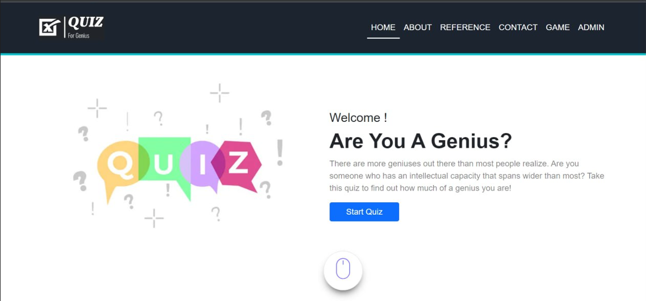
Implementation of the Project

Slide 8
Conclusion
This system provides knowledgeable and exciting questions to the people who are interested in attempting quizzes.
So, users can gain additional knowledge and mind pleasure from this system.
As the users answer quizzes in the precise time limit for every question, this can improve time management skills.

Slide 9
References
Rod Stephens, Programmer’s Reference
http://www.w3resource.com
http://www.stackoverflow.com
http://www.C-Sharpcorner.com
http://www.ASPSnippets.com

Slide 10
THANK YOU

