Slide 1
Fabrication and Simulation of RRAM using HfO₂ as Switching Layer
21IPE337P Semiconductor Process Integration
K Mohammed Hamza-RA2211004010570, Disha Rautela-RA2211004010550
Department of Electronics and Communication Engineering SRM Institute of Science and Technology
May 7, 2025
sha
RRAM using HfO₂

Slide 2










Outline
Introduction
Project Objective
Fabrication Flowchart Project Specifics Fabrication Process Specifications
3
4
5
6
Simulation
I-V Characteristics
Observations
Conclusion
sha
RRAM using HfO₂

Slide 3
What is RRAM?
Introduction
Resistive Random Access Memory (RRAM) is a non-volatile memory technology.
Uses a resistive switching phenomenon to store information. Promising candidate for next-generation memory due to:
Low power consumption High speed
CMOS compatibility Scalability
sha
RRAM using HfO₂

Slide 4
Objective of the Project
Project Objective
To simulate and analyze the fabrication of RRAM using HfO₂ as the switching layer.
Use SEMulator3D to model the full fabrication process flow. Visualize intermediate steps and verify proper layer integration. Analyze structure and layer thickness using 3D modeling.
sha
RRAM using HfO₂

Slide 5
Enhanced RRAM Fabrication and Simulation Flow
Fabrication Flowchart
Start: Si Substrate Cleaning
Deposit Bottom Electrode (TiN, PVD) Pattern/Etch Bottom Electrode
Deposit HfO2 (ALD)
Thickness OK?
Yes
No Adjust ALD Cycles
Deposit Top Electrode (TiN, PVD)
Pattern/Etch Top Electrode
Deposit Isolation Oxide (PECVD) Set Up SEMulator3D Simulation
Run 3D Structure Simulation Analyze Structure & Data
K Mohammed Hamza-RA2211004010570, Di
_{End}RRAM using HfO₂
May 7, 2025
5 / 14
sha Rautela-RA2211004010550

Slide 6
Design Specifics of the Project
Project Specifics
Switching Layer Material: Chose HfO₂ for its high dielectric constant and compatibility with CMOS.
Deposition Methods:
TiN (BE & TE): Physical Vapor Deposition (PVD) HfO₂: Atomic Layer Deposition (ALD)
Simulation Tool: SEMulator3D for process visualization and step-by-step structure modeling.
Layer Thickness: Optimized to ensure switching efficiency and minimal leakage.
Stack Structure: Symmetrical Metal–Insulator–Metal (MIM).
sha
RRAM using HfO₂

Slide 7
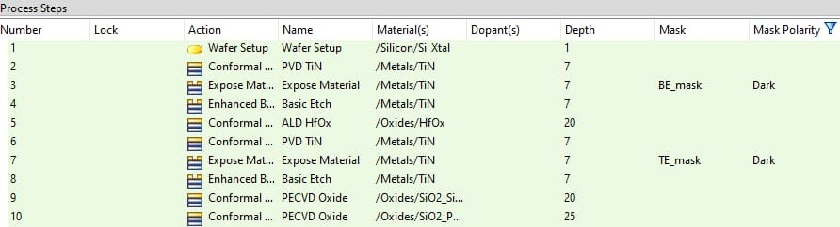
Process Steps Overview
Fabrication Process
Figure: Fabrication steps for RRAM structure in SEMulator3D
sha
RRAM using HfO₂

Slide 8
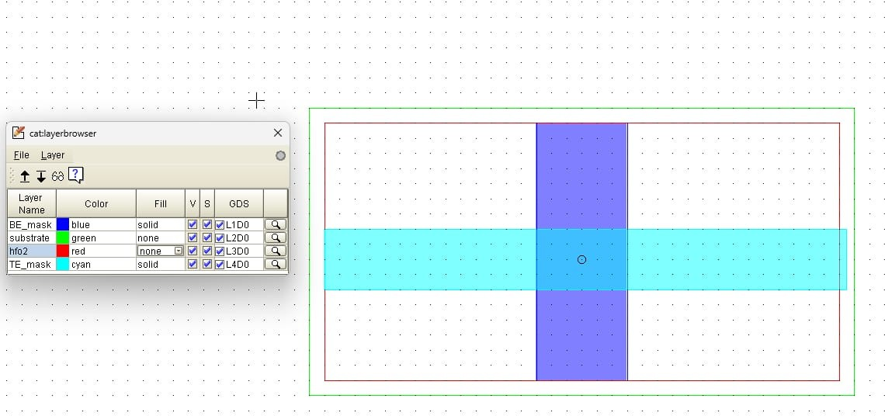
Layer and Mask Layout
Fabrication Process
Figure: Layer layout with BE, TE mask and HfO₂ defined
sha
RRAM using HfO₂

Slide 9
Specifications
Layer Specifications
Layer | Material | Thickness | Deposition Metho
Top Electrode (TE) | TiN | 7 nm | PVD
Switching Layer | HfO₂ | 20 nm | ALD
Bottom Electrode (BE) | TiN | 7 nm | PVD
Passivation/Isolation | SiO₂ or similar | 40 nm | CVD
Substrate | Si | Bulk | Base wafer
Table: Tabulated RRAM Stack Details
sha
RRAM using HfO₂

Slide 10
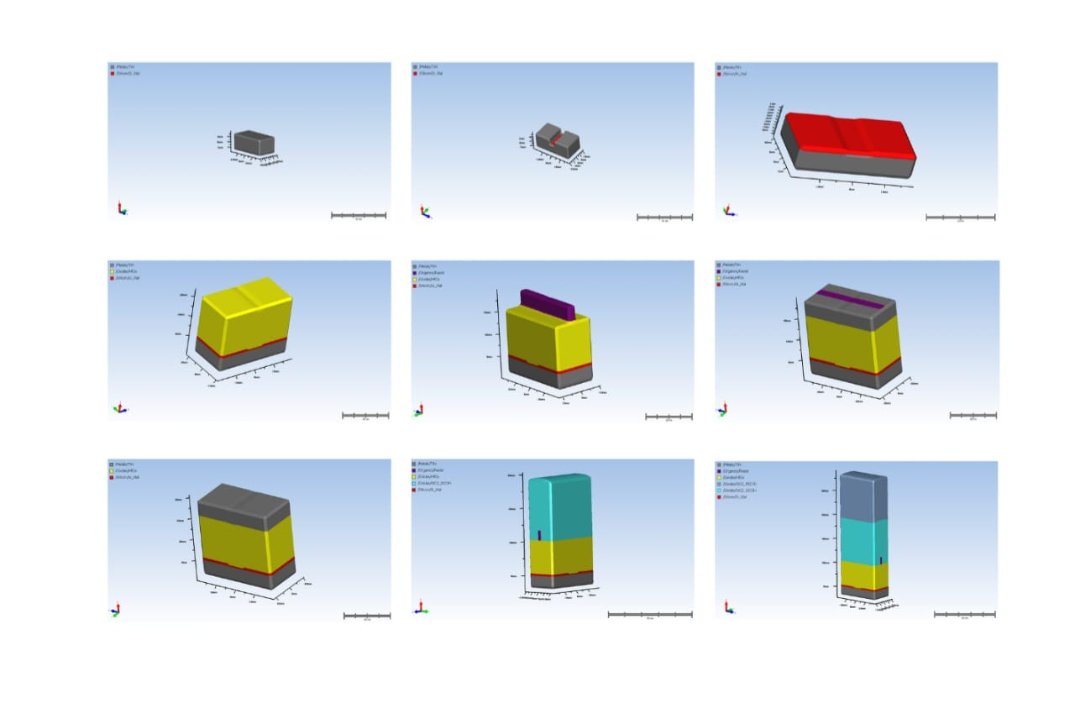
Simulation
3D Model Simulation
sha
RRAM using HfO₂

Slide 11
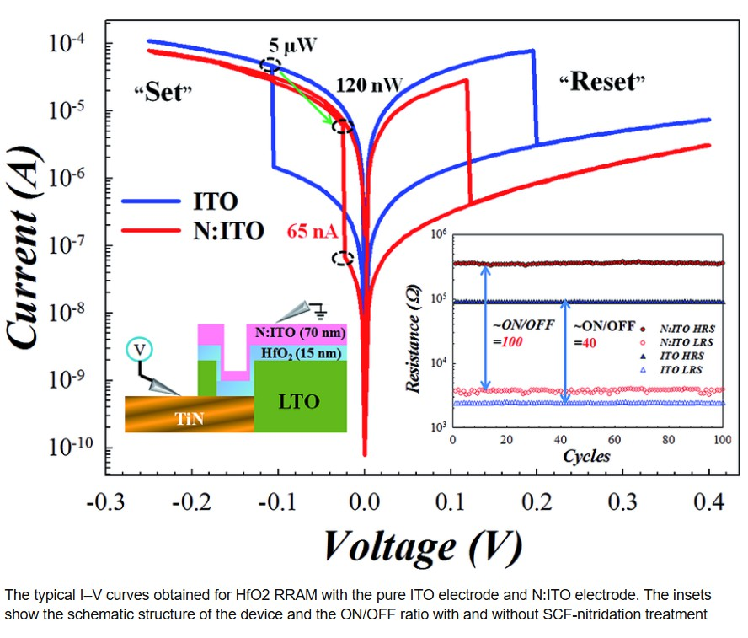
I-V Characteristics
I-V Characteristics of HfO₂ RRAM
sha
RRAM using HfO₂

Slide 12
Key Observations
Observations
HfO₂ switching layer was deposited with 20 nm thickness using ALD. TiN top and bottom electrodes deposited using PVD (7 nm).
Oxide passivation added for structure isolation.
Structure is symmetrical and suitable for future electrical testing.
sha
RRAM using HfO₂

Slide 13
Conclusion
Conclusion
Successfully modeled fabrication of RRAM using SEMulator3D. Simulated structure supports CMOS-compatible design.
Foundation laid for further electrical simulation and reliability testing.
sha
RRAM using HfO₂

Slide 14
Thank You!
Questions?
Conclusion
sha
RRAM using HfO₂

