Slide 1
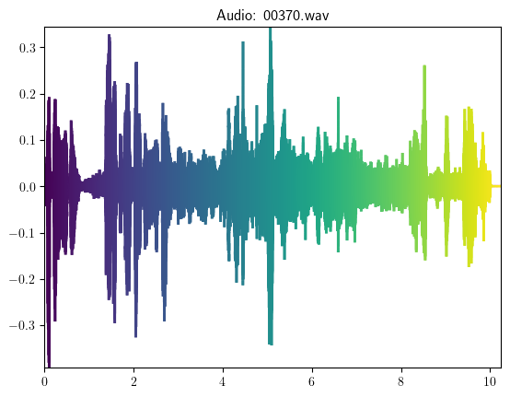


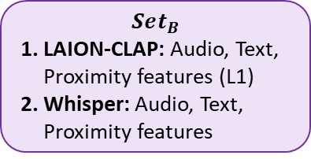




Ensemble Set
Pre-Processor
Pre-trained models
$Set_{A}$
M2D-CLAP: Audio, Text, Proximity features
MS-CLAP: Audio, Text, Proximity features
MGA-CLAP: Audio, Text, Proximity features
Audio-Text Pair
M2D-CLAP
MS-CLAP
Normalize
Audio-Encoder
Text-Encoder
Audio-Encoder
Text-Encoder
Standard Scaler
$$Reg model_{1}$$
MGA-CLAP
LAION-CLAP
Audio-Encoder
Text-Encoder
Audio-Encoder
Text-Encoder
Prediction
$$w_{1}$$
$Set_{B}$
LAION-CLAP: Audio, Text, Proximity features (L1)
Whisper: Audio, Text, Proximity features
Regression models
“Birds singing in the distance, followed by footsteps and soft wind. A woman begins to speak”
Whisper
Optimize weights
Final
Prediction
De-BERTaV3
SVR
Encoder
Decoder
XGBoost
Prediction
$$w_{2}$$
$Set_{C}$
Whisper: Audio features
MS-CLAP: Audio, Text, Proximity features
LAION-CLAP: Audio, Text, Proximity features (L1)
DeBERTa: Text features
Proximity features
$${Reg model}_{2}$$
Cosine Similarity (CS)
Cosine Angle (CA)
Euclidean distance (L2)
Manhattan distance (L1)

