Slide 1

To-Do APP

Slide 2

UI(User Interface)

Slide 3
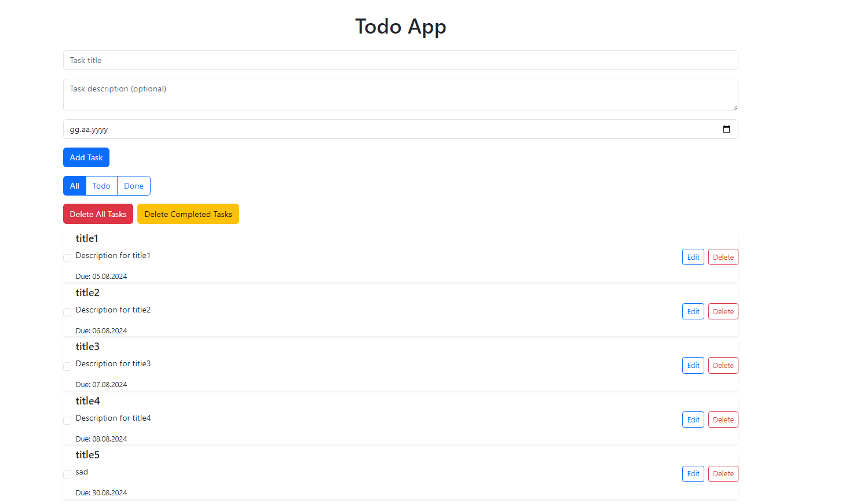

Slide 4
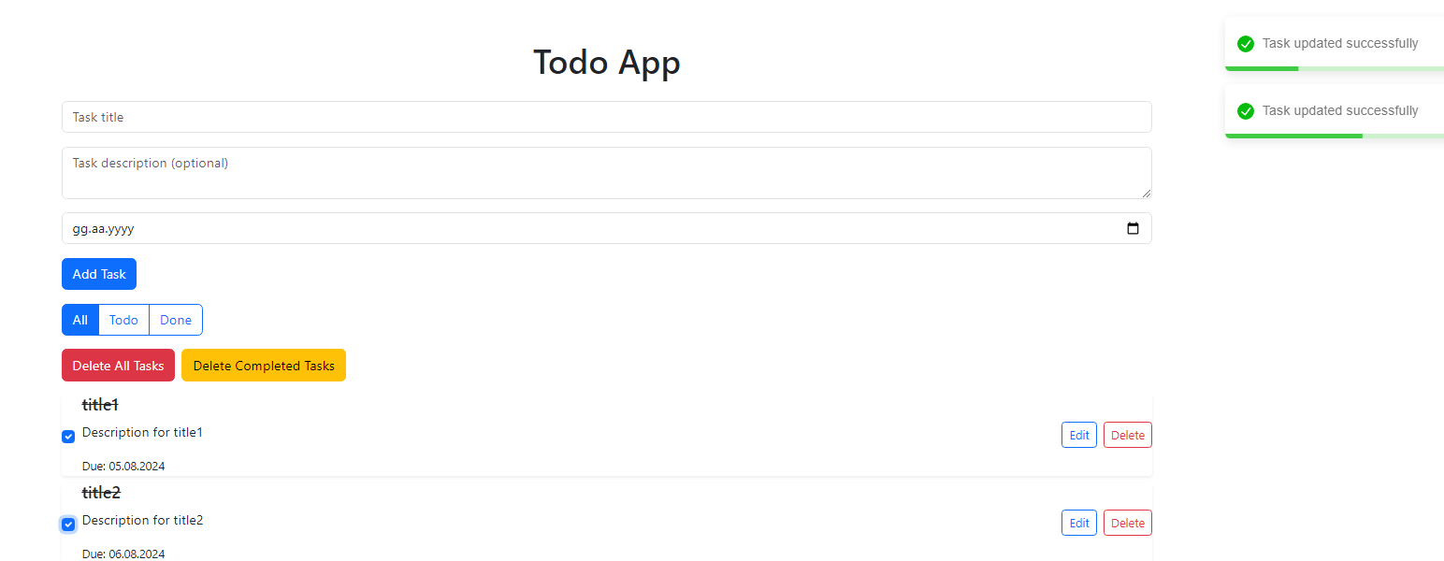
Mark task as done

Slide 5
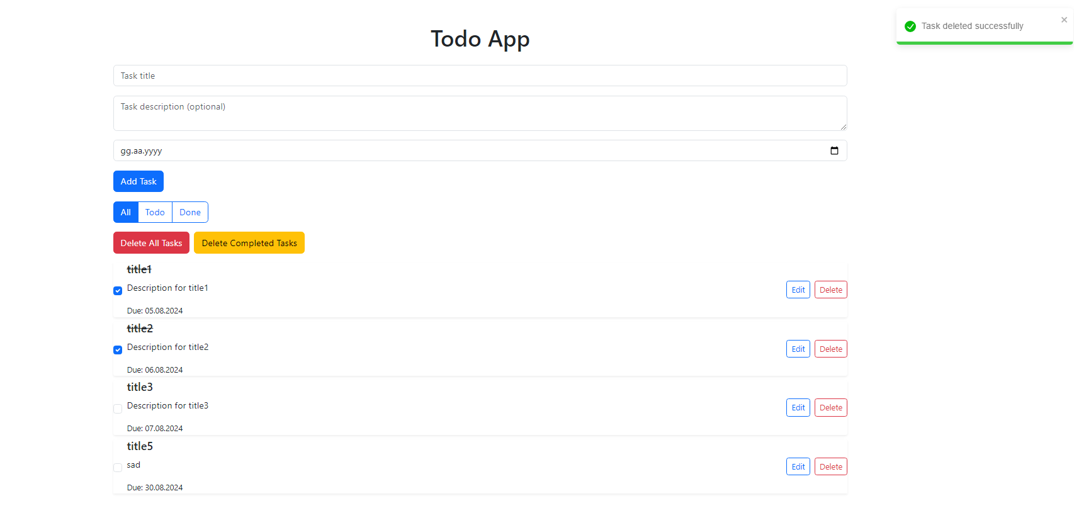
Remove task

Slide 6
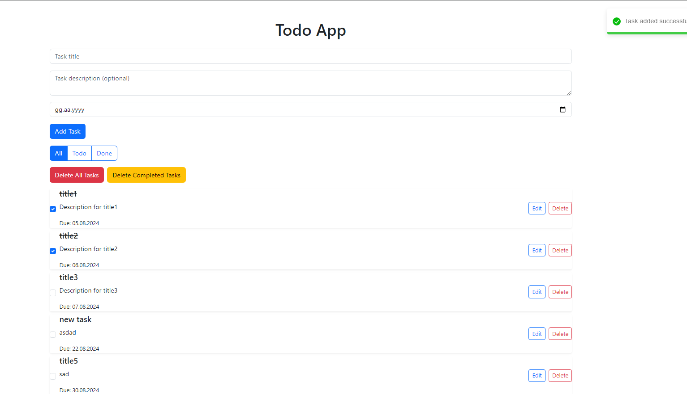
Add task

Slide 7
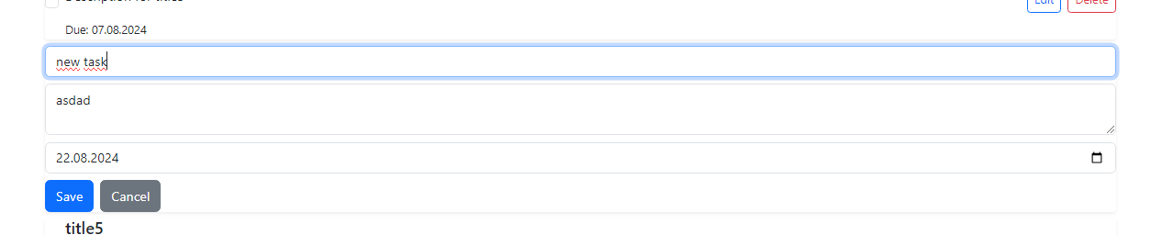
Edit

Slide 8
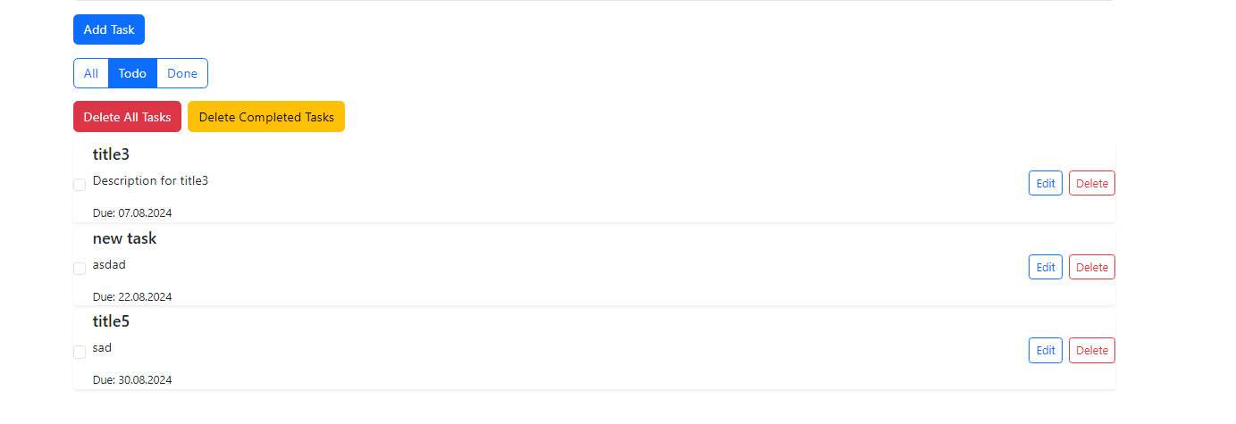
Todo tasks

Slide 9
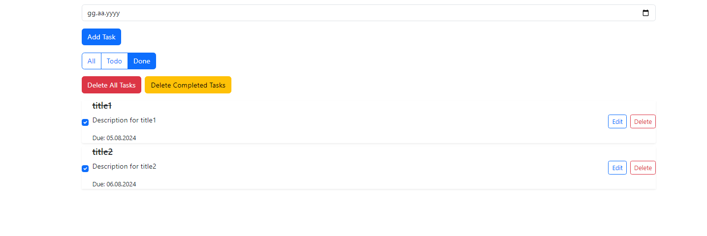
Done tasks

Slide 10
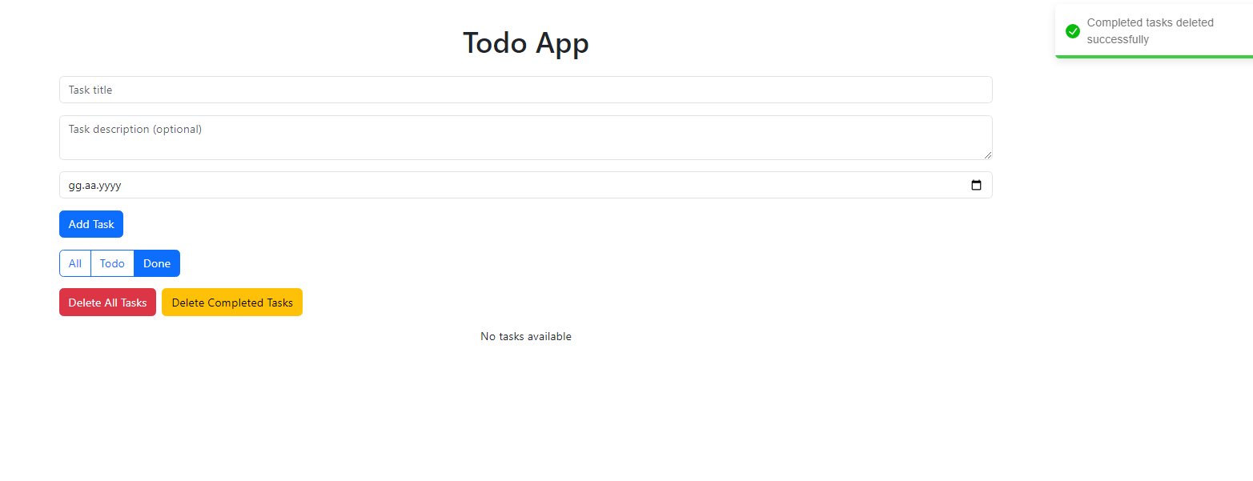
Delete completed tasks

Slide 11
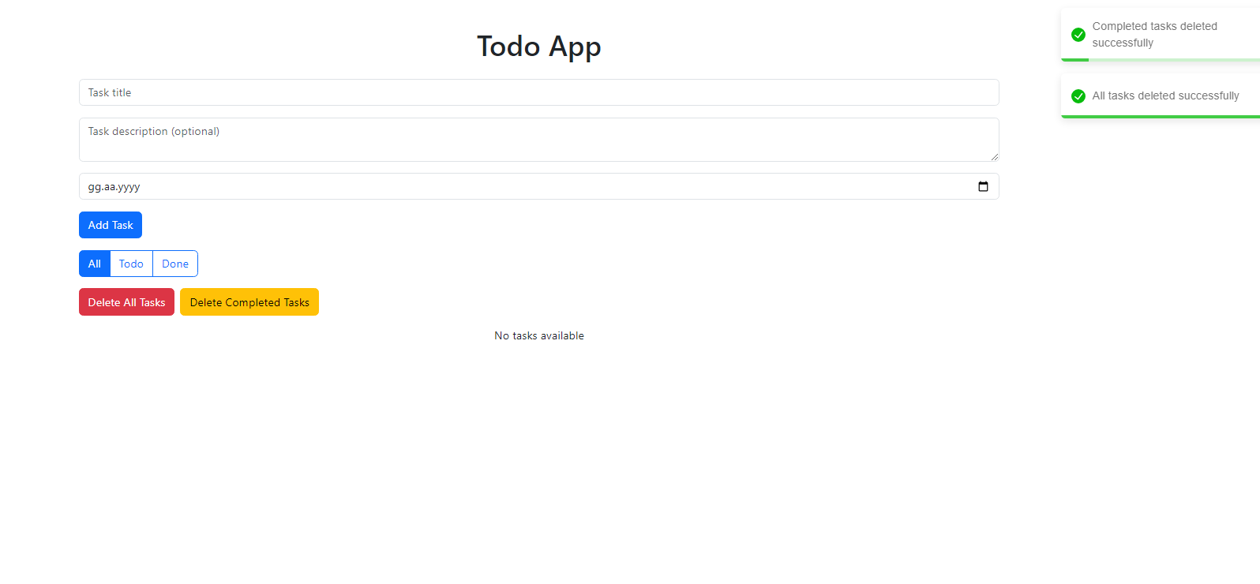
Delete all tasks

Slide 12

Backend part showcase

Slide 13
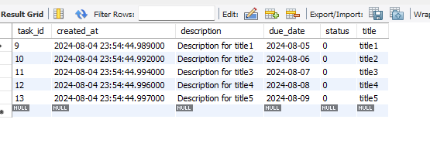
Databas(mysql) task table

Slide 14
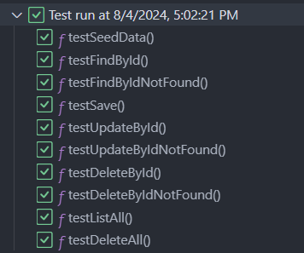
tests

Slide 15

File structures

Slide 16
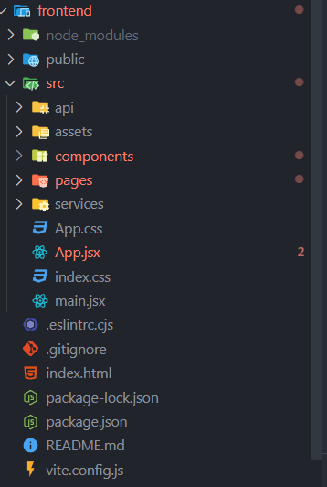
frontend

Slide 17
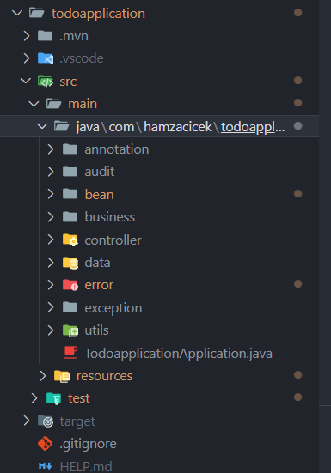
backend(layered architecture style)

