Slide 1
GAEB Modern Platform
From AS/400 to a governed, Arabic-first platform
Executive presentation — the customer pilot proposal · Veebase · All results shown are verified engineering results on synthetic data

Slide 2
Why we are here
2
• GAEB's six business systems still run on IBM i (AS/400) V6R1 — reliable, but out of support and hard to staff
• The risk is not the hardware: it is meaning — Arabic records in legacy codepages, business rules that exist only inside programs
• Veebase has built the replacement platform, tested it at scale, and rehearsed migration end to end on synthetic data
• Today we propose the next step only: a governed pilot on GAEB's own data, under GAEB's written authorization
GAEB Modern Platform — Veebase

Slide 3
The legacy estate — what the evidence shows
3
• 502 legacy program and file objects across six subsystems
• 1,068 fields mapped in the reconciliation register
• One money path links the systems: estimate → certificate → budget payment
• Two file definitions conflict between copies; some masters were never delivered — stated openly, gated honestly
• Reference exports hit legacy row caps — true volumes to be confirmed by GAEB's DSPFD counts
GAEB Modern Platform — Veebase

Slide 4
What we built
4
• A standalone bilingual platform — no dependency on outside infrastructure
• Six complete business workflows, not data-entry screens
• An offline migration engine that never connects to, and never writes to, the AS/400
• An authorization system that refuses customer data until GAEB's approvals exist as verified records
GAEB Modern Platform — Veebase

Slide 5
Platform architecture
5
Presentation
Arabic / English web interface — full RTL, tested dictionary parity (350+ keys per language)
API & governance
Role-based permissions, revocable sessions, login throttling, strict security headers, append-only audit
Data
PostgreSQL 16 — exact decimal money end to end; no floating point, no silent rounding
Migration
Offline staging with per-record lineage and original bytes; field-level Arabic codepage decoding
GAEB Modern Platform — Veebase

Slide 6
Six modules, complete workflows
6
School Map
Budget
Tenders & Contracts
Building registry, server-side search at million-record scale
Allocations and execution — money visible only to finance roles
A 12-stage lifecycle machine — stages cannot be skipped
Payment Certificates
Estimates & BOQ
Real Estate
Exact valuation; the certifier cannot authorize payment
Item catalogue, revisions with full history
Expropriation cases bound to the ministerial-decree gate
GAEB Modern Platform — Veebase

Slide 7
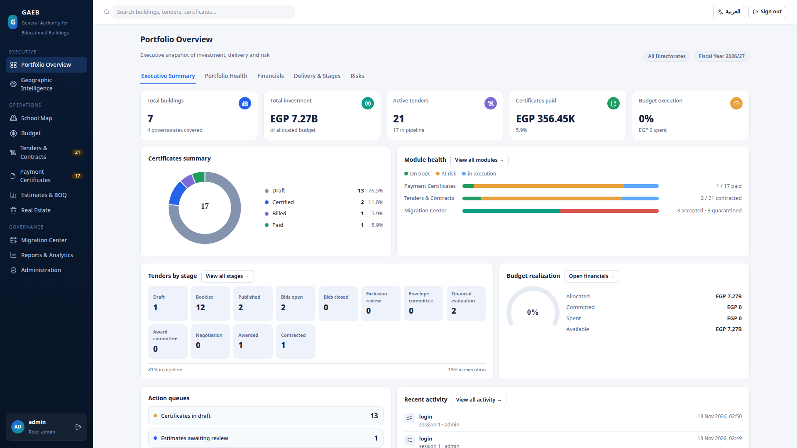
Executive Command Center
7
• Every figure is computed live from platform data
• Action queues show work waiting for a human decision
• Finance figures appear only for finance-permission holders
Live build — synthetic demonstration data
GAEB Modern Platform — Veebase

Slide 8
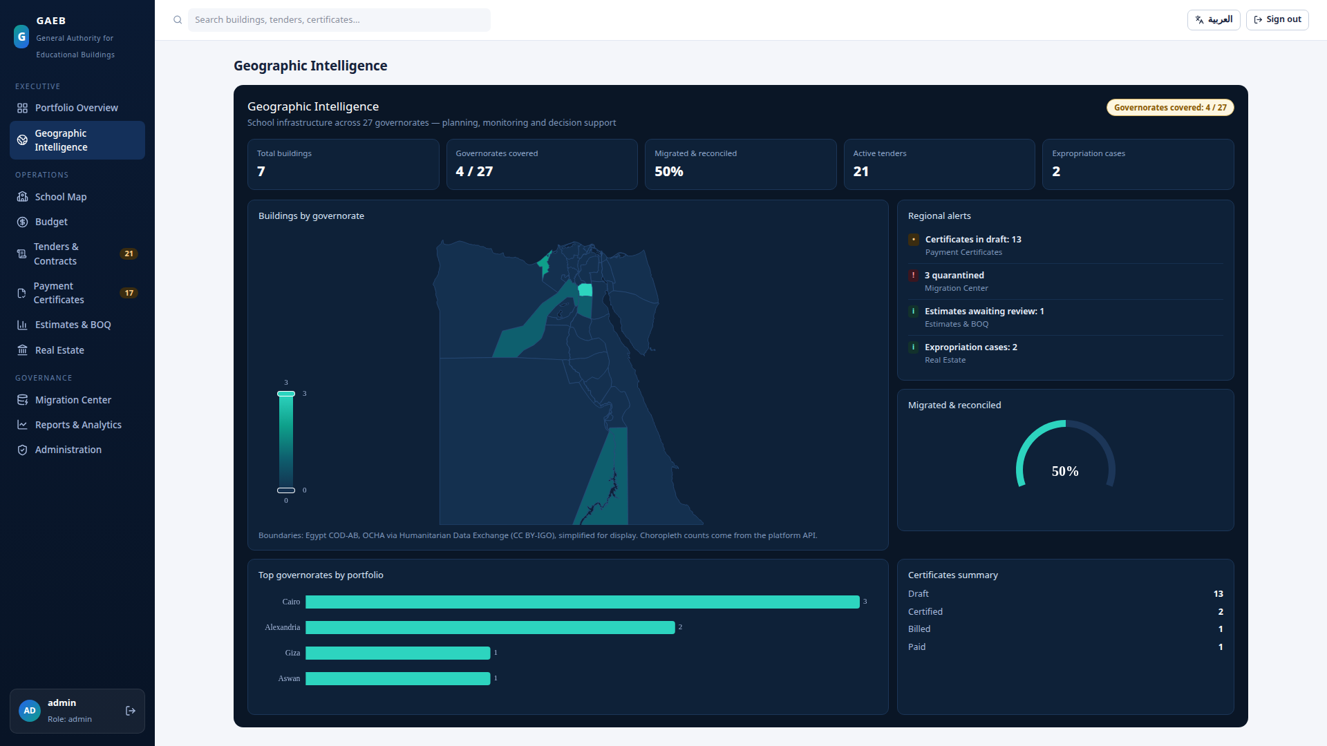
Geographic Intelligence
8
• GAEB legacy codes joined to international P-codes
• Coverage reported honestly — migrated vs not yet
• One click from a governorate to its buildings
Official 27-governorate boundaries (OCHA COD-AB, CC BY-IGO) — synthetic data
GAEB Modern Platform — Veebase

Slide 9
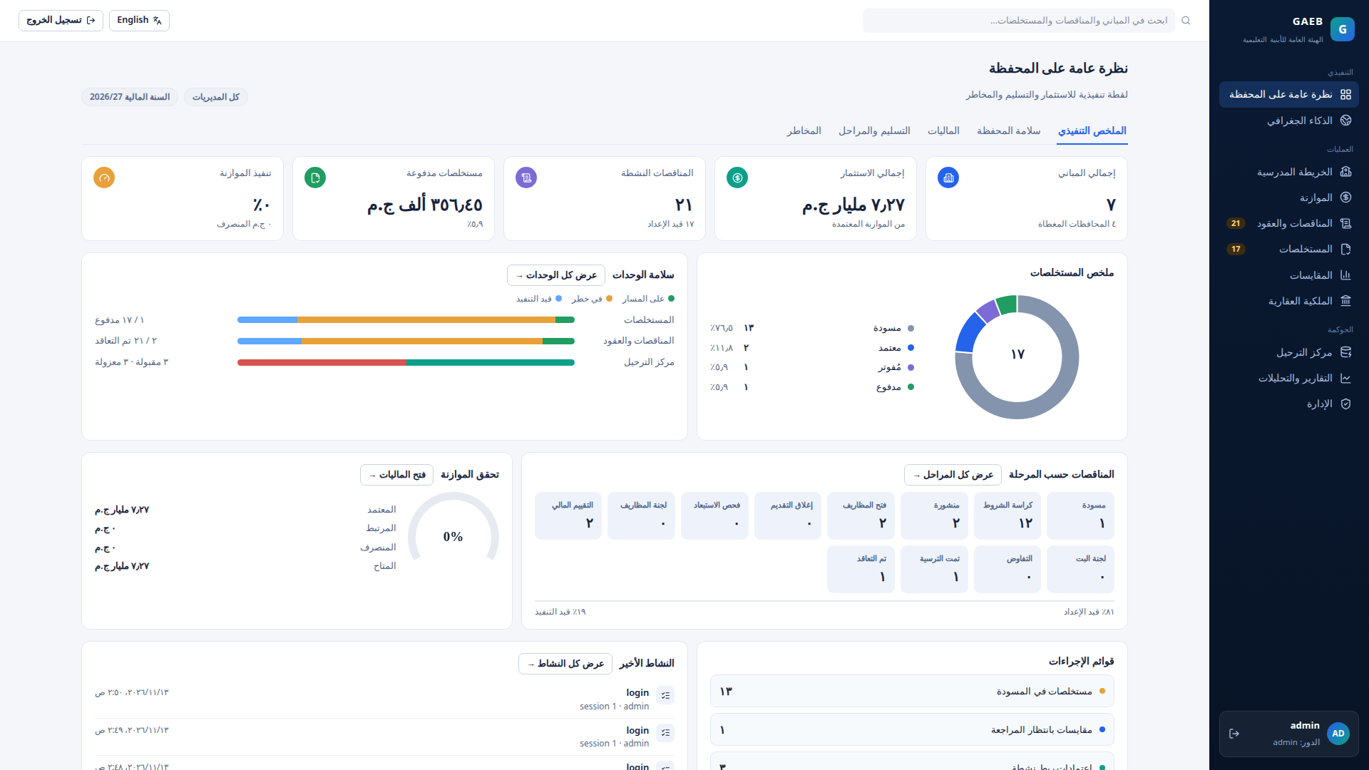
Arabic-first, not Arabic-translated
9
• Field-level decoding: IBM 420/864, Windows-1256
• Originals preserved — search normalization never overwrites
• Unsupported codepages stop for a decision, never a guess
The same live data in Arabic — full RTL
GAEB Modern Platform — Veebase

Slide 10
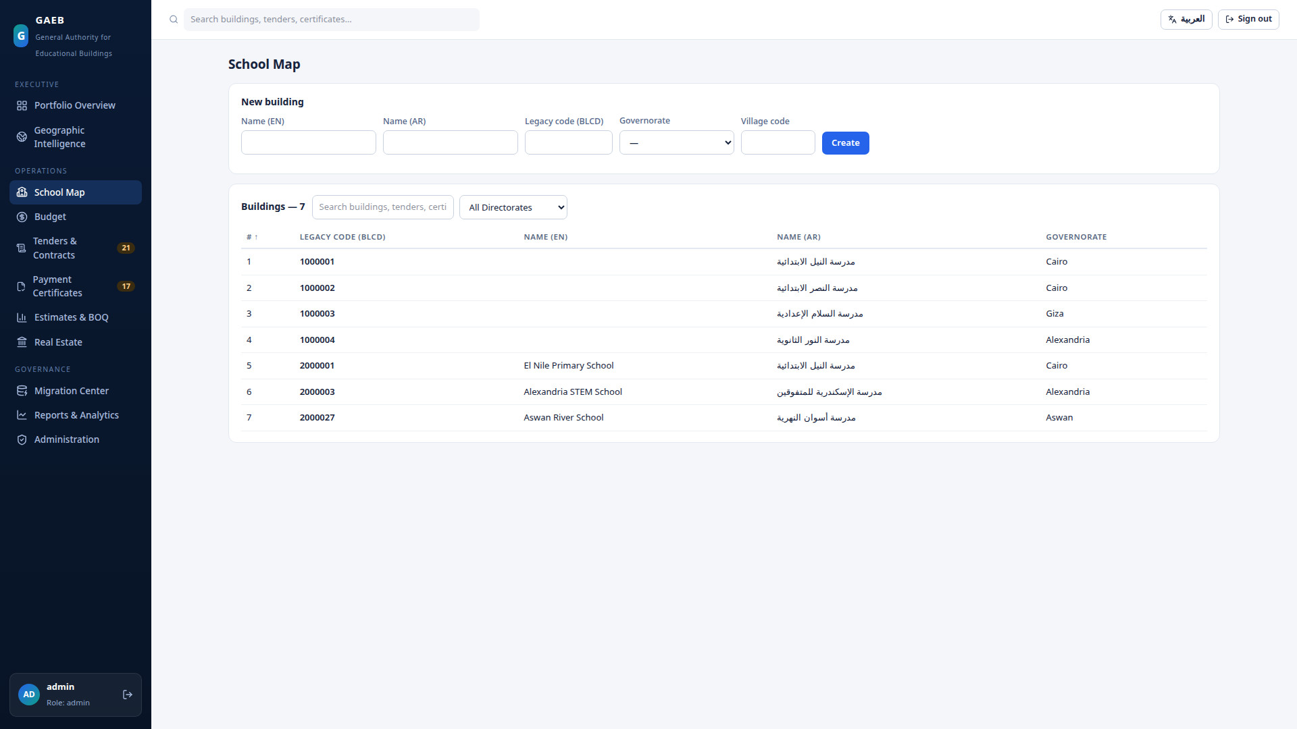
School Map — the building registry
10
• Server-side search and pagination — validated at 1,000,000 synthetic records
• The legacy BLCD code is preserved as the lineage key on every building
Synthetic demonstration data
GAEB Modern Platform — Veebase

Slide 11
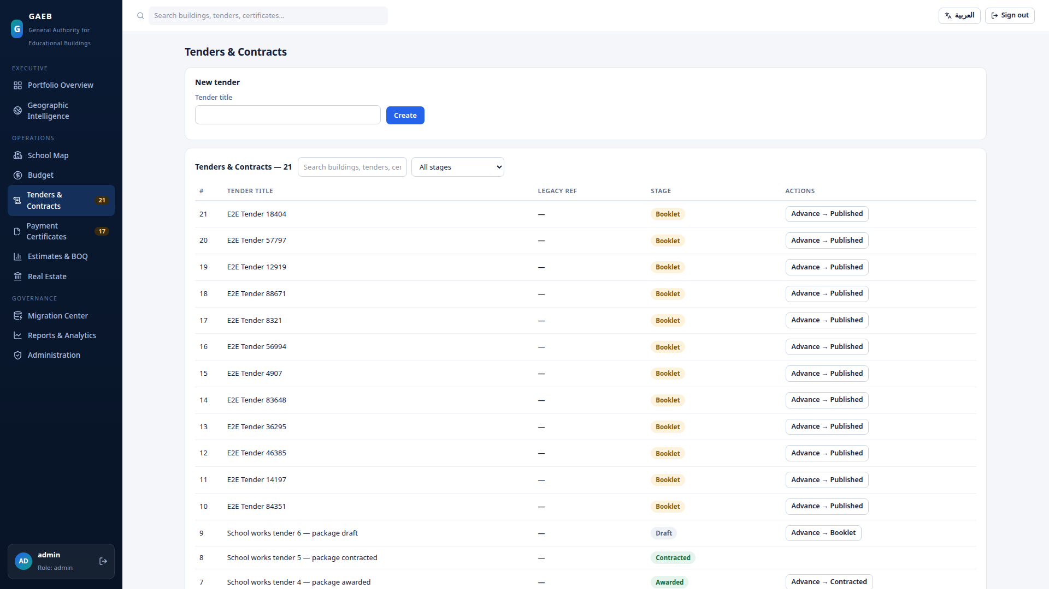
Tenders — a lifecycle, not a form
11
• 12 stages from draft to contracted — skipping is refused by the system
• Every stage transition is written to history
Synthetic demonstration data
GAEB Modern Platform — Veebase

Slide 12
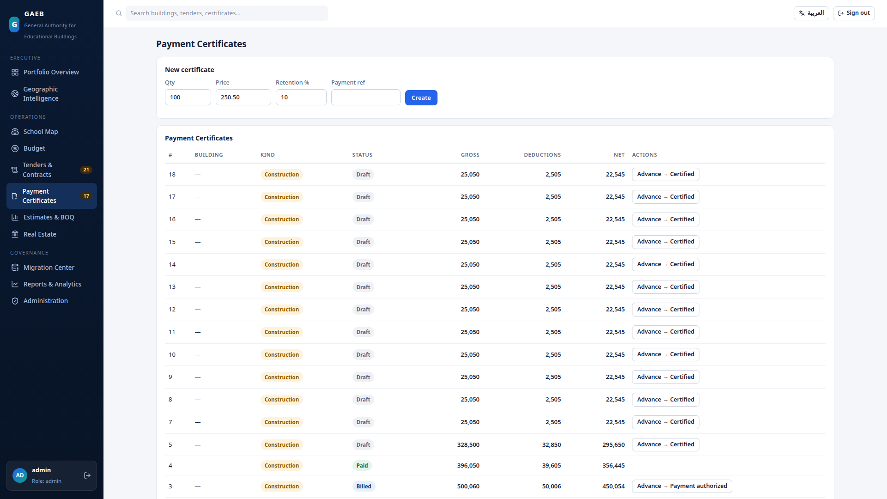
Certificates — money with separation of duties
12
• Valuation is exact: quantity × price less typed deductions
• The user who certifies a certificate cannot authorize its payment — the server refuses
Synthetic demonstration data
GAEB Modern Platform — Veebase

Slide 13
Migration — controlled in 15 steps
13
• Written authorization → classification → approved extraction at GAEB
• SHA-256 at source and at receipt; a mismatch halts intake
• Encoding preflight → tracked import → reconciliation → customer review
• Retention or deletion only per GAEB's approved policy
• Customer data never enters the demonstration environment — and is never sent to any external or AI service
GAEB Modern Platform — Veebase

Slide 14
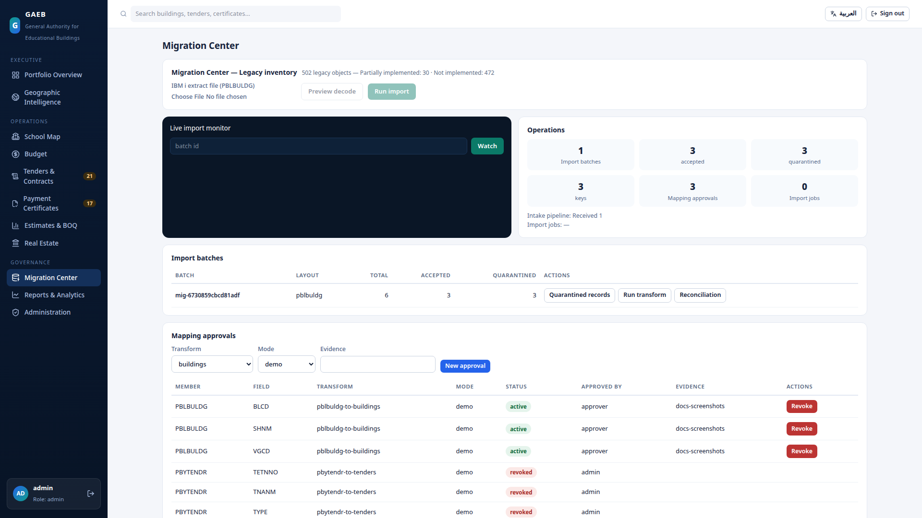
Reconciliation — every record accounted for
14
• The invariant: source = loaded + quarantined
• Quarantined records carry their reason and their raw bytes — nothing is silently dropped
• Money control totals are exact decimals, end to end
A real (synthetic) batch in the Migration Center
GAEB Modern Platform — Veebase

Slide 15
Authorization governance — evidence, not assertions
15
• Every required approval is an evidence record with a lifecycle: pending → submitted → verified — then revocable, expirable, supersedable
• Separation of duties: whoever submits evidence can never verify it — at any role, administrators included
• A typed-in document hash is labeled unverified; only a server-computed hash from the actual bytes is labeled verified
• We do not claim to authenticate GAEB signatures cryptographically — verification is an independent human decision, recorded under their identity
GAEB Modern Platform — Veebase

Slide 16
Continuous authorization — valid now, not once
16
• Eligibility is recomputed from current state at every customer operation — import and transform alike
• Revoke an approval or an evidence record, and the next operation refuses — not the next activation
• Every import is bound to an authorized dataset and to the authorized file's hash — a substituted file is refused
• Streaming imports re-verify after every committed chunk; staged records can never become operational data unauthorized
GAEB Modern Platform — Veebase

Slide 17
The pilot — three weeks after entry conditions
17
• Week 0: host qualification by automated preflight, restore drill, alert test, accounts, evidence verification, activation
• Week 1: controlled intake — first extract, hash verification, first migration, reconciliation package #1
• Week 2: business validation — Arabic fidelity review, module UAT, defect triage and controlled re-runs
• Week 3: acceptance — final reconciliation, UAT retests, handover, pilot closure, production-gap assessment
GAEB Modern Platform — Veebase

Slide 18
Decisions we ask GAEB to make
18
• BD-07 — duplicate record policy (blocks the first import)
• BD-08 — historical migration scope (blocks pilot sizing)
• BD-01…BD-06 — module semantics, closed in the same one-day workshop
• Five approvals: charter, scope, extract authorization, environment, named participants
• Every decision is recorded in a register GAEB signs in the room — and enters the platform as independently verified evidence
GAEB Modern Platform — Veebase

Slide 19
Success — measured, not asserted
19
• 100% record accounting on every batch; the reconciliation equation exact
• Money control totals exact; Arabic fidelity 100% on the agreed sample
• Zero imports without a current authorization
• UAT critical path passed; every exception closed by a recorded decision
• These criteria are our proposal — they bind only when GAEB adopts them
GAEB Modern Platform — Veebase

Slide 20
Verification status — stated plainly
20
• Verified: 65 backend, 32 frontend, 40 browser, 31 visual tests — and a 34-check end-to-end rehearsal
• Verified: backup restore, physical restore, and point-in-time recovery
• Not yet: CI execution (one owner authorization), Docker certification, independent security review, screen-reader validation
• Not claimed anywhere: customer acceptance, production readiness
GAEB Modern Platform — Veebase

Slide 21
The ask
21
• A 30-minute executive meeting — this week or next — to fix the workshop date
• One day of your decision owners' time
• Signatures: charter, then the first extract authorization
• Then Week 0 begins — and the platform itself will hold the sequence, refusing every shortcut
• The first real batch reconciles under GAEB's own signature — or it does not ship
GAEB Modern Platform — Veebase

