Slide 1

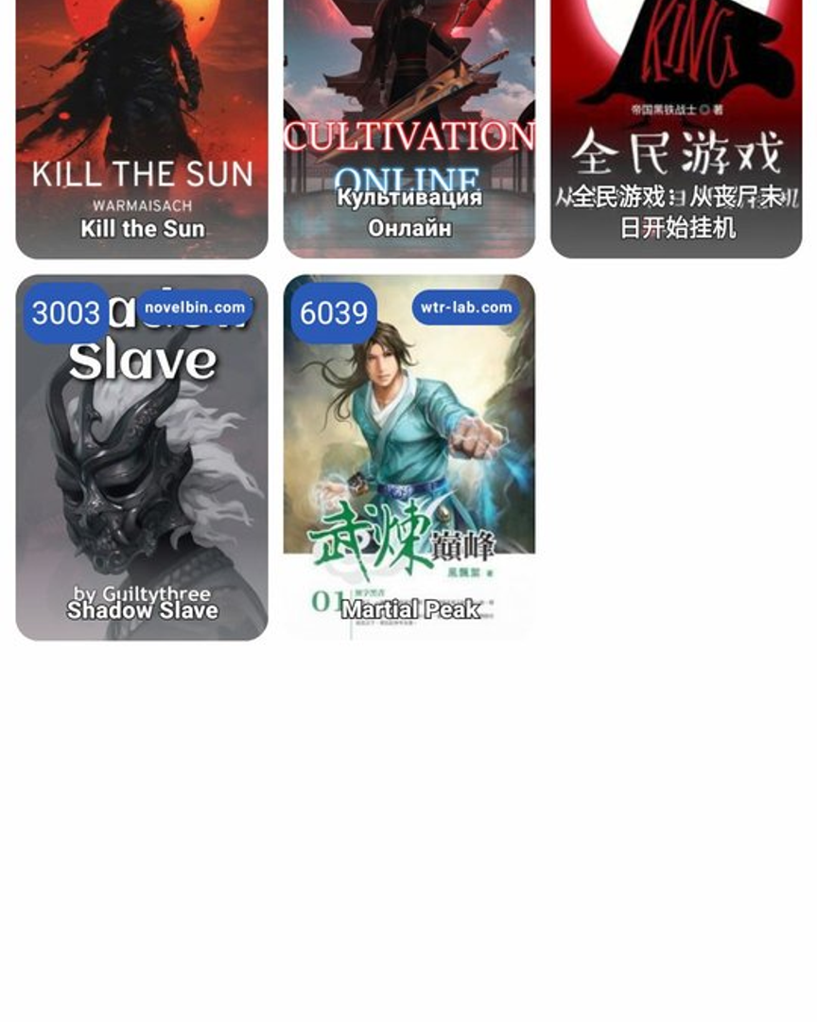

OPEN SOURCE · GPL-3.0 · ANDROID 8.0+
NovelA
Free & open-source web novel reader for Android.
35+ sources · In-reader translation · TTS · Lua plugins · Material 3
KOTLIN 2.0.21
JETPACK COMPOSE
MATERIAL 3
ROOM 2.8.4
HILT 2.52
✦
github.com/Parasgaming122/NoveLA

Slide 2
01 / 14 — OVERVIEW
What is NoveLA?
NoveLA is a free, GPL-3.0 licensed Android application for reading web novels, light novels, and ranobe. Built natively in Kotlin with Jetpack Compose and Material 3, it brings a modern, offline-first reading experience to fans of online fiction — pulling content from 35+ sources, with first-class translation, text-to-speech, and a Lua-based plugin system that lets the community add new sources without app updates.
35+
CATALOG SOURCES
Built-in + Lua plugins
32
GRADLE MODULES
Across 4 architecture layers
The codebase is structured as 32 Gradle modules across four architectural layers, totaling roughly 54,000 lines of Kotlin. It runs on Android 8.0+ (API 26), targets the latest SDK 35, and is fully open to community contribution — bug fixes, new source parsers, and plugin submissions are all welcome.
54K
LINES OF KOTLIN
390 source files · 100% open source
✦
NOVELA · GITHUB.COM/PARASGAMING122/NOVELA
02 / 14

Slide 3
02 / 14 — FEATURES
Feature Highlights
⌕
⇄
◖
Global Multi-Source Search
In-Reader Translation
Text-to-Speech
Search across all 35+ sources in parallel, or add any novel by URL. Results grouped by source for easy comparison.
Four backends including Google and Gemini. Parallel mode shows original + translated side by side, no app switching.
Floating mini-player, background playback, speed/pitch control, Bluetooth support, multiple engine support, reading timer.
▤
✦
⛨
Local EPUB & FB2 Library
Lua Plugin System
Cloudflare Bypass
Import local EPUB and FB2 books with bulk import support. Custom fonts, text size, light/dark Material 3 themes.
External Lua-based source plugins installable directly in-app. Official repo: HnDK0/external-sources. Add new sources without app updates.
Automatic Cloudflare Turnstile bypass. Regex text cleanup to strip injected ads. Novel migration between sources.
NOVELA · FEATURES
03 / 14

Slide 4
03 / 14 — TRANSLATION
Four Translation Backends
Multiple API keys are rotated round-robin on rate limits. Parallel mode displays original and translated text side by side. Novel-specific prompts customize translation behavior per book.
Google Translate
Google Translate
Google Gemini
OpenAI-compatible
ENHANCED
SIMPLE
LLM
FLEXIBLE
COST
COST
COST
COST
Free
Free
Free tier
Varies
API KEY
API KEY
API KEY
API KEY
Not required
Not required
Required
Required
Accepts OpenAI, OpenRouter, DeepSeek, Ollama, Mistral, and any compatible endpoint. Most flexible.
Best default. Uses the enhanced Google translate endpoint with better context handling.
Lightweight classic endpoint. Faster, less context-aware. Good fallback.
LLM-powered. Higher quality literary translation. Subject to Gemini free-tier quotas.
◆
Parallel mode shows original and translated text side by side — no copy-paste, no app switching.
NOVELA · TRANSLATION
04 / 14

Slide 5
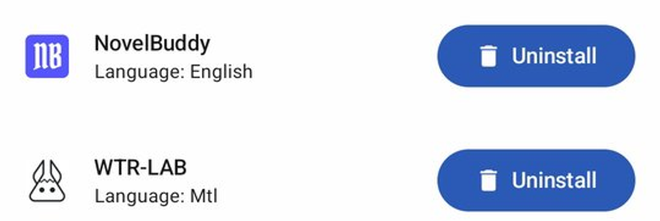
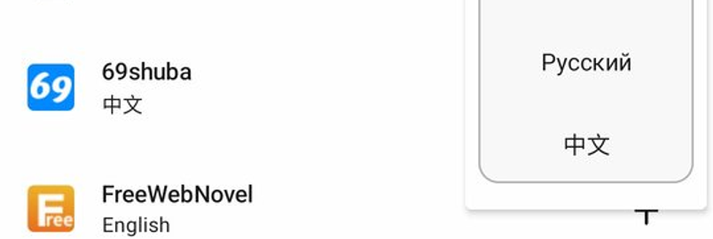
04 / 14 — EXTENSIBILITY
Lua-Based Plugin System
NoveLA supports external Lua-based source plugins installable directly from within the app. The plugin runtime is powered by LuaJ 3.0.1, with YAML configuration via SnakeYAML 2.6. Sources are defined as declarative configuration — HTML selectors, JSON API mappings, pagination rules, filters — and the scraper engine handles the rest.
This means the community can add new sources without waiting for app updates. The official plugin repository is HnDK0/external-sources, but any compatible Git URL works.
1
PLUGIN REPO BROWSER
Open Finder → Extensions in the app
2
Tap the ⚙️ settings icon top-right
3
Paste the plugin repo URL and confirm
plugin_repo: https://github.com/HnDK0/external-sources
INSTALLED PLUGINS
NOVELA · PLUGINS
05 / 14

Slide 6
05 / 14 — ARCHITECTURE
Layered Module Architecture
32 Gradle modules across 4 strict layers. Dependencies flow downward only — upper layers may depend on lower, never the reverse.
APP
APP
↓
FEATURES
READER
LIBRARYEXPLORER
CATALOGEXPLORER
SOURCEEXPLORER
CHAPTERSLIST
GLOBALSOURCESEARCH
EXTENSIONS
DATABASEEXPLORER
SETTINGS
WEBVIEW
↓
TOOLING
LOCAL_DATABASE
TEXT_TRANSLATOR
TEXT_TO_SPEECH
BACKUP_RESTORE
BACKUP_CREATE
EPUB_PARSER
EPUB_IMPORTER
NOVEL_MIGRATION
LOCAL_SOURCE
APPLICATION_WORKERS
ALGORITHMS
STRINGS
↓
CORE
CORE
COREUI
NETWORKING
SCRAPER
DATA
NAVIGATION
build-logic/ — 3 convention plugins (off-diagram)
▤
NOVELA · ARCHITECTURE
06 / 14

Slide 7
06 / 14 — MODULES
Module Breakdown by Layer
MODULES PER LAYER
Tooling (12)
Features (10)
TOOLING
12
Persistence, TTS, translation, backup, EPUB parsing, novel migration, background workers. Pure logic, no UI.
One module per user-facing screen. Each owns its Activity, ViewModel, Composables, and state. Independently testable.
FEATURES
10
CORE
6
1
APP
Core (6)
App (1)
Shared foundation: app context, preferences, models, navigation, networking client, the scraper engine itself.
The thin application shell. Wires Hilt graph, hosts MainActivity, glues all feature modules together via navigation.
32 Gradle Modules
+ 3 build-logic convention plugins
▤
NOVELA · MODULES
07 / 14

Slide 8
07 / 14 — TECH STACK
Technology Stack
A modern, fully-native Android stack — Kotlin-first, Compose-driven, with carefully chosen libraries for networking, persistence, scraping, and extensibility.
✦
Language & Runtime
✦
UI Layer
✦
DI & Async
Kotlin
2.0.21
Coroutines
1.9.0
Jetpack Compose
—
Material 3
1.3.1
Hilt
2.52
Hilt-Work
1.2.0
KSP
2.0.21-1.0.28
kotlinx-serialization
1.7.3
Coil
2.7.0
Landscapist Glide
WorkManager
Coroutines
2.4.4
2.11.2
—
Lifecycle
2.8.7
Java
21
Material Icons Ext.
—
▦
Data & Persistence
▯
Platform & SDK
✦
Specialty Libraries
Room
2.8.4
OkHttp
5.0.0-alpha.14
Android 8.0+
API 26
Compile SDK
35
LuaJ
3.0.1
SnakeYAML
2.6
Retrofit
2.12.0
Jsoup
1.18.1
Target SDK
35
Splash Screen
1.2.0
Readability4j
1.0.8
Crux
5.1.0
Moshi
1.15.2
Gson
2.14.0
Navigation
2.8.4
MLKit Translate
17.0.3
Timber
5.0.1
◆
All dependencies are pinned via a Gradle version catalog (gradle/libs.versions.toml). Convention plugins enforce shared config across every module.
▤
NOVELA · TECH STACK
08 / 14

Slide 9
08 / 14 — BUILD
Convention Plugins & Build Logic
APP/BUILD.GRADLE.KTS
Three convention plugins
plugins
APPLICATION
alias
alias
noveldokusha.android.application
alias
Sets up signing, ABI splits, build types, proguard, namespace. Inherited by :app only.
alias
alias
alias
LIBRARY
android
noveldokusha.android.library
defaultConfig
Default Android library config: min/target SDK, Java 21, test scaffolding. Used by all 31 library modules.
"my.novela"
34
"1.3.3"
COMPOSE
noveldokusha.android.compose
BUILD-LOGIC/CONVENTION/.../APPCONFIG.KT
Adds Jetpack Compose compiler plugin, Material 3 deps, Coil, Glide, tooling. Used by feature modules with UI.
internal object
appConfig
val
com.autonomousapps.dependency-analysis plugin catches unused deps at build time.
const val
35
✓
const val
35
const val
26
▤
NOVELA · BUILD
09 / 14

Slide 10

09 / 14 — READER
Reader & Text-to-Speech
READING EXPERIENCE
▤
Infinite chapter scrolling
Continuous reading across chapter boundaries with prefetching.
☁
Offline caching
Downloaded chapters stored locally for offline access.
✦
Custom fonts & sizing
Built-in Inter, Lora, Merriweather, Source Sans Pro. Import your own.
✦
Material 3 themes
20+ color schemes including Tachiyomi, Catppuccin, Nord, Monet, Mocha.
TEXT-TO-SPEECH
▶
Floating mini-player
Persistent overlay with play/pause/skip controls while reading or in other apps.
▦
Speed & pitch control
Fine-grained tuning. Multiple TTS engine support.
ᛒ
Bluetooth & background
Plays through paired devices. Survives screen lock and app switch.
◔
Reading timer
Auto-stop TTS after a configurable duration for bedtime reading.
CHAPTER READER · DARK MODE
▤
NOVELA · READER
10 / 14

Slide 11
10 / 14 — CODEBASE
By the Numbers
A snapshot of the NoveLA repository — a substantial, actively-maintained open-source Android project.
✦
KOTLIN FILES
✦
LINES OF KOTLIN
▦
GRADLE MODULES
▤
XML RESOURCES
390
54K
32
120
across all modules
~54,386 lines total
+ 3 convention plugins
layouts, strings, themes
⇄
UI LANGUAGES
▣
SCREENSHOTS
✦
CATALOG SOURCES
⚖
LICENSE
20
14
35+
GPL
community-translated
in /screenshots
built-in + Lua plugins
GPL-3.0 · fully open
Repository: github.com/Parasgaming122/NoveLA · applicationId: my.novela · versionName: 1.3.3 (versionCode 34)
▤
NOVELA · CODEBASE
11 / 14

Slide 12

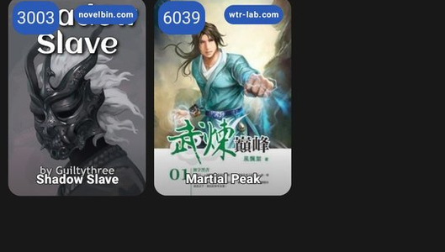



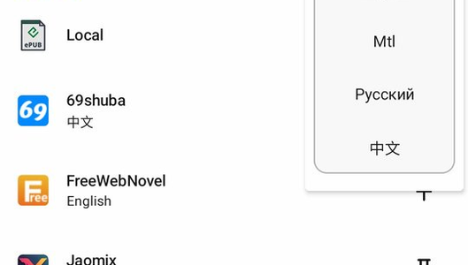
11 / 14 — GALLERY
App Screenshots
A visual tour of NoveLA — library, catalog, reader, translation, and plugin management.
LIBRARY · LIGHT THEME
LIBRARY · DARK THEME
CATALOG EXPLORER
CHAPTER READER
LIVE TRANSLATION
INSTALLED PLUGINS
▤
NOVELA · GALLERY
12 / 14

Slide 13
12 / 14 — ROADMAP
Current Status & Direction
ⓘ
STATUS —New features are temporarily paused. Current focus is on fixing bugs, cleaning up the codebase, and performance/optimization work. Bug reports and PRs targeting existing issues are very welcome.
IN PROGRESS
ACTIVE
WELCOME
DEFERRED
Bug Fixes & Cleanup
Performance Tuning
Source Parser PRs
New Feature Requests
Stabilizing the codebase, removing dead code, improving tests, and addressing open issues. The optimization report (NoveLA_Optimization_Report.md) guides this work.
Database query optimization, scraper caching improvements, Compose recomposition audits, and memory footprint reduction for large libraries.
Fixes and improvements to existing source parsers are actively merged. New sources can be added via the plugin repo without app changes.
New feature requests will be revisited later. The team prioritizes stability and codebase health over new functionality for now.
♥
Want to help? Open issues, submit PRs, or contribute new Lua plugins to HnDK0/external-sources.
▤
NOVELA · ROADMAP
13 / 14

Slide 14

14
13 / 14 — GET STARTED
Get NoveLA. Read Everywhere.
Three ways to engage with the project — pick yours.
↓
✦
♥
Download
Extend with Plugins
Contribute
Get the latest APK from the GitHub Releases page. Requires Android 8.0 or above. No account, no tracking, no ads — ever.
Add new novel sources in seconds. Lua-based plugins install directly from the app — no APK updates needed. Use the official repo or host your own.
Pull requests welcome. Fix source parsers, improve UI, optimize database, add translations. Open issues first for major changes.
github.com/Parasgaming122/NoveLA/releases
github.com/HnDK0/external-sources
github.com/Parasgaming122/NoveLA/issues
Or build from source: git clone + Android Studio
In-app: Finder → Extensions → ⚙️ → paste repo URL
Tech stack: Kotlin · Compose · Hilt · Room · LuaJ
“Free and open source web novel reader for Android.”
GPL-3.0 · Made with readers, for readers.
NOVELA · 14 / 14

