Slide 1
Marketing and Retail Analytics: Capstone Project : Olist, Inventory management Triage.
Team:
Harish N
Jaivadan Joshi
Pragnya Priyadarshani

Slide 2
Agenda
Objectives
Background
Visualizations
Insights
Recommendations
Appendix
Data Sources
Data Methodology

Slide 3
Objective
Detail: OList is an e-commerce company that has faced some losses recently and they want to manage their inventory and In-turn to reduce any unnecessary costs.
To Provide : Top products and category that contribute to the revenue using Pareto Analysis.
To Improve : Our understanding with the use of market basket analysis to analyze the purchase behavior of customers.

Slide 4
Background
OList aims to improve inventory management and In-turn reduce any unnecessary costs.
Each of the products being stored incurs a cost to the company in terms of space and maintenance.
Since storing these products adds to the costs that the company incurs, it is necessary for the organization to plan their inventory well.

Slide 5
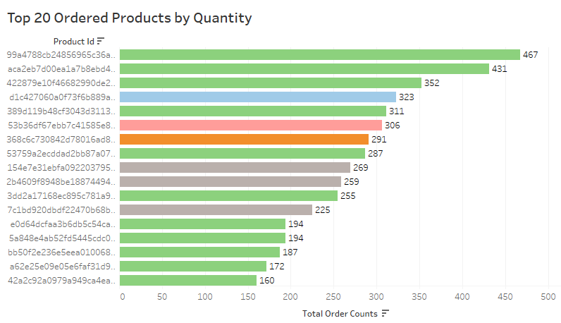
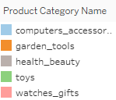
Top 20 Ordered Products by Quantity
Toys product category is the highest ordered category with top quantity order count 467.
Computer accessories, Watches and Garden tools categories also tops the chart.
Health and Beauty category even though in latter part of the list, has a strong footing in ordered products with highest count being 269.
Most of the products in the Top 20 list that are frequently ordered belong to the Toys category.

Slide 6
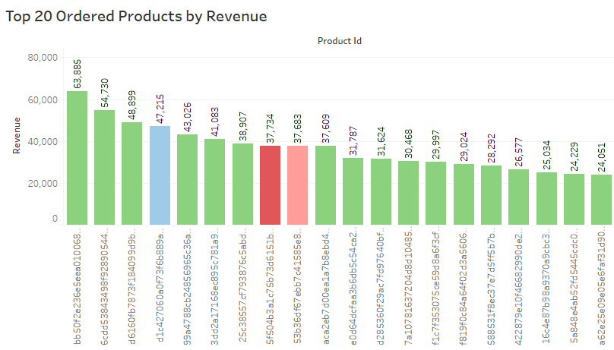
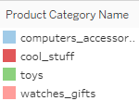
Top 20 Ordered Products by Revenue
Based on revenue an calculated field, Toys category product leads with 63,885.
Computer_accessories,Cool_stuff Watches_gifts are also part of the list with 47,215|37,734|37,683 respective contributions to the revenue.
But toys category dominates the list with total revenue of 6,09,222.

Slide 7
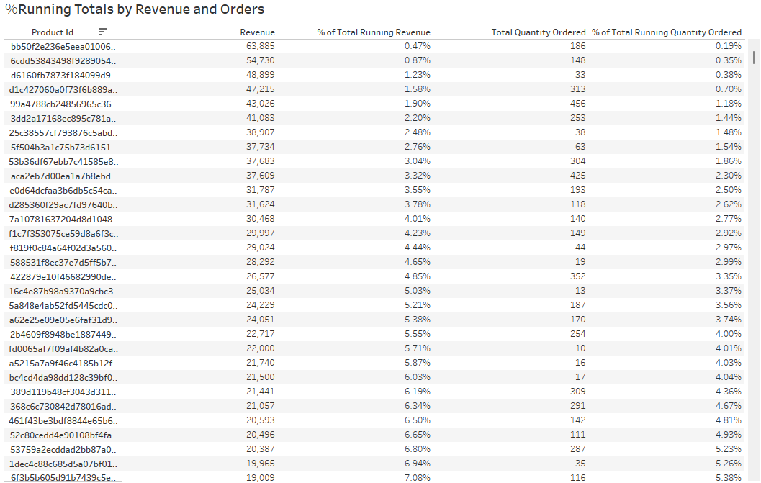
Key Revenue Metrics
The Percentage of Total Running Revenue and Quantity Ordered has been broken down by Product Id.
The contribution of each product towards the total revenue can be identified.
Key metrics such as running total and percentage share of products are essentials for taking data driven actions.

Slide 8
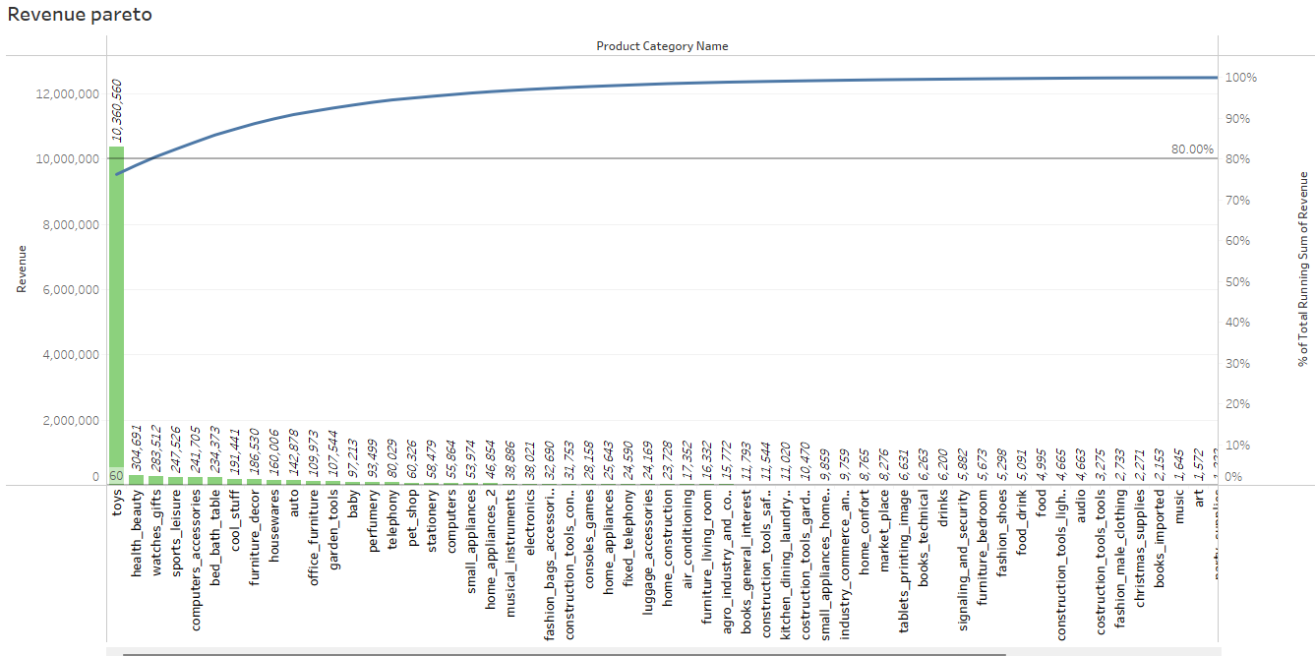
Pareto Analysis: Revenue
Toys product category alone generates 76.23% of the revenue.
Toys,health_beauty and watches_gift combinely generate 80.56% of the revenue.
Remaining 70+ product categories generates 19.44% of the revenue.

Slide 9
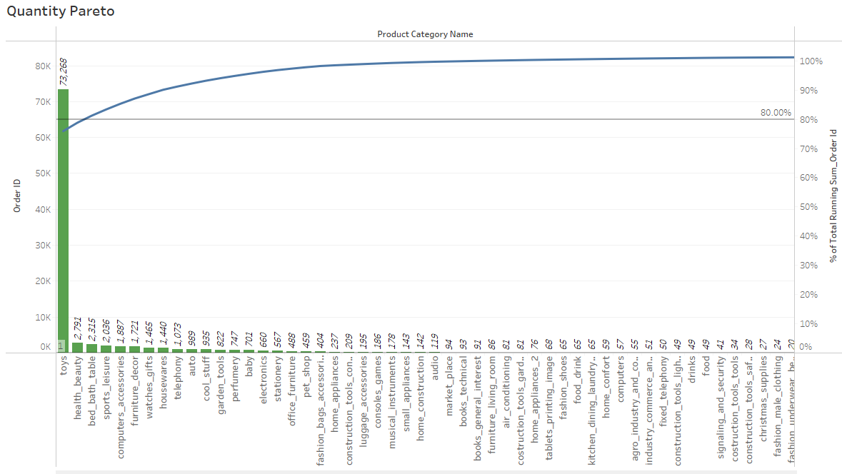
Pareto Analysis: Quantity
Toys product category generates 75.94% of the total orders.
Toys,health_beauty and bed_bath table combinely generates 80.38% of the quantity.
Remaining 70+ product categories generates 19.62% of the total order quantity.

Slide 10
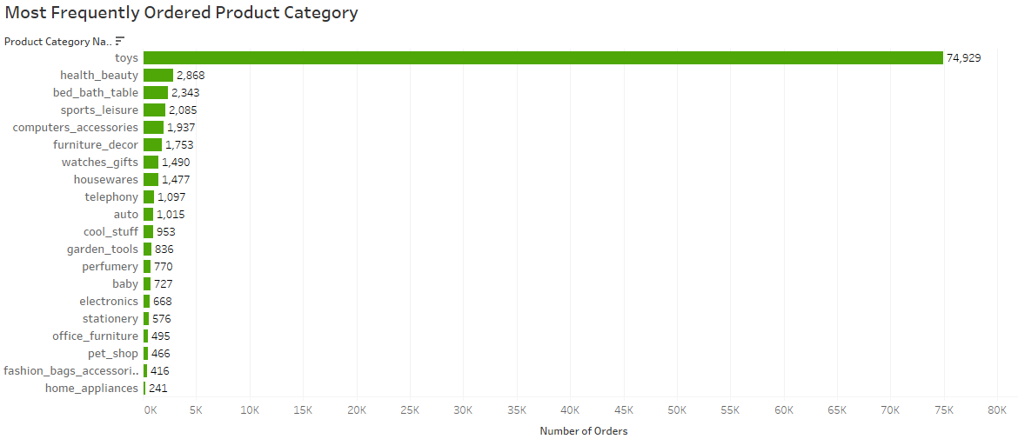
Most Frequently Ordered Product Category
Toys category is the most ordered category with a total of 74,929 orders.
Followed by Health_beauty, bed_bath_table and sports_leisure as most ordered category.

Slide 11
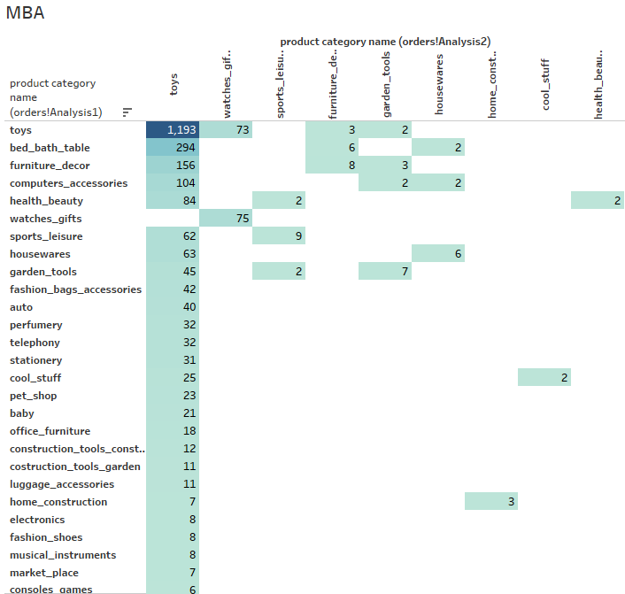
Market Basket Analysis
Market Basket Analysis is performed to identify the frequently ordered category association.
Toys are the most ordered category along with the categories of bed_bath_table, furniture_decor, computers_accessories and health_beauty.

Slide 12
Insights
The Toys category accounts for 20% of the products but contributes to 80% of the revenue. This indicates that customers frequently purchase these products even at higher price points.
In addition to Toys, items from the Bed, Bath & Table, Furniture & Decor, Computers & Accessories, and Health & Beauty categories are also among the most frequently ordered.
These categories, either alongside Toys or among themselves, commonly appear together in customers’ baskets.
This suggests that certain high-priced products are consistently bought by customers, reflecting a strong demand regardless of cost.
Also Indicates a segment of value-driven or brand-loyal customers willing to pay more for perceived quality or utility.

Slide 13
Recommendation
Focus on High Revenue-Generating Categories: Prioritize inventory management for categories that contribute to “over 80% of total revenue” like “Toys”, ensuring they are always in stock.
Targeted Marketing for High-Demand Segments : Given that “Toys” is the most frequently purchased category, develop “targeted campaigns” (emails, push notifications, and personalized offers) aimed at customers with a high likelihood of purchasing toys.
Encourage Cross-Selling Through Promotions: Offer “promo codes, combo deals, or discounts” on frequently co-purchased category pairs. (e.g., Toys + Furniture, or Health & Beauty + Bed & Bath) to encourage larger basket sizes. Highlight these combinations during the checkout process or in product recommendations.
Streamline the Product Catalog: Identify and phase out “underperforming sub-categories” with consistently low sales, to reduce inventory costs.
Dynamic Pricing and Personalization: Implement “dynamic pricing strategies” for top categories during high-demand periods.

Slide 14
Appendix
Data sources: Retail_dataset.xlsx primary data source with below sheets
Order details- Includes order id, order status, order purchased timestamp, etc.
Order Items detail- Includes order item id, seller id, price, shipping charges, etc.
Customer details - Includes as customer is, customer city, customer state, etc.
Payment details- Includes payment type, payment value, etc.
Product details- Includes product id, product category name, product dimensions, etc.
Data Methodology
The dataset was cleaned and transformed using the python libraries of Pandas and Numpy in the Jupyter Notebook.
The missing values for the various columns were replaced with the best values,Redundant and duplicate records were discarded and only first occurrence is kept.
EDA completed with Matplotlib and Seaborn, Cleaned data sheet stored as Retail_dataset_Cleaned.xlsx
A new dataset consisting of order id and product category name was created for Market Basket Analysis.
Various visualizations,key metric analysis and Market Basket Analysis was conducted in Tableau.

