Slide 1

WELLCOME TO OUR PRESENTATION
APPLICATION’S ANALYSIS
Phan Thiên ân - SE150623 Võ Chí Cường – SE150674 Huỳnh Chí Cường – SE150679 Nguyễn Thiện Cao Duy – SE150734 Nguyễn Văn Duy – SE151394 Lý Ngọc Thông - SE151195

Slide 2


Slide 3
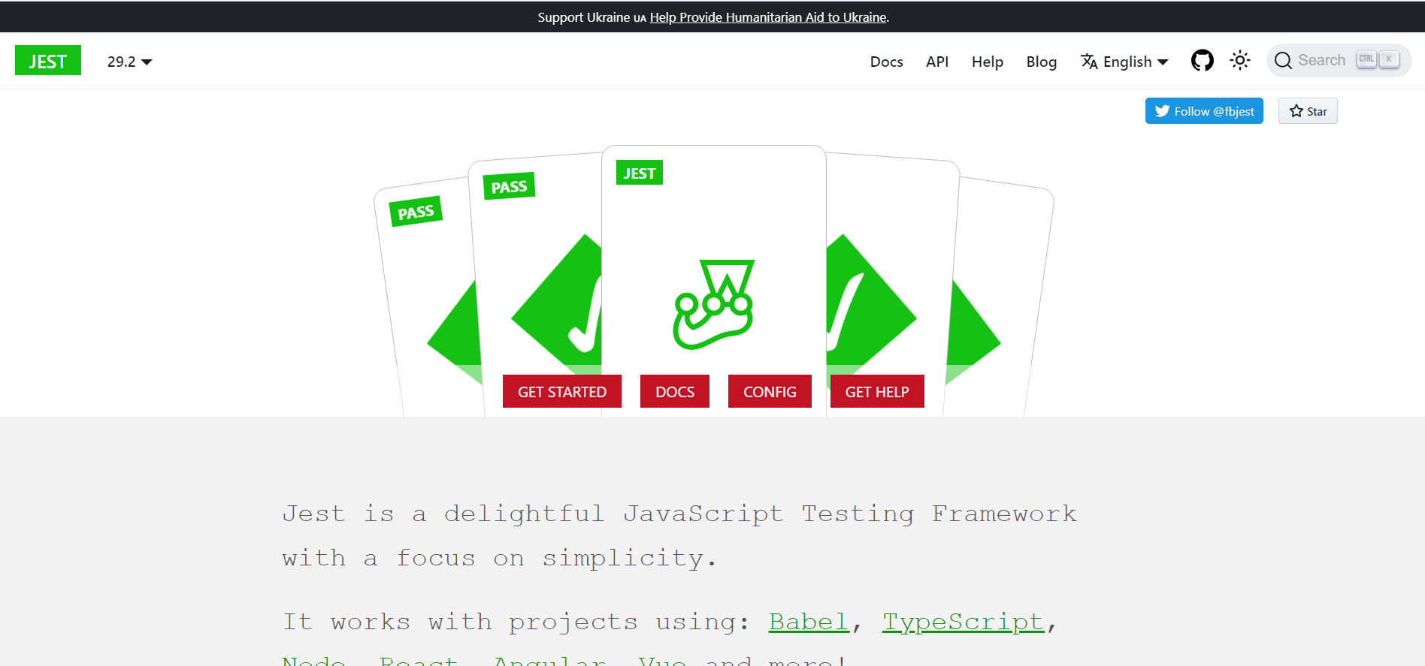

Slide 4
Jest Jest Runner Jest Snippets

Slide 5
npm install --save-dev jest
function sum(a, b) {return a + b;} module.exports = sum;
const sum = require('./sum'); test('adds 1 + 2 to equal 3', () => { expect(sum(1, 2)).toBe(3); });

Slide 6
{"scripts": { "test": "jest"}}
package.json

Slide 7
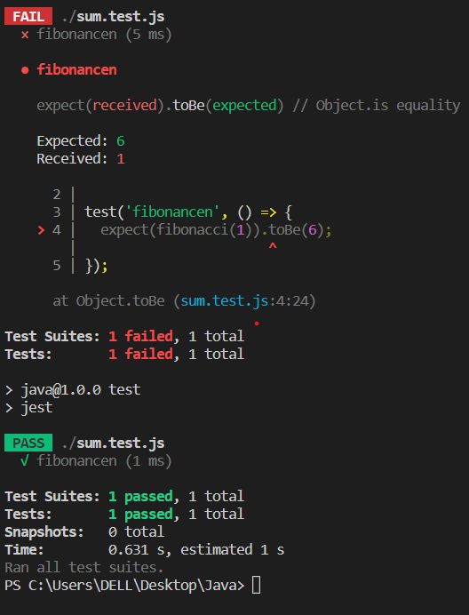

Slide 8
Our Presentation
Javascript
Jest
1

Slide 9
ThANKS FOR WATCHING !

