Slide 1
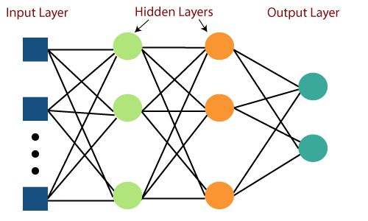




Semantic
Encoder
fɵ1 (•)
Semantic Decoder
Legitimate Channel
fɵ2b (•)
Data Recovery
Data Observed
S
S̃
X
Noisy Channel
Yb
Generator
$$Ŝ$$
b
Discriminator
K
Semantic Decoder
Wiretap Channel
fɵ2e (•)
K
Database (K)
Ye
$$Ŝ$$
e

