Slide 1
Vibes Bot (Implement with UIPath Studio)
4th Year, Knowledge Engineering
Robotic Process Automation (KE-42119)
University of Information Technology
Hnin Htet htet

Slide 2
Presentation Outlines
What is Vibes Bot
Features/Flow
Activities
Why we use Data Scraping
Orchestrator
Snapshot
Future Enhancement
Learning from the project
Conclusions

Slide 3
What is Vibes Bot
Stay informed quickly and easily with a daily email of the latest local and global news.
“Vibes Bot” helps you to keep in touch with the people and things you care about by sending you personal email.
Not only saving you hours of time spent checking sites and scrolling feeds but also with the latest updates it becomes much more than that.
So, you won't miss the latest rumors, theories.
Our goal with “Vibes bot” is to help people follow any topic without stress, easily on their busy schedule.

Slide 4
Features of Automation
The news from one of the following websites can choose.
Myanmar Times
Eleven
Irrawaddy
BBC
VOA
The use of Orchestrator to set time on sending mail.
Ready to see 10 latest news in excel file (containing News Headers, URLs and (Published date if the website has) in your in inbox daily.

Slide 5
Activities that we used
Input Dialog – for user input
If – for error handling
Assign – for error handling
Log Message – for error handling
Switch – for choosing one into 5 of Media websites
Open browser – for opening the Media website
Write Range – for writing extracted data into excel file
Sent SMTP Mail Message – for sending message to user

Slide 6
Why we use Data Scraping
Data Scraping is a powerful component of UiPath Studio which enables us to extract structured data from our browser, application or document to a database, CSV file or Excel spreadsheet.
So we can extract anything we see on a web browser like news’ “title” and “published dates”.
It can automatically log in to a web site, extract data spanning multiple web pages, filter and transform it into the format of our choice, before integrating it into another application or web service.

Slide 7
Orchestrator
UiPath Orchestrator is a web application that enables you to organize your UiPath Robots in executing repetitive business processes.
Orchestrator lets manage the creation, monitoring, and deployment of resources in and applications.

Slide 8
Orchestrator Main Capabilities
Provisioning creates and maintains the connection between Robots and Web application
Deployment assures the correct delivery of the package versions to the assigned Robots for execution
Configuration maintains and delivers Robot environments and process configuration

Slide 9
Orchestrator Main Capabilities
Queues ensures the queues and queue items management
Monitoring keeps track of Robot identification data and maintains user permissions
Logging stores and indexes the logs to an SQL database and/or ElasticSearch (depending on your architecture and configuration)
Inter-connectivity acts as the centralized point of communication for 3rd party solutions or applications

Slide 10
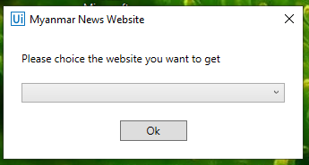
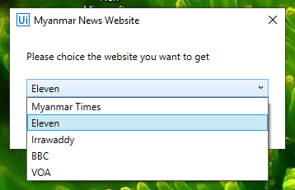
Snapshot
Input Dialog box which indicate user to choose the Media Sites.

Slide 11
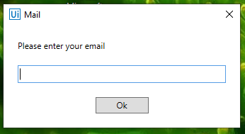
Snapshot (continued)
Input Dialog box which indicate user to type the email address.

Slide 12
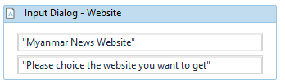
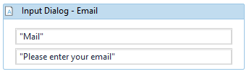
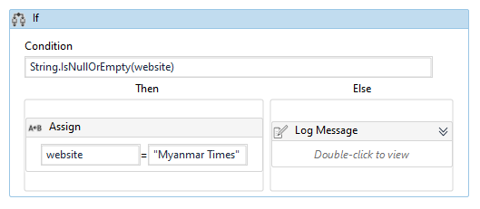
Snapshot (continued)
Input
Error Handling

Slide 13
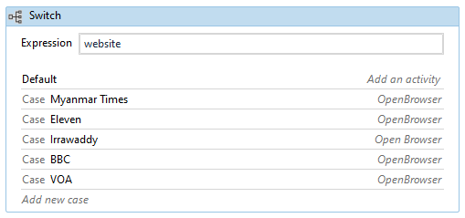
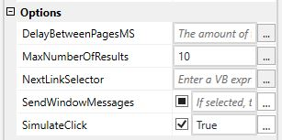
Snapshot (continued)
Switch Case to choose website
In data scraping, we give "MaxNumberOfResults=10" to extract 10 rows

Slide 14
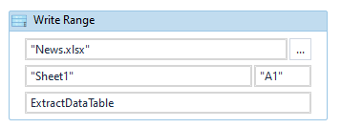
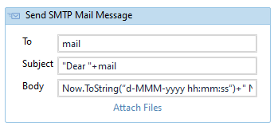
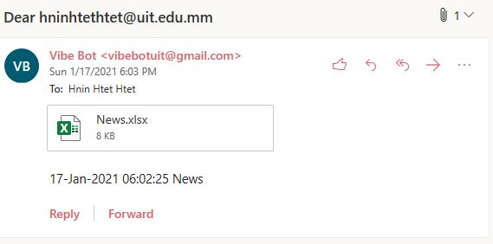
Snapshot (continued)
Write the extract data table to excel
Send .xlsx file to User Email address
Receive the email from Vibe Bot

Slide 15
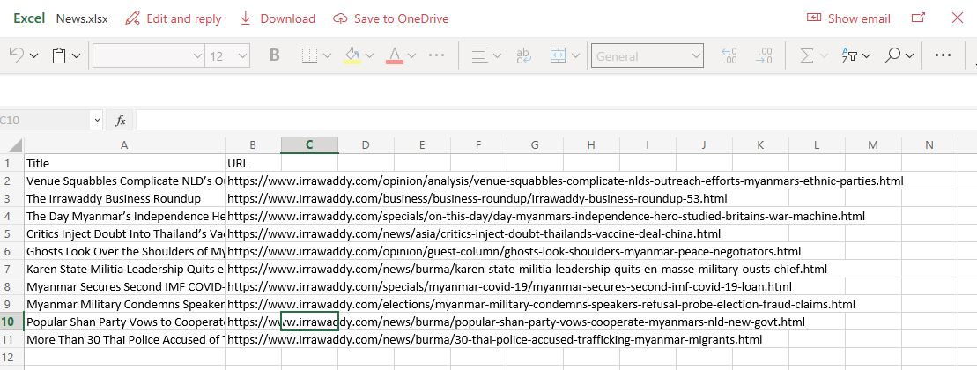
Snapshot (continued)
What we get from mail

Slide 16
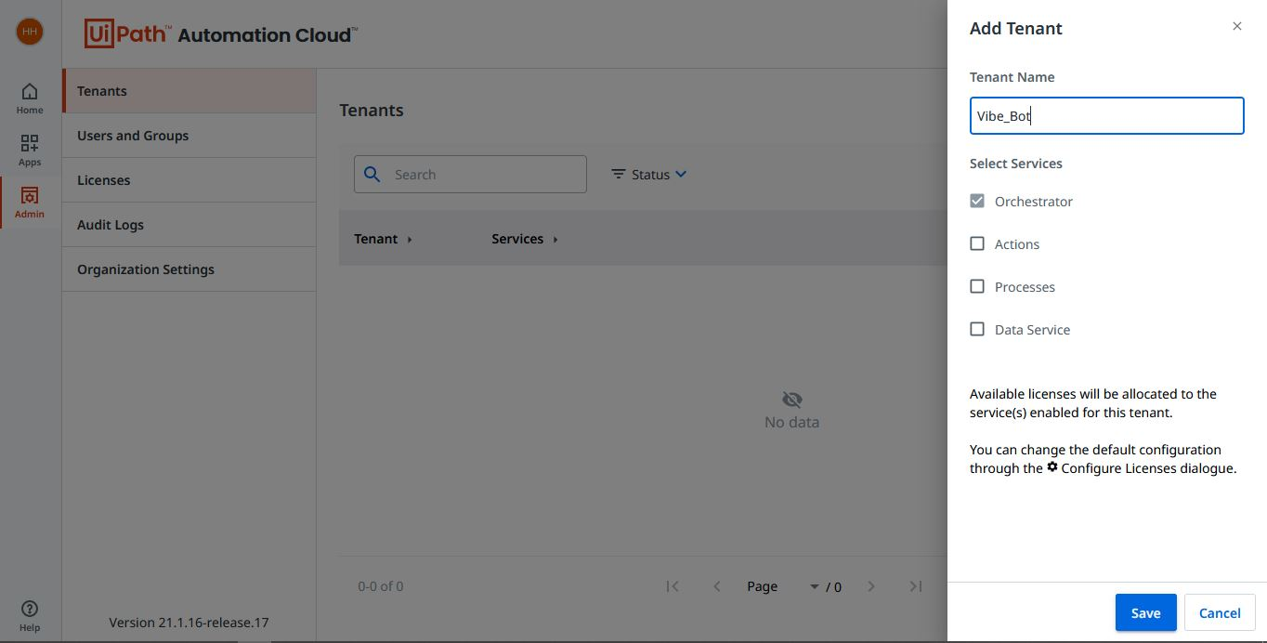
Snapshot (continued)
Create Tenant in UiPath Orchestrator

Slide 17
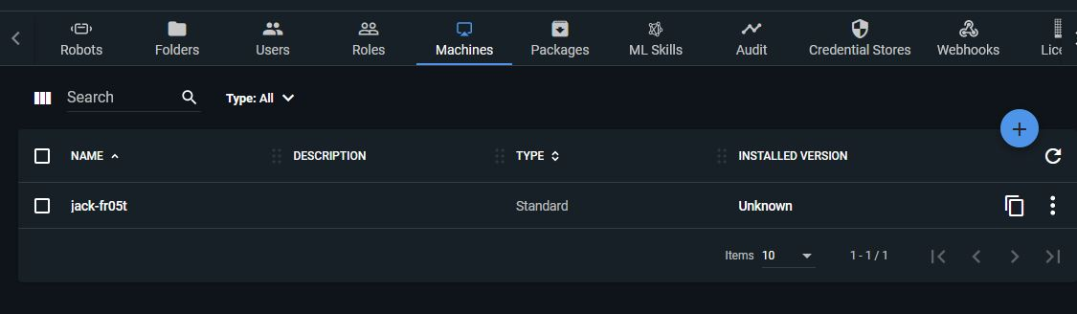
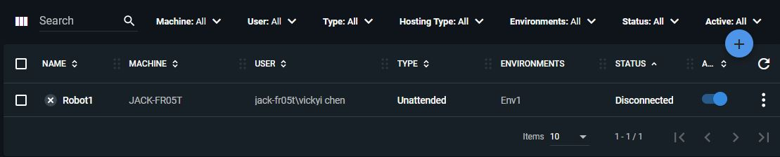
Snapshot (continued)
Create machine
Create robot

Slide 18
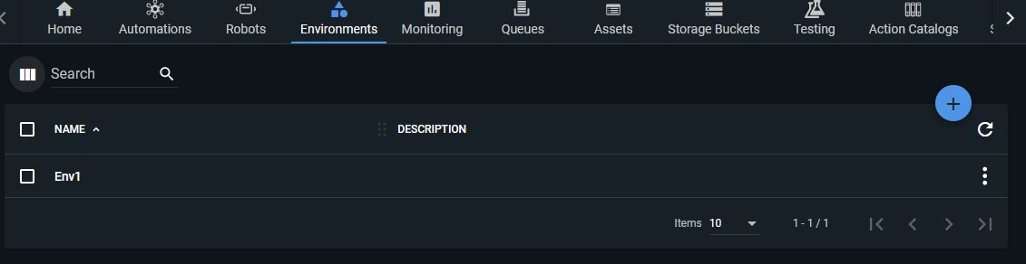
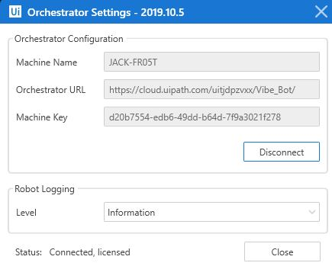
Snapshot (continued)
Create environment
Make connection

Slide 19
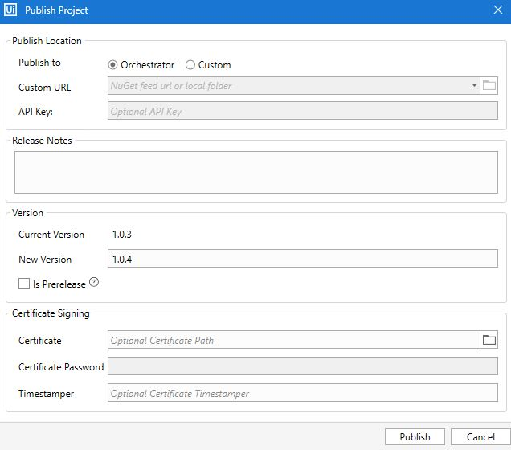
Snapshot (continued)
Publish to Orchestrator

Slide 20
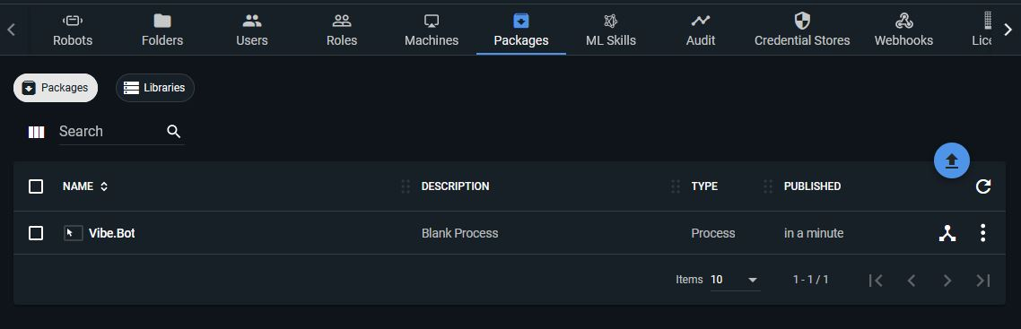
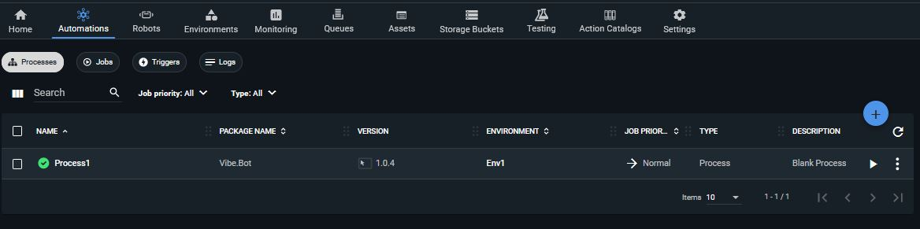
Snapshot (continued)
Receive as a package
Create a process

Slide 21
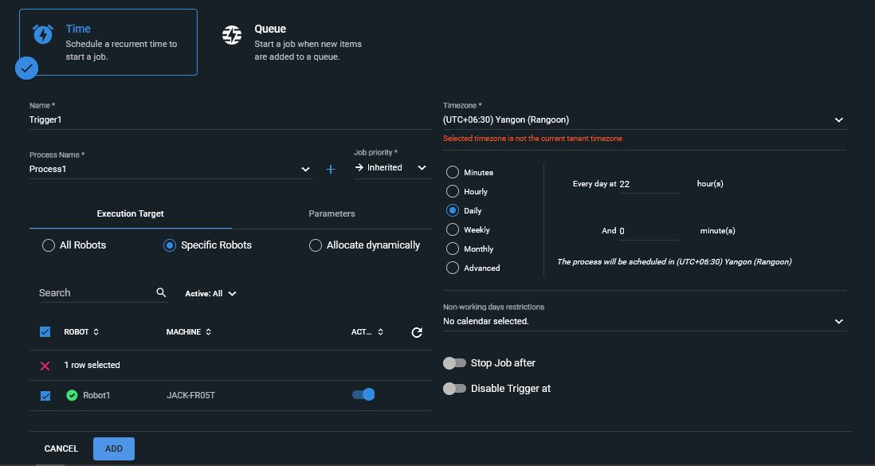
Snapshot (continued)
When create trigger, we choose daily option to receive news daily

Slide 22
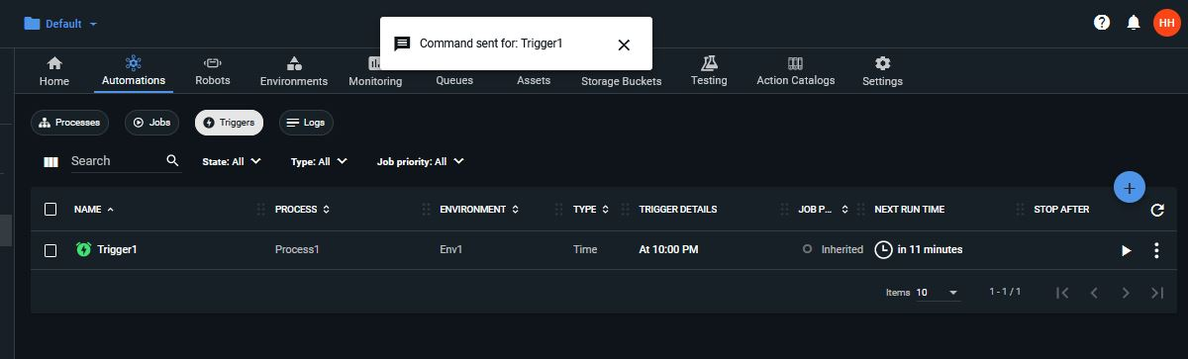
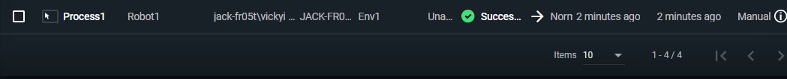
Snapshot (continued)
Pop up when we run trigger.
In job, there will show successfully completed message.

Slide 23
Future Enhancement
Our automation project only use 5 Media Websites then, as could add more sites.
Moreover, News categories like sports, health, politics, technology, crimes could be extract depend on individuals favorite topic.
We could enhance our project to search the word (eg. Covid-19) and extract the news related to that word.

Slide 24
Learning from the project
We get knowledge of Robotic Process Automation(RPA) implementing with UIPath Studio (tool that can model an organization's business processes in a visual way).
Moreover, we get to know the Activities use in UiPath Studio and the practical use of email automation, selectors, exception handling, advanced UI interactions, etc… .

Slide 25
Conclusions
This project offers the following facilities.
1) Select as you like
Vibes Bot offer sources from different sites: Myanmar Times, Eleven, Irrawaddy, BBC, VOA.
2) Combine and mix
send you daily latest news with mixed categories.
3) Done! Sit back and relax
You feel well-rested brain, avoid scrolling a considerable amount of unrequired/mindless information from social media.

Slide 26
Thank You All !

Slide 27
Questions?

