Slide 1
SQL Project on Online Book store

Slide 2
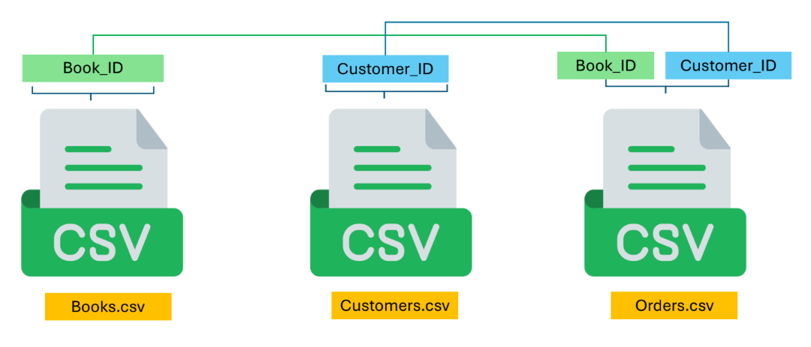
Objective: Apply SQL queries on relational data from an online bookstore system using three connected CSV datasets.

Slide 3
Basic Queries
1) Retrieve all books in the "Biography" genre
2) Find books published before the year 1950
3) List all customers from the Canada
4) Show orders placed in November 2023
5) Retrieve the total stock of books available
6) Find the details of the most expensive book
7) Show all customers who ordered more than 1 quantity of a book
8) Retrieve all orders where the total amount exceeds $20
9) List all genres available in the Books table
10) Find the book with the lowest stock
11) Calculate the total revenue generated from all orders

Slide 4
Advance Queries
1) Retrieve the total number of books sold for each genre
2) Find the average price of books in the "Fiction" genre
3) List customers who have placed at least 2 orders
4) Find the most frequently ordered book
5) Show the top 3 most expensive books of 'Fantasy' Genre
6) Retrieve the total quantity of books sold by each author
7) List the cities where customers who spent over $30 are located
8) Find the customer who spent the most on orders
9) Calculate the stock remaining after fulfilling all orders

