Slide 1


Slide 2


Slide 3
Communication and Collaboration

Slide 4
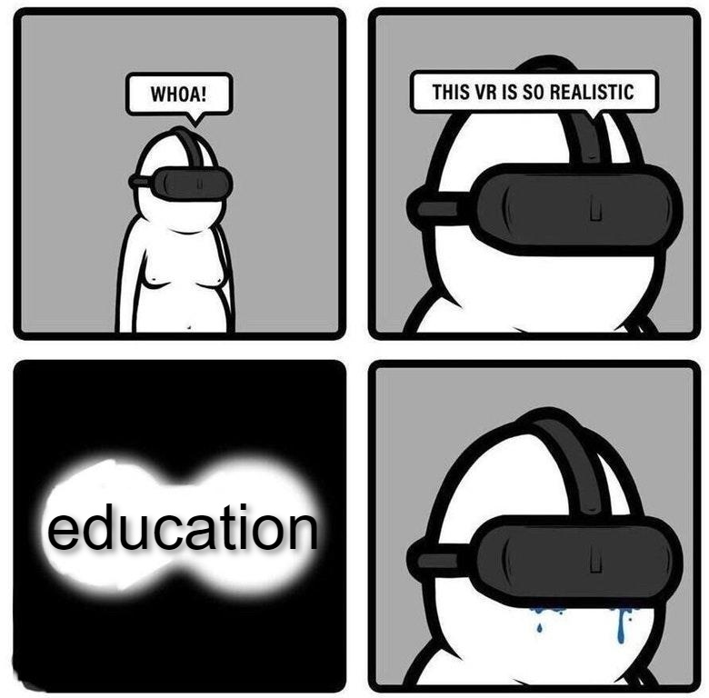
Game-changing technologies in education

Slide 5
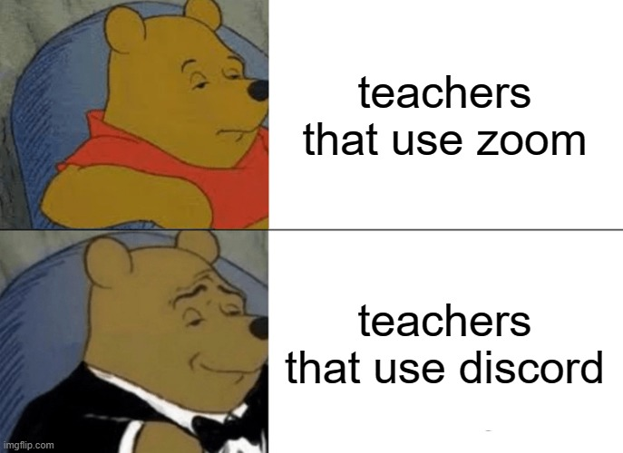
Changing the landscape

Slide 6
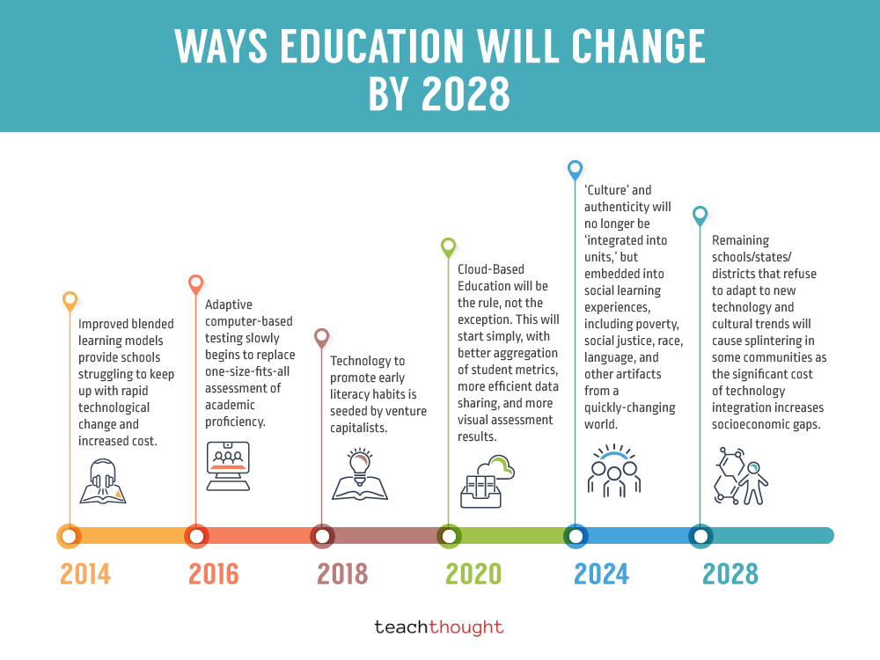

Slide 7


