Slide 1

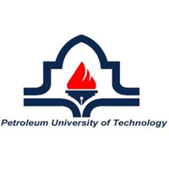

Hussein Mohammadi
Petroleum Production Engineer
Resources:

Slide 2
2
Education
Master of Science
Petroleum Production Engineering
Amirkabir University of Technology
Resources:

