Slide 1
What’s Topdown approach and how to apply it?
Hồ Chí Tài

Slide 2
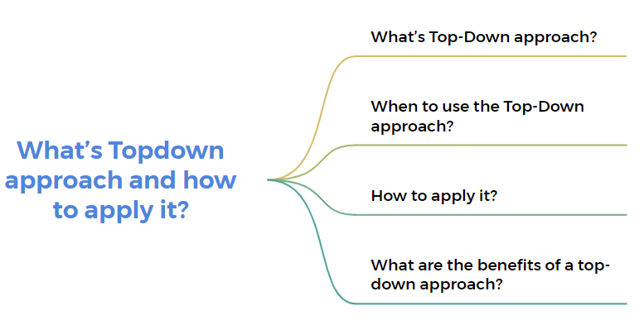

Slide 3
What’s Top-Down approach?
The top-down approach is a design methodology used in various fields, including software development and problem-solving. In the context of software development, the top-down approach involves breaking down a system into smaller, more manageable modules or sub-systems. The process starts with an overarching view of the system and gradually refines the details.

Slide 4
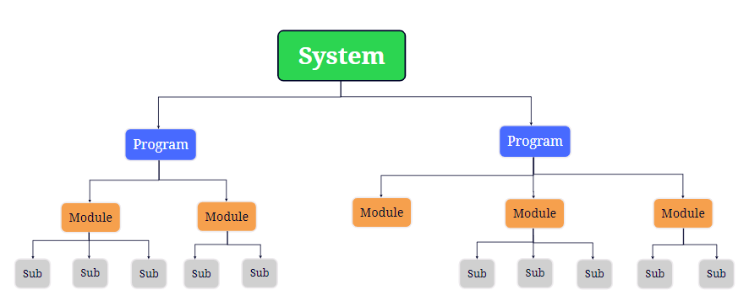
Top-Down approach

Slide 5
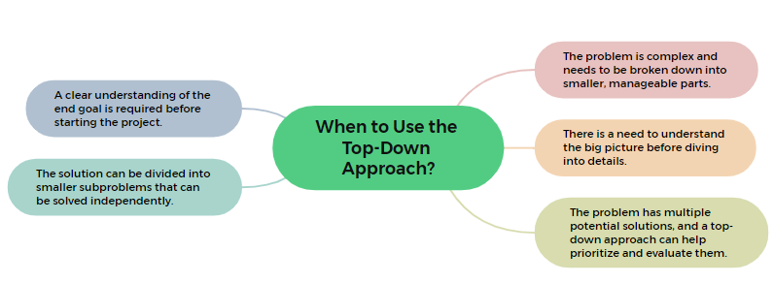
When to use the Top-Down Approach?

Slide 6
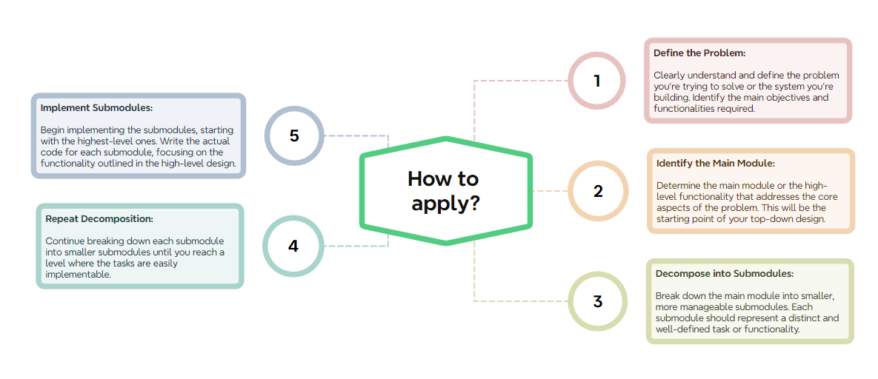
How to apply?

Slide 7
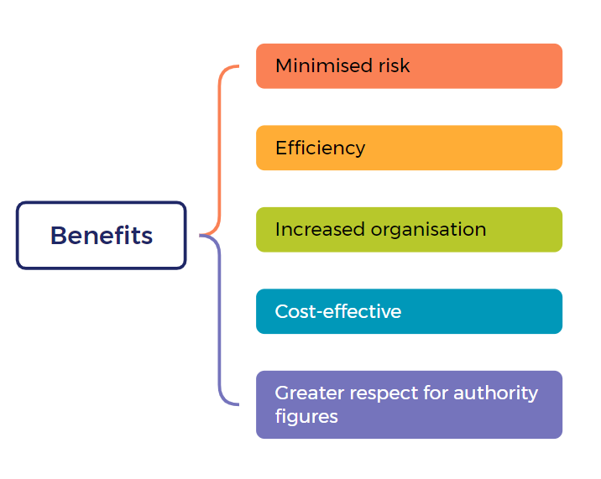
Benefits

Slide 8
THANK YOU

