Slide 1
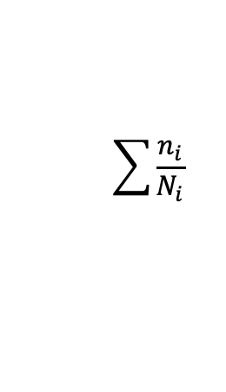
Degradation Method
State0 Method
Damage Acc. Method
State i Method
Element Method
X
Tooth | a0 | n0 | ….
1 | 0.53 | 2.6e6 | …
2 | 0.76 | 3.6e6 | …
Tooth | ai | ni | ….
1 | 1.54 | 5.7e6 | …
2 | 0.96 | 5.7e6 | …
$$\sum{\frac{n_{i}}{N_{i}}}$$

