Slide 1
Homework 1
0610841 林宏哲

Slide 2
Outline
Pseudo Code
Mode 1 (Brute Force)
Mode 2 (Divide and Conquer)
Mode 3
C++ Code Implementation
Point
Point Pair
Sort

Slide 3
Mode 1 (Brute Force)
Find all pairs with distance smaller than D

Slide 4
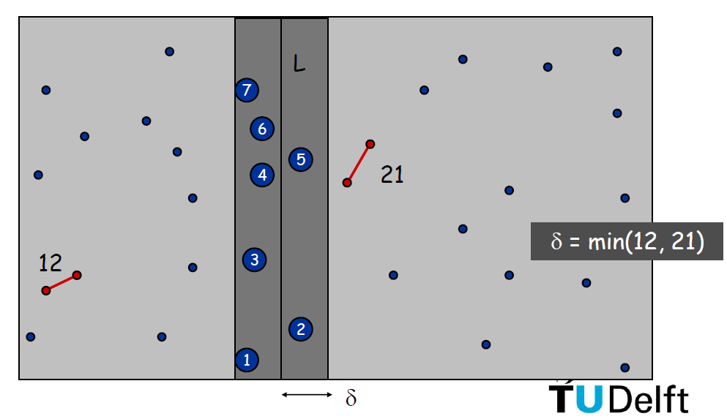
Divide and Conquer
https://ocw.tudelft.nl/wp-content/uploads/Algoritmiek_Closest_Pair_of_Points.pdf

Slide 5
Mode 2 (1/3)
Find nearest N pair of points

Slide 6
Mode 2 (2/3)

Slide 7
Mode 2 (3/3)
Update nearest N pairs list
But this method is slow. (swap a lot when N is large)
Improve? Linked List?

Slide 8
Mode 3
Similar to Mode 2 but with only one pair in rank list

Slide 9
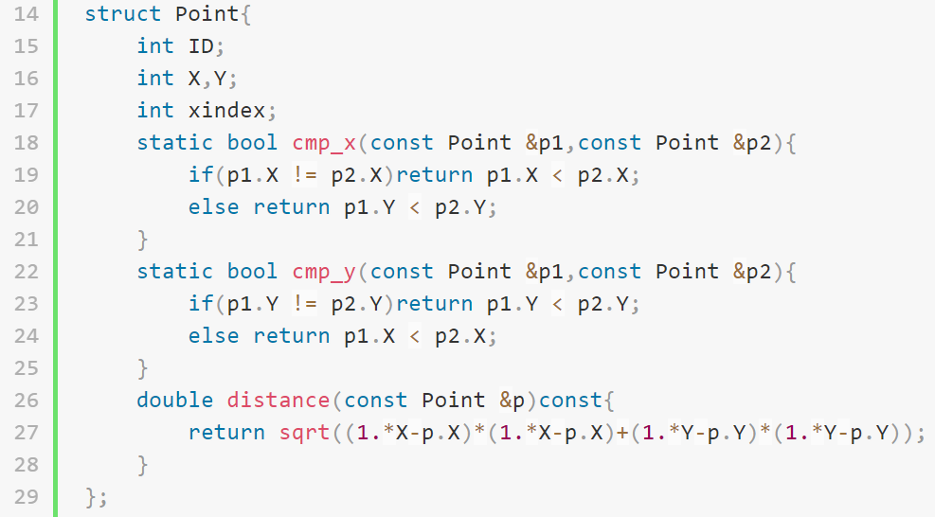
Implementation
Point

Slide 10
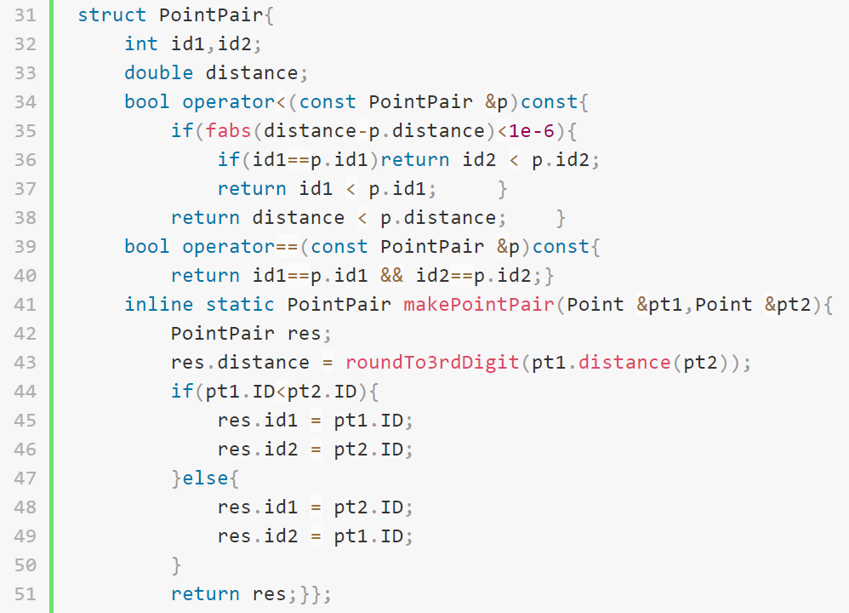
Implementation
Point Pair

Slide 11
Implementation
Sorting
#include <algorithm>
Sort by x
sort(points,points+N,Point::cmp_x);
Sort by y
sort(pointsY.begin(),pointsY.end(),Point::cmp_y);
Sort by distance and IDs
sort(result.begin(),result.end());

Slide 12
END
Thank you

