Slide 1
2048
Data Structure and Object Oriented Programming
Instructor: Sai Keung Wong
National Chiao Tung University, Taiwan

Slide 2
2048
It’s a 4x4 board game. We can change its dimension, of course.
There are numbers (usually 2 and 4) generated randomly.
Move step: use UP, DOWN, LEFT, RIGHT keys to move the numbers to the respective side to combine the numbers.
Number combination rule:
(1) two adjacent numbers in the same movement direction.
(2) they must be the same.
A new number is produced by adding the two numbers together. The new number cannot be combined in the same move step.

Slide 3
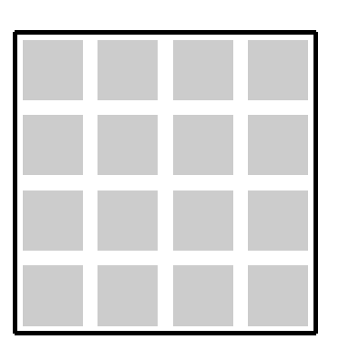
The new number is produced at the position opposite to the movement direction.
An example for DOWN. The preference position starts from the top row and from left to the right. You can use a method other than that to generate new number.

Slide 4
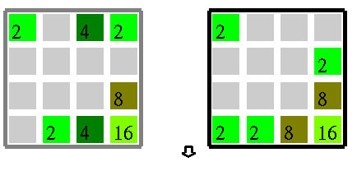
Example
Move down. The two numbers 4 are combined into 8. The other numbers are moved down. A new number 2 is produced at the upper left corner.
Previous step
Current step

Slide 5
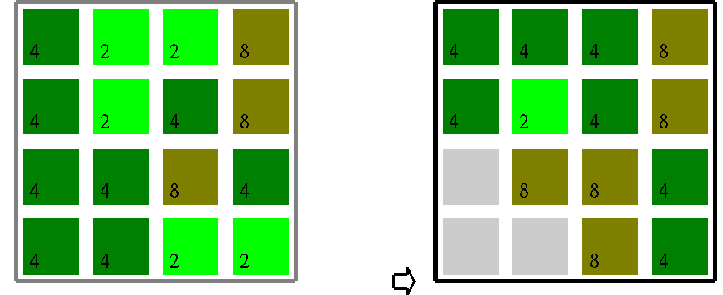
Example
Move to right.
The two numbers 4 are combined into 8 but the new number cannot be combined with the existing 8.

Slide 6
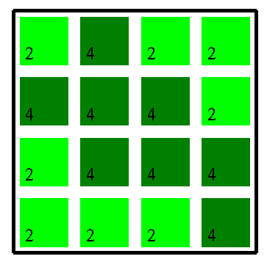
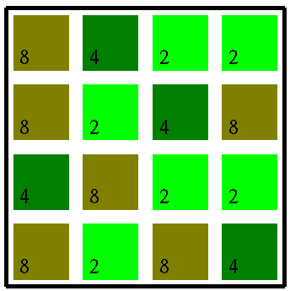
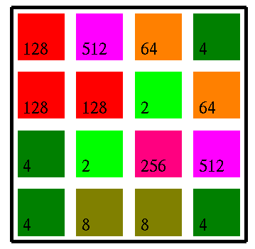
Boards
generateNumbers_All_2to4
generateNumbers_All_2to8
generateNumbers_All

Slide 7
Tasks
generateNumber( ) : generate a new number (2 or 4) after a move step is finished.
void MY_2048::handleSpecialKeyPressedEvent( unsigned char key )
You may also want to implement something inside this function after a move key is handled.

Slide 8
void MY_2048::askForInput( )
{
cout << "MY_2048" << endl;
cout << "Key usage:" << endl;
cout << "1: generate randomly the numbers 2 and 4 for all the cells" << endl;
cout << "2: generate randomly the numbers 2, 4 and 8 for all the cells" << endl;
cout << "3: generate randomly the numbers for all the cells" << endl;
cout << "r: clear all the cells" << endl;
cout << " " << endl;
cout << "UP, DOWN, LEFT, RIGHT: move the numbers to the respective side" << endl;
}

Slide 9
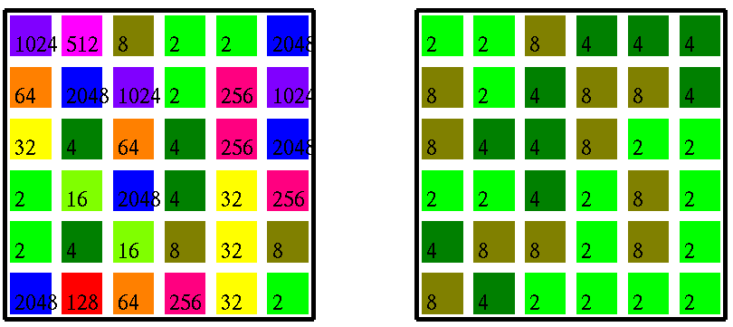
Game board of dimension 6x6

Slide 10
There are some bugs in the demo program. Could you find them?

Slide 11
Enjoy programming

