Slide 1
Prediction of Animal Strike on US Commercial Flights
Gábor Horváth

Slide 2
Business objectives
Create a statistical analysis to identify those reasons (based on the data available), which are determining the the risk of an animal strike for an airport.
Create a prediction model, which can be used to predict the risk of an animal strike for a given flight.

Slide 3
Data sources
Federal Aviation Administration - Wildlife Strike Database
United States Department of Transportation - Bureau of Transportation Statistics - Flight performance
Federal Aviation Administration - Airport Data & Contact Information

Slide 4
Tools used
R
R Studio
knitr, MiKTeX
ggplot2
H2O
CRIPS-DM process model
buckets, github

Slide 5
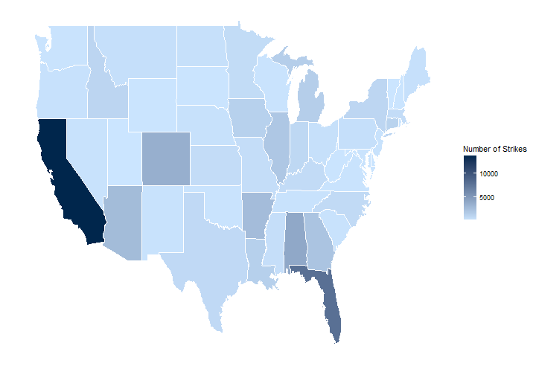
Strike distribution

Slide 6
Model 01 - details
log-log linear regression model
categorical and continous predictor variables from airport point of view
outcome variable: number of animal strike per airport
location and traffic of the airport influence the outcome

Slide 7
Model 02 - details
H2O platform - Java
categorical and continous predictor variables from flight point of view
outcome variable: flight got animal strike or not
most influental predictors were the airports (origin, destination), the arrival and departure time blocks and the month

Slide 8
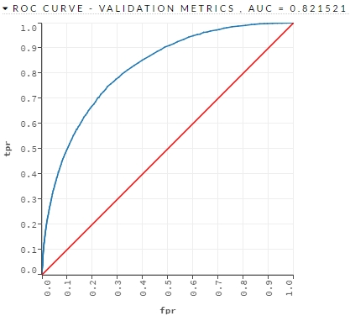
Receiver Operating Characteristic (ROC) curve

Slide 9
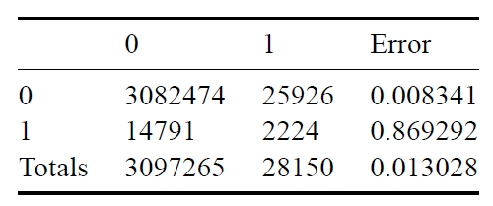
Confusion matrix

Slide 10
Thank you

