Slide 1
Plane Tickets Management
CS 3360
Hồ Gia Huy - 1669908
Phạm Xuân Hùng - 1624702
Trương Khánh An - 1624815

Slide 2

Plane Tickets Management
Functions of our project:
Managing plane tickets and users data in a database.
Allowing users to view and order tickets or change their account’s information.
Staff accounts having access and can keep track or modify data of tickets, orders and users.
Technologies used:
JavaFX with JDBC and MySQL for code and database.
CSS and FXML for design.

Slide 3
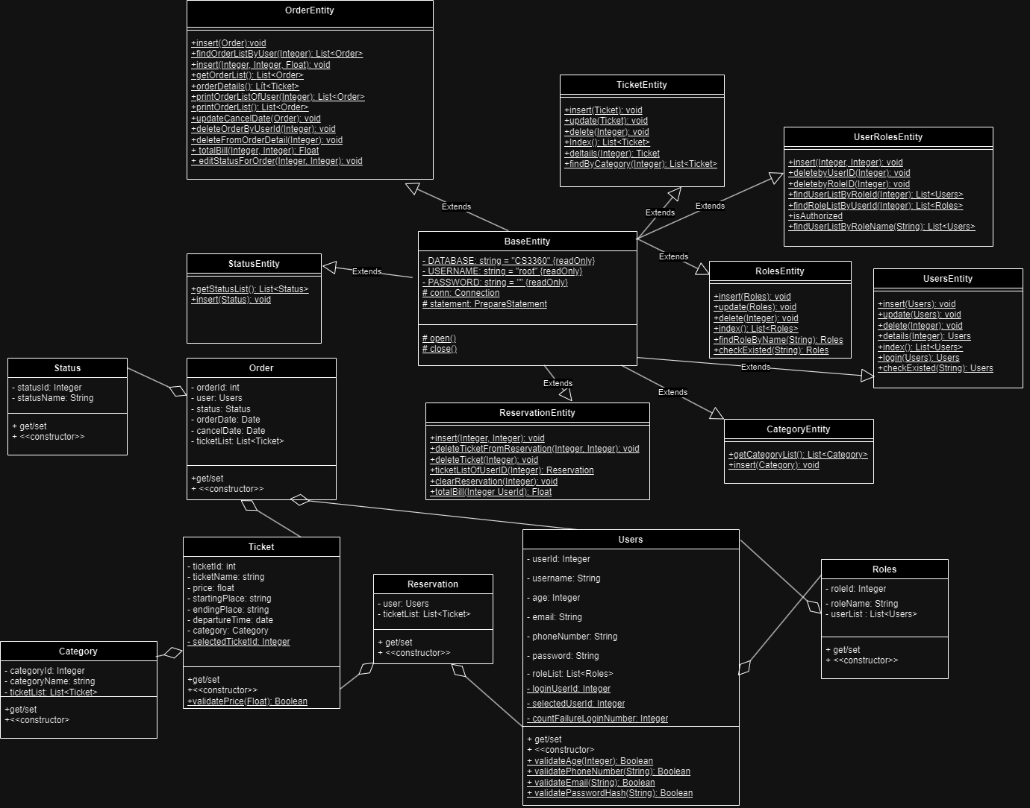
Classes

Slide 4
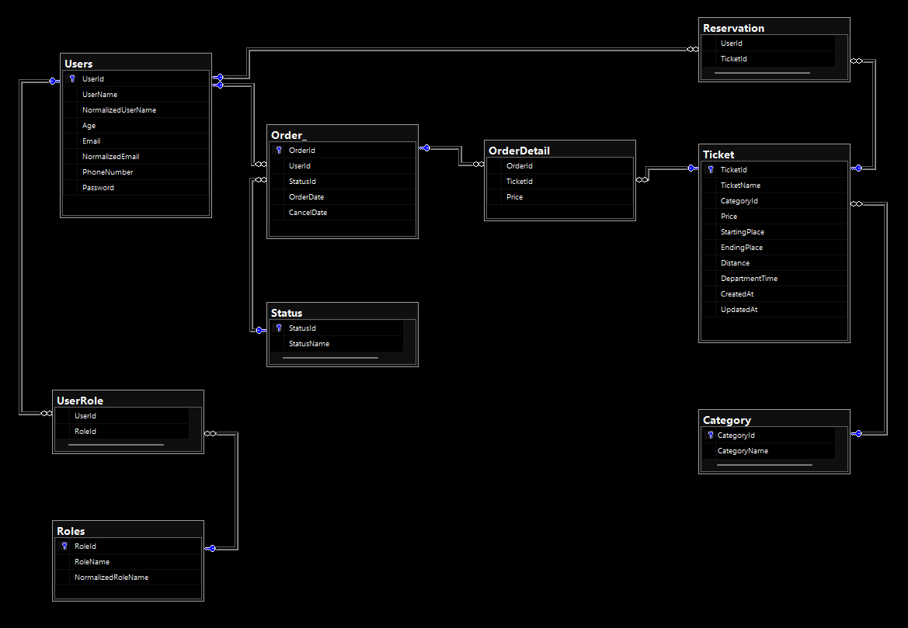
Database: CS 3360

Slide 5

Contributions
Hồ Gia Huy
Trương Khánh An
In charge of making and managing User and Role classes and their databases.
In charge of making and managing Reservation and Order classes and their databases.
Phạm Xuân Hùng
In charge of making and managing Ticket and Category classes and their databases. Also in charge of making the UI for our project.

Slide 6


Thanks!
CS 3360
Hồ Gia Huy - 1669908
Phạm Xuân Hùng - 1624702
Trương Khánh An - 1624815

