Slide 1
Lesson Learn FSN0FS128A
ACT2-Kyle / July 13

Slide 2
Agenda
PLL summary
PLL issue
PLL new config
BISR connect issue

Slide 3
PLL Summary
CONTEXT:
Fsim of 128A need compile PLL IP as newly design for 128A.RD recommended that it would be worked around as another IP.
Expected: FXPLL357HN0V
Workaround: FXPLL357HN0U

Slide 4
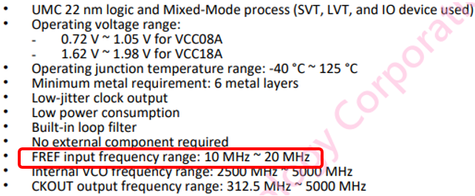
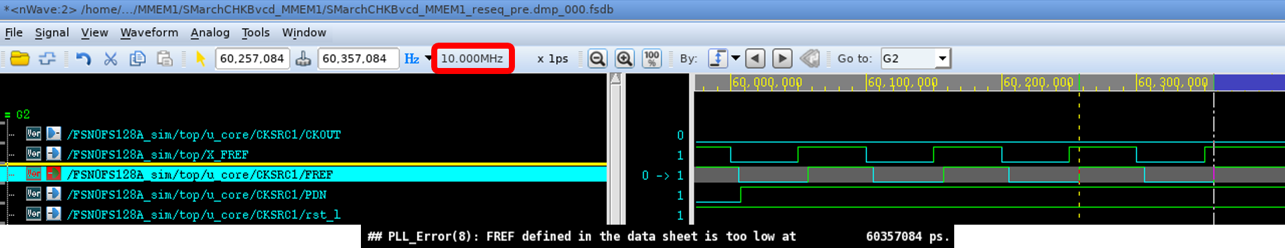
PLL issue detected
FREF satisfy PLL spec, but it notify error in log file → This lead to fail combine in presim

Slide 5
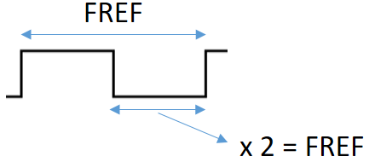
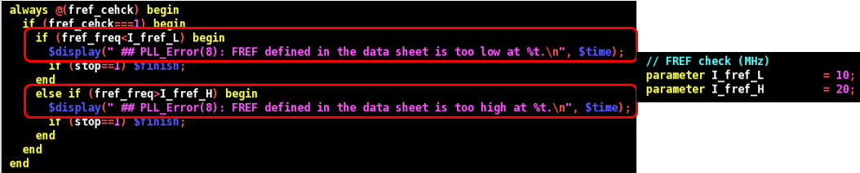
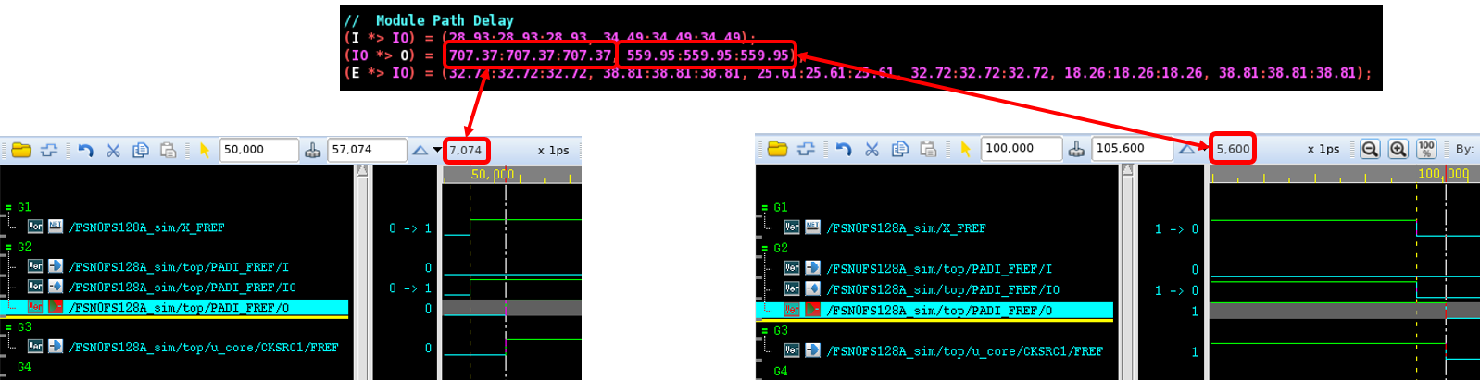
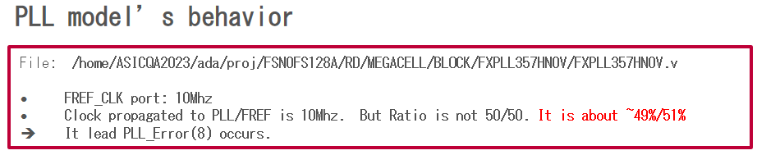
PLL issue root cause
Fref condition check in PLL model by multipled half a cycle, and use result to compare, instead of taking a full cycle
Duty cycle from port to input pin inside chip will be different, due to value define in library
Duty cycle at FREF pin of PLL isn’t at 50%, which make fail compare condition

Slide 6
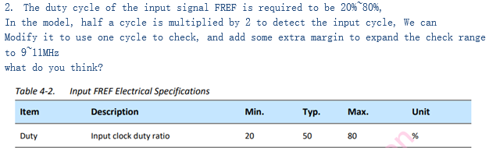
Solution for PLL issue
In PLL spec, it can support duty cycle from 20% to 80%. So when feedback to PLL owner, he will modify input frequency check, and relax the margin for duty cycle check.

Slide 7
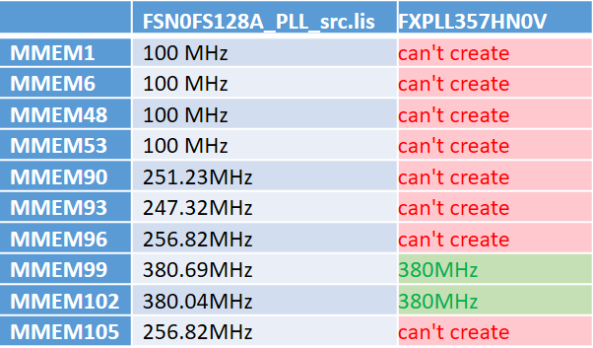
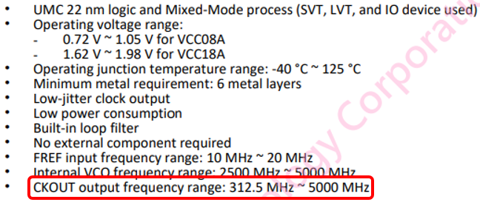
Why need new PLL config ?
1. The minimum frequency that this PLL can support is 312.5MHz (can check it in PLL datasheet)
2. There are some memories use frequency < 312.5MHz
3. Work around solution: use old PLL model to generate frequency < 312.5MHz
→ PLL owner confirm real circuit can’t generate frequency < 312.5MHz either.

Slide 8
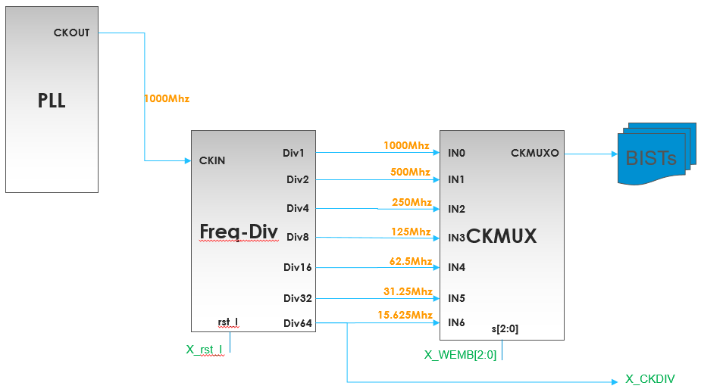
Solution for this frequency issue
RD will add divider, which downgrade the frequency from PLL output to < 312.5MHz.
Minimum freq: 312.5MHz

Slide 9
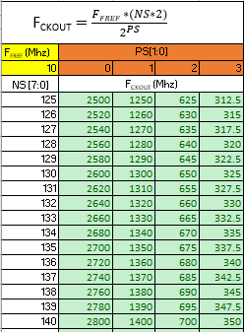
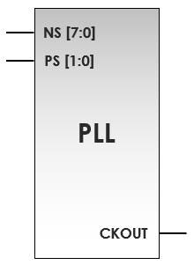
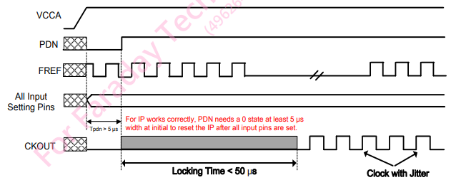
Old PLL config
At old PLL model, we will use NS and PS pin , with PDN and rst to config frequency

Slide 10
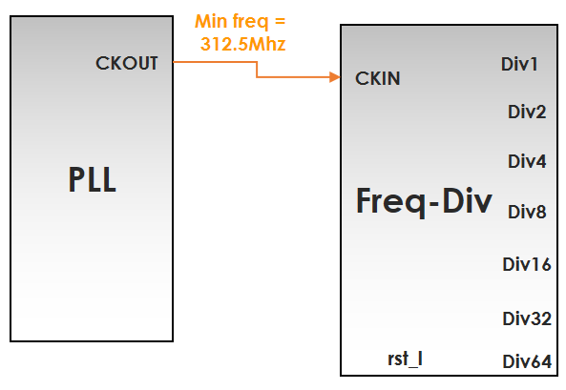
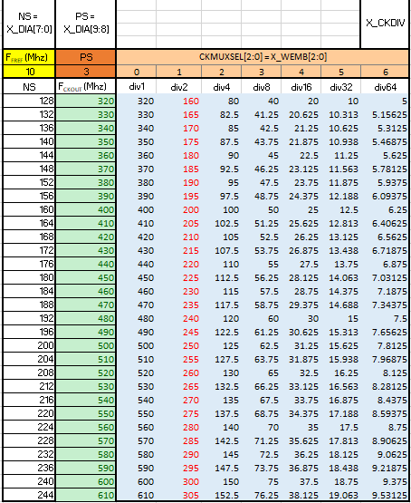
New PLL config
With new PLL config, beside 4 pin at old PLL config, we will take to CKMUXSEL pin, which will use to divide clock from PLL output
Formula for this new PLL model, we will take output freq at PLL and divide it with divider based on divide config.
Note: The rst pin will have new config too, from 1 → 0 change to 1 → 0 → 1 (change to logic 1 before Locking time of CKOUT complete)

Slide 11
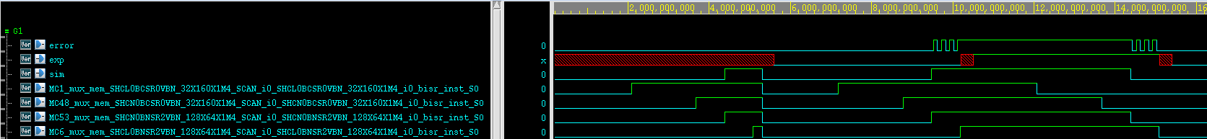
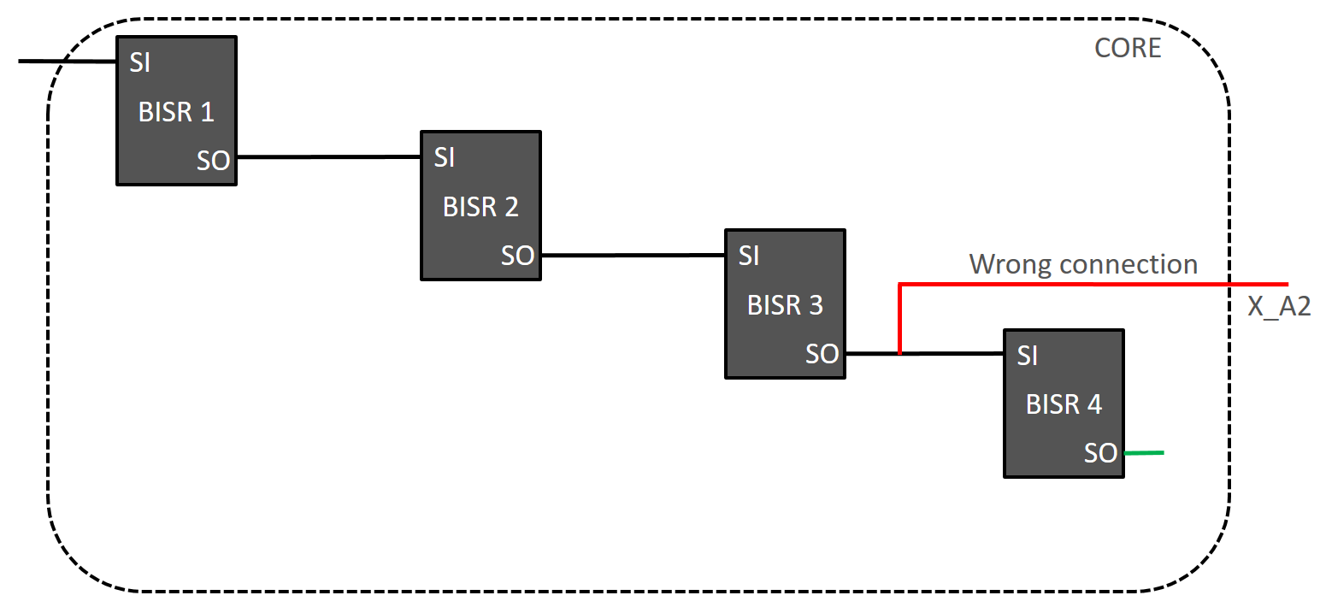
BISR issue detected
Fail Presim
Check waveform
Sim waveform = Mem 53 waveform
Exp waveform = Mem 6 waveform
Check netlist

Slide 12


Wrong BISR connection cause
*BISR_inst.lis
Normally, will use the the last mem defined in *BISR_inst.lis file to connect to port on top.
Defined the connection in *ts_post.cmd
Tessent tool list the ascending order by checking the first number first, and it’s similar to next number
Tool will use MMEM6 for last BISR connect to port to generate pattern, instead of MMEM53 defined in *ts_post.cmd
Note: can check ascending order of Tessent tool by checking file *.bisr_segment_order after insert MBIST.

Slide 13
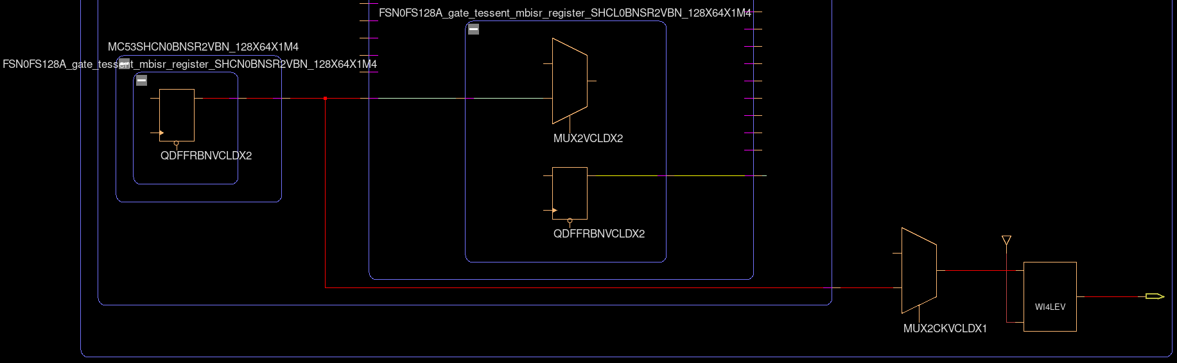
Solution for BISR issue
First method (early project period) : change memory connect port from MMEM53 to MMEM6 in “MBIST insertion” stage and re-run MBIST insertion
Second method (late project period) : ECO netlist, delete connection from MMEM53/SO to BISR_so (red net), connect MMEM6/SO (yellow net) to BISR_so
SO
SI
SO
BISR_so

Slide 14
FSN0FS128A Solving Issue Summary
AC ↔ IP owner:
Work with IP owner to fix and release new PLL model
AC → RD:
Confirm for soon behavior of PLL model firstly
Feedback about PLL config issue
RD → AC:
Release a new PLL config
AC own-self
Carefully checking BISR in Pre-sim.

Slide 15
Document Reference
T:\FTV\DSD\Test_Chip\50_FSN0FS128A\FDI\PLL CKMUX for FSN0FS128A.pptx
T:\FTV\DSD\Test_Chip\50_FSN0FS128A\FDI\FSN0FS128A_PLL_setting_20230614.xlsx
T:\FTV\DSD\DSD_ACD\ACT2\Kyle\Project\FSN0FS128A\FXPLL357HN0U_Data_Book_v0.6.pdf

Slide 16
Confidential information
The material is being disclosed to you pursuant to a non-disclosure agreement between you or your employer and Faraday. Information disclosed in this presentation may be used only as permitted under such an agreement.
Legal notice
The information contained in this presentation is intended to provide a general guide as to which product is suited for a given requirement and shows suggested product applications. Specified functions and properties for products are only valid when handling instructions and other stated conditions and recommendations have been considered and followed. All descriptions, illustrations and dimensions in the information represent general particulars and do not form part of any contract. All information is provided “as is”, with no guarantee of completeness, accuracy, timeliness or of the results obtained from the use of the information, and without warranty of any kind, express or implied, including but not limited to warranties of performance. All information is subject to change without prior notice. Faraday assumes no responsibility whatsoever for any errors or inaccuracies about the information.

