Slide 1
Basic DFT Training
DMD/DTM 2019
KenChi

Slide 2
Agenda
Why need DFT
What’s DFT
Scan - fault model
Scan - basic
Ac scan - fault model
Ac scan - on-chip clock chop
Ac scan - test clock plan
Mbist - structure
Mbist – Algorithm example
IOLT
Faraday test integration platform
Pattern format
Utility for test Pattern

Slide 3
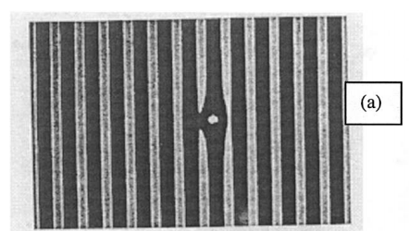
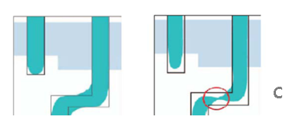
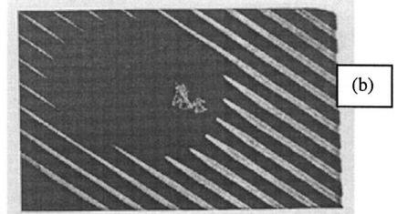
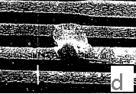
Why need DFT
100% yield is NOT possible, fabrication defects will always present.
Classification of physical defects :
[Manufacture]
dust particles (fig. a)
Mask contamination, Fabrication area contamination (fig. b)
Process Variation (fig. c)
[Aging Effects]
Electro migration (metal migration) (fig. d)
Oxide degradation
[Handling]
ESD

Slide 4
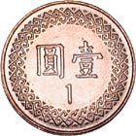



Why need DFT
In View of quality
assume natural yield is 90%
, which means 100000 fail die per million
The number show we must have a high-coverage test for screening out fail dies
In View of test cost
Rule of ten
DFT is the abbreviation of “Design-For-Test”
Chip-level test circuit, as a part of design.
high test coverage and low test cost.
Chip Level
10X
Test
Cost
Package Level
10X
Board Level
10X
System Level

Slide 5
Why need DFT
Pros.
Accelerate the testing process
Guarantee the quality of chips
Cons.
Overhead in chip area
Basic role of test
Separating good dies from bad dies
Expanded role of test
Feedback for yield learning/ramping
Screening out weak dies (reliability)

Slide 6
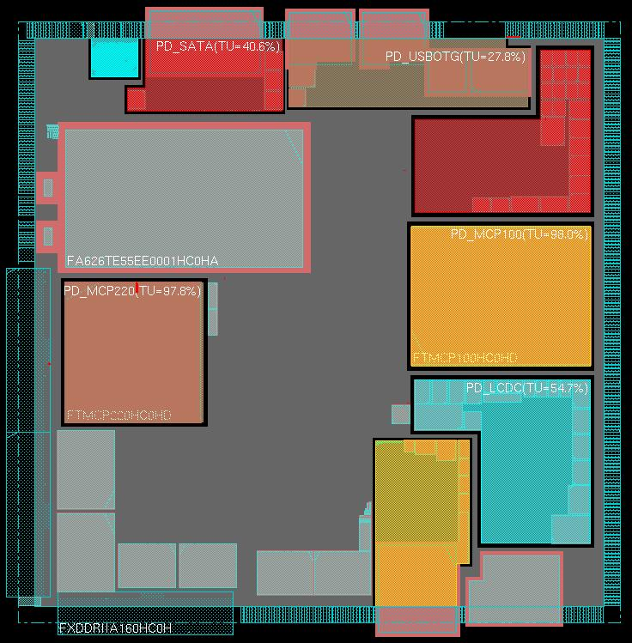

What’s DFT
Circuit open/short
PD_ALIVE
PD_SATA
PD_USBOTG
[Defect-based Test]
Identify physical defect
Convert physical defect to logic fault model and parameter fault model
Decide test method/algorithm to target the certain fault model
PD_ISP
cmos stuck on/
short
PD_MCP100
PD_MPC220
PD_LCDC
PD_PCIE
bridges
Process variation
geometric distortion

Slide 7
What’s DFT
Convert physical defect to fault model
Logical faults
– the fault change the logic function of the circuit
Stuck-at : net stuck at a logic 0/1
Bridging : value on one net affects another net
Coupling : transition on one net affects another net
Parametric faults
- the fault alter physical properties other than logic function
Delay / Transition
Coupling : transition on one net affects another net
IDDQ
DC Level

Slide 8
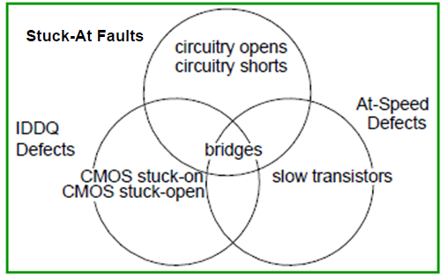
What’s DFT
A example of the fault models that supported by Mentor Graphic

Slide 9
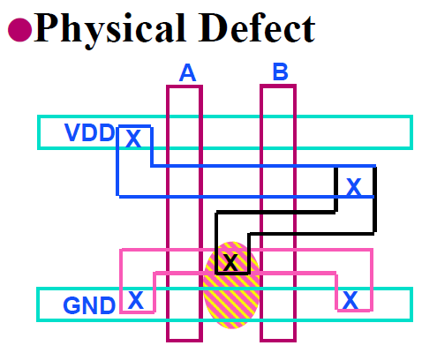
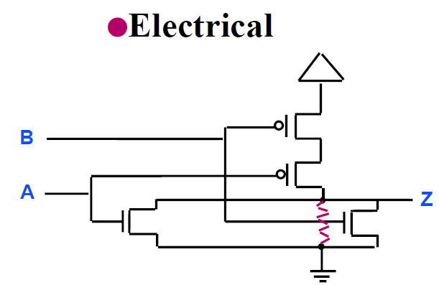
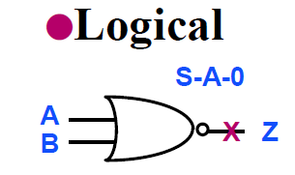
Scan – stuck-at fault model
Many different physical defects may be modeled by the same logical stuck-at fault.
Complexity is greatly reduced.

Slide 10
Scan – concept
For example, to detect a stuck-at-0 fault site, which is behind AND gate.
Place logic-1 at AND’s output (prove it’s not stuck-at 0)
In order to place logic-1 at AND’s output , certain logic-value should be placed in
the input side of the logic cone.
The logic-1 can be captured by DFF, and shift-out for observation
Y
0
SA0
Port A
1
1
0
1
D
Q
D
Q
D
Q
SO
SI
SE
CLK
In order to achieve item1,2,3, all DFFs is needed to be chained up,
which is so-called scan chain

Slide 11
Scan – basic steps
LOAD / UNLOAD
FORCE PI
MEASURE PO
PULSE CAPTURE CLK
Load – shift in vale for control
UnLoad – shift out for observation
Y
Port A
Detect SA0, Required : 1
0
1
X
SO
SI
D
Q
D
Q
D
Q
SE
CLK
In order to achieve item1,2,3, all DFFs is needed to be chained up,
which is so-called scan chain

Slide 12
Scan – basic steps
LOAD / UNLOAD
FORCE PI
MEASURE PO
PULSE CAPTURE CLK
Load – shift in vale for control
UnLoad – shift out for observation
0
Y
1
Detect SA0, Required : 1
Port A
0
1
X
SO
SI
D
Q
D
Q
D
Q
SE
CLK
In order to achieve item1,2,3, all DFFs is needed to be chained up,
which is so-called scan chain

Slide 13
Scan – basic steps
LOAD / UNLOAD
FORCE PI
MEASURE PO
PULSE CAPTURE CLK
Load – shift in vale for control
UnLoad – shift out for observation
1
0
Y
1
Detect SA0, Required : 1
Port A
0
1
X
SO
SI
D
Q
D
Q
D
Q
SE
CLK
In order to achieve item1,2,3, all DFFs is needed to be chained up,
which is so-called scan chain

Slide 14
Scan – basic steps
LOAD / UNLOAD
FORCE PI
MEASURE PO
PULSE CAPTURE CLK
Load – shift in vale for control
UnLoad – shift out for observation
1
0
Y
1
Detect SA0, Required : 1
Port A
0->0
1->1
X->1
SO
SI
D
Q
D
Q
D
Q
SE
CLK
In order to achieve item1,2,3, all DFFs is needed to be chained up,
which is so-called scan chain

Slide 15
Scan – basic steps
LOAD / UNLOAD
FORCE PI
MEASURE PO
PULSE CAPTURE CLK
Load – shift in vale for control
UnLoad – shift out for observation
Y
Port A
Detect SA0, Required : 1
0
1
1
SO
SI
D
Q
D
Q
D
Q
SE
CLK
In order to achieve item1,2,3, all DFFs is needed to be chained up,
which is so-called scan chain

Slide 16
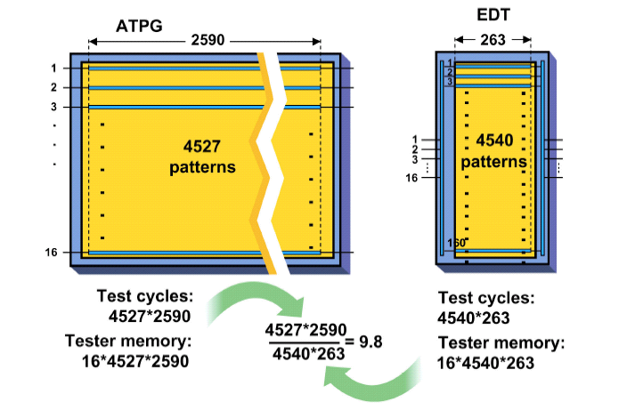
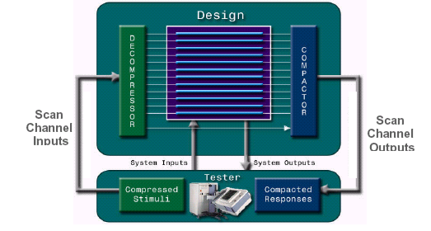
Scan – test compression
Benefit of test compression :
Reduce test cost
Reduce shared-io for scan-in and scan-out

Slide 17
ac Scan – basic & OCC
Y
Port A
D
Q
D
Q
D
Q
SO
SI
SE
PLL
OCC
At-scan share the same circuit with normal scan
Additionally, at-scan required a at-speed double-capture clk pulse.
Occ, onchip-clock-chop help to generate the double-capture-pulse from PLL.
cap_en->ON

Slide 18
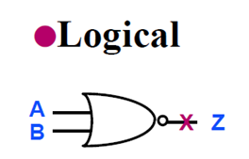
ac Scan – Transitional delay fault model
Slow-to-Rise
The concept is similar to Stuck-at fault model
Two types of fault :
Slow-to-Rise
Slow-to-Fall
To detect the fault, DFF’s clock require a double-capture-pulse,
And the transition of a path must be completed within a double-capture-pulse

Slide 19
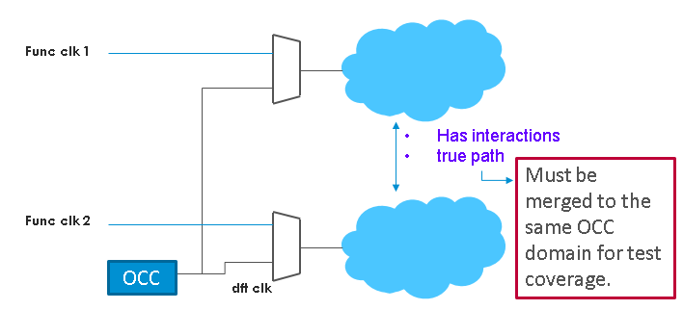
ac Scan – clock plan
The second problem of ac scan is “test clock plan”
The principle of test clock is :
Test Freq must be identical with functional usage
If two clock domains are functional timing true path , they should be merged with one occ clock domain.
If two clock domains are functional timing false path , they shouldn’t be merged into one occ clock domain.

Slide 20
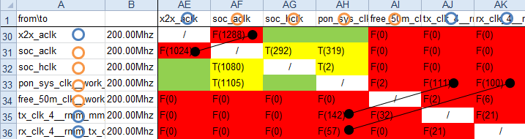
ac Scan – clock plan
To meet the principle, the difficulties are :
Where is the root point of each clock domain ?
What’s the freq of the domain ?
What is the interacting condition and timing exception condition between domains ?
Faraday test Clock Builder (fcb) help to analyze and plan test clock

Slide 21
Mem Bist - structure
Tap ports
TAP Ctrl
Mbist controller
(Algorithm-based pattern generator)
Comparator
Fail_h
RAM
Func Logic
Func logic
ADDR
DI
DO
Control

Slide 22
March C+ Algorithm (1/7)
Mem Bist – Algorithm Intro
Write 0s (initialize)
w0 7
Read 0s, Write 1s, Read 1s
Read 1s, Write 0s, Read 0s
w0 6
Read 0s, Write 1s, Read 1s
w0 5
Read 1s, Write 0s, Read 0s
w0 4
Read 0s
w0 3
w0 2
w0 1
w0 0
smeax2
Notes:
先全部寫0

Slide 23
March C+ Algorithm (2/7)
Mem Bist – Algorithm Intro
Write 0s (initialize)
r0, w1, r1 7
Read 0s, Write 1s, Read 1s
Read 1s, Write 0s, Read 0s
r0, w1, r1 6
Read 0s, Write 1s, Read 1s
r0, w1, r1 5
Read 1s, Write 0s, Read 0s
r0, w1, r1 4
Read 0s
r0, w1, r1 3
Stuck-At Fault
w1, r1 => sa0
r0, w1, r1 2
r0, w1, r1 1
Transition Fault
w0, r0, w1, r1 => up TF
r0, w1, r1 0
smeax2

Slide 24
March C+ Algorithm (3/7)
Mem Bist – Algorithm Intro
Write 0s (initialize)
r1, w0, r0 7
Read 0s, Write 1s, Read 1s
Read 1s, Write 0s, Read 0s
r1, w0, r0 6
Read 0s, Write 1s, Read 1s
r1, w0, r0 5
Read 1s, Write 0s, Read 0s
r1, w0, r0 4
Read 0s
r1, w0, r0 3
Stuck-At Fault
w0, r0 => sa1
r1, w0, r0 2
r1, w0, r0 1
r1, w0, r0 0
smeax2

Slide 25
March C+ Algorithm (4/7)
Mem Bist – Algorithm Intro
Write 0s (initialize)
r0, w1, r1 7
Read 0s, Write 1s, Read 1s
Read 1s, Write 0s, Read 0s
r0, w1, r1 6
Read 0s, Write 1s, Read 1s
r0, w1, r1 5
Read 1s, Write 0s, Read 0s
r0, w1, r1 4
Read 0s
r0, w1, r1 3
r0, w1, r1 2
Coupling Fault
w1, r1 (address n-1)
r1 (address n)
r0, w1, r1 1
r0, w1, r1 0
smeax2

Slide 26
March C+ Algorithm (5/7)
Mem Bist – Algorithm Intro
Write 0s (initialize)
r0, w1, r1 7
Read 0s, Write 1s, Read 1s
Read 1s, Write 0s, Read 0s
r0, w1, r1 6
Read 0s, Write 1s, Read 1s
r0, w1, r1 5
Read 1s, Write 0s, Read 0s
r0, w1, r1 4
Read 0s
r0, w1, r1 3
r0, w1, r1 2
(0-1-1-0)
r0, w1, r1 1
(0-1-1)
r0, w1, r1 0
smeax2

Slide 27
March C+ Algorithm (6/7)
Mem Bist – Algorithm Intro
Write 0s (initialize)
r1, w0, r0 7
Read 0s, Write 1s, Read 1s
Read 1s, Write 0s, Read 0s
r1, w0, r0 6
Read 0s, Write 1s, Read 1s
r1, w0, r0 5
Read 1s, Write 0s, Read 0s
r1, w0, r0 4
Read 0s
r1, w0, r0 3
r1, w0, r0 2
(0-1-1-0)
r1, w0, r0 1
(0-1-1)
r1, w0, r0 0
smeax2

Slide 28
March C+ Algorithm (7/7)
Mem Bist – Algorithm Intro
Write 0s (initialize)
r0 7
Read 0s, Write 1s, Read 1s
Read 1s, Write 0s, Read 0s
r0 6
Read 0s, Write 1s, Read 1s
r0 5
Read 1s, Write 0s, Read 0s
r0 4
Read 0s
r0 3
r0 2
r0 1
r0 0
smeax2

Slide 29
IOLT
Measure steady-state electrical characteristics
Common Test Items
Open/Short
VOL/VOH (IOL/IOH)
VIL/VIH
IOZL/IOZH
IIL/IIH
RPU/RPD

Slide 30
IOLT – DC properties
VIL : max Voltage Input that chip is still sensed as logic Low,
IIL is the current.
VIH : min Voltage Input that chip is still sensed as logic High
IIH is the current.
VOL/IOL : Verify the ability of an output to provide current (IOL)
, without exceeding the specified voltage (VOL)
VOH/IOH : Verify the ability of an output to provide current (IOH)
, at a specified voltage (VOH)
RPU/RPD : resistance of pulling circuit
Leakage : current of IO at Input direction without any pulling

Slide 31
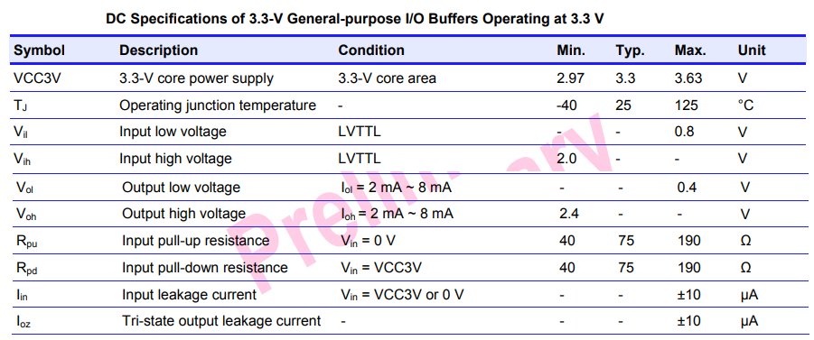
IOLT – DC properties

Slide 32
IOLT – circuit
1. To test IOLT, all digital IO will be
chained up by NAND-tree structure.
2. DC characteristics will be tested
one by one.

Slide 33
Faraday Test Integration Platform
Modern ASIC/SoC design contains variety of test items :
analog IP
memory bist blocks
scan of digital part for Mixed-mode IP
functional test vectors for Mixed-mode IP
Top scan
IOLT
How to plan / integrate these test mode and circuits?
>> FTIP – faraday test integration platform

Slide 34
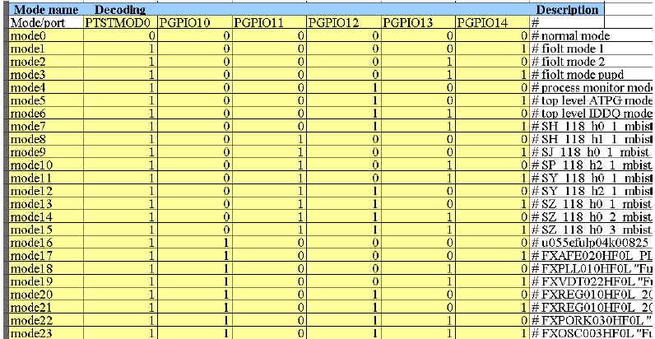
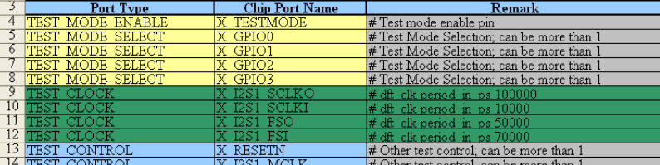
Faraday Test Integration Platform
Phase A
plan test mode decoder
declare test clock / ctrl / obs port

Slide 35
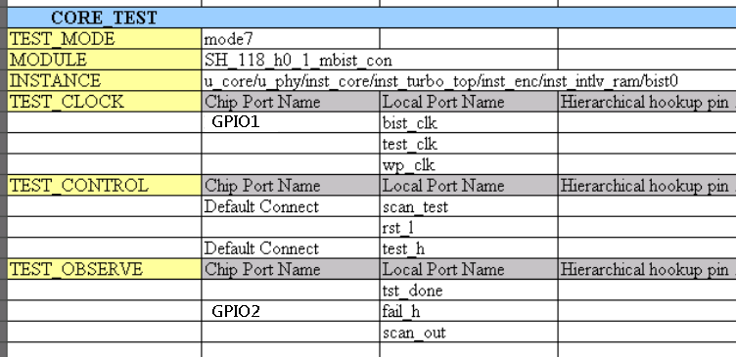
Faraday Test Integration Platform
Phase B
plan mux-in, mux-out, or internal hookup for each testmode
Output of ftip :
Netlist with the specified test circuit
Partial timing constraints

Slide 36
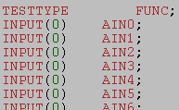



Test pattern
Faraday has internal vector format, called FTL.
Advantages is simple for edit.
Four parts to descript test vectors :
- Declare port name and direction
- Descript waveform
- Descript the sequence of vectors
- vectors

Slide 37
Test pattern utilities
FTL is exchangeable with wgl.
Utilities, Ftl2ver and ftrc, can convert ftl to testbench, and convert fsdb to FTL, respectively
Summary table :
Utility | FUNCTION
ftl2wgl | convert ftl to wgl
ftl2ver | convert ftl to verilog testbench and vectors
ftrc | convert fsdb or wgl to FTL

Slide 38
Confidential information
The material is being disclosed to you pursuant to a non-disclosure agreement between you or your employer and Faraday. Information disclosed in this presentation may be used only as permitted under such an agreement.
Legal notice
The information contained in this presentation is intended to provide a general guide as to which product is suited for a given requirement and shows suggested product applications. Specified functions and properties for products are only valid when handling instructions and other stated conditions and recommendations have been considered and followed. All descriptions, illustrations and dimensions in the information represent general particulars and do not form part of any contract. All information is provided “as is”, with no guarantee of completeness, accuracy, timeliness or of the results obtained from the use of the information, and without warranty of any kind, express or implied, including but not limited to warranties of performance. All information is subject to change without prior notice. Faraday assumes no responsibility whatsoever for any errors or inaccuracies about the information.

