Slide 1
Internship Final-term report
ACT2/MinhLe
ACT1/EricTa
June 09, 2023

Slide 2
Outline
Action Items
MBIST Concept
Trial MBIST Flow
Achievement
Difficulty & Resolve

Slide 3
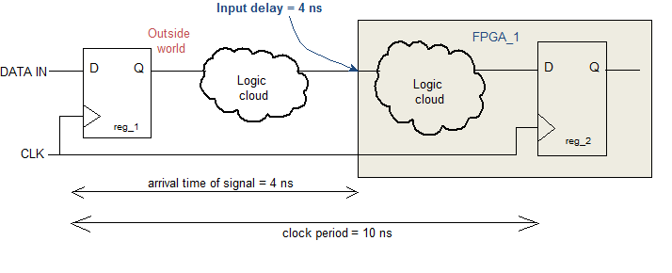
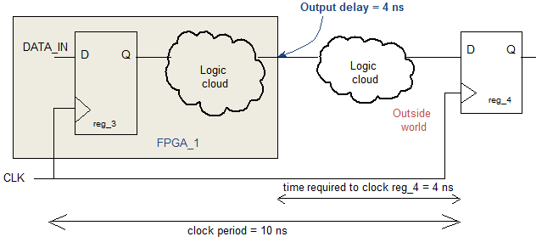
Action item
Purpose of input and output delay
EDA tools know “How long the signal from launch point appear at input of design”
EDA tools know “How long the signal form output of design appear at capture point”

Slide 4






Action item
Spare cell :
Spare cells enable us to modify/improve the functionality of a chip with minimal changes in the mask. We can use already placed spare cells from the nearby location and just need to modify the metal interconnect. There is no need to make any changes in the base layers. Using metal ECO we can modify the interconnect metal connection and make use of spare cells
Spare cells generally consist of a group of standard cells mainly inverter, buffer, nand, nor, and, or, mux, flip flops

Slide 5
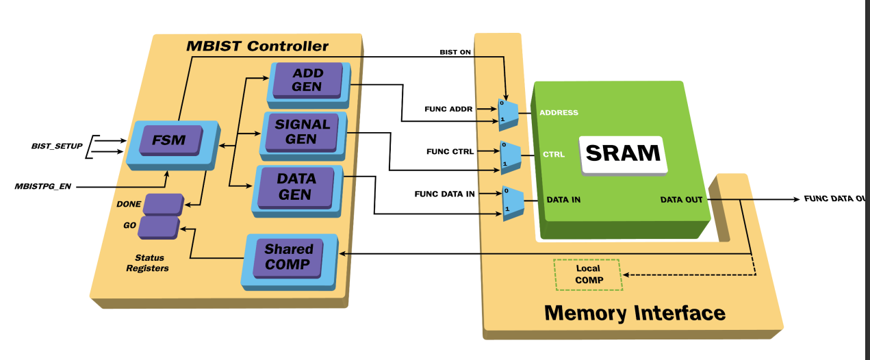
Mbist concept
BIST(Built-in Self-test): is a design-for-testability that places the testing functions physically with the circuit under test
Architecture of MBIST:
MBIST (Memory Built-in Self-test) is a self-testing within the memory chip which tests the memories through an effective set of algorithms to detect possibly all the faults. The self-test circuit is designed to write a test pattern to the memory, read it back, and compare the results with the expected results
BISR Built-In Self-Repair, which is a technique used in Memory Built-In Self-Test (MBIST) to automatically identify and repair faults or defects in the memory array. The memory repair feature diverts faulty areas of memories (e.g. row, column or both) by spare or redundant rows and columns available

Slide 6
ftl2ver: to generate testbench for simulation
Trial MBIST Flow
Feedback check result to customer:
- flre/ferc: any critical error
- ftcv: timing constraint is qualified enough
- fstaH: any critical violation (WNS)
Trial MBIST flow with project FSN0FS118A
Post DFT Netlist Verification
Release Data
Pad cell list generator.
To generate the I/O pad list file information for test and simulation flow.
flec
flre
ferc
Pre-layout netlist Verification
STA
fpad
Post-layout Netlist Verification
flre
ferc
ftcv
STA
flec
flre
ferc
STA
To translate functional simulation waveform to FTL (Faraday Tester interface Language) format.
To detect violations against tester rules.
Passed?
No
headergen
.th
Yes
ftrc
MBIST
Post simulation
Compile library
Libcom.atpg
ftlutil
MBIST Insertion
MBIST Netlist
.ftl
Modify MBIST SDC
MBIST SDC
ftl2ver
.vt (.rom)
Gen_pattern
fsim
<Projec>.v
<Projec>.vg
<Projec>.tstmb
<Projec>.v.fixass
<Projec>.v.feco
Release data:
MBIST_netlist
<Project>.sdc
<Project>_MBIST_expand.sdc
DFT_size_cell_only.sdc
<Projec>_MBIST.sdc
<Projec>_MBIST_expand.sdc
Notes:
fsim, the Faraday integrated Verilog simulator, is well-defined for users to easily complete the simulation flow. Nonetheless, all features of the conventional Verilog functions remain unchanged. Only certain options of the Verilog command lines have been modified to automatically fit the Faraday design-kit environment.

Slide 7
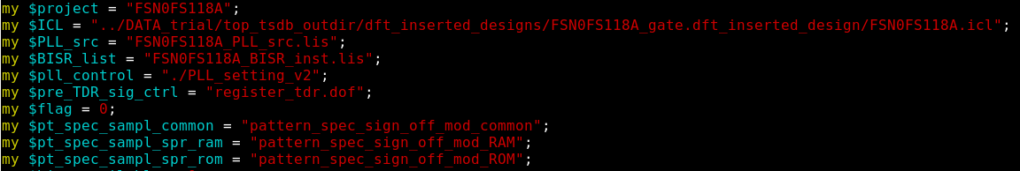
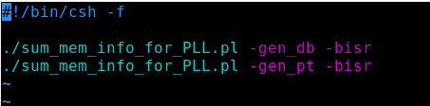
Generate pattern
1. Fsim includes Post Fsim and Pre Fsim, before run Fsim must generate pattern
2. Execution step to gen pattern
. Sumarize data
Output file includes: FSN0FS118A_MBIST_PAT_config.csv(period),pattern_spec_sign_off_FSN0FS118A
Run file

Slide 8
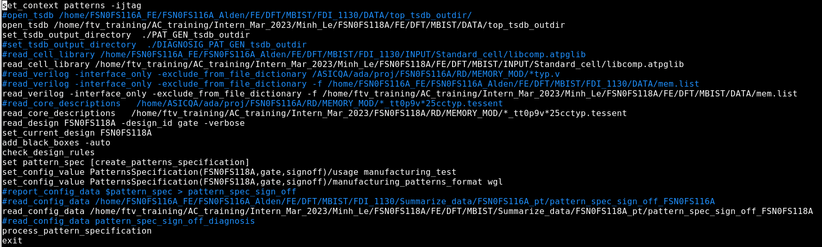
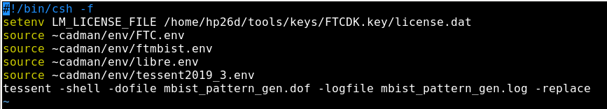
Gen pattern
Gen pattern
- Modify mbist_pattern_gen.dof
After gen pattern, results includes FSN0FS118A_gate.patterns_spec_signoff
(X_FREP, wait_time, algorithm test, test_time),
*.wgl.gz, pdl file

Slide 9
Gen pattern
Resequence pattern
Purpose: Mapping signal pin from MBIST circuits to pin of top chip and resequence period of PLL or DCO to pattern.
Execution step:
1. FTL gen using ftrc (ftl file)
2. Fpad (<project>.th, <project>.pad)
3. Resequence pattern using ftl2ver
(<project>.rom, <project>.vt)
Functional simulation waveform in ftl format
<project>.th : FTL template to gen FTL pattern
<project >.pad: contains I/O cell information
Test vector using simulation
Verilog test bench for Memory

Slide 10
Pre sim
. After gen pattern , run Pre sim with non delay
.rom file
.vt file
.log file
Fsim
Input files
Pre layout netlist after eco
Output files
mem.list
.out file
setup.ftc
PLL_checker.v

Slide 11
Post-layout Data Check
fstaH
Gen aocv using Fsta with spef file of PI to run Post STA , after that gen SDF file for run Post sim
flec
Equivalent check between Post-layout netlist and Post-DFT netlist
flre
Check quality of Post-layout netlist
ferc

Slide 12
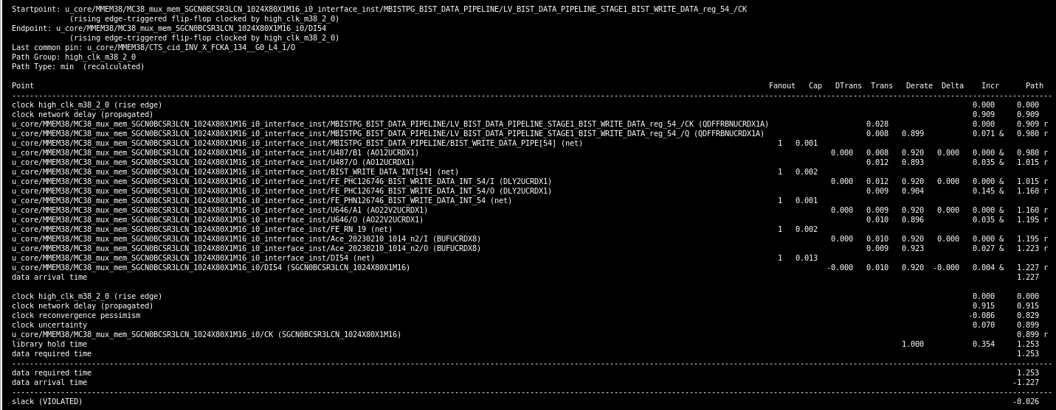
Clock to Q
Startpoint: *_red_54_/CK
Endpoint: *_io/DI54
Data arrival time
Time appear Capture clock
Data required time
Launch clock and clock network delay
Incremental delays
Time signal clock appear at CK pin of launch FF
Slack value

Slide 13
Post sim
After gen SDF (Standard delay format) , run Post sim with SDF file
.rom file
.vt file
Post layout netlist
.log file
Input files
Fsim
Output
files
mem.list
setup.ftc
PLL_checker.v
.out file
SDF file

Slide 14
ACHIEVEMENT
Understand about the purpose of each phase in Test-chip flow
Understand about some basic Design Kits ( syntax, reading log file , how to execute DKS)
Understand basic concept about Mbist

Slide 15


DIFFICULTY & RESOLVE
Insert MBIST failed by forgetting to do some step and writing wrong location file : getting support by mentor and also reading carefully documents to get clearly about that
Not understand clearly about STA in test-chip flow, new knowledge , new technical term: ask the solution from mentor as well as other members in AC team
Notes:
First time using Linux, and some technical problem with computer : helped by mentor ,everybody in team , and technical staff

Slide 16

Q&A

Slide 17
Confidential information
The material is being disclosed to you pursuant to a non-disclosure agreement between you or your employer and Faraday. Information disclosed in this presentation may be used only as permitted under such an agreement.
Legal notice
The information contained in this presentation is intended to provide a general guide as to which product is suited for a given requirement and shows suggested product applications. Specified functions and properties for products are only valid when handling instructions and other stated conditions and recommendations have been considered and followed. All descriptions, illustrations and dimensions in the information represent general particulars and do not form part of any contract. All information is provided “as is”, with no guarantee of completeness, accuracy, timeliness or of the results obtained from the use of the information, and without warranty of any kind, express or implied, including but not limited to warranties of performance. All information is subject to change without prior notice. Faraday assumes no responsibility whatsoever for any errors or inaccuracies about the information.

