Slide 1
ftrc, timgen, ftlutil_ui Introduction

Slide 2
Outline
Overview
File Format
Tester Rule File Usage
Limitations of Simulation Waveform

Slide 3
FTL Flow Overview
.v
Faraday Libraries
.lib, .db
ftie
.v
ferc
ERC Report
ASIC Design
Constraints
fpad
現在少見
.cec,.fpc,.ckc
.pad
fprc
fcdc
Pin List File
Text Editor
TAB
.setload
.settrans
.sdf
.pls
.th
WGL
Constraints
Check Report
STA Timing
Constraints
fppa
ftrc
.ppa
.ftl
VCD
fdrc
fsta
fpgc
ftlutil
FSDB
.feco
.ftl
DRC Report
STA Report
P/G Analysis
Report
ftl2ver
feco
.vt
(.rom)
ftrc可以
把這三種format
→轉成FTL
，做為量產pattern
ECO netlist
fsim
.fsdb
.out
powercat
Simulation
Result Summary
Power Analysis
Report

Slide 4
ftrc Function Overview
To translate functional simulation waveform to FTL (Faraday Tester interface Language) format.
To detect violations against tester rules.
Many utilities support FTL format:
  ftlutil_ui (stilutil_ui):
    re_seq
    mask
    chks
    chk_cycle
    rename
  ftl2ver: to generate testbench for simulation

Slide 5
ftrc Flow Overview
Design
.v
Simulation waveform
fsdb, vcd,wgl
Rule file
trc.rul
fpad
ftrc
Design pad file
.pad & .fv
Log file
.tlg
FTL pattern
.ftl
Command file
.tmd
Tpre
User(AC)沒感覺
Check error message and finetune timegen
Monitor file
.fv
Header file template
.th
Modify header
No
Yes
Complete FTL creation

Slide 6
Outline
Overview
File Format
Tester Rule File Usage
Limitations of Simulation Waveform

Slide 7
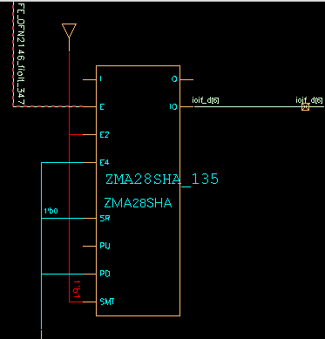
.pad File Format
Instance Name Cell Name Connected Net I/O Port Cell Type Pads Control Net Cont. Net Dir.
---------------------------------------------------------------------------------------------------------------------------------------------------------------
XMHA_10 XMHA X[0] X[0] IP 1 -- --
UYSCI1000HA_83 UYSCI1000HA ddr_vref ddr_vref IP 1 -- --
XMHA_161 XMHA ioif_rdy ioif_rdy IP 1 -- --
XMHA_18 XMHA pixin[13] pixin[13] IP 1 -- --
XOSCHINTHA_0 XOSCHINTHA refclk_12mhz_in refclk_12mhz_in IP 1 FE_OFN2721_fiolt_824 --
YA28SHA_31 YA28SHA shd shd OP 1 -- --
YA28SHA_36 YA28SHA shp shp OP 1 -- --
XOSCHINTHA_0 XOSCHINTHA refclk_12mhz_out refclk_12mhz_out BP 1 FE_OFN2721_fiolt_824 OUTIF0
ZMA28SHA_156 ZMA28SHA ioif_a[19] ioif_a[19] BP 1 FE_OFN2104_fiolt_392 OUTIF1
ZMA28SHA_155 ZMA28SHA ioif_a[18] ioif_a[18] BP 1 FE_OFN2049_fiolt_430 OUTIF1
ZMA28SHA_136 ZMA28SHA ioif_d[7] ioif_d[7] BP 1 FE_OFN2147_fiolt_344 OUTIF1
ZMA28SHA_135 ZMA28SHA ioif_d[6] ioif_d[6] BP 1 FE_OFN2146_fiolt_347 OUTIF1
Lookup settings in .lib file

Slide 8
Header File Format Template
TESTTYPE FUNC;
// ---------------------------------------
// Please fill timegen number for each pin
// ---------------------------------------
INPUT( ) X[0];
INPUT( ) ddr_vref;
INPUT( ) ioif_rdy;
INPUT( ) pixin[13];
INPUT( ) refclk_12mhz_in;
OUTPUT( ) shd;
OUTPUT( ) shp;
INOUT( , ) refclk_12mhz_out;
INOUT( , ) ioif_a[19];
INOUT( , ) ioif_a[18];
INOUT( , ) ioif_d[7];
INOUT( , ) ioif_d[6];
//====================================================
//=Following OUTIF0/1 definitions comes from pad file=
//====================================================
OUTIF1 ioif_a[19], ioif_a[18], ioif_d[7], ioif_d[6];
OUTIF0 refclk_12mhz_out;
// -------------------------------------------
// Please make your own waveform generatior by
// the reference of 4 TIMEGEN examples
// -------------------------------------------
// TIMEUNIT 1 NS;
// CYCLE 1000;
// TIMEGEN( ) DNRZ, 0;
// TIMEGEN( ) RZ, 0, 10;
// TIMEGEN( ) RO, 0, 10;
// TIMEGEN( ) STROBE, 0, 10;
SEQUENCE X[0], ddr_vref, ioif_rdy, pixin[13],refclk_12mhz_in //5
, shd, shp,refclk_12mhz_out, ioif_a[19], ioif_a[18] //10
, ioif_d[7], ioif_d[6];
Signal declare
Direction setup
Timegen declare
Pattern sequence

Slide 9
Initial Header File
TESTTYPE FUNC;
// ---------------------------------------
// Please fill timegen number for each pin
// ---------------------------------------
INPUT ( 0 ) X[0];
INPUT ( 0 ) ddr_vref;
INPUT ( 0 ) ioif_rdy;
INPUT ( 0 ) pixin[13];
INPUT ( 0 ) refclk_12mhz_in;
OUTPUT ( 1 ) shd;
OUTPUT ( 1 ) shp;
INOUT ( 0 , 1 ) refclk_12mhz_out;
INOUT ( 0 , 1 ) ioif_a[19];
INOUT ( 0 , 1 ) ioif_a[18];
INOUT ( 0 , 1 ) ioif_d[7];
INOUT ( 0 , 1 ) ioif_d[6];
//====================================================
//=Following OUTIF0/1 definitions comes from pad file=
//====================================================
OUTIF1 ioif_a[19], ioif_a[18], ioif_d[7], ioif_d[6];
OUTIF0 refclk_12mhz_out;
// -------------------------------------------
// Please make your own waveform generatior by
// the reference of 4 TIMEGEN examples
// -------------------------------------------
TIMEUNIT 1 NS;
CYCLE 50;
TIMEGEN( 0 ) DNRZ, 0;
// TIMEGEN( ) RZ, 0, 10;
// TIMEGEN( ) RO, 0, 10;
TIMEGEN( 1 ) STROBE, 45, 5;
SEQUENCE X[0], ddr_vref, ioif_rdy, pixin[13],refclk_12mhz_in //5
, shd, shp,refclk_12mhz_out, ioif_a[19], ioif_a[18] //10
, ioif_d[7], ioif_d[6];
請自行填值

Slide 10
Initial Header File
Declare signal direction, it could be INPUT, OUTPUT, or INOUT
TESTTYPE FUNC;
// ---------------------------------------
// Please fill timegen number for each pin
// ---------------------------------------
INPUT ( 0 ) X[0];
INPUT ( 0 ) ddr_vref;
INPUT ( 0 ) ioif_rdy;
INPUT ( 0 ) pixin[13];
INPUT ( 0 ) refclk_12mhz_in;
OUTPUT ( 1 ) shd;
OUTPUT ( 1 ) shp;
INOUT ( 0 , 1 ) refclk_12mhz_out;
INOUT ( 0 , 1 ) ioif_a[19];
INOUT ( 0 , 1 ) ioif_a[18];
INOUT ( 0 , 1 ) ioif_d[7];
INOUT ( 0 , 1 ) ioif_d[6];
//====================================================
//=Following OUTIF0/1 definitions comes from pad file=
//====================================================
OUTIF1 ioif_a[19], ioif_a[18], ioif_d[7], ioif_d[6];
OUTIF0 refclk_12mhz_out;
// -------------------------------------------
// Please make your own waveform generatior by
// the reference of 4 TIMEGEN examples
// -------------------------------------------
TIMEUNIT 1 NS;
CYCLE 50;
TIMEGEN( 0 ) DNRZ, 0;
// TIMEGEN( ) RZ, 0, 10;
// TIMEGEN( ) RO, 0, 10;
TIMEGEN( 1 ) STROBE, 45, 5;
SEQUENCE X[0], ddr_vref, ioif_rdy, pixin[13],refclk_12mhz_in //5
, shd, shp,refclk_12mhz_out, ioif_a[19], ioif_a[18] //10
, ioif_d[7], ioif_d[6];
Signal name
Timegen mapping

Slide 11
Initial Header File
TESTTYPE FUNC;
// ---------------------------------------
// Please fill timegen number for each pin
// ---------------------------------------
INPUT ( 0 ) X[0];
INPUT ( 0 ) ddr_vref;
INPUT ( 0 ) ioif_rdy;
INPUT ( 0 ) pixin[13];
INPUT ( 0 ) refclk_12mhz_in;
OUTPUT ( 1 ) shd;
OUTPUT ( 1 ) shp;
INOUT ( 0 , 1 ) refclk_12mhz_out;
INOUT ( 0 , 1 ) ioif_a[19];
INOUT ( 0 , 1 ) ioif_a[18];
INOUT ( 0 , 1 ) ioif_d[7];
INOUT ( 0 , 1 ) ioif_d[6];
//====================================================
//=Following OUTIF0/1 definitions comes from pad file=
//====================================================
OUTIF1 ioif_a[19], ioif_a[18], ioif_d[7], ioif_d[6];
OUTIF0 refclk_12mhz_out;
// -------------------------------------------
// Please make your own waveform generatior by
// the reference of 4 TIMEGEN examples
// -------------------------------------------
TIMEUNIT 1 NS;
CYCLE 50;
TIMEGEN( 0 ) DNRZ, 0;
// TIMEGEN( ) RZ, 0, 10;
// TIMEGEN( ) RO, 0, 10;
TIMEGEN( 1 ) STROBE, 45, 5;
SEQUENCE X[0], ddr_vref, ioif_rdy, pixin[13],refclk_12mhz_in //5
, shd, shp,refclk_12mhz_out, ioif_a[19], ioif_a[18] //10
, ioif_d[7], ioif_d[6];
Declare direction of inout signal by using .pad file settings.

Slide 12
Initial Header File
TESTTYPE FUNC;
// ---------------------------------------
// Please fill timegen number for each pin
// ---------------------------------------
INPUT ( 0 ) X[0];
INPUT ( 0 ) ddr_vref;
INPUT ( 0 ) ioif_rdy;
INPUT ( 0 ) pixin[13];
INPUT ( 0 ) refclk_12mhz_in;
OUTPUT ( 1 ) shd;
OUTPUT ( 1 ) shp;
INOUT ( 0 , 1 ) refclk_12mhz_out;
INOUT ( 0 , 1 ) ioif_a[19];
INOUT ( 0 , 1 ) ioif_a[18];
INOUT ( 0 , 1 ) ioif_d[7];
INOUT ( 0 , 1 ) ioif_d[6];
//====================================================
//=Following OUTIF0/1 definitions comes from pad file=
//====================================================
OUTIF1 ioif_a[19], ioif_a[18], ioif_d[7], ioif_d[6];
OUTIF0 refclk_12mhz_out;
// -------------------------------------------
// Please make your own waveform generatior by
// the reference of 4 TIMEGEN examples
// -------------------------------------------
TIMEUNIT 1 NS;
CYCLE 50;
TIMEGEN( 0 ) DNRZ, 0;
// TIMEGEN( ) RZ, 0, 10;
// TIMEGEN( ) RO, 0, 10;
TIMEGEN( 1 ) STROBE, 45, 5;
SEQUENCE X[0], ddr_vref, ioif_rdy, pixin[13],refclk_12mhz_in //5
, shd, shp,refclk_12mhz_out, ioif_a[19], ioif_a[18] //10
, ioif_d[7], ioif_d[6];
timeunit & Cycle time
Delay time
Pulse width
Timgen shape definition, there are 4 kinds of timegen: DNRZ, RO, RZ for input signal and STROBE for output signal

Slide 13
Input TIMEGEN in FTL Format
1
1
0
0
Delay
DNRZ Delayed-Non-Return-to-Zero
Delay
For example: DNRZ, 50;
1
0
Delay
RZ Return-to-Zero
Pulse Width
For example: RZ, 25, 50;
1
0
RO Return-to-One
Pulse Width
Delay
For example: RO, 25, 50;

Slide 14
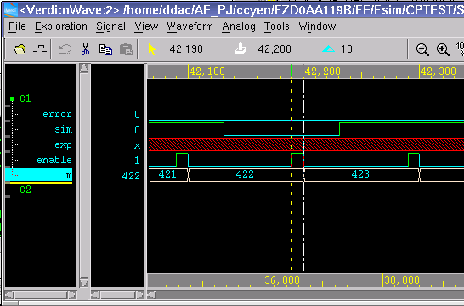

Output TIMEGEN in FTL Format
H
L
X
Delay
STROBE STROBE output value
Strobe width
For example: STROBE, 95;
STROBE, 95, 5;
只比這個瞬間
那就是90unit~100unit都要Simulated = Expected
100ns

Slide 15
FTL Format
TESTTYPE FUNC;
INPUT ( 0 ) X[0];
INPUT ( 0 ) ddr_vref;
INPUT ( 0 ) ioif_rdy;
INPUT ( 0 ) pixin[13];
INPUT ( 0 ) refclk_12mhz_in;
OUTPUT ( 1 ) shd;
OUTPUT ( 1 ) shp;
INOUT ( 0 , 1 ) refclk_12mhz_out;
INOUT ( 0 , 1 ) ioif_a[19];
INOUT ( 0 , 1 ) ioif_a[18];
INOUT ( 0 , 1 ) ioif_d[7];
INOUT ( 0 , 1 ) ioif_d[6];
TIMEUNIT 1 NS;
STABLEREGION 5;
CYCLE 50;
TIMEGEN( 0 ) DNRZ, 0;
// TIMEGEN( ) RZ, 0, 10;
// TIMEGEN( ) RO, 0, 10;
TIMEGEN( 1 ) STROBE, 45, 5;
SEQUENCE X[0], ddr_vref, ioif_rdy, pixin[13],refclk_12mhz_in //5
, shd, shp,refclk_12mhz_out, ioif_a[19], ioif_a[18] //10
, ioif_d[7], ioif_d[6];
BEGIN
?????XXXXXXX; // 1 : 0
REPEAT <3> // 2 - 4
1111?XXXXXXX; // 4 : 150
?111?XXXXXXX; // 5 : 200
REPEAT <108> // 6 - 113
0111?XX?XXXX; // 113 : 5600
REPEAT <79> // 114 - 192
0111?XX?1111; // 192 : 9550
0111?XX?????; // 193 : 9600
……
……
……
END
Pattern added into
original header file.

Slide 16
Outline
Overview
File Format
Tester Rule File
Limitations of Simulation Waveform

Slide 17
Tester Rule File
To record the rule of time generator and timing format for different testers.
User cannot modify these rules.
  /home/ASICAE/FTC/ftclib/ETC/TRC/trc.rul
<DEFAULT>
timeunit = 1 ns;
min_cycle = 25;
max_cycle = 40960;
max_input_timegen = 1000;
max_output_timegen = 1000;
max_vector = 4096000;
max Freq
= 1/(25ns) = 40MHz
應該不會用到那麼多…
Many Testers:
<DEFAULT>
<FREE>
<93KC200>
<93KC400>
<93KC400E>
<SC212>
<93KPS3600_4X_LVDS>
<93KPS3600>
<93KPS800>
<93KP600>
Pattern
長度不可超過4Mega
(Default Rule)

Slide 18
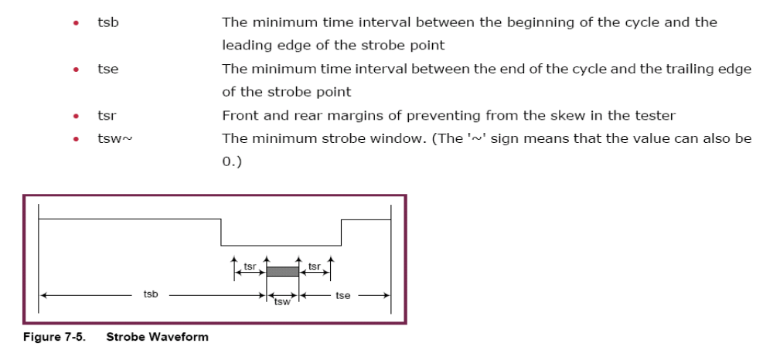
Tester Rule File
※定義每台tester的精確度
tdb_of_dnrz ~= 0 ;
tde_of_dnrz = 0 ;
tdb_of_rz = 0 ;
tpw_of_rz = 5 ;
tde_input_of_rz = 0;
tdb_of_ro = 0 ;
tpw_of_ro = 5 ;
tde_input_of_ro = 0;
tsb= 0 ; (strobe begin)
tse = 0 ; (strobe end)
tsw~ = 5 ; (strobe width) 如下圖
RZ,RO Waveforms
Tdb
Tpw
Tde_input
CYCLE
Tdb = Delay
Tpw = pulse_width (越好的機台可以灌越小的pulse)
Delay + pulse_width = CYCLE - Tde_input
Delay + pulse_width = CYCLE - Tde_bidirection
Tdb_of_RZ = 10;
Tpw_of_RZ = 20;
Tde_input_of_RZ = 10;
Tde_bidirection_of_RZ = 20;
這個strobe window 可以是0(只比一瞬間)，若不是0，至少 ≧ 5ns .
tsr: 前/後 的 margin，值不可以變，越好的機台可以越小

Slide 19
Tester Rule File
Ttol=5
  Tolerance of input waveform delay time between each cycle.
  For example, if the Ttol is 5 and the cycle time is 100 ns, then the tolerance is 100 * 5% = 5 ns
Ttol
Ttol
DNRZ 45~55;
FSDB/VCD
waveform
f t r c
FTL
Definition
DNRZ 50;
cycle = 100ns

Slide 20
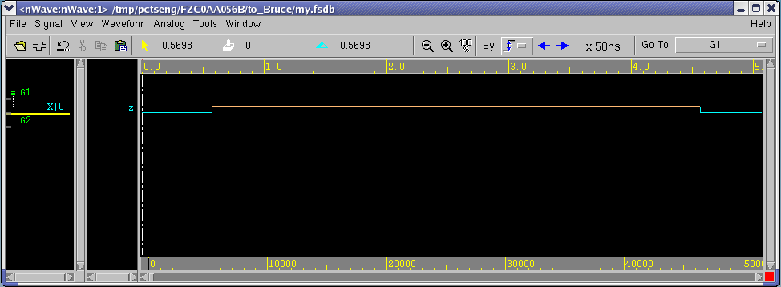

Review .tlg File
原本用 DNRZ, 0; 波形轉FTL → 轉不過去，tlg error.
→去看波形發現，都在 0.5698 x 50ns的地方轉態
→把Timegen 改成 DNRZ, 28; 即可。
** Error(err_dat011): can't decide state of input pin<X[0]> at cycle<1>
** Error(err_dat011): can't decide state of input pin<X[0]> at cycle<5>
Original timegen:
DNRZ, 0;
Delay: 0.5698*50ns=28.49ns
Waveform: DNRZ
Timegen: DNRZ, 28;
0.5698
DNRZ, 0 ;
轉不成功
50ns*5%= 2.5
→ 0.49ns < 2.5ns
→ 在誤差內！
→28.49ns轉態，可當做28ns轉態
用 DNRZ, 28 ; 是允許的！

Slide 21
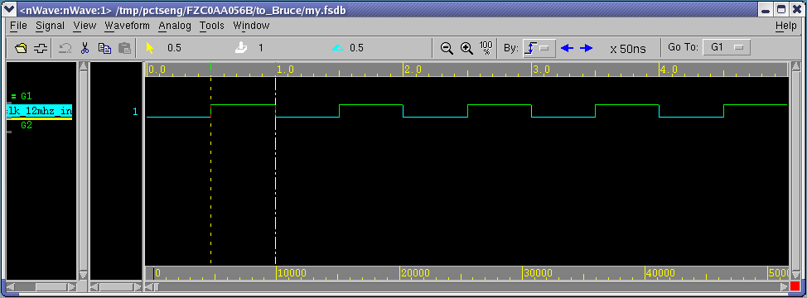
Review .tlg File
** Error(err_dat011): can‘t decide state of input pin<refclk_12mhz_in> at cycle<1>, cycle <2>, cycle <3>……
➔ Log顯示，每個cycle都錯！全錯！
Delay: 0.5*50ns=25ns
Pulse: 0.5*50ns=25ns
Original timegen:
DNRZ, 0;
1個cycle = 50ns
Wavefrom: RZ
Timgen: RZ, 25, 25;

Slide 22
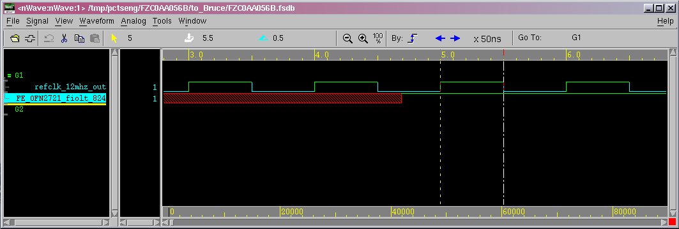
Review .tlg File
** Error(err_dat011): can't decide state of input pin<refclk_12mhz_out> at cycle<3>, cycle <4>, cycle <5>……
這三個 cycle 的 Control pins 為Unknown
→ 無法辨別方向 (In or Out)
→ 轉出來會是問號 ?
Pattern in cycle<3>, cycle<4> is ‘?’
Wavefrom:RZ
Timgen: RZ, 0, 25;
cycle3
cycle4
cycle5
cycle6
cycle7

Slide 23
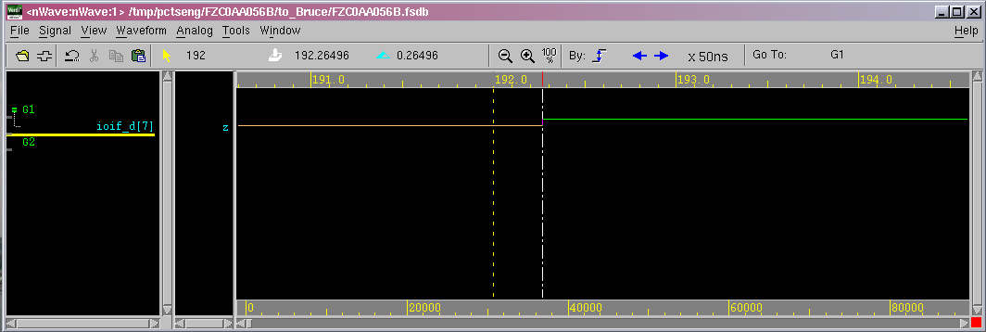
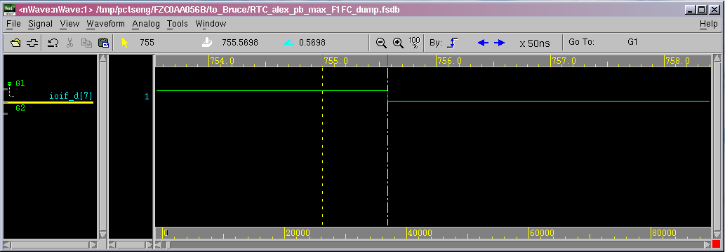
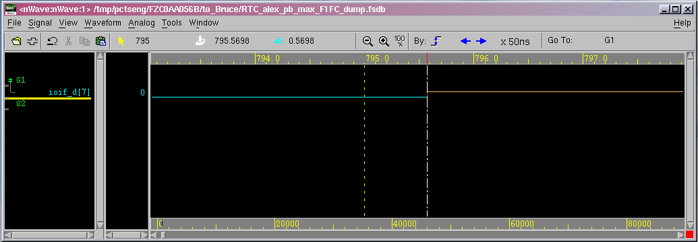
Review .tlg File
此波形無法轉成FTL：
cycle 756 and 796 timegen一致
cycle 193 要請客戶改波形
因為同一隻FTL不可以有兩個timegen
** Error(err_dat011): can't decide state of input pin<ioif_d[7]> at cycle<193>
** Error(err_dat011): can't decide state of input pin<ioif_d[7]> at cycle<756>
** Error(err_dat011): can't decide state of input pin<ioif_d[7]> at cycle<796>
……
0.2649*50ns=13.245
∵0.245/50=0.0049<5%
∴13.245 is ok to be seen as 13ns
cycle 193
Timgen: DNRZ, 13;
0.5698*50=28.49
0.49/50=0.0098<5%
➔ 28.49 is ok to be seen as 28ns
cycle 756
Timgen: DNRZ, 28;
Timgen: DNRZ, 28;
cycle 796

Slide 24
Modify Header File
TESTTYPE FUNC;
// ---------------------------------------
// Please fill timegen number for each pin
// ---------------------------------------
INPUT ( 0 ) X[0];
INPUT ( 0 ) ddr_vref;
INPUT ( 0 ) ioif_rdy;
INPUT ( 0 ) pixin[13];
INPUT ( 2 ) refclk_12mhz_in;
OUTPUT ( 1 ) shd;
OUTPUT ( 1 ) shp;
INOUT ( 3 , 1 ) refclk_12mhz_out;
INOUT ( 0 , 1 ) ioif_a[19];
INOUT ( 0 , 1 ) ioif_a[18];
INOUT ( 0 , 1 ) ioif_d[7];
INOUT ( 0 , 1 ) ioif_d[6];
[ No need to edit below gray ones; but need to include all IO control Signal info. from FSA0AC054A.fv ]
//====================================================
//=Following OUTIF0/1 definitions comes from pad file=
//====================================================
OUTIF1 ioif_a[19], ioif_a[18], ioif_d[7], ioif_d[6];
OUTIF0 refclk_12mhz_out;
// -------------------------------------------
// Please make your own waveform generatior by
// the reference of 4 TIMEGEN examples
// -------------------------------------------
TIMEUNIT 1 NS;
CYCLE 50;
TIMEGEN( 0 ) DNRZ, 28;
TIMEGEN( 2 ) RZ, 25, 25;
TIMEGEN( 3 ) RZ, 0, 25;
TIMEGEN( 1 ) STROBE, 45, 5;
SEQUENCE X[0], ddr_vref, ioif_rdy, pixin[13],refclk_12mhz_in //5
, shd, shp,refclk_12mhz_out, ioif_a[19], ioif_a[18] //10
, ioif_d[7], ioif_d[6];

Slide 25
Generate FTL
TESTTYPE FUNC;
INPUT ( 0 ) X[0];
INPUT ( 0 ) ddr_vref;
INPUT ( 0 ) ioif_rdy;
INPUT ( 0 ) pixin[13];
INPUT ( 2 ) refclk_12mhz_in;
OUTPUT ( 1 ) shd;
OUTPUT ( 1 ) shp;
INOUT ( 3 , 1 ) refclk_12mhz_out;
INOUT ( 0 , 1 ) ioif_a[19];
INOUT ( 0 , 1 ) ioif_a[18];
INOUT ( 0 , 1 ) ioif_d[7];
INOUT ( 0 , 1 ) ioif_d[6];
TIMEUNIT 1 NS;
STABLEREGION 5;
CYCLE 50;
TIMEGEN( 0 ) DNRZ, 28;
TIMEGEN( 2 ) RZ, 25, 25;
TIMEGEN( 3 ) RZ, 0, 25;
TIMEGEN( 1 ) STROBE, 45, 5;
SEQUENCE X[0], ddr_vref, ioif_rdy, pixin[13],refclk_12mhz_in //5
, shd, shp,refclk_12mhz_out, ioif_a[19], ioif_a[18] //10
, ioif_d[7], ioif_d[6];
BEGIN
REPEAT <4> // 1 - 4
11111XXXXXXX; // 4 : 150
01111XXXXXXX; // 5 : 200
REPEAT <107> // 6 - 112
01111XX1XXXX; // 112 : 5550
REPEAT <79> // 113 - 191
01111XX11111; // 191 : 9500
01111XX1????; // 192 : 9550
REPEAT <563> // 193 - 755
01111XX10011; // 755 : 37700
……
……
……
Need to fill !!
With 0/1
波形轉 FTL 之後，
問號的部份，請人工填入~~

Slide 26
Outline
Overview
Header File Format
FTL (Faraday Tester interface Language) Format
Tester Rule File Usage
Limitations of Simulation Waveform
→ FTL是一種比較單純的 test language（對比於Stil…）
以下是一些FTL的限制~~

Slide 27
Limitations of Simulation Waveform
Avoid multiple clock cycle time, for example:
  Clock cycle time is 9ns in first 4 cycles and 20 ns in 5th and 6th cycle.
clock
9ns
20ns
不可以同一個波形
有兩種Period.

Slide 28
Limitations of Simulation Waveform
Input Signal must exactly map to one kind of timegen, for example:
  Input signal is RZ type timegen in first cycle, DNRZ type timegen in 2nd cycle, and RO type timegen in 3rd cycle
clock
input
RZ
DNRZ
RO
一個波形只可以用到一種Timegen，這邊用了三個
→Not allowed!!

Slide 29
Limitations of Simulation Waveform
Input Signal can not toggle more than one (two) times in one cycle, for example:
  Input signal has 4 transitions in one cycle.
clock
input
4個transitions
in One cycke
→不允許
只有2個transitions in One cycle → 可以!!

Slide 30
Headergen Introduction

Slide 31
Outline
Headergen
  Overview
  Functionality
  Command
  Message & Report File
STILUTIL
  Overview
  Functionality
  Re_seq.cmd
  command

Slide 32
FTL Flow
.v
Faraday Libraries
.lib, .db
ftie
.v
ferc
ERC Report
ASIC Design
Constraints
fpad
.cec,.fpc,.ckc
.pad
fprc
fcdc
Text Editor
TAB
Pin List File
headergen
.setload
.settrans
.sdf
.pls
.th
WGL
Constraints
Check Report
STA Timing
Constraints
fppa
ftrc
.ppa
.ftl
VCD
fdrc
fsta
fpgc
ftlutil
FSDB
.feco
.ftl
DRC Report
STA Report
P/G Analysis
Report
ftl2ver
feco
.vt
(.rom)
ECO netlist
fsim
.fsdb
.out
powercat
Simulation
Result Summary
要跑ftrc需要先觀察波形，寫出header file
→ 難！
→ headergen 可以幫忙產生header
Power Analysis
Report

Slide 33
Headergen Flow
Pad file
Pad file
.pad
Waveform
.fsdb or .vcd
setup.ftc
headergen
Header file
.th
report file
.rpt
log file
.hlg
command file
hg.cmd

Slide 34
Functionality
Automatically generate timegen of each signal in simulation waveform.
Check whether a waveform could be translated to FTL.
User needs to fix testbench if there are error during headergen.

Slide 35
Command
Waveform file主檔名
headergen <pat_id> <cycle_time> <time_unit>
[-strobe <delay> <pulse_width>]
Ex: headergen my 38400 1ps
Must be integer !
Resolution of analyzer
(1ps, 10ps, 100ps, 1ns)
headergen my 38.4 1ns
headergen my 38400 1ps

Slide 36
Resolution
Delay or Pulse less than resolution will be discarded, but better resolution means more CPU time.
Original
waveform
2ps
2ps
2ps
resolution:
1ps
2ps
2ps
2ps
resolution:
>1ps
解析度(Resolution)只有1ps, 10ps, 100ps, 1ns…，這個 pulse太小，會被當作沒這個Pulse

Slide 37
Command
headergen <pat_id> <cycle_time> <time_unit>
[-strobe [<delay> <pulse_width>]]
Ex: headergen my 100 1ns
  To Generate output timegen(s) by checking maximum stable region.
  A more strict output timegen.
Ex: headergen my 100 1ns –strobe
  Use default output timegen (cycle_time*0.95) :
  STROBE, 95;
EX: headergen my 100 1ns –strobe 80 10
  Use user define output timegen:
  STROBE, 80, 10;
可以問 designer 要填什麼值，或觀察clock那隻pin得知.
如果有加 -strobe 會用cycle*95%當作strobe點
也可以自己assign.
my.fsdb → my.FTL

Slide 38
Maximum Stable Region
Maximum stable region may not be what users expect:
MSR
Output
如果沒下”-strobe”，headergen 就會自動偵測，波型最交集的 Most Stable Region to be the strobe time.

Slide 39
Message & Report File
六種波形！
Timegen predict okay:
===================================================================
Recognized Waveform List of <SYS_MCLK>:
====================================================================
Waveform:RZ010:418893
-------------------------------------------------------------------
@19200:418893
@38400:418893
=> Predicted TimeGen: RZ, 19200, 19200;
===================================================================
Recognized Waveform List of <MEM_DQ3>:
====================================================================
Waveform:DNRZ0:271601
Waveform:DNRZ1:5686
Waveform:DNRZ01:944
Waveform:DNRZ10:957
-------------------------------------------------------------------
@30157:1901
=> Predicted TimeGen: DNRZ, 30157;
=> Predicted TimeGen: STROBE 34278
DNRZ0
DNRZ1
RZ010有418893個cycles
在19200 0→1 有418893個
DNRZ01
在38400 1→0 有418893個
DNRZ10
DNRZ 0→1 944個cycles
DNRZ 1→0有957個cycles
RZ010
1901=944+957→ 1901cycles 都在30157 轉態!
RO101

Slide 40
Message & Report File
Command: headergen my 20 1ns
** Error(TG-002): Input pin<SYS_MCLK> has more than 1 timegen (10 >1)
===================================================================
Recognized Waveform List of <SYS_MCLK>:
====================================================================
Waveform:DNRZ01:450468
Waveform:DNRZ10:450468
Waveform:RZ010:19586
Waveform:RO101:19585
-------------------------------------------------------------------
Transition1:
@2:39171
@3:39171
@4:78342
@5:39171
@6:39171
@7:39171
@8:78342
@9:39171
@10:39171
@11:39171
@12:78342
@13:39171
@14:39171
@15:39171
@16:78342
@17:39172
@18:39172
@19:39172
@20:39171
=> Predicted TimeGen: DNRZ, 16;
=> Predicted TimeGen: DNRZ, 4;
=> Predicted TimeGen: DNRZ, 8;
=> Predicted TimeGen: DNRZ, 12;
=> Predicted TimeGen: DNRZ, 18;
=> Predicted TimeGen: DNRZ, 2;
=> Predicted TimeGen: DNRZ, 6;
=> Predicted TimeGen: DNRZ, 10;
=> Predicted TimeGen: DNRZ, 14;
=> Predicted TimeGen: DNRZ, 0;
Fix SYS_MCLK in testbench
20ns*5%=1ns，所以在16ns轉態與在17ns、15ns轉態，可算是同一個timegen
☹可是這根sig， timegen實在太多了，轉不出來~~

Slide 41
Message & Report File
Command: headergen my 20 1ns
** Error(TG-003): Unable to find a valid output timegen for pin: MEM_DQMH
===================================================================
Recognized Waveform List of <MEM_DQMH>:
====================================================================
Possible Strobe Window:20-19
TimeGen Prediction Failed !!
TimeGen prediction failed: Can't find a stable region
The following are the toggle distribution:
-------------------------------------------------------------------
@0:17
@1:9
@2:4
@3:5
@4:14
@5:18
@6:5
@7:4
@8:8
@9:14
@10:12
@11:8
@12:5
@13:10
@14:9
@15:12
@16:11
@17:6
@18:7
@19:11
No stable region to inspect
☹找不到Most Stable Region！
→考慮用 -strobe

Slide 42
Un-recognized Timegen in Headergen
** Error(TG-006): Signal <SYS_MCLK> has more than two transition at cycle <1>.
input
Wrong cycle time
☹單位沒錯，但cycle time設太大了!

Slide 43
Un-recognized Timegen in Headergen
** Error(TG-008): signal <SPI_SI> has three different state in cycle <2>.
Input
☹要請客戶改 testbench
重新給波形!!
Fix SYS_MCLK in testbench

Slide 44
Un-recognized Timegen in Headergen
** WARNING(TG-007): Unknown control state of <VIF_PIXCLK> signal at cycle <2>
Inout
Ctrl_of_Inout
☹無法辨別signal方向(In or Out)，還是可以產生.th
（所以是Warning）.

Slide 45
Outline
Headergen
  Overview
  Functionality
  Command
  Message & Report File
STILUTIL
  Overview
  Functionality
  Re_seq.cmd
  command

Slide 46
Overview
FTL/STIL
Header file
.th / .th.stil
AC scan
pattern
.stil
Command
file
.cmd
stilutil
Resequenced
AC scan pattern
.stil

Slide 47
Functionality
Resequence Stil pattern
Remove power ground pin

Slide 48
re_seq.cmd
// STIL Tester Language Utility Version 200701.2.1
// Copyright (c) 2001-2007 by Faraday Technology Corp.
// template control file
Header {
Mode = RESEQ ; // [RESEQ|CHECK|MASK|CYCLE]
InputFile = "ATPG_SEQ_1.stil";
OutputFile = "ATPG_SEQ_1_reseq.stil";
TargetHeader = “FZC0AA056E.th";
TimeGen = Source; //[Source|Target]
DefaultInputValue = '0' ;
DefaultInoutValue = 'X' ;
DefaultOutputValue = 'X' ;
}

Slide 49
Command
stilutil –i re_seq.cmd

Slide 50
Summary
Headergen
  Command: headergen <pat_id> <cycle_time> <time_unit>
  Error in headergen means part of waveform cannot transfer to FTL
STILUTIL
  Command: stilutil –i re_seq.cmd

Slide 51
ftlutil_ui

Slide 52
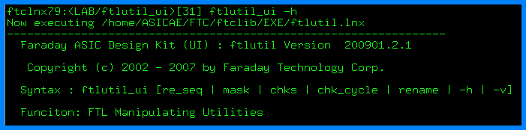
ftlutil_ui
用途：後處理ftl 檔案
執行：
ftlutil_ui <option> → 產生 <option>.cmd
→ 編輯 <option>.cmd
→ 再執行 ftlutil_ui <option>

Slide 53
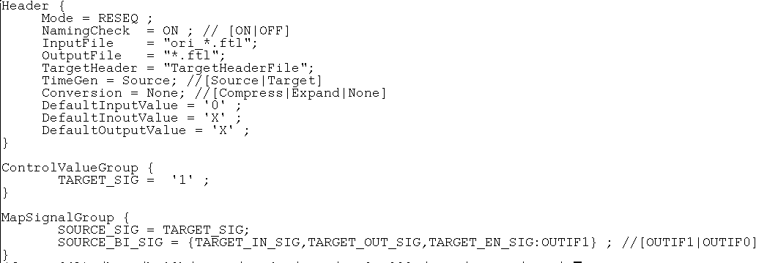
re_seq option
轉出的ftl，signal sequence將與
TargetHeader 一致。

Slide 54
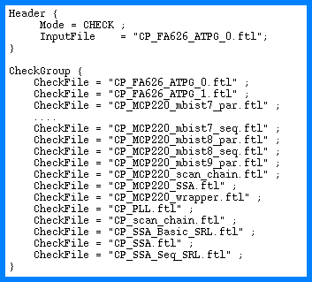
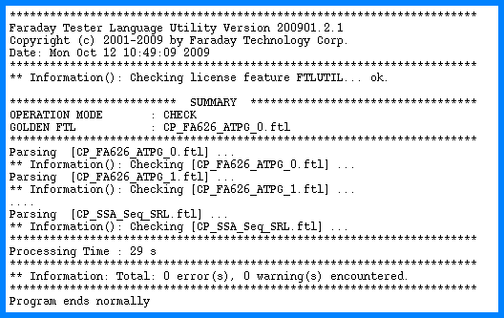
chks option
檢查signal順序是否一樣！(in Each FTL)
AC chk2會檢查
要一致才可以上機台

Slide 55
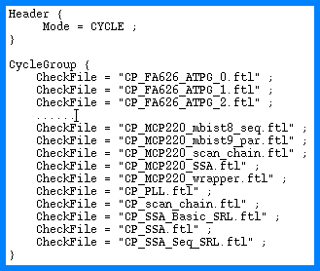
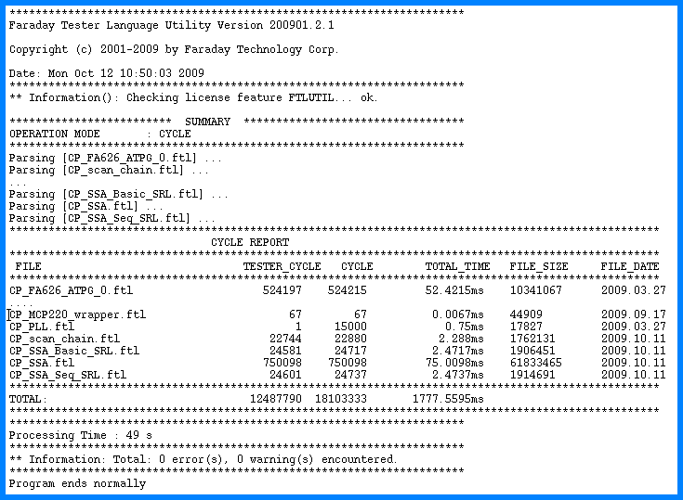
chk_cycle option
檢查本資料夾內，所有的FTL
總共需要多少tester cycle.
(Defaul Rule ≦ 4Mega)
(Better tester → larger memory)

Slide 56
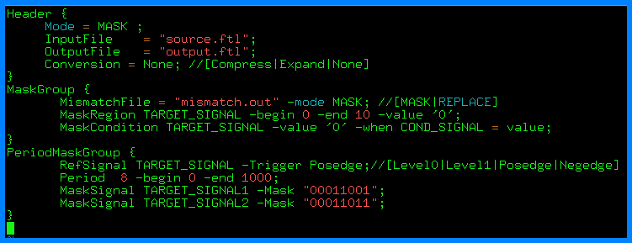
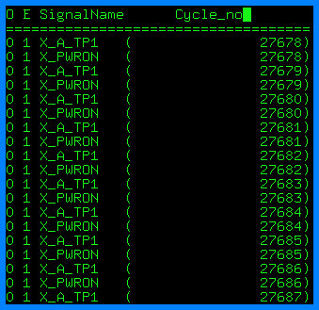
mask option
將 fsim 跑出的mismatches(in .out )
拿來 mask 掉，以得到新的 ftl.
**How to Mask:
(a) With Don’t care → X
(b) Replaced with the simulated value.
(Expected =0, but Simulated =1
→改成Expected =1)

Slide 57
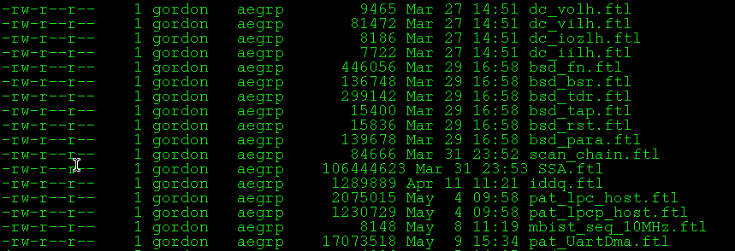
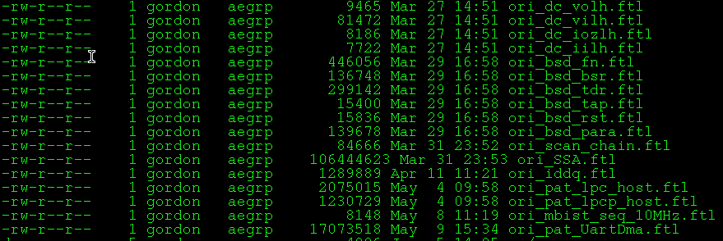
rename option
ftlutil_ui rename +ori

