Slide 1
AC TECHNICAL SHARING PLL CONFIG
FTV/DSD/ACD/ACT2 – Harry Luong
2022/07/07

Slide 2
Agenda
Functional block diagram FXPLL357HN0U
Purpose of blocks in PLL
How to control PLL

Slide 3
What is PLL?
Phase-locked loop or phase lock loop (PLL) is a control system that generates an output frequency whose frequency is related to input frequency

Slide 4
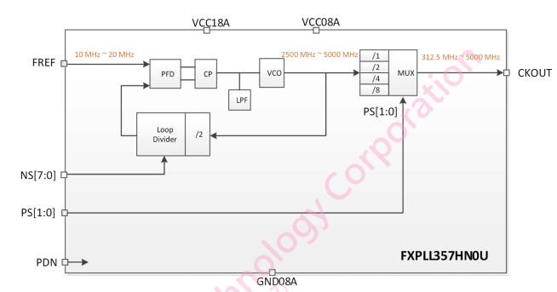
Functional block diagram FXPLL357HN0U

Slide 5
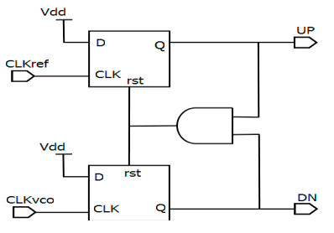
Purpose of blocks in PLL
PFD ( Phase frequency detector)
The PFD block compares the phase difference of the output signals between the pre-divider and the loop divider. According to these signals, PFD will then generate the control signals to be used by the charge pump.

Slide 6
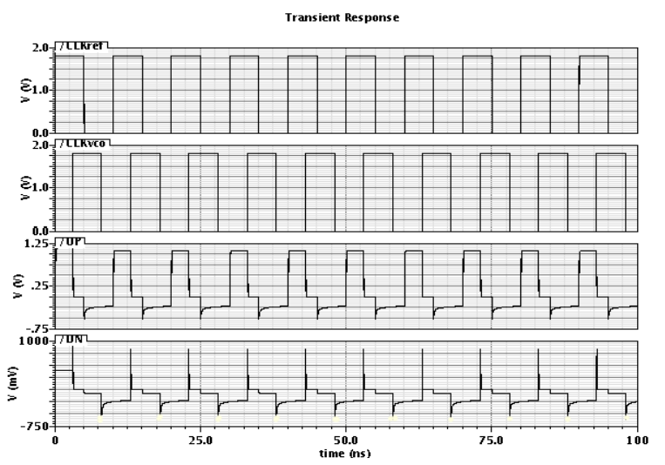
Purpose of blocks in PLL
PFD ( Phase frequency detector)

Slide 7
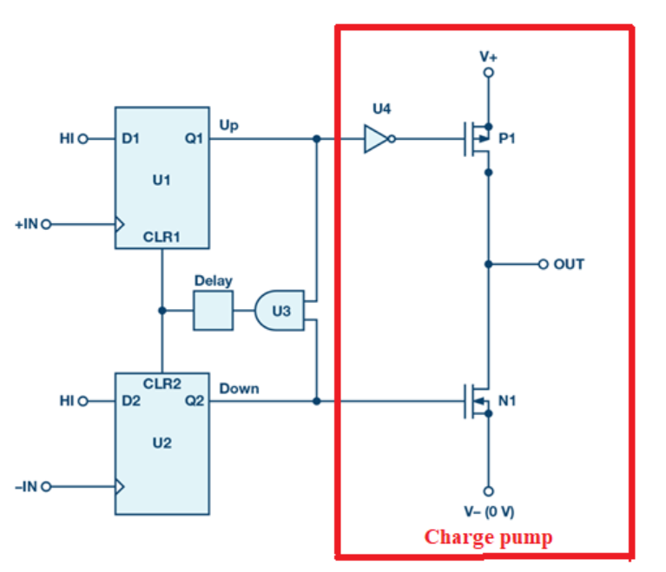
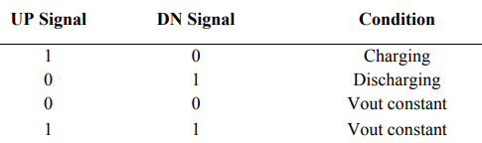
Purpose of blocks in PLL
Charge pump
The charge pump block utilizes the control output signals from the PFD block to determine whether to charge or discharge the loop filter.

Slide 8
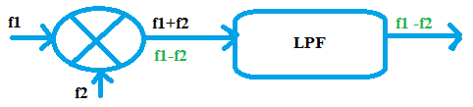
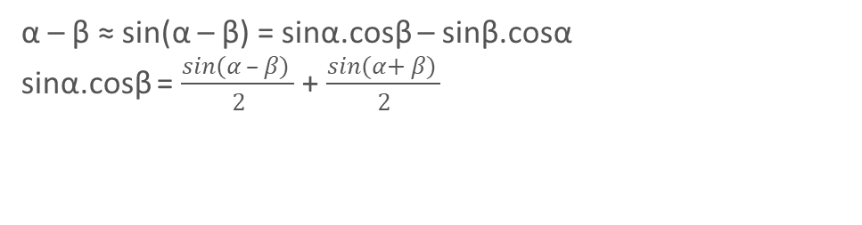
Purpose of blocks in PLL
LPF ( Low pass filter)
This block cooperates with the charge pump to convert the current to voltage to be used by the VCO block.
Phase Detector
Phase Difference
α
β
α – β ≈ sin(α – β) = sinα.cosβ – sinβ.cosα
sinα.cosβ = $\frac{sin(α – β) }{2}$ + $\frac{sin(α+ β) }{2}$
LPF

Slide 9
Purpose of blocks in PLL
VCO (Voltage-Controlled Oscillator)
This block generates the output clock frequency according to the voltage level that is received from the LPF block.
Divider (Loop divider and Post divider)
These blocks are used to generate the desired output clock frequency

Slide 10
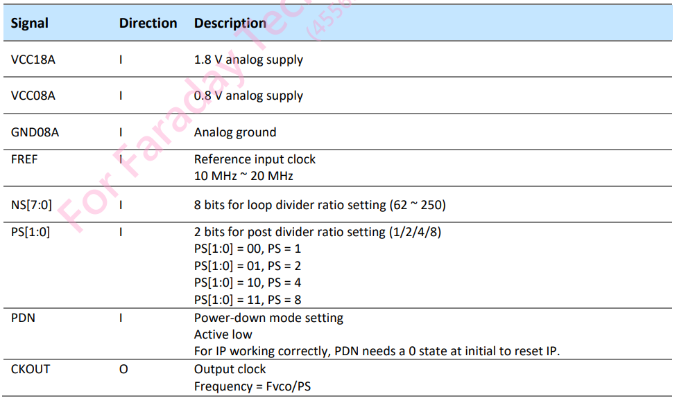
Pin descriptions

Slide 11
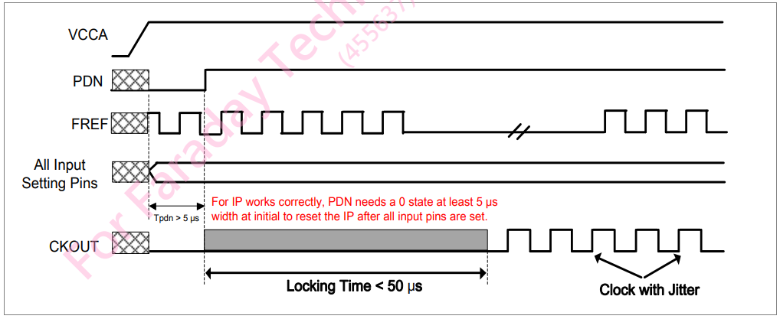
Timing diagram in normal mode

Slide 12

How to config PLL
➔ CKOUT = (FREFX * NS[7:0]*2)/PS
FSN0FS102A project: FREFX = 10Mhz
We want to have CKOUT=190Mhz
We can calculate: PS=8 and NS = 76

Slide 13
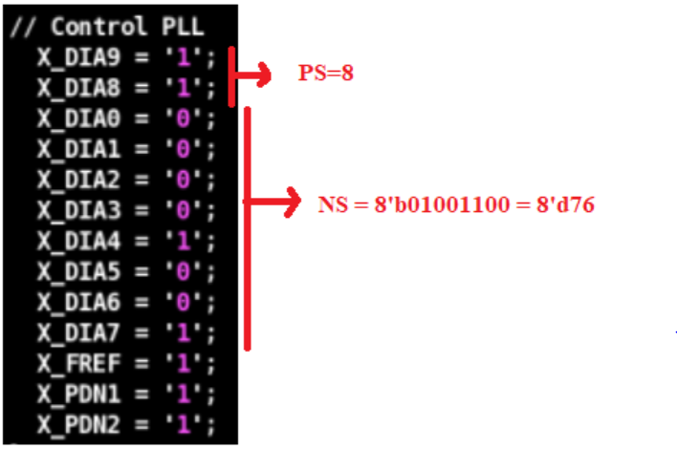
How to config PLL
Control PS, NS, X_FREF, X_PDN1 and X_PDN2

Slide 14

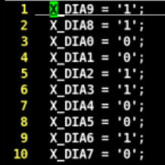
How to config PLL
Command to put config information to resequence pattern
Information of FSN0FS102A_BIST_PLL_190_10.ftlcon

Slide 15
Action item
What are the advantages of PLL?
PLL can control output clock easily.

Slide 16
Reference
https://www.analog.com/en/analog-dialogue/articles/phase-locked-loop-pll-fundamentals.html#:~:text=In%20its%20most%20basic%20configuration,operating%20in%20the%20frequency%20domain.
https://electronics.stackexchange.com/questions/361845/understanding-phase-frequency-detector-logic
https://iopscience.iop.org/article/10.1088/1742-6596/1049/1/012060/pdf#:~:text=The%20Charge%20Pump%20in%20a,only%20works%20on%20either%20way.
https://blogs.keysight.com/blogs/tech/rfmw.entry.html/2020/12/08/consider_the_source-jfPt.html

Slide 17
Confidential information
The material is being disclosed to you pursuant to a non-disclosure agreement between you or your employer and Faraday. Information disclosed in this presentation may be used only as permitted under such an agreement.
Legal notice
The information contained in this presentation is intended to provide a general guide as to which product is suited for a given requirement and shows suggested product applications. Specified functions and properties for products are only valid when handling instructions and other stated conditions and recommendations have been considered and followed. All descriptions, illustrations and dimensions in the information represent general particulars and do not form part of any contract. All information is provided “as is”, with no guarantee of completeness, accuracy, timeliness or of the results obtained from the use of the information, and without warranty of any kind, express or implied, including but not limited to warranties of performance. All information is subject to change without prior notice. Faraday assumes no responsibility whatsoever for any errors or inaccuracies about the information.

