Slide 1

Process 2 Essay
Subject: Mining Massive Datasets
Group: 11
Instructor: MSc Nguyễn Thành An

Slide 2
Introduction to LSH
Locality Sensitive Hashing (LSH):
LSH is fuzzy hashing technique
Hashes similar input items into the same "buckets" with high probability
This technique can be used for data clustering and nearest neighbor search
It differs because it hash collisions are maximized, not minimized
A way to reduce the dimensionality of high-dimensional data

Slide 3
Introduction to LSH
Upside:
Designed correctly, only a small fraction of points are ever examined.
Performs well on large datasets with high dimensions.
reducing computational complexity in high-dimensional problems.
Downside:
There are false negatives – there might be similar items that get missed
selecting hash functions and other parameters
LSH is not a perfect solution for all problems, experimentation and tuning to fit specific scenarios.

Slide 4
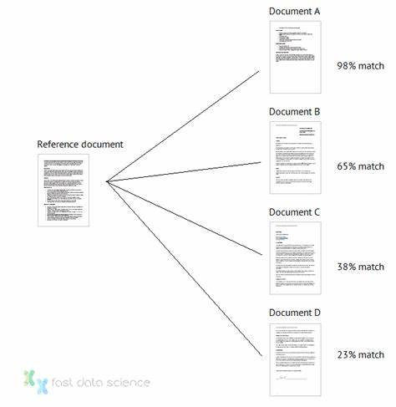
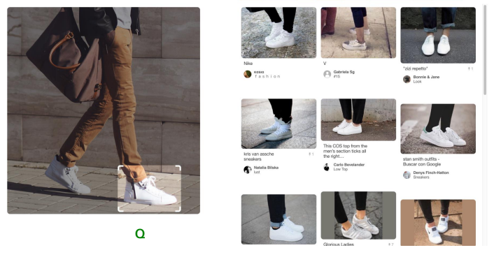
Application
Searching for Similar Images
Finding similar documents

Slide 5
Solve the requirements

Slide 6
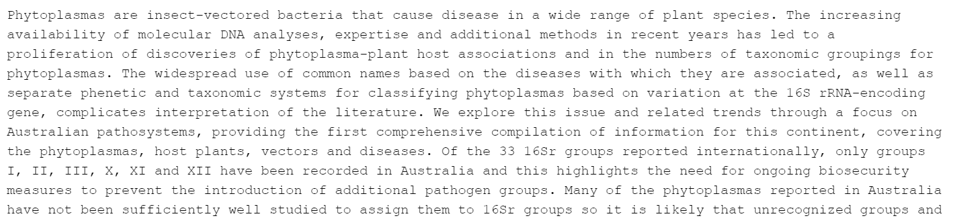
Dataset:
WebOfScience-5736.txt
The WebOfScience-5736 dataset contains 5736 corresponding documents, one per line.
Request:
Implement the MinHashLSH algorithm:
+ In-memory MinHashLSH
+ LargDataMinHashLSH
The first paragraphs of WebOfScience-5736.txt:

Slide 7
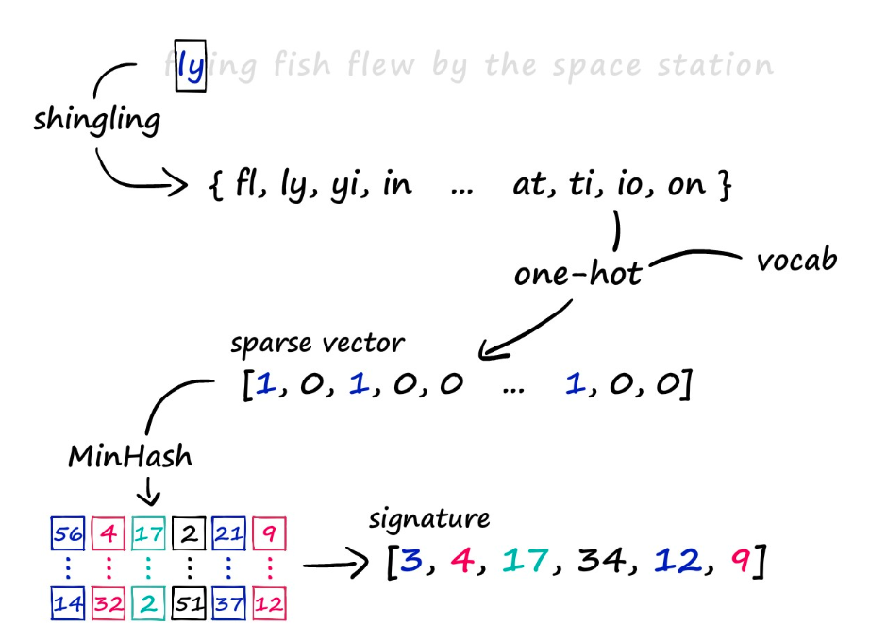
Shingling and Minhash

Slide 8
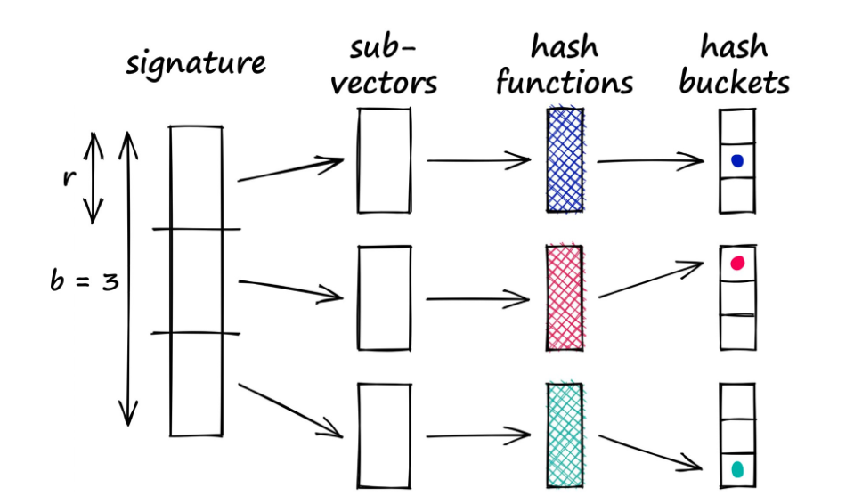
locality_sensity_hashing

Slide 9
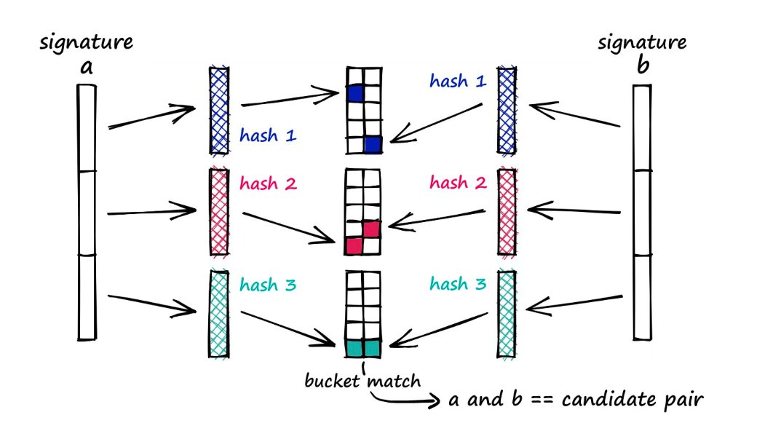
approxNearestNeighbors

Slide 10
Pseudocode

Slide 11
Pseudocode for Shingling
1 Function shingling(self, documents : pd.DataFrame):
2 shingles_set <- an empty set
3 for each doc in documents['text'] do
4 for i from 0 to len(doc) - self.shingle_size + 1 do
5 shingle <- substring of doc from index i to index i+self.shingle_size
6 add shingle to shingles_set
7 bool_vectors <- an empty list
8 for each doc in documents['text'] do
9 document_vector <- an empty list
10 for each shingle in shingles_set do
11 if shingle exists in doc then
12 add 1 to document_vector
13 else
14 add 0 to document_vector
15 add document_vector to bool_vectors
16 returns bool_vectors

Slide 12
Pseudocode for minhashing
1 Function minhashing(self, bool_vectors):
2 num_docs <- length of bool_vectors
3 num_features <- length of bool_vectors[0]
4 signatures <- a 2D array of zeros with dimensions (self.num_hashes, num_docs)
5
6 for i from 0 to self.num_hashes-1 do
7 if length of self.permutations <= i then
8 append create_permutation(num_features) to self.permutations
9 permutation <- self.permutations[i]
10
11 for j from 0 to num_docs-1 do
12 signatures[i, j] <- minhash(bool_vectors[j], permutation)
13
14 return signatures

Slide 13
Pseudocode for jaccard_similarity
1 Function jaccard_similarity(self, sequence1, sequence2):
2 intersection_count <- 0
3 union_count <- length of sequence1
4 for each element1, element2 in zip(sequence1, sequence2) do
5 if element1 equals element2 then
6 increment intersection_count by 1
7 similarity <- intersection_count / union_count
8 return similarity

Slide 14
Pseudocode for locality_sensity_hashing
1 Function locality_sensity_hashing(self, signatures):
2 num_buckets <- 102233
3 r <- self.num_hashes divided by self.num_bands
4 num_docs <- number of columns in signatures
5 results <- an empty dictionary
6
7 for each band from 0 to self.num_bands-1 do
8 start_row <- band * r
9 end_row <- (band + 1) * r
10
11 for each column from 0 to num_docs-1 do
12 band_signature <- slice of signatures from start_row to end_row, column-wise
13 hash_value <- hash of the tuple formed by band_signature modulo num_buckets
14 signature_str <- concatenate all elements in band_signature
15 signature_hash_str <- concatenate signature_str and hash_value
16
17 if column not in results then
18 create an empty list in results for column
19
20 append signature_hash_str to results[column]
21
22 return results

Slide 15
Pseudocode for approxNearestNeighbors
1 Function approxNearestNeighbors(self, key, n):
2 textqueried_df <- DataFrame containing the key as a single text document
3 bool_vectors_queried <- shingling(textqueried_df)
4 signature_queried <- 2D array of zeros with dimensions (self.num_hashes, 1)
5
6 for i from 0 to self.num_hashes-1 do
7 permutation <- self.permutations[i]
8 signature_queried[i, 0] <- minhash(bool_vectors_queried[0], permutation)
9
10 lsh_signature_queried <- locality_sensity_hashing(signature_queried)
11 list_query_bucket_id <- Extract bucket IDs from lsh_signature_queried
12 candidate_docs <- empty list
13
14 for each doc_id, lsh_signatures in self.lsh_buckets.items() do
15 current_bucket_ids <- Extract bucket IDs from lsh_signatures
16 if any bucket_id in list_query_bucket_id matches current_bucket_ids then
17 append doc_id to candidate_docs
18
19 similarities <- empty list
20
21 for each doc_id in candidate_docs do
22 signature_set_queried <- Flatten signature_queried
23 lsh_signature_existing <- Flatten self.signatures[doc_id]
24 jaccard_similarity <- jaccard_similarity(signature_set_queried, lsh_signature_existing)
25 if jaccard_similarity >= self.similarity_threshold then
26 append (doc_id, jaccard_similarity) to similarities
27
28 Sort similarities in descending order based on similarity value
29 Return the top n similarities

Slide 16
In-memory MinHashLSH

Slide 17
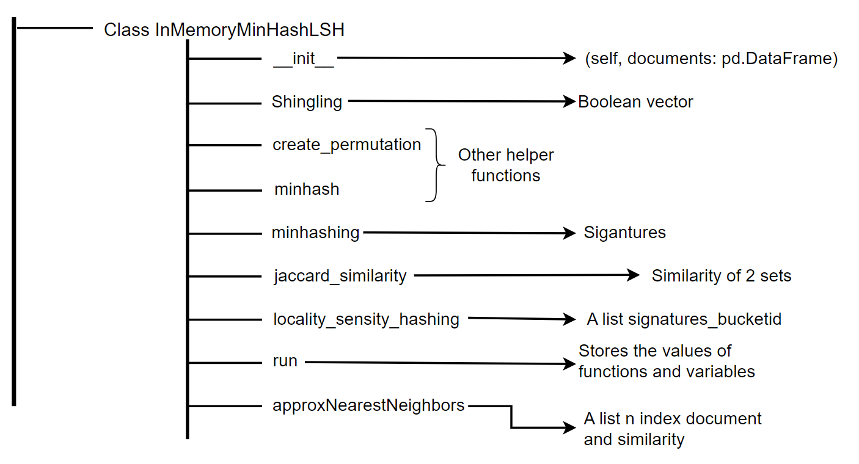
Summary of how to solve the requirements of In-memory MinHashLSH

Slide 18
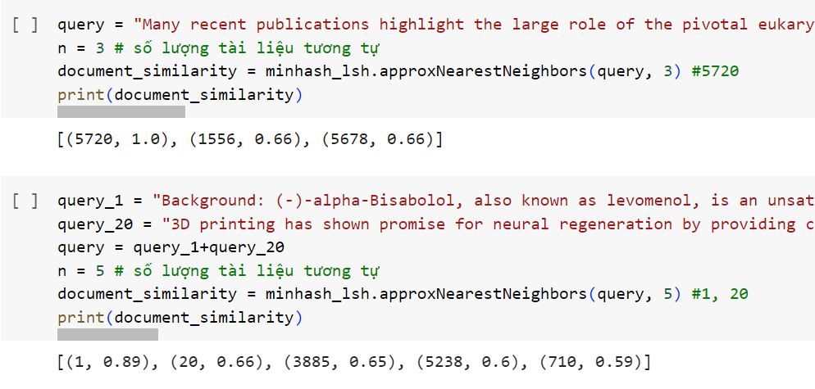
Output

Slide 19
LargDataMinHashLSH

Slide 20
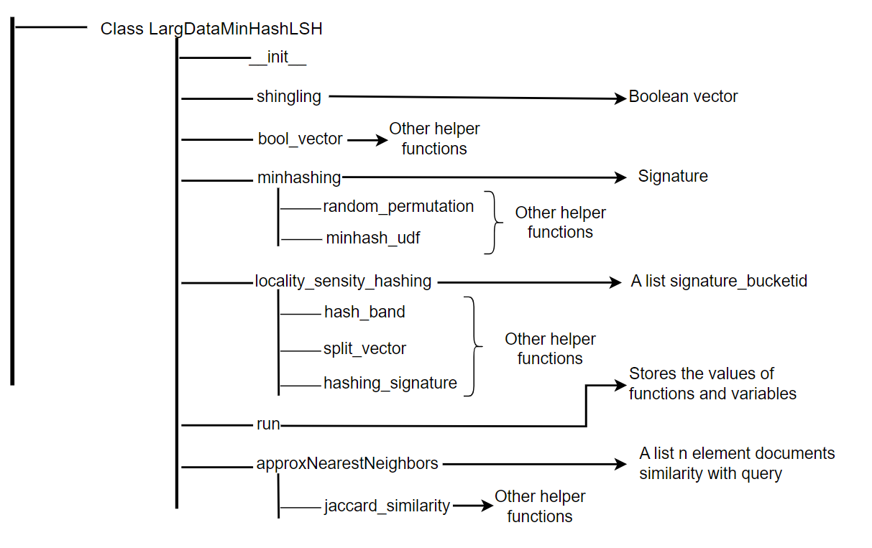
Summary of how to solve the requirements of LargDataMinHashLSH

Slide 21
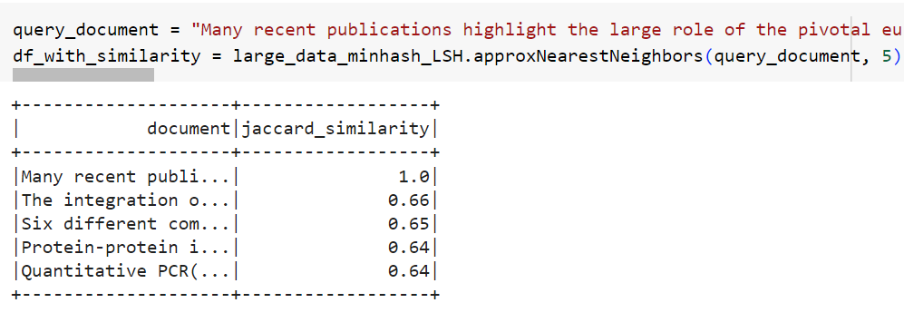
Output

Slide 22
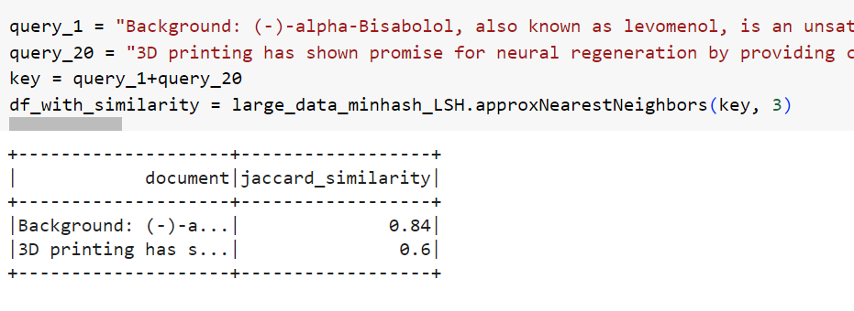
Output

Slide 23
Advantages versus disadvantages
Advantages:
Rich documentations
Diverse perspectives
Collaboration and synergy
Reduced workload
Disadvantages:
Coordination and communication challenges
Differences in work styles and commitment levels
Information disorder

Slide 24
REFERENCES
[1] "Locality Sensitive Hashing (LSH): The Illustrated Guide | Pinecone," www.pinecone.io. [Online]. Available: https://www.pinecone.io/learn/series/faiss/locality-sensitive-hashing/.
[2] "Locality-sensitive hashing," Wikipedia, Nov. 11, 2022. [Online]. Available: https://en.wikipedia.org/wiki/Locality-sensitive_hashing.
[3] "Finding similar documents," Fast Data Science, Nov. 09, 2021. [Online]. Available: https://fastdatascience.com/finding-similar-documents-nlp/ (accessed Apr. 27, 2024).
[4] A. R. J. U. Jure Leskovec, "Stanford University," 10 March 2024. [Online]. Available: http://www.mmds.org.
[5] A. R. J. U. Jure Leskovec, Mining of Massive Datasets, California: Cambridge University Press, 2014.
[6] J. a. R. A. a. U. J. D. Leskovec, Mining of Massive Datasets, USA: Cambridge University Press, 2014.

Slide 25
Task assigments
ID | FULL NAME | EMAIL | TASK | COMPLETE
521H0290 | Do Minh Quan | 521h0290@student.tdtu.edu.vn | 1, 3 | 100%
521H0489 | Ho Huu An | 521h0489@student.tdtu.edu.vn | 2, 3 | 100%
521H0287 | Van Cong Nguyen Phong | 521h0287@student.tdtu.edu.vn | 2, 3 | 100%
521H0514 | Nguyen Le Phuoc Tien | 521h0514@student.tdtu.edu.vn | 1, 3 | 100%

Slide 26
Self-assesment
TASKS | COMPLETE PERCENTAGE
Task 1 | 100%
Task 2 | 100%
Task 3 | 100%

Slide 27
Thanks for listening!

