Slide 1
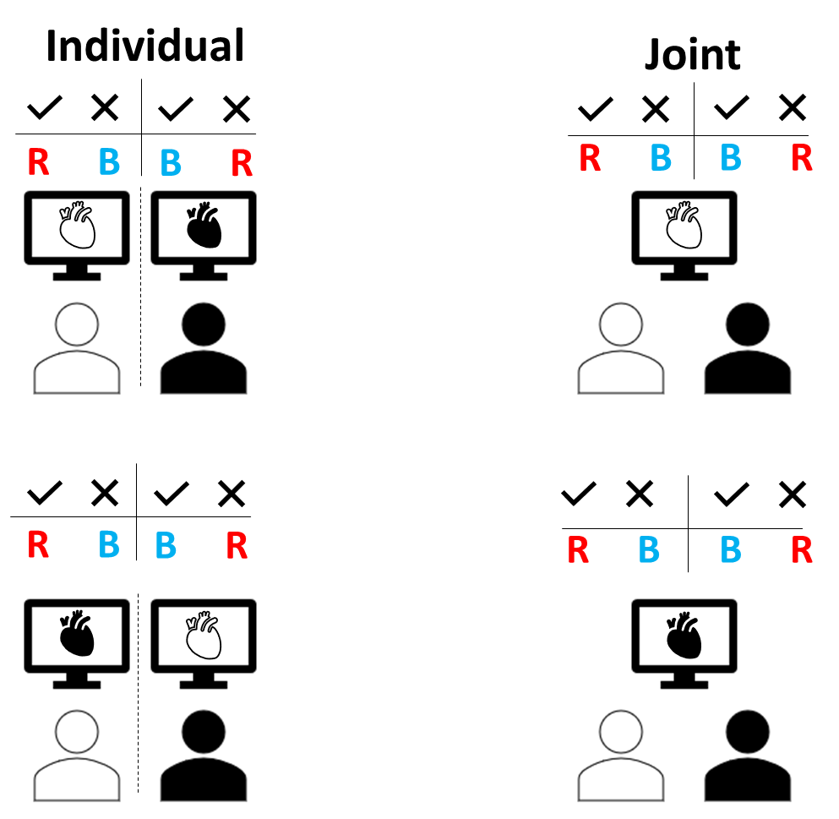
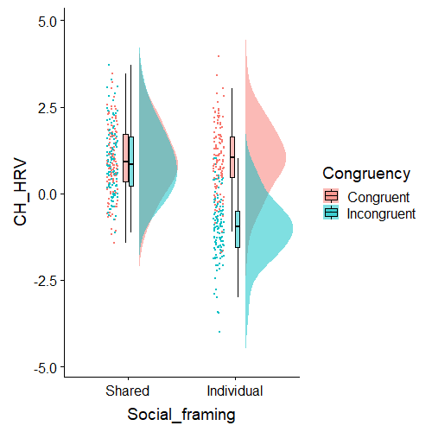
Original idea is problematic as the increase HRV in the joint incongruent condition could just come from belief congruency (the result we had in our previous study) and not the social framing meaning - this design can be confounded.
Biofeedback

Slide 2
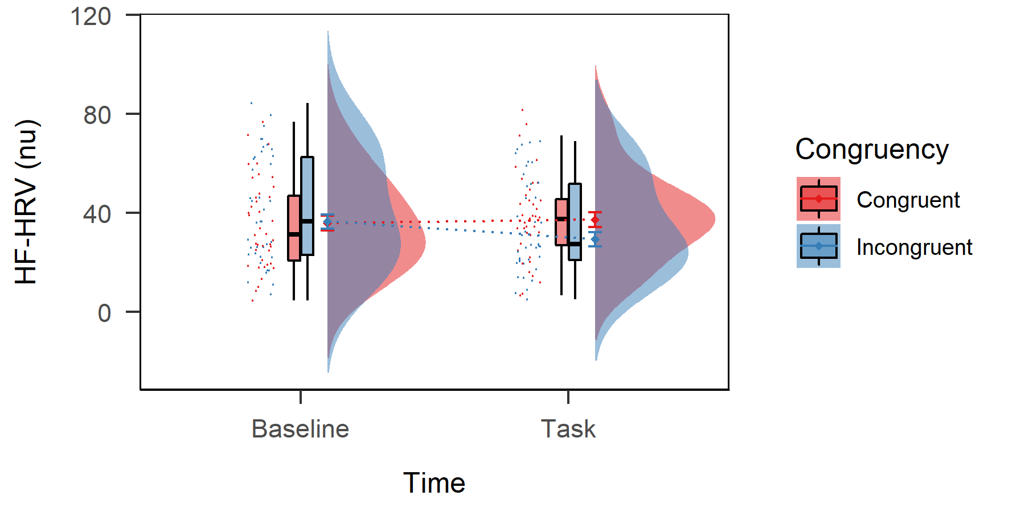
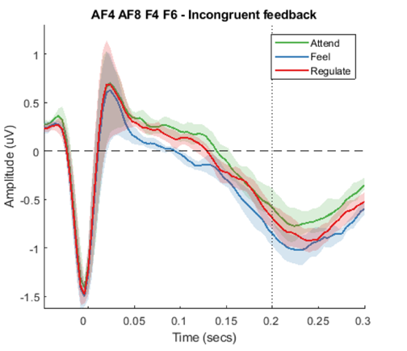
New idea - background
Our rationale focuses on what we want to explore, which is the changes in the processing of incongruent (IC) biofeedback
From our previous studies we have seen that it is mainly the effects coming from the IC feedback that drives our findings.
Study 2 Study 3 Study 4
Study 2: In study we see that the incongruent
feedback is significantly lower in the IC condition but not only when compared to C but also to baseline.
Study 3: When looking at the simple effects
Belief (belongs to me vs. someone else) had
an effect for IC but not for C.
Study 4: HEP differences across conditions
appeared at the IC feedback too.

Slide 3
New idea – Pros
Focusing on the IC biofeedback would simplify our design and enable us to focus theoretically more interesting conditions
Physiological regulatory processes of interpersonal autonomic physiology (IAP) relatively unexplored, although it has the potential to disentangle confusing findings on synchrony between people (both during empathy and conflict).
As Palumbo et al. (2017) suggested, physiological entanglement of the parasympathetic system would more likely to appear during empathy than in conflict where the sympathetic changes are more likely to couple and co-vary.
By introducing a different version of the joint condition we could accommodate these ideas as well as the social framing effect (i.e. individual to joint).

Slide 4





New design
Task: Spot your colour of the rainbow!
To make the counting a bit more challenging more colours will be introduced – but participant would still only be responsible for counting the appearance of only one colour.
The biofeedback presented would always be from a third person and would be the same for both people.
me
me
us
me
me
+
+
Baseline:
People sit in silence with
their eyes open
Individual: Performance is
evaluated based on
own skills
Joint – Positive: Participants boost each other
(e.g. Blue’s score will be added
To Red’s final score as extra).
Joint – Negative:
Participants hamper
each other (e.g. Blue’s score will be subtracted from Red’s final).

Slide 5
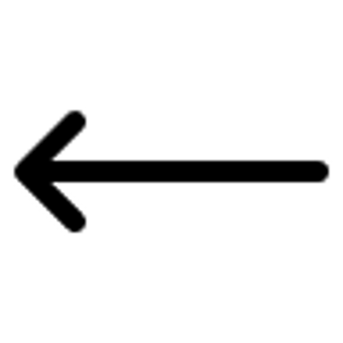
Expected physiological results for IC feedback
Condition | Representation of Self | Autonomic state HRV | Synchrony
Individual + neutral
Joint + positive
Joint + negative
CRQA measures
me
me
us
me
me

Slide 6
Numbers
1 baseline (BL) recording
Fully randomised order
Experiment’s length w 1 repetition: 5 min + 1 x 3 x 5 min = 20 min
2 repetitions: 35 min – feasible (even with extra setting up time)
1 session w 2 repetitions gives us:
- for HRV: 2 x 3 observations/PP = 12 observations/session + BL
for CRQA: 2 x 3 observations/dyad = 6 observations/session + BL
Min N = 40 sample i.e. 20 dyads = 20 experiments
(80 HRV observation/condition; 40 CRQA observations)
Aim N = 60 sample i.e. 30 dyads = 30 experiments
(120 HRV observation/condition; 60 CRQA observations)

Slide 7
Design v3
We agreed that we would like to keep the +/- aspects of the joint condition as it has the potential to track interesting differences in HRV (i.e. + vs -), something that previous studies cannot.
We also decided to keep the Congruency aspect (i.e. Congruent, Incongruent) as we want to make the study about the people who are in the room.
However, to me, the most interesting part to see if more synchrony would arise during the joint condition (both +/-) than in the individual condition. Without having an individual condition we won’t be able to talk about this as I am expecting + and – social contexts levels be the same in terms of synchrony.
Can we have it all without sacrificing power? I think yes.

Slide 8
Understanding our measures
For the synchrony measure we would only test 3 levels of the Social Context factor (i.e. individual, joint +, joint -) as we don’t have a theoretical reason to expect an interaction bw Congruency and Soc Context for the synch measure.
Also, given that within each joint condition one person receives Congruent the other receives Incongruent feedback we need to mirror this in the Individual condition too. This also means that within each Soc Context condition we would have 2 synchrony observations, which increases power in this domain.
In contrast, for HRV, our main interest still lies in the difference bw +/- and C/IC AND potentially their interaction. SO! We can keep the HRV from the Individual condition only as a covariate.

Slide 9


Design V3
C for Blue IC for Red
C for Blue IC for Red
C for Blue IC for Red
Task still : Spot your colour of the rainbow!
To make the counting a bit more challenging more colours will be introduced – but participant would still only be responsible for counting the appearance of only one colour.
IC for Blue C for Red
IC for Blue C for Red
IC for Blue C for Red
+
+
Individual
Joint – Positive
Joint – Negative
me
me
Baseline
us
me
me

Slide 10
How would our data look
For synchrony (CRQA)
For HRV
Dyad ID | Social Framing | Repetition | CV_Baseline
1_2 | Individual | 1 | -
1_2 | Joint positive | 1 | -
1_2 | Joint negative | 1 | -
1_2 | Individual | 2 | -
1_2 | Joint positive | 2 | -
1_2 | Joint negative | 2 | -
ID | Social Framing | Congruency | CV_Baseline | CV_Individual
1 | Joint positive | Congruent | - | -
1 | Joint negative | Congruent | - | -
1 | Joint positive | Incongruent | - | -
1 | Joint negative | Incongruent | - | -
2 | Joint positive | Congruent | - | -
2 | Joint negative | Congruent | - | -
2 | Joint positive | Incongruent | - | -
2 | Joint negative | Incongruent | - | -

Slide 11
Expected results HRV
Condition | Autonomic state HRV
C +
IC +
C -
IC -
Congruent feedback can be interpreted as “this is about me” therefore self-relevant.
With the positive/negative Social Context we are affecting what counts as “me”.
Negative social context will hamper HRV only when the feedback is self-relevant.
Incongruent feedback could have a hampering effect in the Positive social context because it is self-relevant perturbation, but at the same time if the partner actually becomes part of one’s self could become similar to the congruent feedback under this condition.
But anyway we could still expect a significant interaction between Social Context and Congruency.
or

Slide 12
Expected results Synchrony
Social context | Synchrony CRQA
Individual
Joint +
Joint -
Given these people are strangers it would be very cool to see higher levels of Synchrony in the Joint conditions when compared to the Individual. It would show us that people don’t have to related or significant others for synchrony to appear – it is about how the situation in framed.
According to the previous literature we should not see difference between the Positive and Negative conditions.

Slide 13
How long would the study take
With this design we won’t be repeating conditions within people (apart from the synchrony measure as we are not looking at congruency differences there). Unless we can keep pps there >1 h, but that might not be wise.
1 BL (5min) + 6 tasks (5 min each) = 35 min
With 20 dyads (40pps) we would have 40 observations/condition both for the HRV and Synchrony measures.
I would aim for 30 dyads just in case. Should be doable.

Slide 14
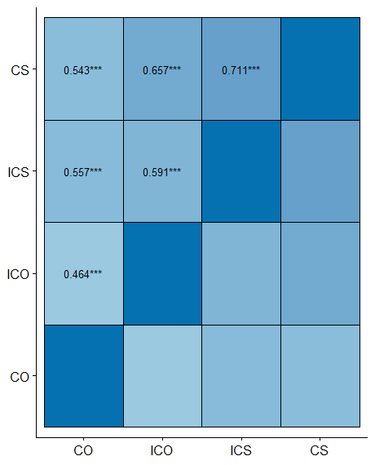
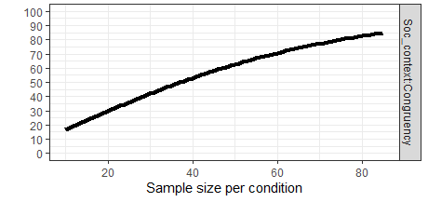
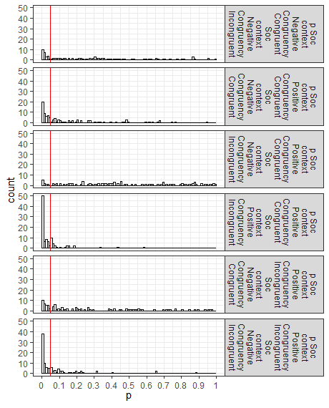
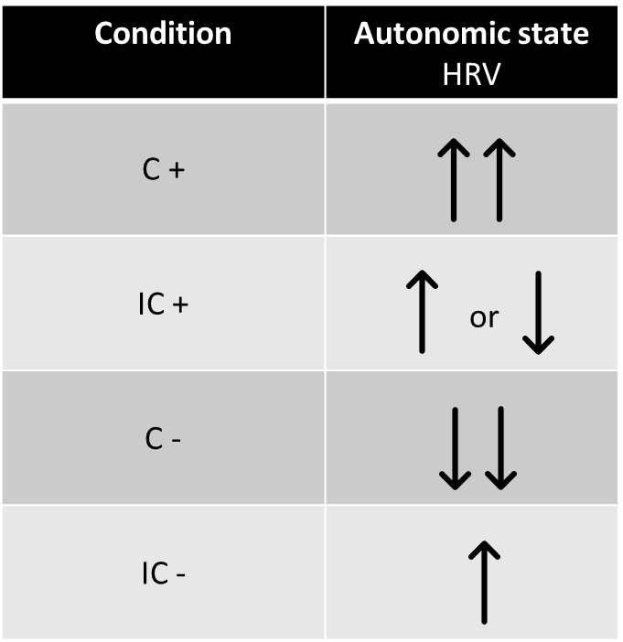
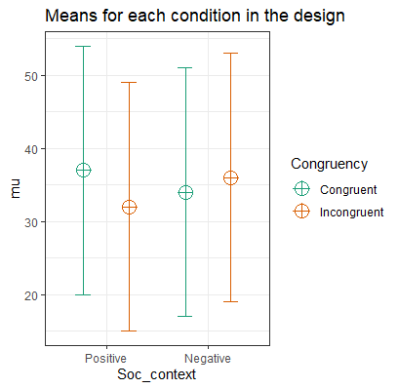
Power calculation
Using the ANOVApower package by Lakens
Specifications:
design = "2w*2w"
n = 80
based on Belief study:
mu = c(37, 32, 34, 36)
sd = 17
r<- c(0.5, 0.6, 0.5, 0.7, 0.6, 0.7)
power
How does power increase
with sample size?
Power and Effect sizes for ANOVA tests
power p.eta^2 cohen_f non_centrality
Soc_context 6.96 0.0022 0.0468 0.1730
Congruency 23.42 0.0193 0.1404 1.5571
Soc_context*Congruency 82.02 0.0969 0.3276 8.4775
Theory:
Based on Belief study:
Simulation results i.e. how many times is
a certain comparison significant?

