Slide 1

claudia
alves
UI / UX Designer

Slide 2
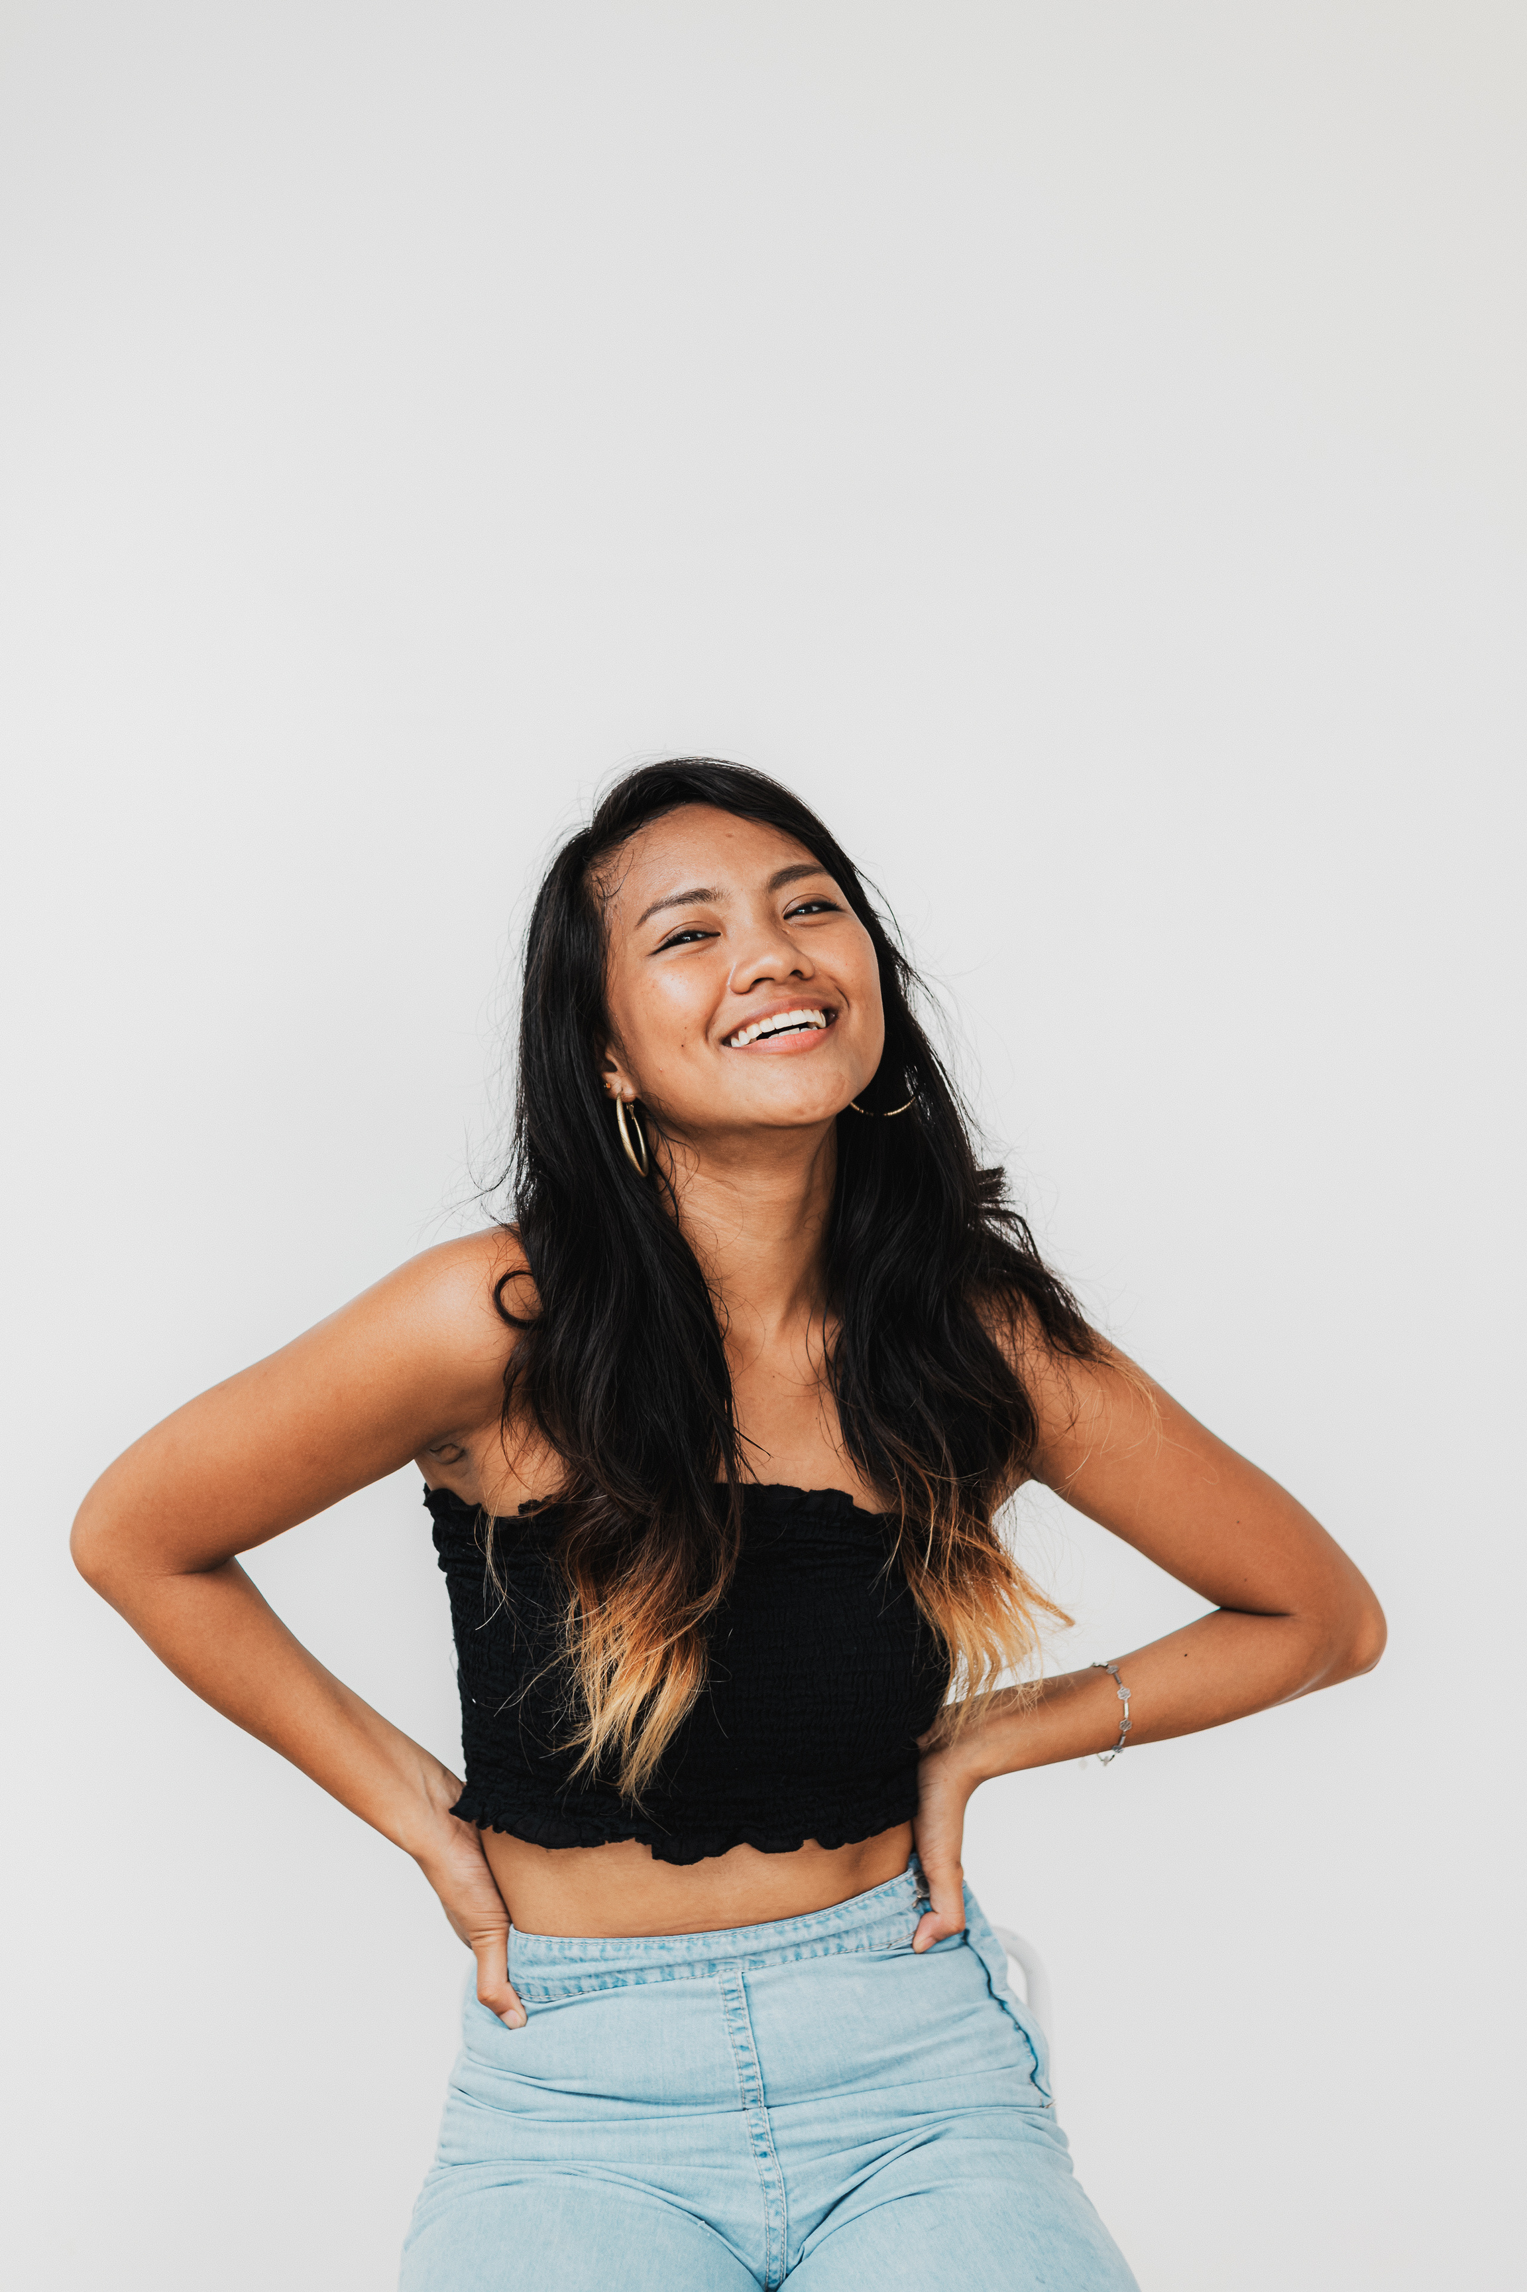

about
I'm passionate about visual storytelling and using design to create impactful and engaging experiences. During my studies, I honed my skills in illustration, graphic design, and animation, developing a strong foundation in design principles and softwares.

Slide 3
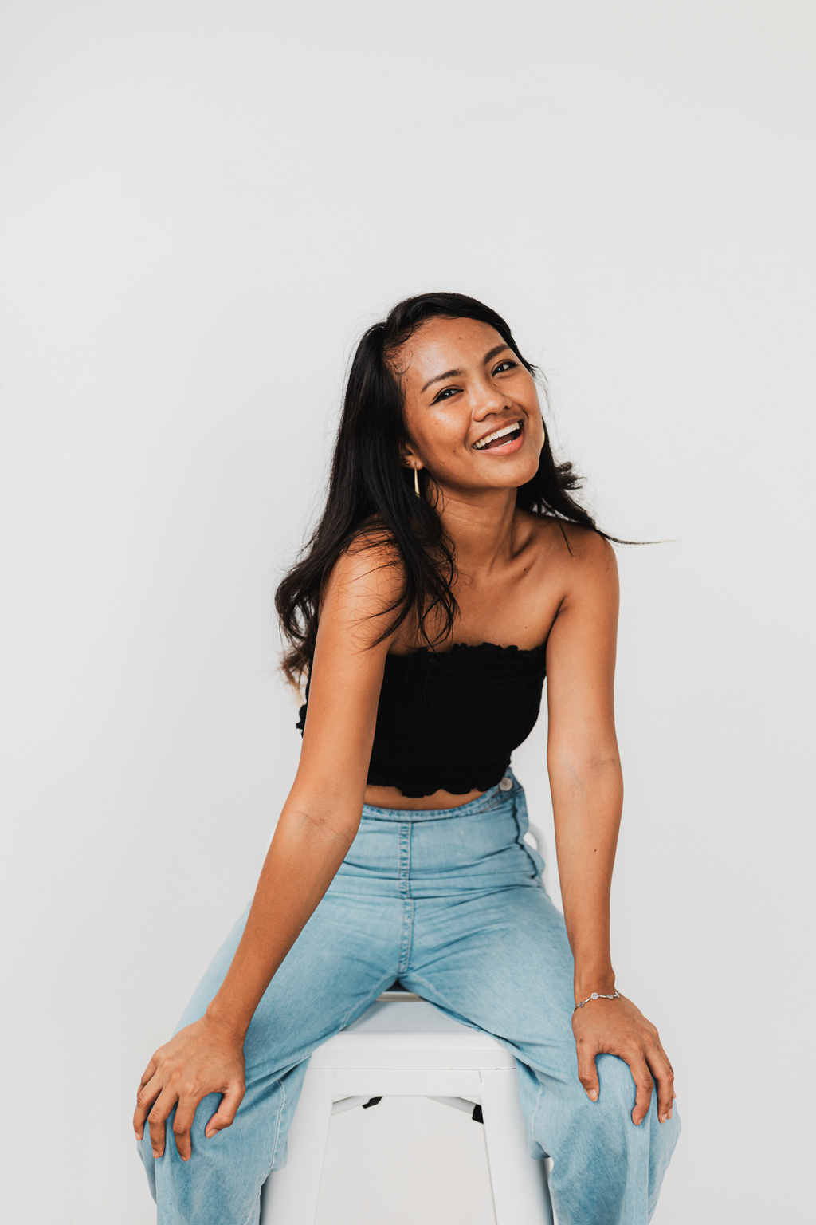

design philosophy
I believe design has the power to connect with people on an emotional level. I strive to create visually compelling work that fosters understanding, sparks conversation, and leaves a lasting impression.
My inspiration comes from everyday encounters, nature's beauty, and the human experience. Whether it's a captivating illustration or a user-friendly interface, I aim to inject a touch of creativity and purpose into every project.

Slide 4


UX Design Mastermind: Crafting intuitive interfaces and captivating visuals to bring your brand to life.
Creative Problem Solver: Design thinking meets user empathy to deliver impactful solutions.
skills
Team Player with a Pixel-Perfect Eye: Collaborating seamlessly to create beautiful and functional experiences.

Slide 5

#1 | Student Hub Mobile App > See Case Study
#2 | Plant Care App Redesign > See Case Study
projects

Slide 6
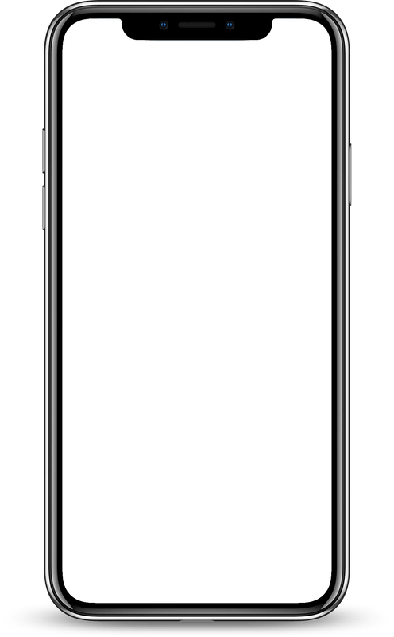
project #1
About | Borcelle is a mobile application designed to be a one-stop hub for students, centralizing resources, communication channels, and academic tools.
Goal | Increase student engagement and academic performance within the Borcelle mobile app by 20% within the first 6 months of launch.
Results | Increased app downloads and active users by 25% exceeding the initial target. Tracked a 30% rise in student access to academic resources (e.g., class materials, assignment submission) through the app. In-app messaging platform saw a 40% increase in student-to-student and student-to-faculty communication, fostering collaboration and improved learning outcomes.
Student Hub Mobile App

Slide 7
project #2
About | Borcelle is a mobile application designed to empower users to take care of their plants.
Goal | Increase user engagement in the Borcelle app by 20% within 3 months of launching the redesigned interface.
Results | 20% increase in daily active users within 3 months of the app launch. 15% reduction in plant-related help desk inquiries after implementing clear and accessible plant care information within the app. A 10% rise in the completion rate of plant care reminders indicating increased user engagement in responsible plant care practices.
Plant Care App Redesign

Slide 8

achievements
May 2040
Aug 2040
Nov 2040
Awarded 1st place in the Sustainable Tech Design Challenge.
Featured Artist in the "Emerging Artists Showcase" at the Studio Showde’s Art Gallery 2040.
Featured in Hanover and Tyke’s Design Anthology highlighting its innovative approach to user engagement in plant care.

Slide 9
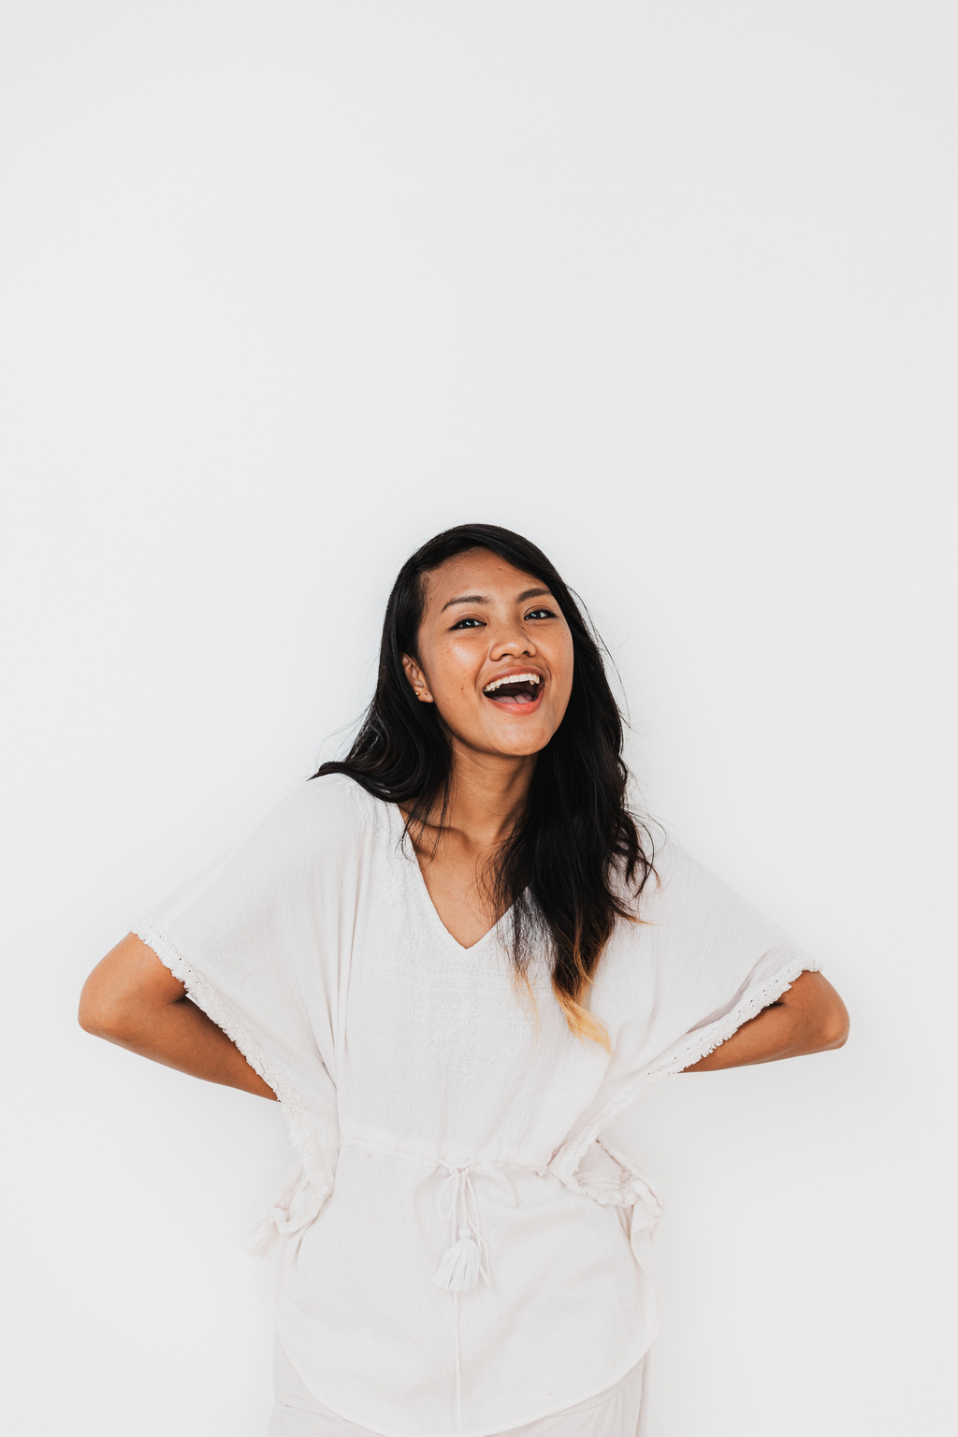

I'm not just a designer, I'm a design problem solver. I translate ideas into impactful experiences that engage users and drive results.
Looking for a fresh perspective and creative spark? I bring a blend of design expertise and youthful energy to your team.
why hire me

Slide 10
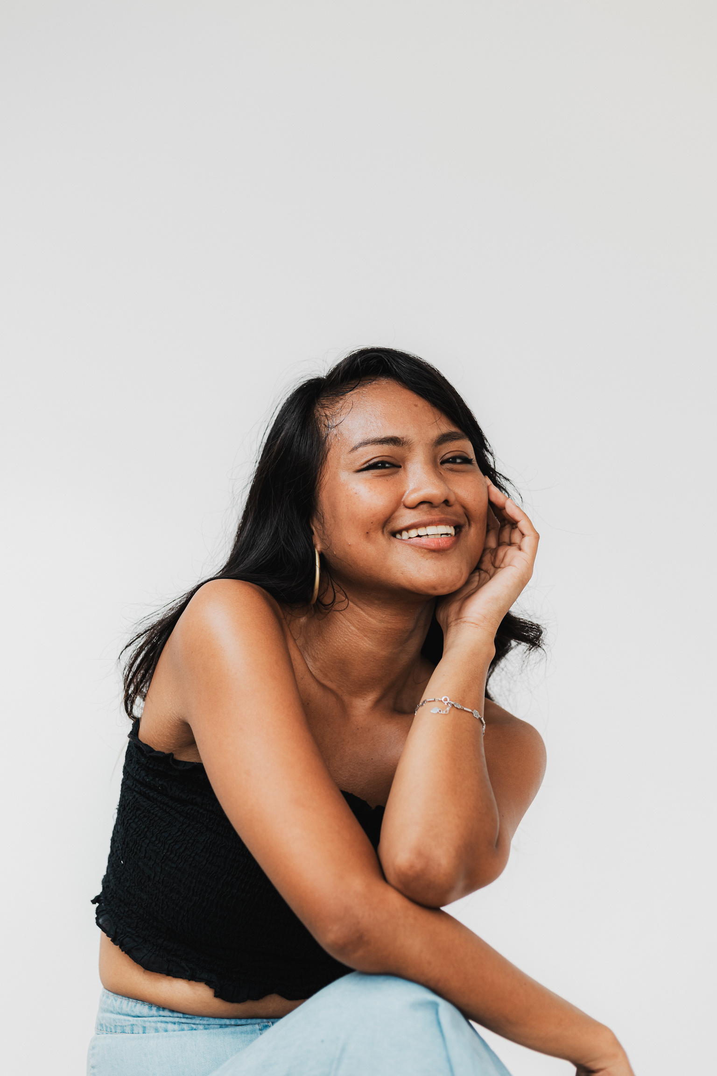

Let's connect and design solutions that leave a lasting impact!
+123-456-7890 hello@reallygreatsite.com www.reallygreatsite.com

