Slide 1

Classification of Covering Spaces and
Canonical Change of Basepoint
HoTT/UF Workshop 2023
Jelle Wemmenhove
Cosmin Manea, Jim Portegies

Slide 2


Jim Portegies
Cosmin Manea

Slide 3
Motivation
learn how to use HoTT as
synthetic framework

Slide 4
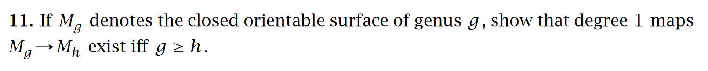

Starting point: formalize an exercise from Hatcher
Concepts involved
Closed orientable genus $g$ surface
Degree
Covering spaces
Homology
How to translate classical statements into Homotopy Type Theory …
… such that they are easy to formalize?

Slide 5
Classification of Covering Spaces
*already shown in [Buchholtz, Van Doorn, Rijke (2018)]

Slide 6
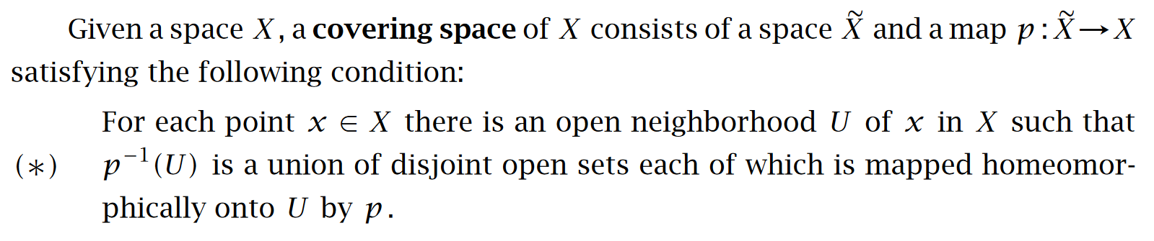

Covering Spaces in HoTT
Hou (Favonia) and Harper (2016)
Hatcher
No need to track local, point-set topological properties
Work directly with the fibers $p^{−1}\left(x\right)$ as family of sets

Slide 7


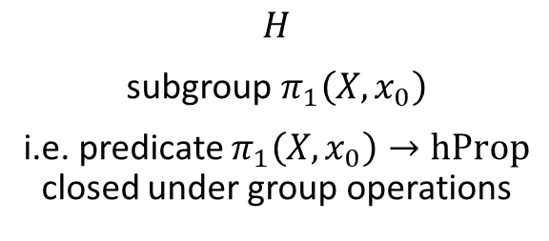
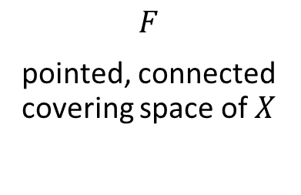
Classification
For a connected, pointed type $(X,x_{0})$
$$F$$
pointed, connected covering space of $X$
$$H$$
subgroup$π_{1}\left(X,x_{0}\right)$
i.e. predicate $π_{1}\left(X,x_{0}\right)→\text{hProp}$ closed under group operations
From covering space to subgroup
Surjective via the universal covering space
Injective via the lifting criterion
$F ⟼ H_{F}$, loops $p$ in $X$ for which there exists a loop in the covering space lying over $p$
Hou (Favonia) and Harper (2016)

Slide 8
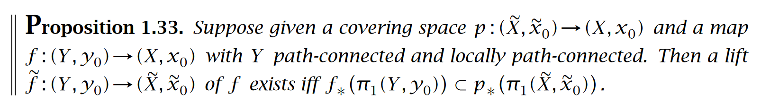
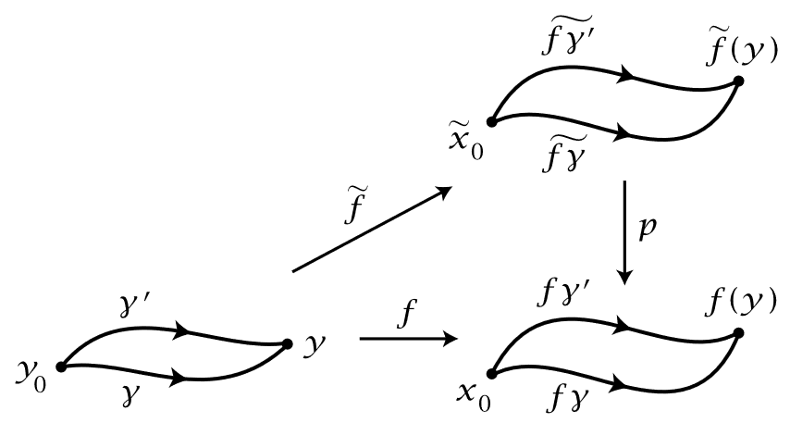
Lifting Criterion in HoTT
Hatcher
Definitions needed in HoTT
pointed covering space
total space and the covering map
lift of a pointed map to the covering space

Slide 9




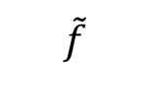

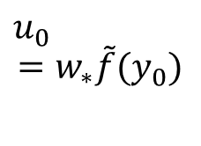


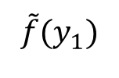




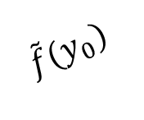



Definitions in HoTT
Pointed covering space of $\left(X,x_{0}\right)$
family
with a point $u_{0}:F\left(x_{0}\right)$
Total space
$Σ_{X}F$ with point $\left(x_{0};u_{0}\right)$
Covering map
$\text{p}{\text{r}}_{\text{1}}:Σ_{X}F→X$
Pointed lift of$f :\left(Y,y_{0}\right)→\left(X,x_{0}\right)$
where $w :f\left(y_{0}\right)=x_{0}$
$\tilde{f}\left(y\right) :F\left(f\left(y\right)\right)$
such that $w_{∗}\tilde{f}\left(y_{0}\right)=_{F\left(x_{0}\right)}u_{0}$
$$F :X→\text{hSet}$$
$$Σ_{X}F$$
$$F(x_{0})$$
$$u_{0}$$
$$={w_{∗}\tilde{f}(y}_{0})$$
$${\tilde{f}(y}_{1})$$
$${\tilde{f}(y}_{0})$$
$$\tilde{f}$$
$$f$$
$$Y$$
$$X$$
$$x_{0}$$
$$y_{0}$$
$$y_{1}$$
$${f(y}_{1})$$
$$w$$
$${f(y}_{0})$$

Slide 10
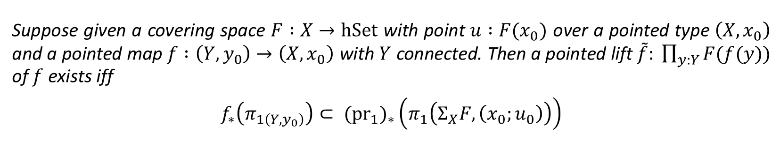
Hatcher
Lemma
Suppose given a covering space $F :X→\text{hSet}$ with point $u :F(x_{0})$ over a pointed type $\left(X,x_{0}\right)$ and a pointed map $f :\left(Y,y_{0}\right)→\left(X,x_{0}\right)$ with $Y$ connected. Then a pointed lift $\tilde{f}: \prod_{y:Y}{F(f(y))}$ of $f$ exists iff
$$f_{∗}\left(π_{1\left(Y,y_{0}\right)}\right)⊂ {{(\text{pr}}_{1})}_{∗}\left(π_{1}\left(Σ_{X}F, \left(x_{0};u_{0}\right)\right)\right)$$

Slide 11
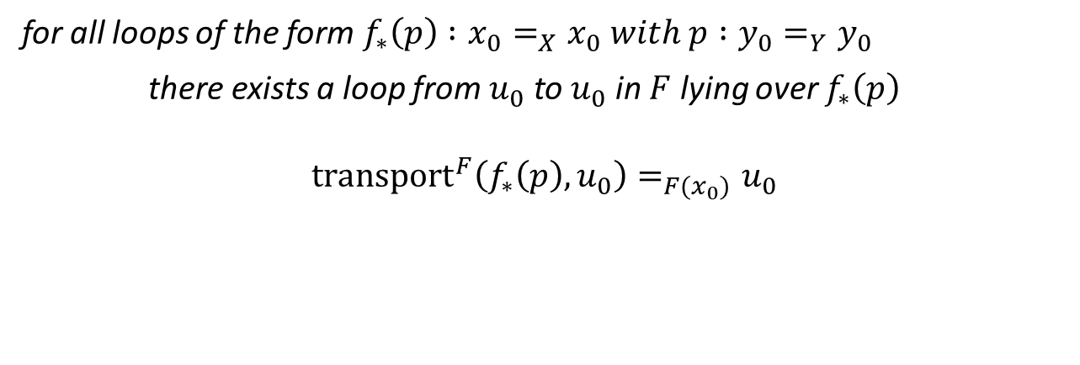

About this criterion…
$$f_{∗}\left(π_{1\left(Y,y_{0}\right)}\right)⊂ {{(\text{pr}}_{1})}_{∗}\left(π_{1}\left(Σ_{X}F, \left(x_{0};u_{0}\right)\right)\right)$$
Disadvantages
Conceals multiple truncations
Forces us to work with the total space $Σ_{X}F$
Can we do better?
for all loops of the form$f_{∗}\left(p\right) :x_{0}=_{X}x_{0} with p :y_{0}=_{Y}y_{0}$
there exists a loop from $u_{0}$ to $u_{0}$ in $F$ lying over $f_{∗}\left(p\right)$
$$\text{transpor}{\text{t}}^{F}\left(f_{∗}\left(p\right), u_{0}\right)=_{F(x_{0})}u_{0}$$

Slide 12
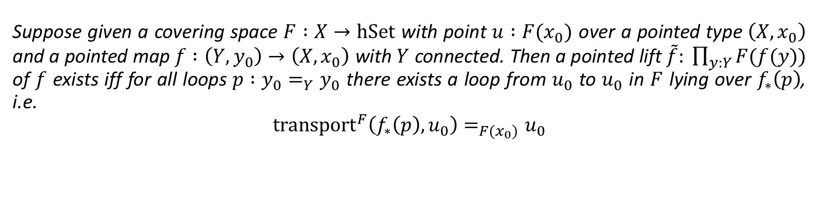
Hatcher
Lemma (version 2)
Suppose given a covering space $F :X→\text{hSet}$ with point $u :F(x_{0})$ over a pointed type $\left(X,x_{0}\right)$ and a pointed map $f :\left(Y,y_{0}\right)→\left(X,x_{0}\right)$ with $Y$ connected. Then a pointed lift $\tilde{f}: \prod_{y:Y}{F(f(y))}$ of $f$ exists iff for all loops $p :y_{0}=_{Y}y_{0}$ there exists a loop from $u_{0}$ to $u_{0}$ in $F$ lying over $f_{∗}\left(p\right)$, i.e.
$$\text{transpor}{\text{t}}^{F}\left(f_{∗}\left(p\right), u_{0}\right)=_{F(x_{0})}u_{0}$$
Proof closely reflects the classical proof

Slide 13
Canonical Change of Basepoint

Slide 14
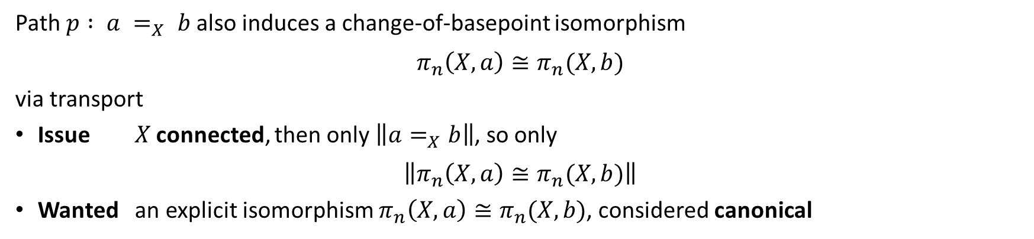

Classical setting
Path from $a$ to $b$ induces a change-of-basepoint isomorphism
\$π_{n}\left(X,a\right)≅π_{n}(X,b)$
depends on the homotopy class of the path
a priori, not canonical
HoTT
Path $p : a =_{X} b$also induces a change-of-basepoint isomorphism
$$π_{n}\left(X,a\right)≅π_{n}(X,b)$$
via transport
Issue $X$ connected, then only $\left\|a=_{X}b\right\|$, so only
$$\left\|π_{n}\left(X,a\right)≅π_{n}(X,b)\right\|$$
Wanted an explicit isomorphism $π_{n}\left(X,a\right)≅π_{n}(X,b)$, considered canonical

Slide 15

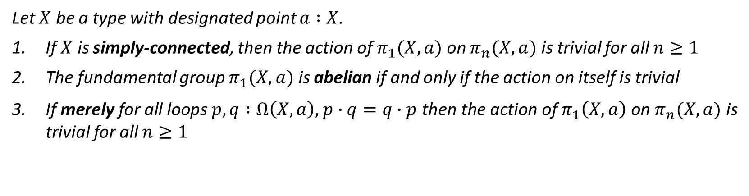
Via extension by weak constancy [Hou (Favonia) and Harper (2016)] it suffices to show that
Forces us to keep using set-truncation
For all paths $p, q :a=_{X}b$
$${\text{transport}}^{π_{n}\left(X,−\right)}\left(p,−\right)= {\text{transport}}^{π_{n}\left(X,−\right)}(q,−)$$
equivalent to
$π_{1}\left(X,a\right)$ acts trivially on $π_{n}\left(X,a\right)$
Theorem
Let $X$ be a type with designated point $a :X$.
If $X$ is simply-connected, then the action of $π_{1}(X,a)$ on $π_{n}(X,a)$ is trivial for all $n≥1$
The fundamental group $π_{1}(X,a)$ is abelian if and only if the action on itself is trivial
If merely for all loops $p, q :Ω\left(X,a\right),$ $p∙q=q∙p$ then the action of $π_{1}\left(X,a\right)$ on $π_{n}(X,a)$ is trivial for all $n≥1$

Slide 16
Conclusion
Formalized classification of covering spaces
Formalized conditions for when change-of-basepoint isomorphism is canonical
Learned how to use HoTT as a synthetic framework
Less layers of abstraction than in classical setting
Ignore local, point-set topological properties
Lessons learned for formalization
Work with fibrations instead of the total space
Remove truncations
… not always possible

Slide 17
References
Ulrik Buchholtz, Floris van Doorn, and Egbert Rijke. Higher Groups in Homotopy Type Theory. In Proceedings of the 33rd Annual ACM/IEEE Symposium on Logic in Computer Science, LICS ’18, page 205–214, New York, NY, USA, 2018. Association for Computing Machinery.
Kuen-Bang Hou (Favonia) and Robert Harper. Covering Spaces in Homotopy Type Theory. In Silvia Ghilezan, Herman Geuvers, and Jelena Ivetić, editors, 22nd International Conference on Types for Proofs and Programs (TYPES 2016), volume 97 of Leibniz International Proceedings in Informatics (LIPIcs), pages 11:1–11:16, Dagstuhl, Germany, 2018. Schloss Dagstuhl–Leibniz-Zentrum fuer Informatik.

