Slide 1
gRPC
By: HoHai
Oct-2023

Slide 2
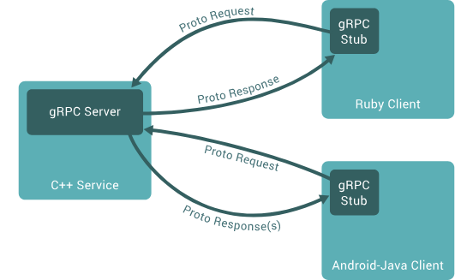
What is gRPC ?
For Singple request: client send request to server and get single response back
For streaming response, server return a stream to client
For streaming request, client sent a stream
For Bidirectional stream: client and server send read-write stream
Use .proto mechanism for serializing structure data

