Slide 1
JavaScript Advanced
By: HoHai

Slide 2

















Prototype
function Function2() {
return { a: 1 };
}
const obj2 = new Function2();
console.log(Object.getPrototypeOf(obj2));
console.log(Function2.prototype);
console.log(Object.getPrototypeOf(obj2) === Function2.prototype);
function Function1() {}
const obj1 = new Function1();
console.log(Object.getPrototypeOf(obj1) === Function1.prototype);

Slide 3




Closure

Slide 4









Closure

Slide 5

Closure

Slide 6
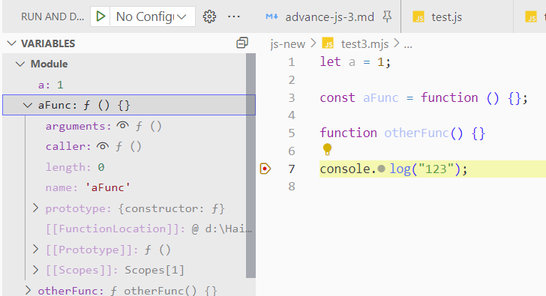
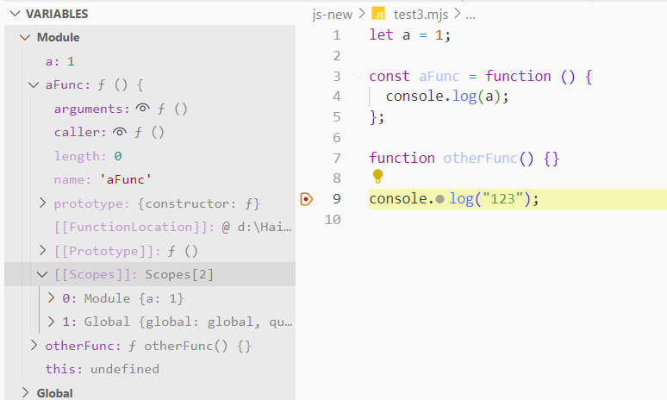



Static Scoping (1)
JS use Static Scoping. It mean the scope of a function will be capture at Creation time (not Calling time)
Module: {a: 1, aFunc: f, otherFun: f,…}
In aFunc, otherFun although the [[scopes]] will refer scope
(global in this case) at creation time. In this time, we don’t do any call
file: test3.mjs
(*.mjs is module file)

Slide 7
Static Scoping (2)
let a = 1;
const aFunc = function () {
console.log(a);
};
console.log("123");
aFun.[[scopes]] =
a
property as bag, value is captured at creation time
let a = 1;
const aFunc = function () {
console.log(a);
aFunc();
};
console.log("123");
aFun.[[scopes]] =
a
aFunc
property as bag, value is captured at creation time
let a = 1;
const aFunc = function () {
console.log(a);
};
const aFunc2 = function () {
return aFunc;
};
console.log("123");
aFun.[[scopes]] =
a
aFunc
aFun2.[[scopes]] =
a
aFunc
{a} is copied from aFunc’s scopes

Slide 8











Closure
var F = function () {
var obj1 = { name: "hohai", age: 40 };
var value1 = 123;
function F2() {
console.log("In F2, refer to outer scopes: obj1, value1 ");
obj1.age += 1;
value1 += 1;
console.log(obj1);
console.log(value1);
return "Finished Called F2";
}
function F3() {
console.log("In F3, refer to outer scopes: F2, value1 ");
F2();
value1 += 1;
console.log(value1);
return "Finished Called F3";
} // return obj1; { name: "hohai", age: 40 }
// return value1; // 123
return F2;
// return F3();
};
Correct partly

Slide 9















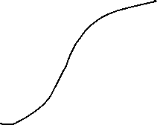








Promise

