Slide 2
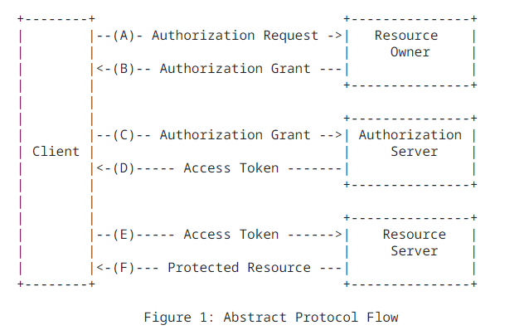
OAuth 2.0 Introduction
Authorization Code (user-agent defined)
https://datatracker.ietf.org/doc/html/rfc6749#page-4

Slide 3
OAuth 2.0 Integrated in my website
My App
Authentication Provider (support OAuth)
login with X
Authorization code
https://blog.miguelgrinberg.com/post/oauth-authentication-with-flask-in-2023

