Slide 1
MIS132 – Lecture 6
程式設計實習課

Slide 2
Outline
Review C
struct
typedef
struct + pointer

Slide 3
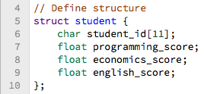
What is struct(structure)?
struct student
 |  |  |  |  |  |  |  |  |  |  |  |  |  | ...
char student_id[11]
float economics_score

Slide 4
Variable order in struct about performance
Memory space
 | …
8 bytes (on 64bits machine)

Slide 5
Variable order in struct about performance
Memory space
 | …

Slide 6
Variable order in struct about performance
a struct
 |  |  |  |  |  | …
char
(1 byte)
float
(4 bytes)
double
(8 bytes)

Slide 7
Variable order in struct about performance
a struct
 |  |  |  |  |  | …
char
(1 byte)
float
(4 bytes)
double
(8 bytes)

Slide 8
Variable order in struct about performance
a struct
 |  |  |  |  |  | …
char
(1 byte)
float
(4 bytes)
double
(8 bytes)

Slide 9
Variable order in struct about performance
a struct
 |  |  |  |  |  | …
char
(1 byte)
float
(4 bytes)
double
(8 bytes)

Slide 10
Variable order in struct about performance
a struct
 |  |  |  |  |  | …
char
(1 byte)
float
(4 bytes)
double
(8 bytes)

Slide 11
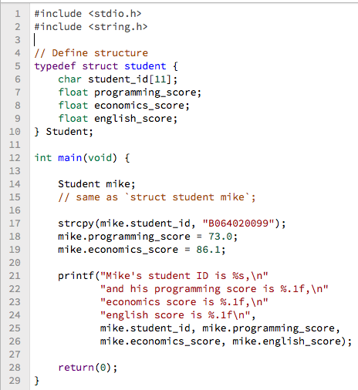

Typedef (I)

Slide 12
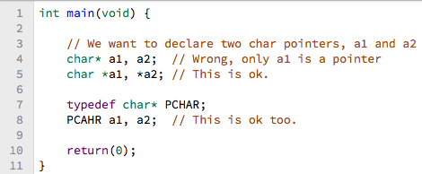
Typedef (II)

Slide 13

Typedef (III)

Slide 14
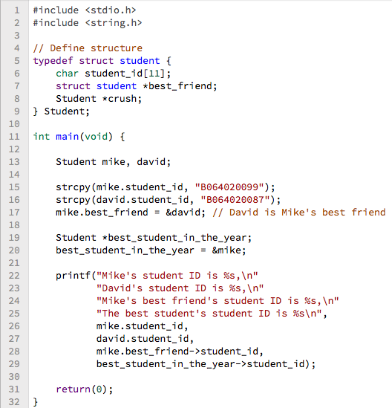

Struct pointer
This is wrong

Slide 15


Struct pointer

Slide 16
Struct pointer

Slide 17
“安西教練！ 我好想打程式” – 三井壽

Slide 18
Practice
Please define a struct passenger. Every passenger has their name, phone number, age, balance in the wallet and seat number; And define a struct railroad_car. Every car can contains up to 6 passengers. There are 5 cars in one train. Remember to connect all cars order by order.
Without using for loop, write a function to list all passenger information on the train order by the car number and passenger’s seat number.
Output example: [car 1] 1A: Mike, 0912345678, 17 yo, $1.983.15 1B: David, 0998765612, 23 yo, $991.2. [car 2] ...

