Slide 1
MIS132 – Lecture 7
程式設計實習課

Slide 2
Outline
Review C
Hands-on the practice last week
File processing
File stream
Open file
R/W file
Close file
Practice

Slide 3
Practice
Please define a struct passenger. Every passenger has their name, phone number, age, balance in the wallet and seat number; And define a struct railroad_car. Every car can contains up to 6 passengers. There are 5 cars in one train. Remember to connect all cars order by order.
Without using for loop, write a function to list all passenger information on the train order by the car number and passenger’s seat number.
Output example: [car 1] 1A: Mike, 0912345678, 17 yo, $1.983.15 1B: David, 0998765612, 23 yo, $991.2. [car 2] ...

Slide 4
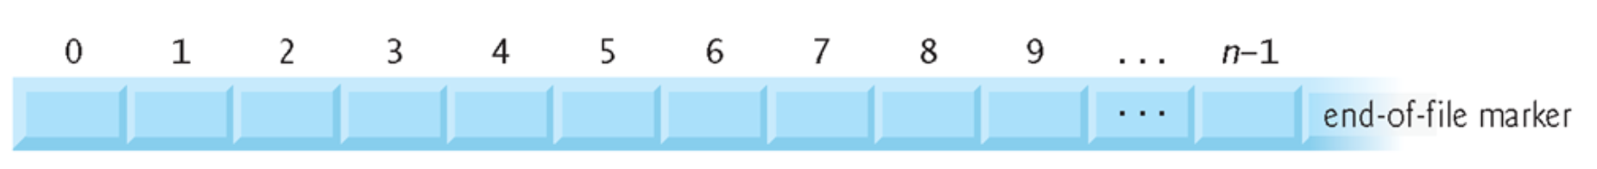
Your file in the disk should be like this …
In the disk
EOF

Slide 5
Before reading or writing your file…
You have to open it first!
FILE *fopen(const char *filename, const char *mode)
filename is the name of your file.
mode is the mode how you open it

Slide 6
fopen really did
From disk
Copy
To memory
(buffer)
FILE pointer

Slide 7
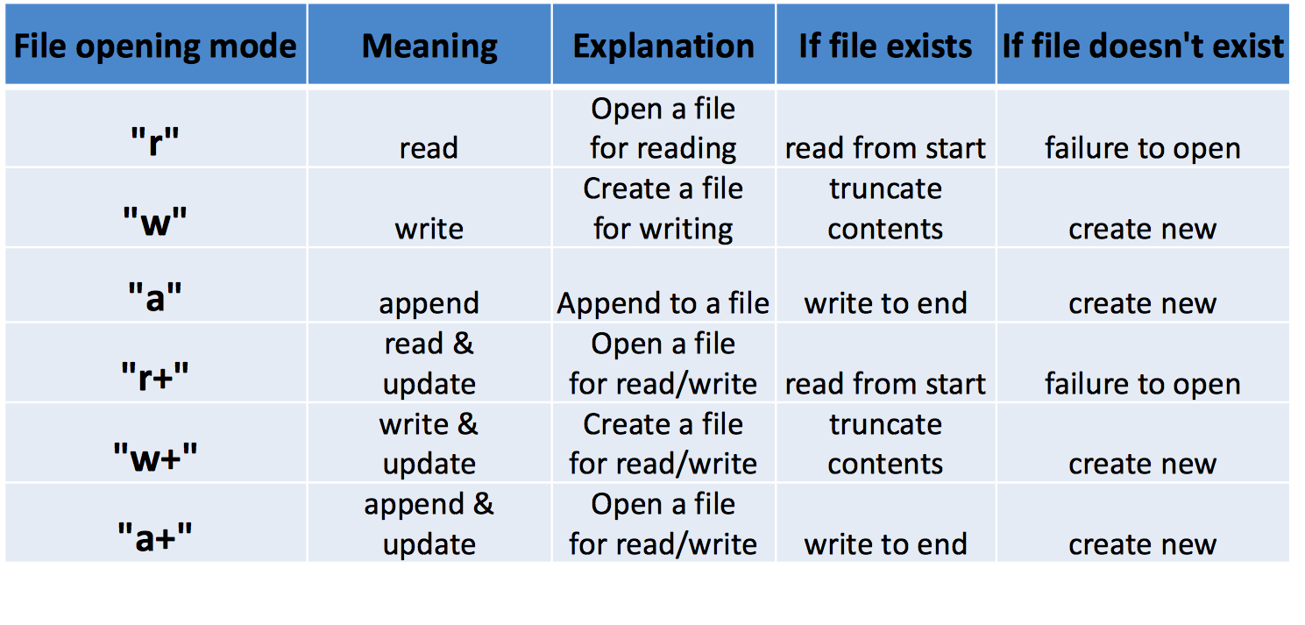
Mode in fopen

Slide 8
Mode in fopen

Slide 9
Mode in fopen

Slide 10
Mode in fopen

Slide 11
Mode in fopen

Slide 12
Mode in fopen

Slide 13
Okay, since you have opened it, what’s next?
It’s time to read/write something in the file.
Read:
fgetc – read a character from stream int fgetc ( FILE *stream ); fgets – read a string from stream
char *fgets ( char *str, int num, FILE *stream );
Write:
fputc – write a character to stream
int fputc ( int character, FILE * stream ); fputs – write a string to stream int fputs ( const char *str, FILE *stream );

Slide 14
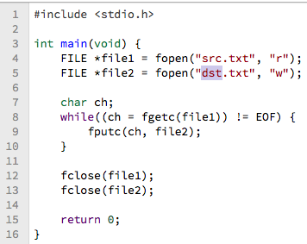
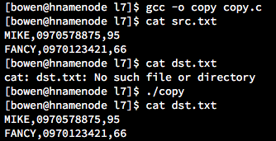
Okay, since you have opened it, what’s next?

Slide 15
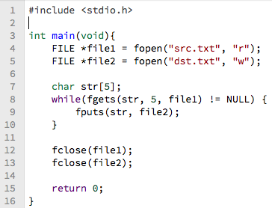
Okay, since you have opened it, what’s next?

Slide 16
Okay, since you have opened it, what’s next?
Finally, remember to close your stream.

Slide 17
“安西教練！ 我好想打程式” – 三井壽

Slide 18
Practice
Please download the csv file named students.csv on cyber university, and write a C program to read this file. In this file, every row is one student’s information about his/her name, phone and grade point. Change the third column(which is grade point) in every row to the grade format(You can reference the grade rule in NSYSU). Then write down new student information into new csv file named new_students.csv.
[Hint] To get the third column, you may need the function strtok to split the row content by the comma delimiter.
Output example: // after executing your program, there is a new csv file, and its // content is like following. Mary,0999300598,E Anna,0931146297,D Emma,0938440803,A Elizabeth,0984919577,E ...

