Slide 1

Duration: 120 min
Chungnam University
Graduate class
Remote Sensing
Collecting domain data
September 17th 2025
By the end of this lecture you should be able to:
Understand what makes a high‑quality training document and why it matters.
Identify different file types usable for AI training (with pros/cons and examples).
Spot and fix common data problems (duplicates, noise, irrelevant material).
Prepare files for RAG (Retrieval-Augmented Generation): chunking, formatting, cleaning.
Evaluate your AI assistant’s retrieval by asking domain‑specific questions.

Slide 2
Understanding RAG (Retrieval-Augmented Generation)
What is RAG?
Definition: Retrieval-Augmented Generation (RAG) is a technique where an LLM combines its built-in reasoning ability with external documents that you provide at query time.
Instead of relying only on what the model was trained on, RAG retrieves chunks of relevant text from your files and inserts them into the model’s content window so answers are grounded.
Key Characteristics
Short-term memory: RAG does not make the model remember documents permanently. Once the files are removed, the knowledge is gone.
On-demand: You can upload documents at the moment you need them.
Flexible: You can add or replace documents without retraining.

Slide 3
Understanding RAG (Retrieval-Augmented Generation)
RAG vs LoRA Training
RAG = external reference. The model looks up chunks when asked.
LoRA = fine-tuning. The model permanently stores new knowledge in its weights.
Analogy: RAG is like consulting a library; LoRA is like memorizing the content.
Persistent RAG
If you connect RAG to a vector database (e.g., Pinecone, FAISS, Chroma), you can simulate long-term memory.
The database permanently stores your documents, and the LLM retrieves from it whenever needed.
Still, the knowledge is external — not built into the model’s parameters.

Slide 4
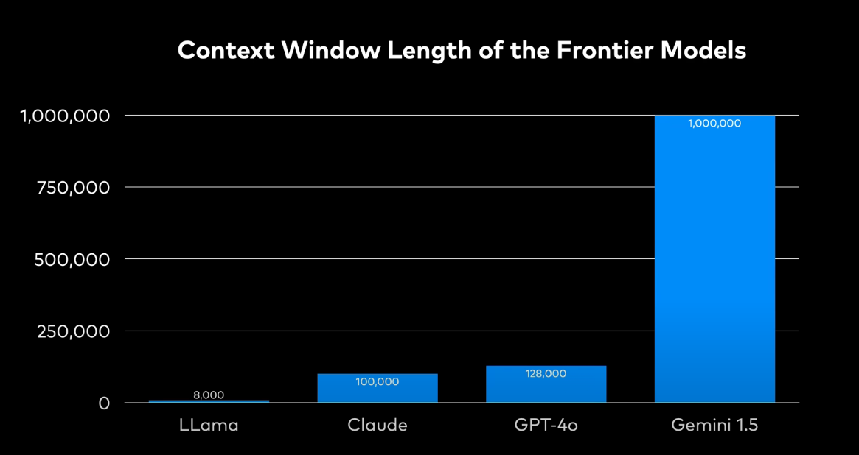
Context Window
The content window length is the maximum number of tokens (words, subwords, symbols) a Large Language Model (LLM) can handle in one input prompt.
It sets the limit on how much text (your question + retrieved documents + system prompt) can be processed at once.

Slide 5
Context Window
How it works
When you call an LLM, you specify (or the system sets) a maximum output length in tokens.
The model keeps generating until it either:
Reaches that max output token limit, or
Predicts an end-of-sequence token naturally (like stopping at the end of a sentence).
Input vs Output Token Budget
The total (input + output) must fit within the model’s content window length.
Example (GPT-4 with 128k tokens):
If your prompt is 80k tokens, you have ~ 48k tokens left for output.
If your prompt is short (say 5k tokens), then you can generate up to ~ 43k tokens in the response.

Slide 6
Context Window: Why It Matters?
1/ For RAG
If your retrieved chunks + question are larger than the content window, some parts will be dropped.
Example: If the model supports 8k tokens, and you upload a 300-page book, you cannot insert all of it at once. Instead, RAG retrieves relevant chunks only to fit inside the window.
2/ For Training (LoRA)
During fine-tuning, samples must also fit into the model’s context window.
If your training sample is longer than the window, you need to split or truncate it.
3/ For Users
Longer context = better memory for large documents.
But longer windows also mean slower inference and more compute usage.

Slide 7
Why Do We Need Chunking?
Chunking in RAG means splitting large documents into smaller, manageable pieces of text (called chunks) before storing them in a retrieval system.
Each chunk is usually a few hundred tokens long.
Later, when you ask a question, the retriever selects the most relevant chunks and passes them to the LLM.
Why Do We Need Chunking?
Context window limits: LLMs can only handle a certain number of tokens at once (e.g., 8k, 32k). If you load an entire 200-page PDF, it won’t fit.
Precision: Smaller chunks make it easier for the retriever to pull only the relevant text, not irrelevant pages.
Avoid noise: If chunks are too big, you may drag in unnecessary sections. If too small, context may be lost.
Original PDF (12 pages) → 6,000 tokens.
If you chunk into 600 tokens each, with 100 overlap → you get ~12 chunks.
Each chunk might represent a section, paragraph, or figure description.
When you ask: “What spectral feature indicates illite?” → only the relevant chunk about Al–OH absorption near 2.20 µm is retrieved and fed to the model.

Slide 8
RAG pipeline (Assignment)
RAG has two main parts:
Retriever → finds the most relevant text chunks from your corpus.
Generator (LLM) → takes those chunks + your question and produces the final answer.
For the retriever to work efficiently, your documents must be stored in a special way: as vector embeddings.
Each chunk of text is converted into a vector (a list of numbers that represent meaning).
Those vectors go into a vector database (vector DB).
When you ask a question, your query is also converted into a vector, and the DB finds the “closest” vectors (semantic similarity).
Tools Commonly Used in RAG Pipelines (FAISS, Chroma, Pinecone) ???

Slide 9
What is Corpus?
A corpus (plural: corpora) is a large, organized collection of texts.
In AI/ML, it means the set of documents you feed to your system for training, fine-tuning, or retrieval.
In Our Context
For RAG
The corpus = all the documents you upload into the retrieval system.
Example: a folder with 20 geology papers, 5 lab reports, and 10 Python scripts → that’s your RAG corpus.
For LoRA Training
The corpus = the cleaned, formatted dataset of text examples you use to fine-tune your model.
Example: 5,000 cleaned chunks of text in JSONL, each formatted as Q&A or instruction–response → that’s your training corpus.

Slide 10
Five Steps to Create a New AI Model
Data Prep
Train
Deploy
Tune
Validate

Slide 11
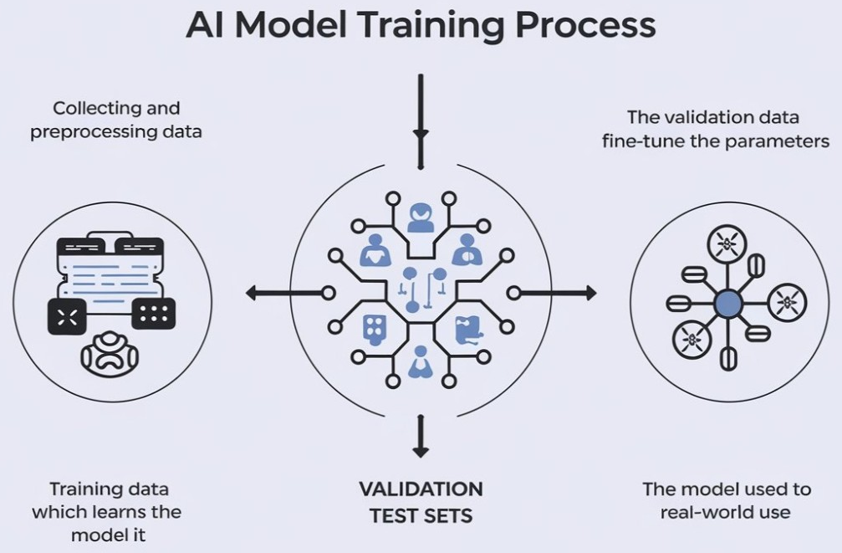
Why Data Quality Matters?
Your AI assistant is only as good as the documents you provide. Garbage in → garbage out.
RAG depends on retrieving relevant and clear passages. If your files are incomplete or noisy, answers will be poor.
Think of your dataset as a knowledge library. If the library is full of duplicated, irrelevant, or blurry books, no student (AI) can learn effectively.
Similarly, LoRA training next week will depend on clean, well-formatted text data. Poor formatting or irrelevant data can harm model fine-tuning.

Slide 12
Why Data Quality Matters?
Reduces Bias: Bias in AI data can lead to unfair or inaccurate model predictions. For instance, an AI-based credit rating app may always give a higher credit score to a specific ethnic group. Organizations can minimize biases and improve fairness by ensuring diversity and representation during data collection. Careful data curation helps prevent skewed results that could reinforce stereotypes, ensuring ethical AI applications and trustworthy decision-making.
Helps in Feature Extraction: Feature extraction relies on raw data to identify relevant patterns and meaningful attributes. Clean and well-structured data enables more effective feature engineering and allows for better model interpretability. Poor data collection leads to irrelevant or noisy features, making it harder for models to generalize to real-world use cases.
Improves Compliance: Regulatory frameworks require organizations to collect and handle large datasets responsibly. An optimized collection process ensures compliance by maintaining data privacy, accuracy, and transparency right from the beginning. It builds customer trust and supports ethical AI development to prevent costly fines and reputational damage.
Determines Model Performance: High-quality data directly impacts the performance of AI systems. Clean, accurate, and well-labeled data helps improve model training, resulting in better predictions and insights. Poor data quality, including missing values or outliers, can degrade model accuracy and lead to unreliable outcomes and loss of trust in the AI application.

Slide 13
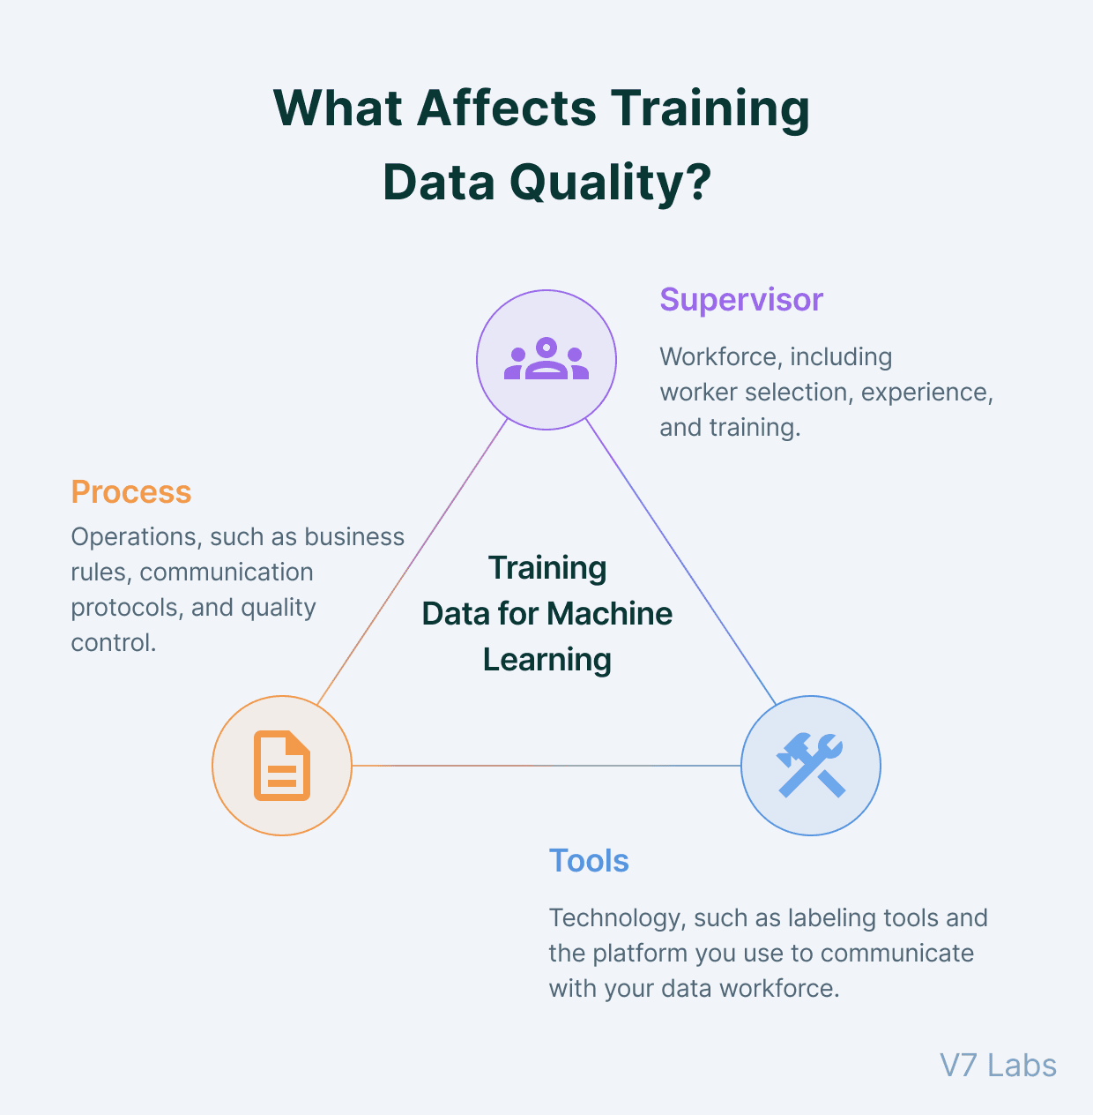
What Makes a Good Training Document ?
Principles of Quality
Clarity: Clear explanations, readable text, minimal ambiguity.
Domain Relevance: Must directly support your target field.
Completeness: Includes background, methodology, results, and implications.
Good vs Bad Examples
Good: PDF paper titled “Hyperspectral Band Ratios for Clay Mineral Mapping” with full methodology and spectral plots.
Bad: A single-page note: “Band ratio → classification good.”
Why It Matters for LoRA Training
LoRA training requires high-quality, domain-rich text samples. Clear and complete documents become better training pairs.

Slide 14
Types of Usable Files
RAG and LoRA training both rely on structured, high-quality input. Each file type has strength
File Type | Example Source | Pros | Problems
.txt | Exported notes, lab logs | Lightweight, simple | No structure, may miss headings
.pdf | Journal papers, manuals | High-quality, rich | If scanned, needs OCR
.md | Github READMEs | Clear structure, easy headings | External images/ links not embedded
.py | Python scripts | Combines code and explanations | Needs well-written comments
.csv | Lab result, spectral tables | Structured, parseable | Needs clear headers; lacks narrative
.doc/ .docx | Reports, essays | Editable, common | Messy formatting
.xlsx | Accuracy tables, band stats | Structured, multiple sheets | Formatting lost, best converted

Slide 15
Types of Usable Files
Domain Examples
.txt: Atmospheric correction steps.
.pdf: Paper on PCA vs band ratio.
.md: README from Random Forest repo.
.py: Classification script.
.csv: Reflectance table by wavelength.
.docx: Field report with descriptions.
.xlsx: Accuracy assessment confusion matrix.
For LoRA Training
.txt and .md are best for direct ingestion.
.pdf, .docx, .xlsx, .csv → must be cleaned and converted next week.

Slide 16
Spot and Fix Common Data Problems
1. Duplicates
Problem: Same document saved multiple times or slightly different versions.
Fix: Use file hashes or similarity tools (SimHash, cosine similarity). Keep the most complete version.
Example: band_ratio_v1.pdf and band_ratio_final.pdf → keep final.
2. Noise
Problem: Headers, footers, watermarks, boilerplate text.
Fix: Remove during cleaning stage (regex or manual edits).
Example: “Page 1 of 10” appearing in every chunk → delete.
3. Irrelevant Content
Problem: Files outside your domain.
Fix: Remove them from the corpus.
Example: A cooking recipe in your geology dataset → discard.
Why This Matters:
Duplicates → over-representation of some information.
Noise → model retrieves useless chunks.
Irrelevant → distracts retrieval and confuses LoRA training.

Slide 17
Assignment
Tasks
Collect 10–20 files (mix formats).
Organize, clean, and prepare corpus.
Load into Chatbox RAG, test retrieval.
AI Check: Ask 2–3 domain questions.
Submit PPTX:
Corpus overview + screenshots.
Cleaning + chunking steps.
Example queries with AI answers + citations.
Reflection + prep for LoRA.
https://chatgpt.com/g/g-68672d46a12481918a69a6cfd9a544ae-remote-sensing-pro

