Slide 1
Machine learning integration – GUI for his classification
LAB 5

Slide 2
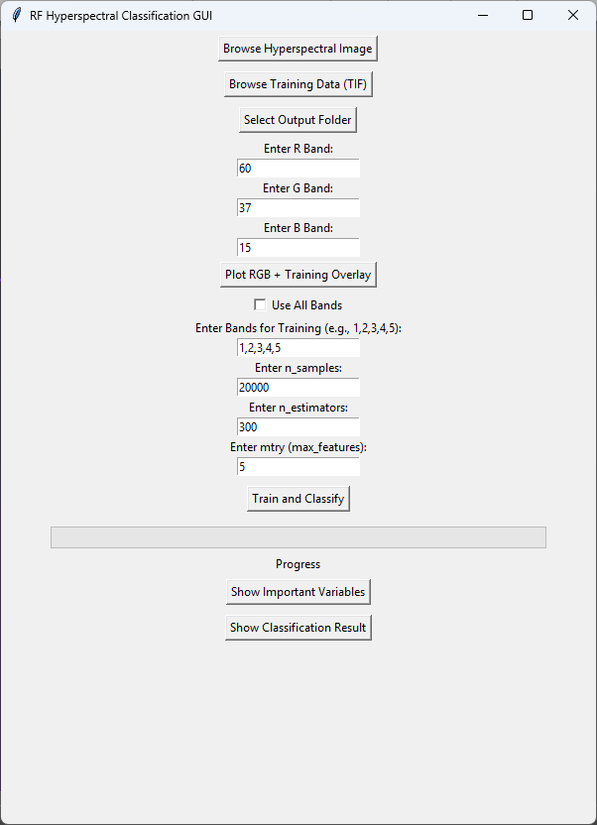
objectives
Create a Tkinter GUI software that allows users to:
Select hyperspectral image (TIF).
Select training data (TIF).
Select output folder.
Enter 3 bands for RGB composite (via Entry).
Plot RGB + Training data overlay (Button).
Select specific bands for training (via Entry) or use all bands (via checkbox)
Enter n_samples, n_estimators and mtry.
After training (with progress bar), show:
Important features (Button)
Classification result (Button)

Slide 3
PHASE 1: START WITH THE ORIGINAL SCRIPT
# Original script — static console-based code
img_path = r'D:\Coding_class\Final_Exam\Code-RS1\Multispectral_Image.tif'
train_tif_path = r'D:\Coding_class\Final_Exam\Code-RS1\ground_truth_tif.tif'
output_dir = r"C:\Users\HUYHOA-REMOTESENSING\Documents”
img = rasterio.open(img_path)
img_data = img.read()
...
model = RandomForestClassifier(...)
model.fit(X_train, y_train)
...
plt.show()
...

Slide 4
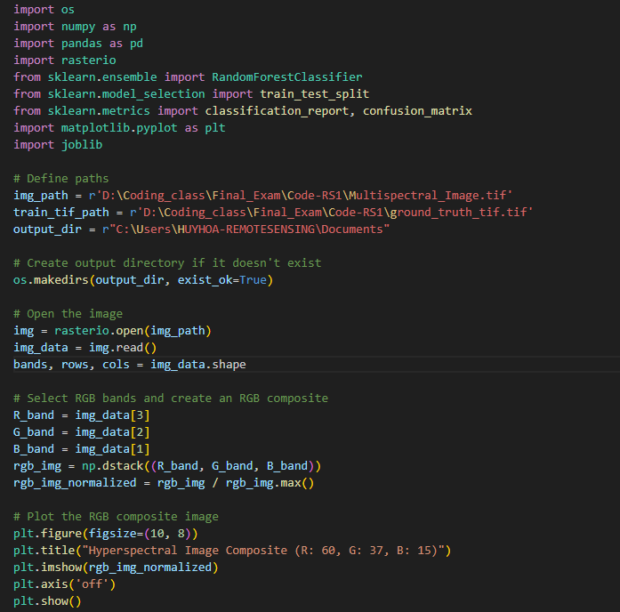
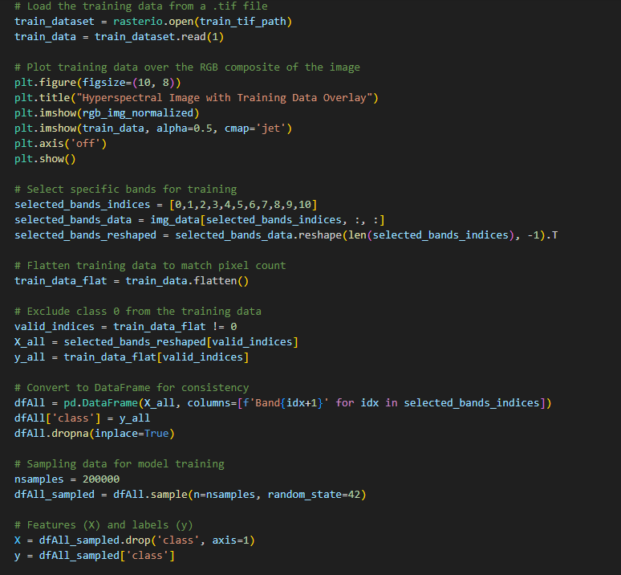

Slide 5
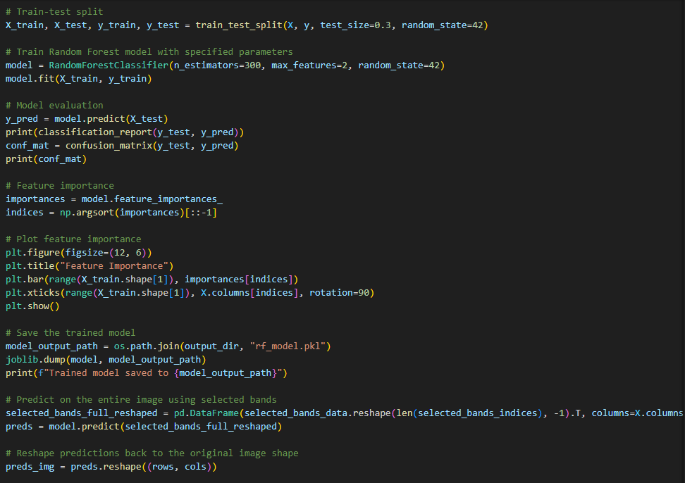
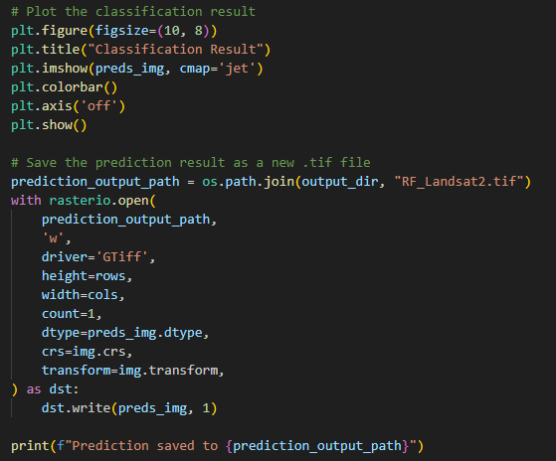

Slide 6
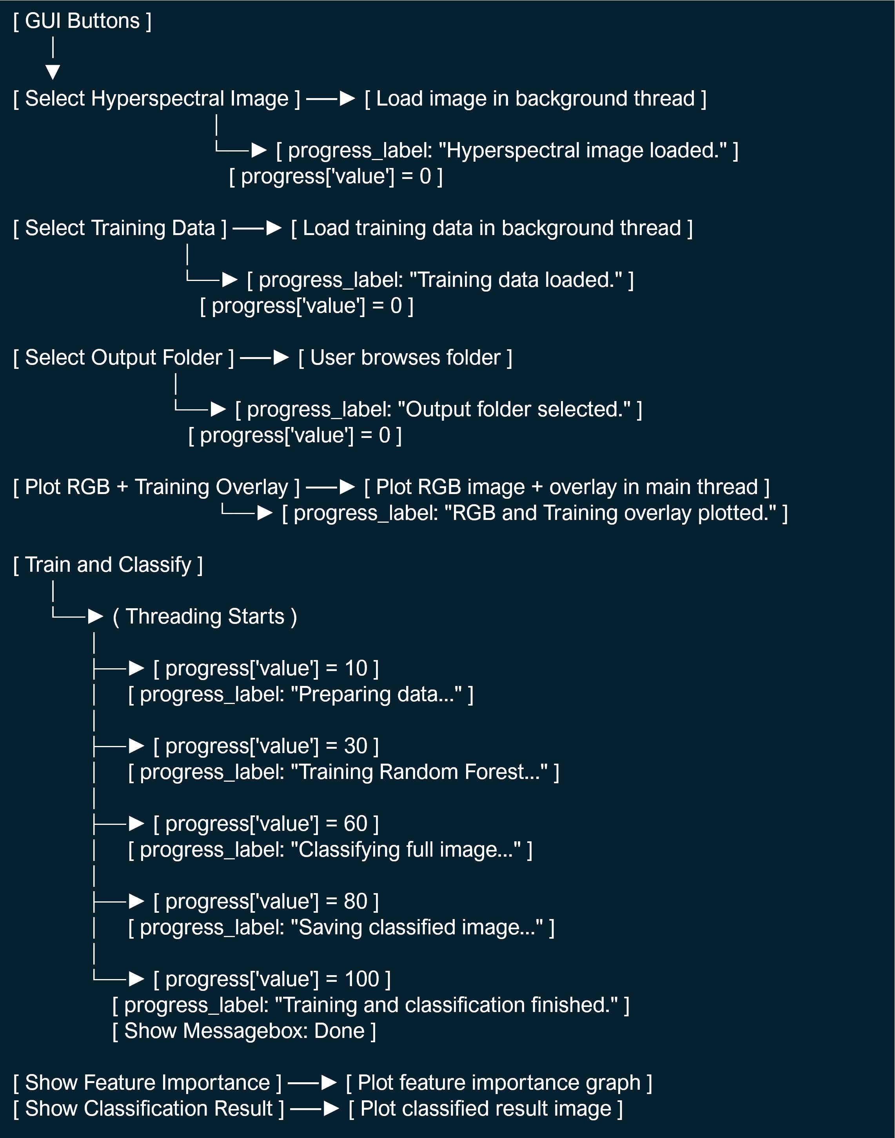
Drawing a workflow diagram in your head.

Slide 7
PHASE 2: start building gui body
import tkinter as tk
from tkinter import filedialog
# --- Start GUI at the END of the script ---
root = tk.Tk()
root.title("Simple Hyperspectral GUI")
tk.Button1(root, text="Load Image", command=…)
tk.Button2(root, text="Plot RGB Composite", command=…)
root.mainloop()

Slide 8
Phase 3: Refactor into functions step by step
# --- Clean function-based, still no class ---
def load_image():
global img_data
img_path = filedialog.askopenfilename(filetypes=[("TIFF files", "*.tif")])
img = rasterio.open(img_path)
img_data = img.read()
print("Image loaded:", img_path)
def plot_rgb_overlay_button():
bands = [int(b) for b in rgb_entry.get().split(',')]
R = img_data[bands[0]-1]
G = img_data[bands[1]-1]
B = img_data[bands[2]-1]
rgb = np.dstack((R, G, B))
rgb_norm = rgb / rgb.max()
plt.figure(figsize=(10, 8))
plt.title("RGB Composite")
plt.imshow(rgb_norm)
plt.axis('off')
plt.show()
# --- GUI Skeleton now connects to clean functions ---
root = tk.Tk()
root.title("Simple Hyperspectral GUI")
tk.Button(root, text="Load Image", command=load_image).pack()
tk.Button(root, text="Plot RGB Composite", command=plot_rgb).pack()
root.mainloop()

Slide 9
How to decide which variables should be global?
✅ Rule 1:
If the variable must be accessed by multiple independent functions or GUI buttons, make it global.
Example | Why global?
img, img_data, rows, cols | Loaded once by the user and needed in multiple functions (plotting, training, classification)
train_data | Loaded once, used for training and overlay
model | Needs to be reused after training by classification or plotting feature importance
preds_img | Needs to be accessed by 'Show Mapping Result' button after classification is done
output_dir | Set once, used by both training and classification functions
trained_X_columns | Captured during training, required later by feature importance and classification

Slide 10
How to decide which variables should be global?
✅ Rule 2:
If a variable is only needed inside 1 function (temporary computation), keep it local.
Example (local inside run_train_and_classify)
selected_bands
X_all, y_all, dfAll, dfAll_sampled, X, y
X_train, X_test, y_train, y_test
conf_mat

Slide 11
VISUAL DECISION FLOW
Is the variable set by user or by a button?
|
➡ YES ➡ Will other buttons/functions need it later?
|
➡ YES ➡ Make it global
➡ NO ➡ Keep it local
➡ NO ➡ Temporary calculation ➡ Keep it local

Slide 12
How to decide which variables to put inside ( ) in def function()?
✅ Rule 1:
If the variable is needed only inside the function and is not global ➡ pass it explicitly via ( ).
✔ Example
def classify_full_image(selected_bands, model, X_columns):
➡ These are needed inside the function, but not global (or you want to avoid globals)
Why?
Keeps the function clean, modular, and reusable anywhere.
Does not depend on outside variables or GUI state (safer).

Slide 13
How to decide which variables to put inside ( ) in def function()?
✅ Rule 2:
If the variable is set as global (like img_data, rows, cols) ➡ you can choose to not pass it, and let the function access it as global.
✔ Example
img_data is always loaded globally when you load the hyperspectral image.
You could access it directly inside functions without passing it as parameter.

Slide 14
How to decide which variables to put inside ( ) in def function()?
✅ Rule 3 (if unsure):You can always start by using global inside function, and later when you modularize, decide to pass as parameter if multiple variables are needed.
✅ When not sure?
✔ Option 1: Use global carefully inside function. ✔ Option 2 (Recommended Best Practice): Pass everything needed in ( ). ✔ Option 3 (Lazy but cleanable later): Start with global and refactor later to clean parameterized functions.

Slide 15
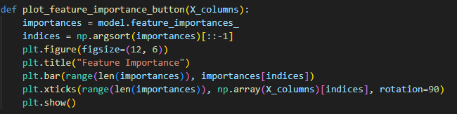
Why only X_columns inside ( ), but importances, indices are NOT in ( )?
Variable | Why not passed? / Why passed? | Scope
X_columns | ✅ Passed inside ( ) because it's computed outside the function (in training step) and this function depends on it to plot band labels | Must pass explicitly
importances | Computed inside the function (model.feature_importances_) | Local inside function
indices | Computed inside the function (np.argsort(...)) | Local inside function
model | Uses global model, not passed (since model is trained and stored as global) | Global

