Slide 1

Duration: 120 min
Chungnam University
Graduate class
Remote Sensing
LoRA Training Workflow and 1st model build
October 1st 2025
By the end of this lecture you can:
Turn I-A pairs into a machine-ready dataset (JSONL) with splits, token budgets, and validation.
Choose LoRA / QLoRA / Full FT based on VRAM and objectives.
Run a first fine-tune on a local GPU (or CPU if needed), monitor, evaluate, and export.
Plan incremental LoRA with replay sets to avoid catastrophic forgetting.

Slide 2
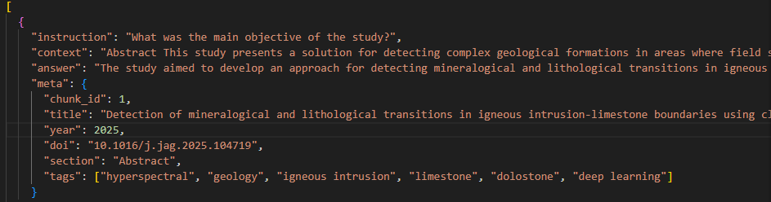
Previous lecture
In Week 4, we focused on data preparation for fine-tuning:
Extracted raw content from mixed file formats (.pdf, .docx, .txt, etc.).
Cleaned and formatted text (removing noise, normalizing).
Chunked text with overlap for context preservation.
Added metadata for traceability.
Built Instruction–Answer (I-A) pairs (I-A).
At this point, you now have a collection of human-checked I-A pairs. This week, we will continue the pipeline by turning that dataset into a fine-tuned model.

Slide 3
This Week’s Focus
Dataset Preparation
Convert I-A pairs into JSONL format.
Check token lengths and dataset quality.
Model Selection
LoRA, QLoRA, or Full Fine-Tuning?
Hardware/VRAM trade-offs.
Running Fine-Tuning
Training setup, parameters, logging.
Monitoring loss & avoiding instability.
Evaluation
Automatic metrics (loss, perplexity).
Human evaluation with rubrics.
Saving & Exporting Models
Saving LoRA adapters.
Optional merging into full weights.
Deployment
Using Chatbox or Ollama for inference.
Testing on domain-specific prompts.

Slide 4
Dataset Preparation
3.1 Required JSON Structure
Each line of the training file must contain:
system → defines the assistant’s role and tone.
instruction → the question/task.
context → (optional) background text from your paper or chunk.
answer → the gold standard response.
meta → metadata (for traceability, not used in training).
{
"system": "You are a geology and hyperspectral remote sensing assistant.",
"instruction": "What was the main objective of the study?",
"context": "Abstract This study presents a solution for detecting complex geological formations in areas where field surveys are difficult or impossible...",
"answer": "The study aimed to develop an approach for detecting mineralogical and lithological transitions in igneous intrusion-limestone boundaries using close-range hyperspectral remote sensing, supported by petrographic, chemical, and spectral analyses.",
"meta": {
"chunk_id": 1,
"title": "Detection of mineralogical and lithological transitions in igneous intrusion–limestone boundaries using close-range hyperspectral remote sensing: a resource perspective",
"year": 2025,
"doi": "10.1016/j.jag.2025.104719",
"section": "Abstract",
"tags": ["hyperspectral", "geology", "igneous intrusion", "limestone", "dolostone", "deep learning"]
}
}

Slide 5
Dataset Preparation
3.2 Why add system here?
Without system:
The model only learns Q&A mappings. Tone/style is enforced only at runtime (Chatbox/Ollama system prompt).
With system:
The model learns the role during training. This makes it more consistent, especially if you export to different environments (Python, APIs, other GUIs).
So:
If you are training for a general-purpose Q&A assistant, you can skip the system line.
If you want the model to always roleplay as something specific (teacher, coding tutor, geology expert), adding system in training makes its style more stable across deployments.

Slide 6
Dataset Preparation
Why not rely only on Chatbox system prompt?
Chatbox system prompt is a runtime wrapper: it tells the model how to behave at inference.
But if the model was never trained with that style, sometimes it ignores or drifts from your system prompt.
If you bake the role into training (system line), the model naturally learns the tone/role, and Chatbox prompt just reinforces it.

Slide 7
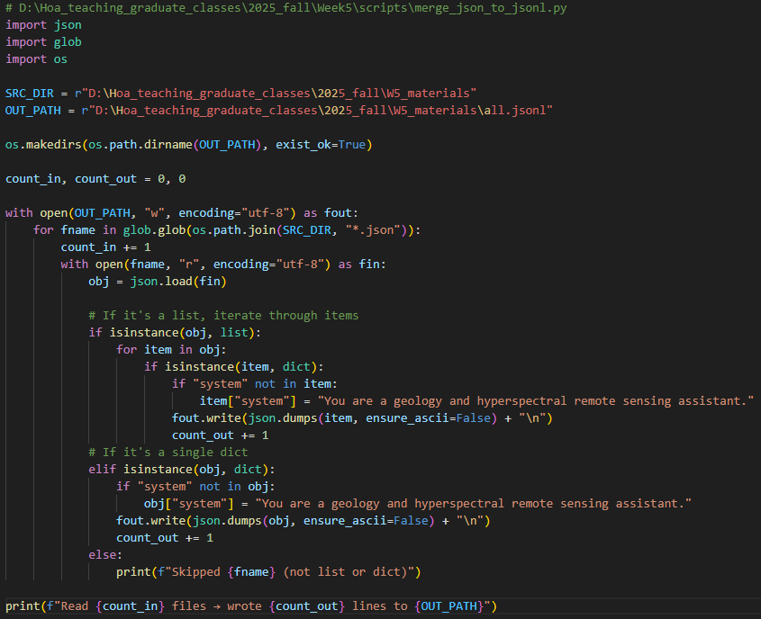

Dataset Preparation
3.3 Merge all .json files → one .jsonl file

Slide 8
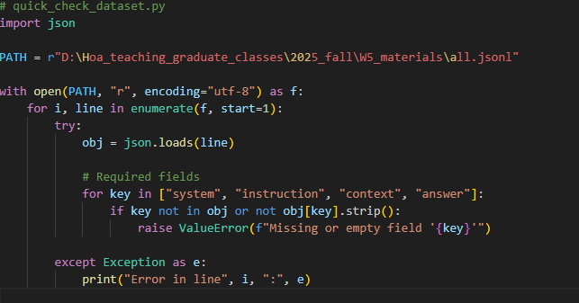
Dataset Validation
Before training, we need to check the dataset’s integrity. Ensures every row has system, instruction, context, and instruction.
system → makes the assistant role consistent.
instruction → the task/question.
context → grounding text (without this, training is not domain-specific).
answer → gold reference.

Slide 9
Model Selection
For fine-tuning, we need a base model. In this course, we will use Llama-3.1:8B (Meta’s open LLM).
But there’s a catch:
The model you downloaded with Ollama (.gguf files) is only for inference.
To fine-tune, we need the model in Hugging Face format (PyTorch or safetensors).

Slide 10

What is Hugging Face (HF)?
Hugging Face is an AI platform and open-source community.
Think of it as GitHub for AI models & datasets.
It provides:
Model Hub → thousands of pre-trained models (LLMs, vision models, etc.).
Transformers library → Python code to load/train LLMs.
Datasets library → efficient dataset loaders (JSON, CSV, Parquet, etc.).
Spaces → deploy ML demos.
For us: Hugging Face is where we download Llama-3.1:8B weights in a format usable for LoRA fine-tuning.

Slide 11
Why not just Ollama?
Ollama models = .gguf format → optimized for inference with llama.cpp backend.
Hugging Face models = PyTorch/safetensors → required for LoRA/QLoRA fine-tuning.
That’s why:
Use HF model for fine-tuning.
Use Ollama model for inference demos.
Why HF Access is Needed?
Some models (like Meta’s Llama family) are restricted:
You must agree to Meta’s license before downloading.
Hugging Face enforces this with an Access Request.
Steps to request access:
Create a free account at huggingface.co.
Go to the model page: meta-llama/Meta-Llama-3.1-8B
Click “Access request”.
Read and accept the license agreement.
Wait for approval (usually 1–2 hours, sometimes longer).
Once approved, you can download and fine-tune.

Slide 12
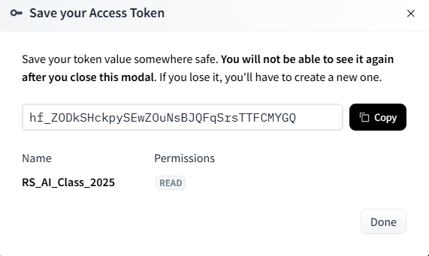
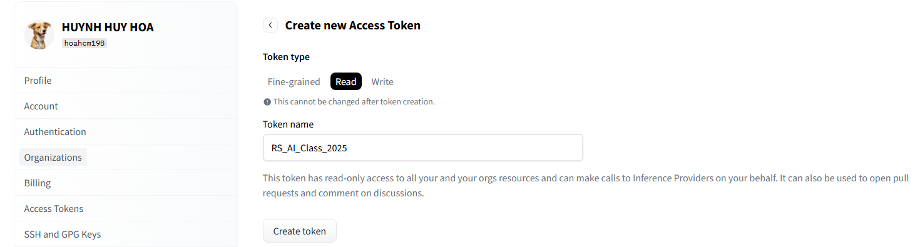
Hugging Face User Access Token
When using Hugging Face models from Python, you need a personal access token:
This token verifies you have permission to download restricted models.
It works like a password for Hugging Face’s API.
How to get it:
Log in at https://huggingface.co/settings/tokens
Select “Create New Token”
Select role: Read
Token name: “RS_AI_Class_2025”
Create token
DO NOT SHARE YOUR TOKEN

Slide 13
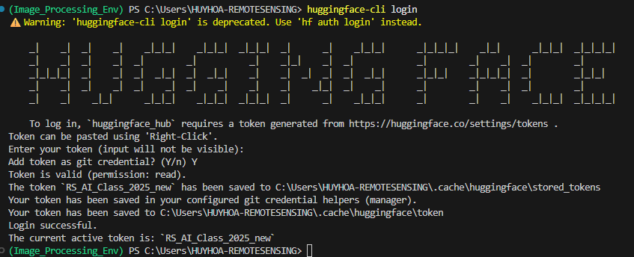
Fine-Tuning Execution
1. Install Libraries
pip install torch "transformers>=4.43" "datasets>=2.19" "peft>=0.11" "accelerate>=0.33" "bitsandbytes>=0.43" "huggingface_hub>=0.23"
2. Log in to Hugging Face in your environment
huggingface-cli login

Slide 14
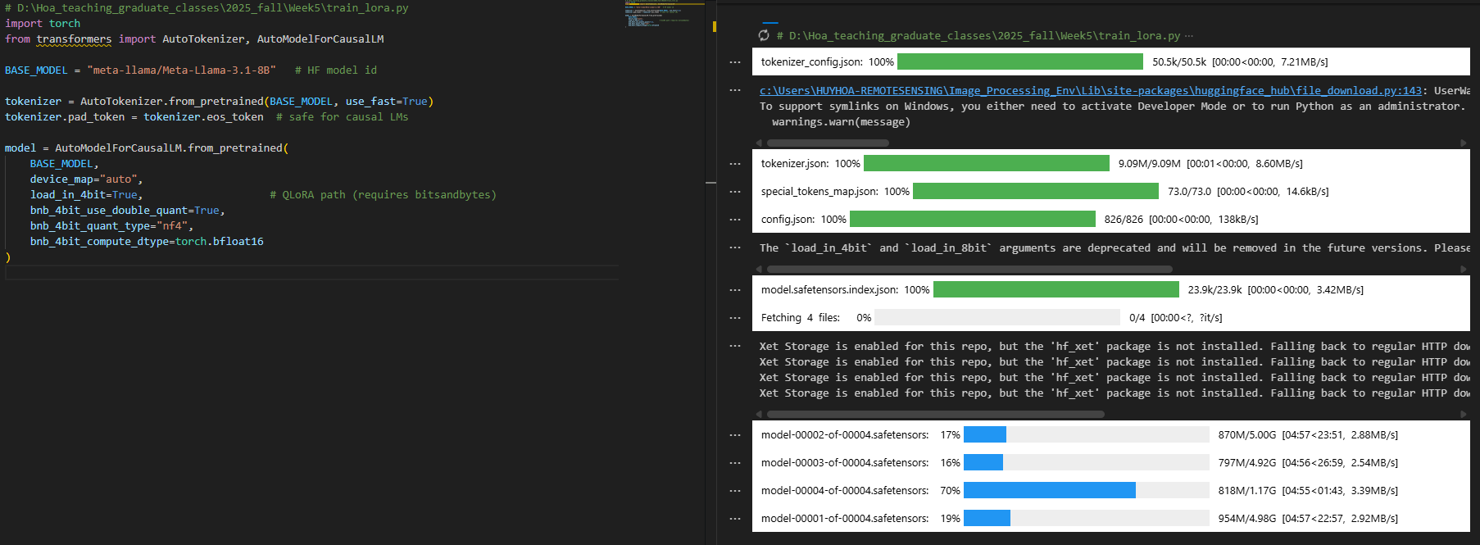
Fine-Tuning Execution
3. Load the base LLM (QLoRA, 4-bit)
device_map="auto" → spreads layers onto your GPU automatically.
load_in_4bit=True → QLoRA memory savings (base weights quantized).
bnb_4bit_* → standard QLoRA recipe (NF4 + double quant + bf16 compute).

Slide 15
Fine-Tuning Execution
4. LoRA configuration
r (rank): Capacity of the adapter matrices. Higher = more expressive updates.
Typical ranges: 8 – 32 (defaults we used: 16)
Larger r → Better fit, but more VRAM and higher overfitting risk
from peft import LoraConfig, get_peft_model, TaskType
lora_cfg = LoraConfig(
task_type=TaskType.CAUSAL_LM,
r=16,
lora_alpha=32,
lora_dropout=0.05,
target_modules=[
"q_proj","k_proj","v_proj","o_proj",
"gate_proj","up_proj","down_proj"
]
)
model = get_peft_model(model, lora_cfg)
Scales LoRA update magnitude; interacts with r. Typical ranges: 16–64 (we used 32). Symptoms & fixes:
Model updates too timid (no improvement) → increase to 48–64
Model gets unstable/verbose → decrease to 16–24 (or lower LR)
Overfitting (train loss ↓ fast, eval/manual quality not improving) → 0.05–0.1
Underfitting (hard to learn even simple tasks) → 0.0–0.03
Which linear layers receive LoRA adapters

Slide 16
Fine-Tuning Execution
5. Load your training JSONL + format
from datasets import load_dataset
DATA_PATH = r"D:\Hoa_teaching_graduate_classes\2025_fall\Week5\data_ready\all.jsonl"
raw = load_dataset("json", data_files=DATA_PATH)["train"]
def format_row(r):
# Validate required fields
for key in ["system", "instruction", "context", "answer"]:
if key not in r or not str(r[key]).strip():
raise ValueError(f"Missing/empty '{key}' in record: {r.get('meta',{})}")
system = r["system"].strip()
ins = r["instruction"].strip()
ctx = r["context"].strip()
ans = r["answer"].strip()
prompt = f"{system}\n\nInstruction: {ins}\nContext: {ctx}\nAnswer:"
return {"prompt": prompt, "label": ans}
ds = raw.map(format_row)

Slide 17
Fine-Tuning Execution
6. Tokenize and sample packing (control length, stability and memory)
What it is: Hard cap on tokens for prompt + answer. Why it matters: Longer sequences explode memory/time. Tune:
OOM or slow epochs → 1536 or 1024
def tokenize(batch):
enc_prompt = tokenizer(batch["prompt"], truncation=True, max_length=2048)
enc_label = tokenizer(batch["label"], truncation=True, max_length=2048)
input_ids = enc_prompt["input_ids"] + enc_label["input_ids"]
attention = [1] * len(input_ids)
# Mask prompt tokens so loss is computed only on the answer part
labels = [-100] * len(enc_prompt["input_ids"]) + enc_label["input_ids"]
return {"input_ids": input_ids, "attention_mask": attention, "labels": labels}
tok_ds = ds.map(tokenize, remove_columns=ds.column_names)
Assignment: Understanding each parameters and make a presentation

Slide 18
Fine-Tuning Execution
7. Training configuration
from transformers import TrainingArguments, Trainer, DataCollatorForLanguageModeling
args = TrainingArguments(
output_dir=r"D:\Hoa_teaching_graduate_classes\2025_fall\Week5\runs",
num_train_epochs=1,
per_device_train_batch_size=1,
gradient_accumulation_steps=16,
learning_rate=2e-4,
warmup_ratio=0.03,
lr_scheduler_type="cosine",
logging_steps=20,
save_steps=500,
save_total_limit=2,
bf16=True, # or fp16=True if needed
evaluation_strategy="no" # set to "steps" and add a val set if you want live eval
)
collator = DataCollatorForLanguageModeling(tokenizer, mlm=False)
trainer = Trainer(
model=model,
args=args,
data_collator=collator,
train_dataset=tok_ds
)
trainer.train()
num_train_epochs=1 → start small; extend to 2–3 if val loss keeps improving.
per_device_train_batch_size=1 + gradient_accumulation_steps=16 → effective batch 16 with low VRAM.
learning_rate=2e-4 → standard for LoRA SFT (try 1e-4 if outputs look unstable/verbose).
warmup_ratio=0.03 + cosine → smooth LR behavior (fewer spikes).
bf16=True → faster & more stable on newer GPUs (use fp16=True if bf16 unsupported).
Assignment: Understanding each parameters and make a presentation

Slide 19
Fine-Tuning Execution
8. Save your LoRA adapter (for deployment/ use)
ADAPTER_DIR = r"D:\Hoa_teaching_graduate_classes\2025_fall\Week5\adapters\week5_lora_v01"
trainer.model.save_pretrained(ADAPTER_DIR)
tokenizer.save_pretrained(ADAPTER_DIR)
print("Saved adapter to:", ADAPTER_DIR)
You’ll load base model + this adapter for inference (Chatbox/HF Transformers). (Merging into full weights is optional and not needed for class.)
Assignment: Understanding each parameters and make a presentation

Slide 20
Fine-Tuning Execution
9. Quick test (generate once after training)
from transformers import pipeline
pipe = pipeline(
"text-generation",
model=model, # already has LoRA attached
tokenizer=tokenizer,
device_map="auto"
)
test_prompt = (
"You are a geology and hyperspectral remote sensing assistant.\n\n"
"Instruction: Summarize how dolomitization affected economic value in the study.\n"
"Context: Results show igneous intrusion reduced economic value by ~80% compared to pure limestone, "
"and hydrothermal alteration caused extensive dolomitization, transforming limestone into dolostone.\n"
"Answer:"
)
out = pipe(test_prompt, max_new_tokens=200, do_sample=False)
print(out[0]["generated_text"])
Assignment: Understanding each parameters and make a presentation

Slide 21
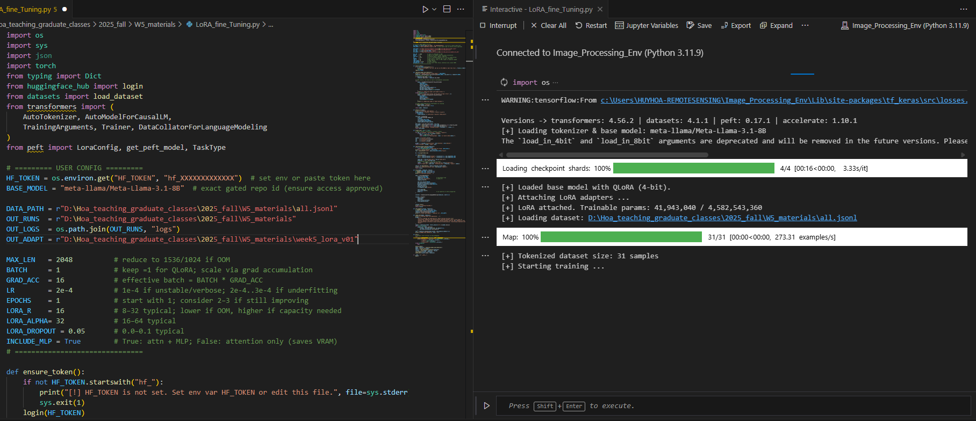
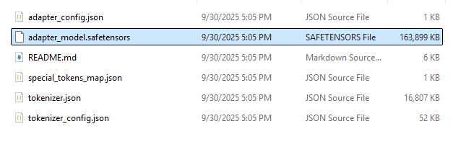
Fine-Tuning Execution

Slide 22
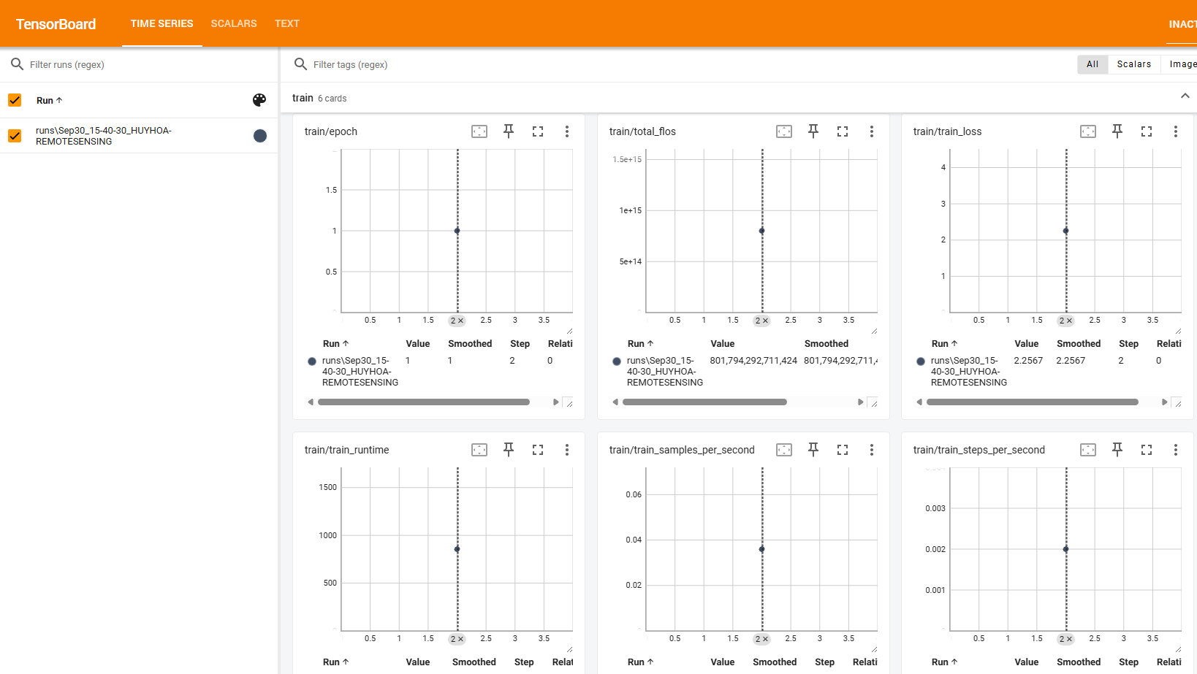
TENSOR BOARD

Slide 23
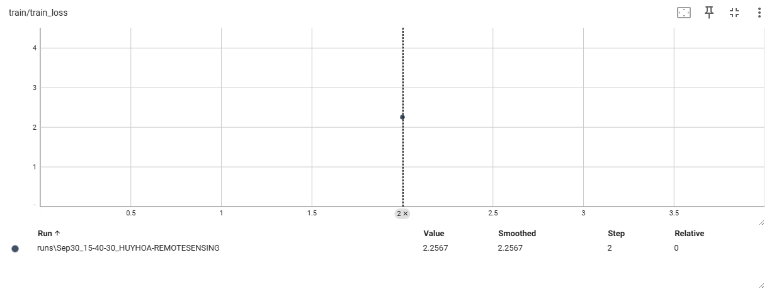
TENSOR BOARD

Slide 24
TENSOR BOARD
Cross-Entropy Loss (per token) | Perplexity (≈ e^loss) | Interpretation | Next step
>5.0 | >150 | Random guessing / not learning | Bad. Check dataset, learning rate, or tokenization.
3.0 – 5.0 | 20 – 150 | Very poor fit | Model still confused. Needs more data or better setup.
2.0 – 3.0 | 7 – 20 | Learning but weak | 😐 Okay start. Acceptable in very technical/small datasets. Try more epochs.
1.5 – 2.0 | 4.5 – 7.4 | Decent fit | 🙂 Model is capturing patterns. Often “good enough” for small LoRA fine-tunes.
1.0 – 1.5 | 2.7 – 4.5 | Strong fit | ✅ Good. Indicates model is adapting well without severe overfitting.
0.5 – 1.0 | 1.6 – 2.7 | Very strong fit | ⚠️ Watch validation loss: may be overfitting if val_loss doesn’t also decrease.
<0.5 | <1.6 | Near perfect memorization | 🚩 Likely overfit. Model may just memorize training samples.

Slide 25
Assignment
Week 5 – Assignment | RS_AI_Class_2025

