Slide 1

Duration: 60 mins
Chungnam University
Graduate class
Remote Sensing
Incremental LoRA Training with Replay Sets
October 21st 2025
By the end of this lecture, you can:
Resume LoRA fine-tuning from the last checkpoint safely.
Merge new training data with a replay set from old data.
Choose stable training parameters to prevent instability.
Identify the difference between overfitting and true improvement using logs and validation metrics

Slide 2

Concept Overview – What is Incremental LoRA Training ?
1.1. Background: The Challenge of Continual Learning
When fine-tuning a model multiple times on different datasets, a common problem occurs called Catastrophic Forgetting - the model forgets previously learned information once it is trained on new data.
For example:
After fine-tuning a model on geological terms, if we later fine-tune on remote sensing scripts, the model may forget geology terms entirely.

Slide 3
Concept Overview – What is Incremental LoRA Training ?
1.2. Solution: Incremental Training
Incremental (Continual) Training = continue fine-tuning a model by combining new knowledge with previous knowledge.
Instead of starting from scratch, you:
Load the previous checkpoint of LoRA fine-tuning.
Add new data.
Resume training using the same or slightly modified hyperparameters.
1.3. Why Use LoRA for Incremental Training?
LoRA (Low-Rank Adaptation) modifies only a small set of parameters inside large pre-trained models. This makes it ideal for incremental updates because:
It’s lightweight (less GPU memory).
It preserves original model weights.
You can combine multiple adapters for multi-domain learning.
🧩 Example analogy: Think of LoRA adapters as “plug-ins” — you can plug in different adapters for different datasets, or combine them when retraining with replay data.

Slide 4
Concept Overview – What is Incremental LoRA Training ?
1.3. Why Use LoRA for Incremental Training?
LoRA (Low-Rank Adaptation) modifies only a small set of parameters inside large pre-trained models. This makes it ideal for incremental updates because:
It’s lightweight (less GPU memory).
It preserves original model weights.
You can combine multiple adapters for multi-domain learning.
🧩 Example analogy: Think of LoRA adapters as “plug-ins” — you can plug in different adapters for different datasets, or combine them when retraining with replay data.

Slide 5
Concept Overview – What is Incremental LoRA Training ?
1.4. Should we merge new data with old data?
There are two main approaches to incremental LoRA training:
Strategy | Description | When to Use | Pros | Cons
A. New Data Only | Train the previous adapter further using only new data. | When new data represents a new domain or when you want the model to focus only on the latest topic. | Simpler, faster, minimal data handling. | May cause forgetting of previous knowledge.
B. Merged Data (New + Replay) | Combine the new data with a small random subset (10–30 %) of the old data. | When you want the model to remember previous abilities while learning new ones. | Prevents forgetting, improves generalization. | Requires data preparation and slightly longer training.
Scenario | Dataset for Week 6 | Result
Only new data | new_data.jsonl | Learns new domain fast, but old tasks may degrade.
Merge new + replay | merged_dataset.jsonl | Slower, but maintains both old and new skills.

Slide 6
Incremental vs. Replay – What’s the Difference?
Concept | What It Means | Do We Load Old Adapter? | Do We Use Old Data? | Purpose
Incremental Training | Continue fine-tuning the same LoRA adapter from the previous checkpoint. | Yes | Not required | Extend model knowledge with new data.
Replay Training | Incremental + add small portion of old data to avoid forgetting. | Yes | Yes (10–30 %) | Preserve previous knowledge while adding new.
If you load the Week 5 adapter and train on Week 6 data, you are already doing incremental LoRA training.
If you also include some Week 5 samples in the new dataset, you are doing incremental + replay training.
Both are valid continual fine-tuning strategies.

Slide 7
Incremental vs. Replay – What’s the Difference?
Key Takeaways
Incremental LoRA training = resuming from last LoRA weights (even without merging data).
Replay is optional — a stability trick to prevent forgetting, not a requirement.
Both approaches are incremental because you are extending the previous adapter instead of starting over.
Merging datasets is recommended only when your goal is to preserve past performance across multiple domains.
If your goal is rapid specialization, skip merging and use only new data.

Slide 8
How to test your Fine-Tuning Adapter?
There are several GUI interfaces that can dynamically load both a base model and a LoRA adapter.
🧩 1. Text Generation WebUI (oobabooga / Koboldcpp style)
🔹 Overview
This is the most popular and flexible GUI for working with LoRA adapters. It’s built on top of Hugging Face Transformers and PEFT, so it natively supports base models and LoRAs.
Website: https://github.com/oobabooga/text-generation-webui
🔹 Key Features
Load base models (LLaMA, Mistral, Falcon, etc.)
Dynamically attach/detach LoRA adapters during runtime (no merge needed).
Combine multiple adapters.
Control LoRA scaling strength (e.g., apply 0.5× adapter influence).
GUI sliders for temperature, top-p, top-k, etc.
Works on Windows / macOS / Linux (with or without GPU).

Slide 9
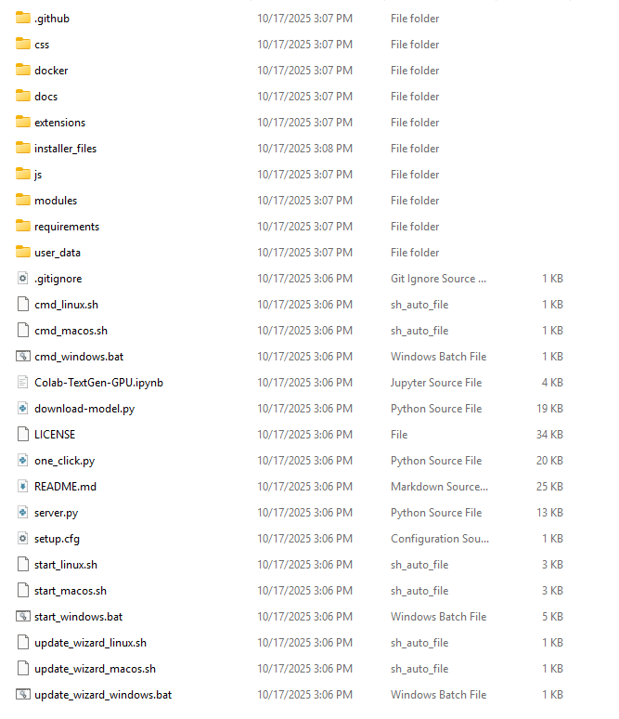
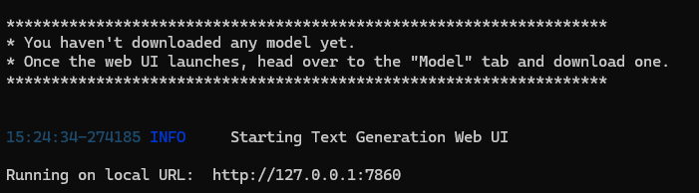
How to use ?

Slide 10
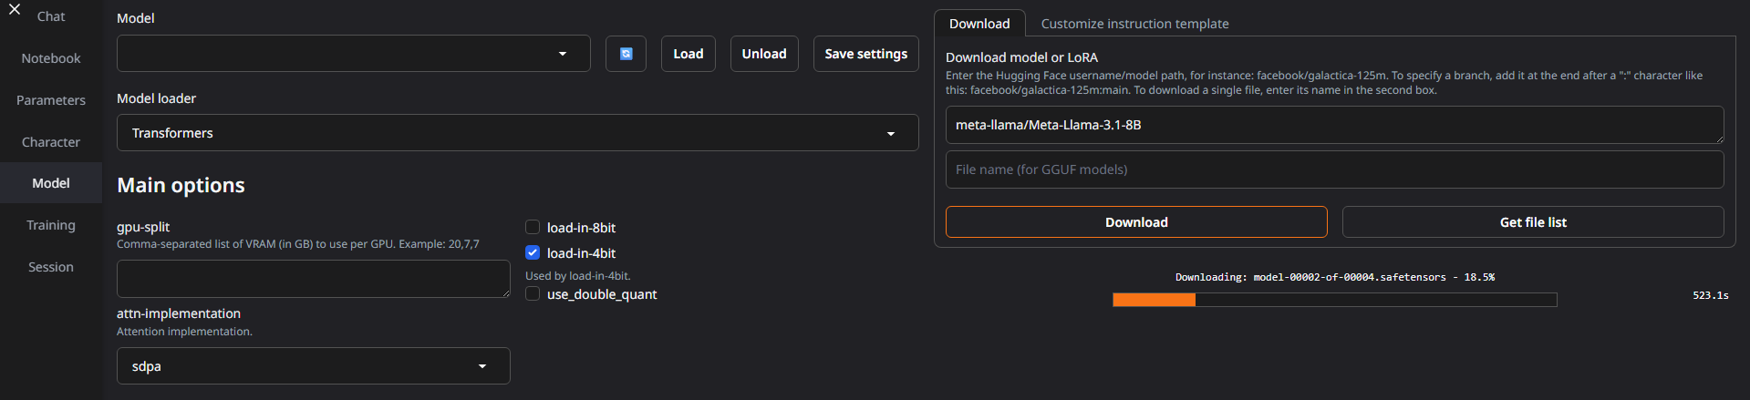
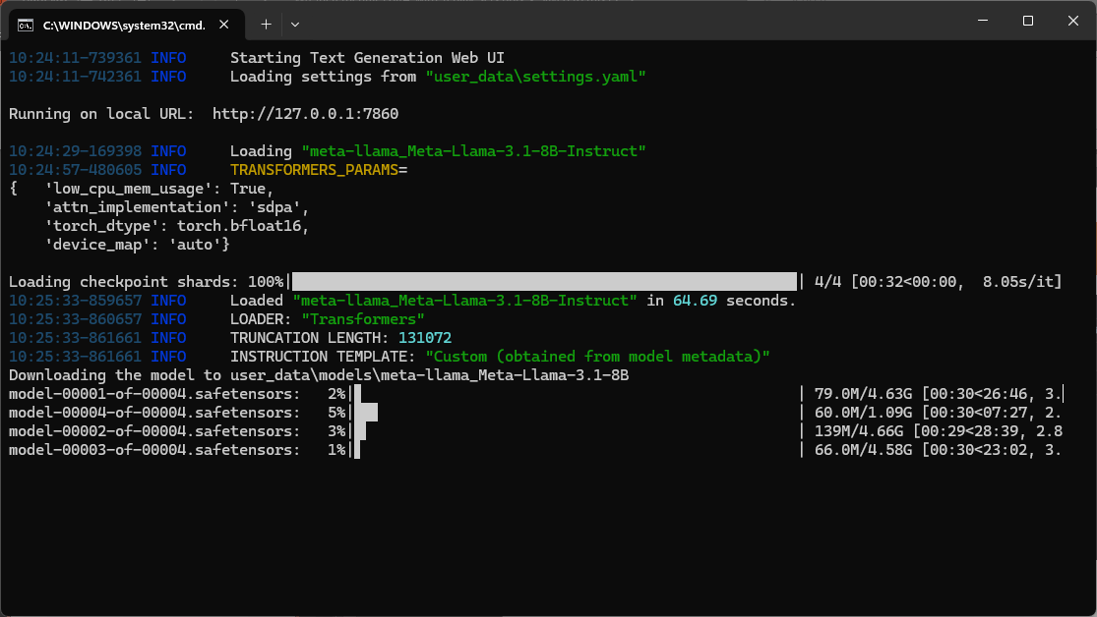
How to use ?

Slide 11
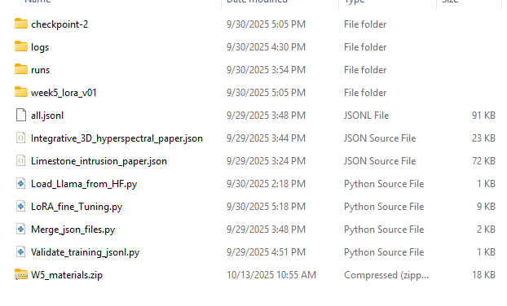
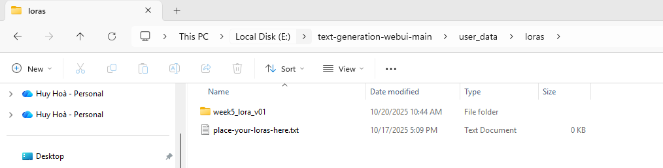
How to import local LoRA adapter ?

Slide 12
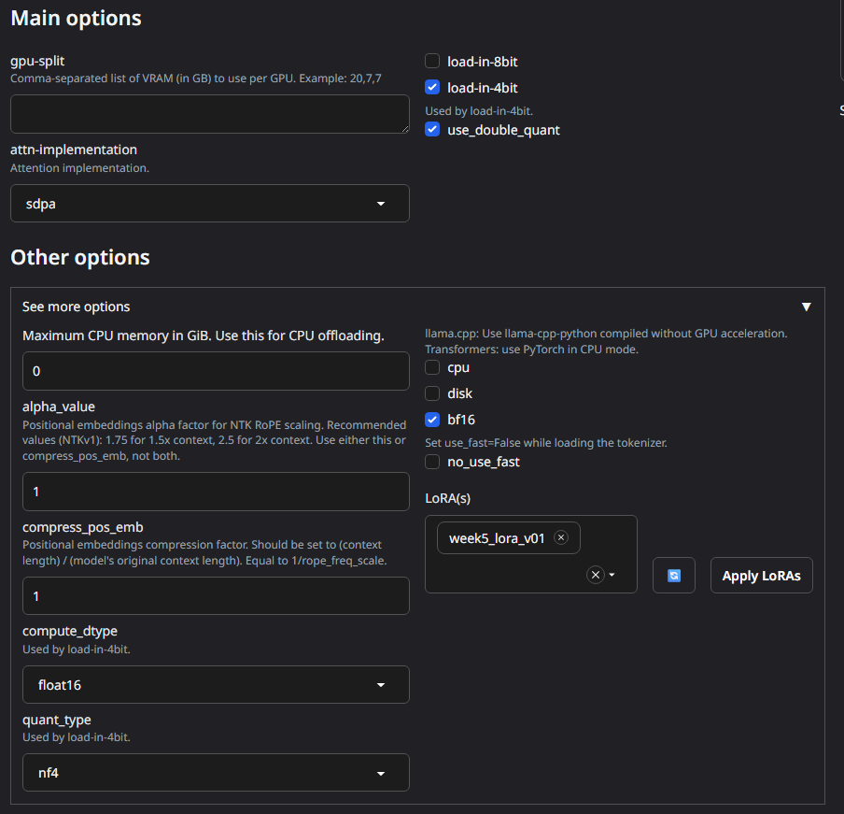

How to import local LoRA adapter ?

Slide 13
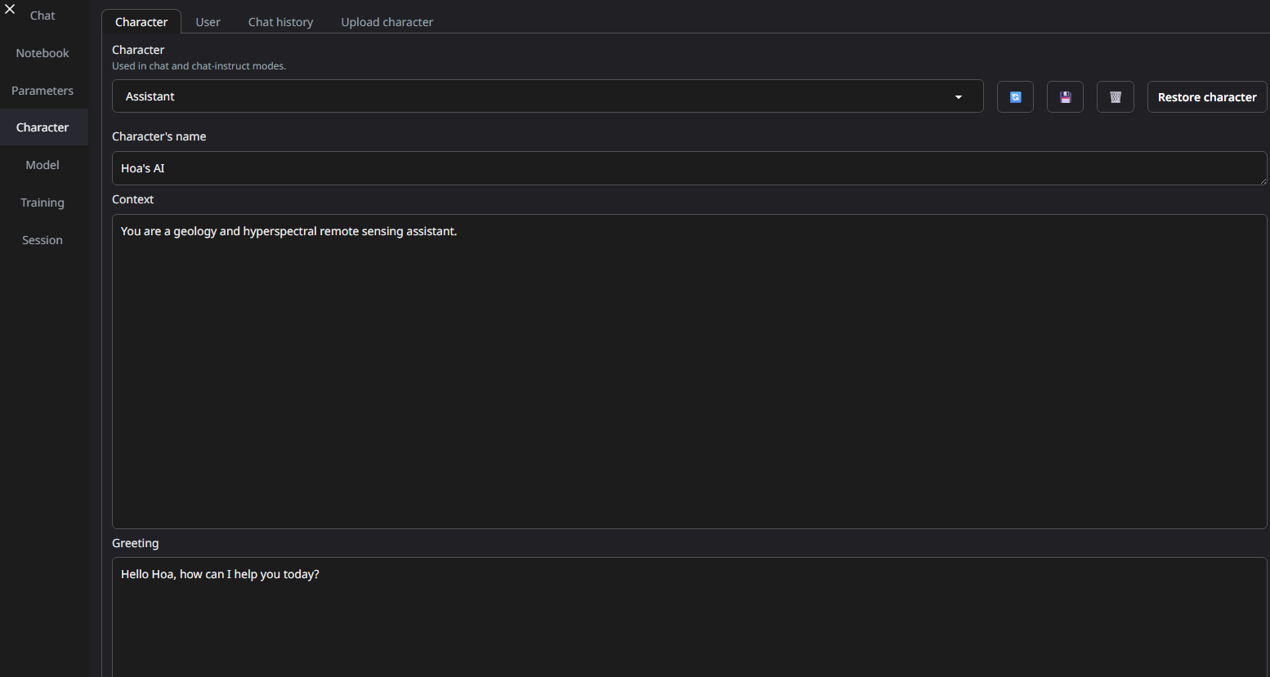
Define Character

Slide 14
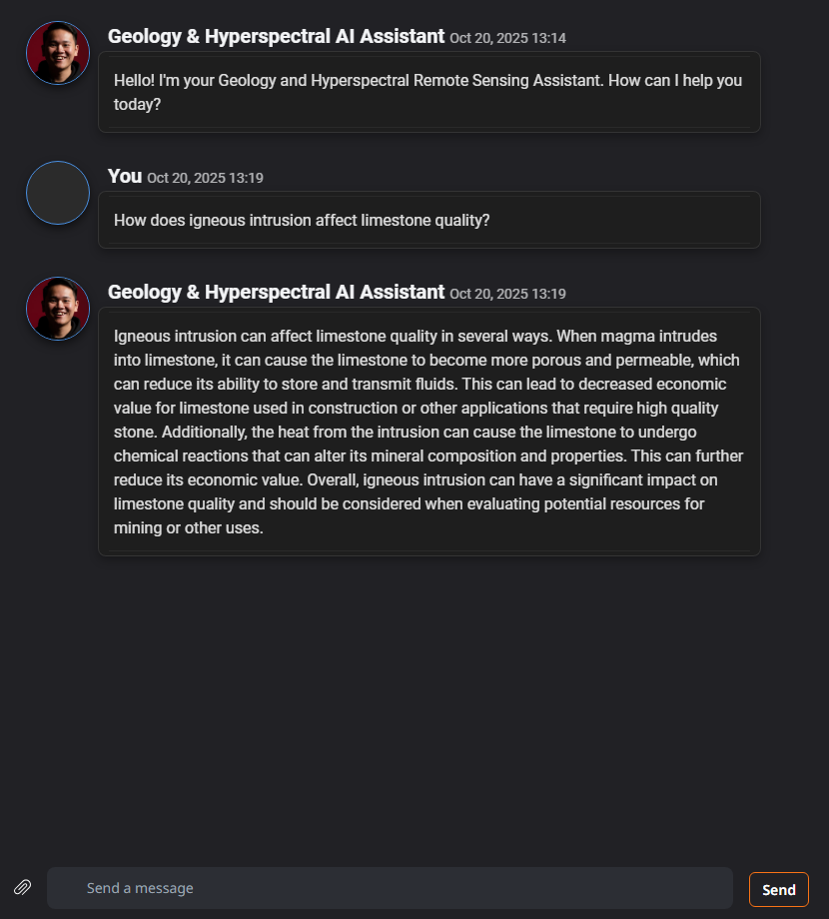
Test Fine Tuning (No adapter)

Slide 15
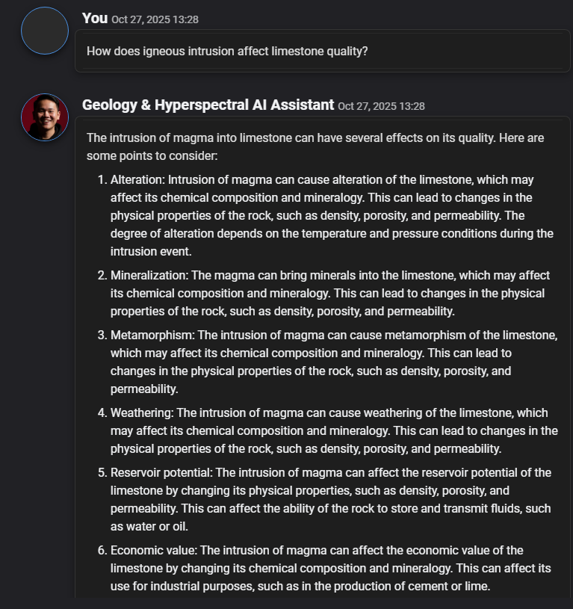
Test Fine Tuning (LoRA Adapter)
NO ADAPTER

Slide 16
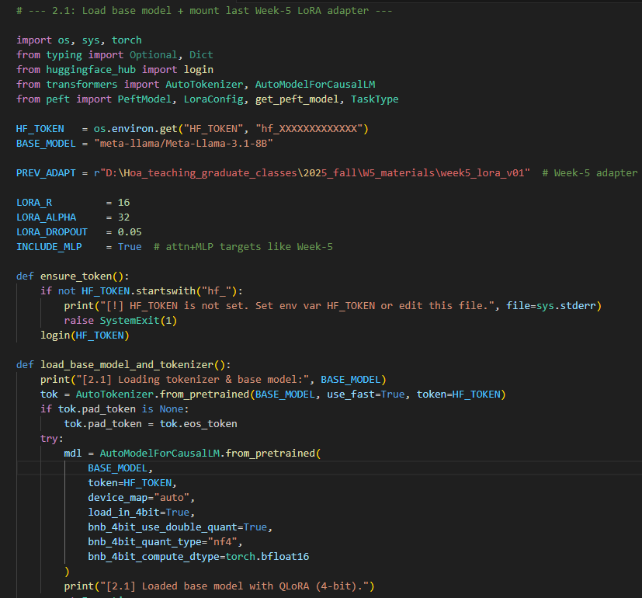
Resuming from Last Checkpoint
2.1 Load the base model and mount the last Week-5 LoRA adapter
When continuing training, you want to start from the LoRA weights you already learned, not from scratch. This preserves what the model already learned. If the adapter folder is missing (e.g., moved), we attach a fresh LoRA head with the same target modules so training can proceed anyway.
Key points:
Keep the same BASE_MODEL and tokenizer.
Try to load in 4-bit (QLoRA); if that fails, fall back to fp16.
Disable use_cache for training.
Load the Week-5 adapter (best) or attach a fresh LoRA (fallback).

Slide 17
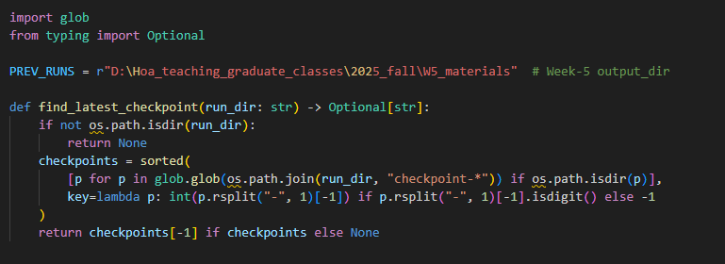
Resuming from Last Checkpoint
2.2 Restore the optimizer/ scheduler state from the lastest trainer checkpoint
Loading the adapter gives you the weights, but your optimizer state (momentum, LR scheduler position) is also important for a faithful resume. If you have HF Trainer checkpoints (e.g., checkpoint-1500), restore from the latest one. If they don’t exist, just continue from the adapter.
Key points:
Look inside your Week-5 output_dir for checkpoint-*.
If found, call trainer.train(resume_from_checkpoint=that_checkpoint).
If not, call trainer.train() (it will “resume” from the loaded adapter weights only).

Slide 18
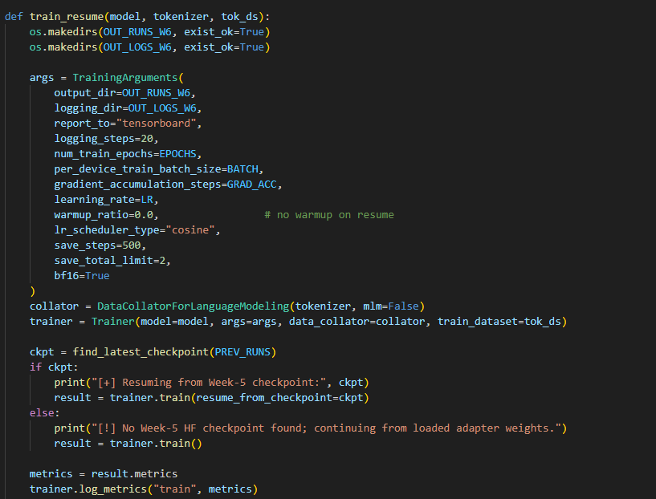
Resuming from Last Checkpoint
2.3 Use stable incremental hyperparameters, log everything, and save to Week 6 folder
Incremental training should be gentle: smaller LR, no warmup (you warmed up already in Week-5), short epochs, and clean Week-6 output directories to avoid mixing Week-5 logs.
Key points:
LR: lower (e.g., 1e-4) for stability.
warmup_ratio=0.0 (already warmed in Week-5).
Keep BATCH=1 + GRAD_ACC if you used QLoRA.
Save loss CSV for quick QA; write all to W6 directories.

Slide 19
Assignment
Week 6 – Assignment | RS_AI_Class_2025

