Slide 1

Duration: 60 mins
Chungnam University
Graduate class
Remote Sensing
Advanced system prompts and prompt chaining
November 12th 2025
By the end of this lecture, you can:
Explain the difference between System Prompt, User Prompt, and Assistant Output.
Design a system prompt to control model tone, style, and task boundaries.
Apply prompt chaining to divide complex workflows into logical sub-prompts.
Implement multi-step reasoning in Python for data and text tasks.
Integrate system prompts and chaining into LoRA fine-tuned models.

Slide 2
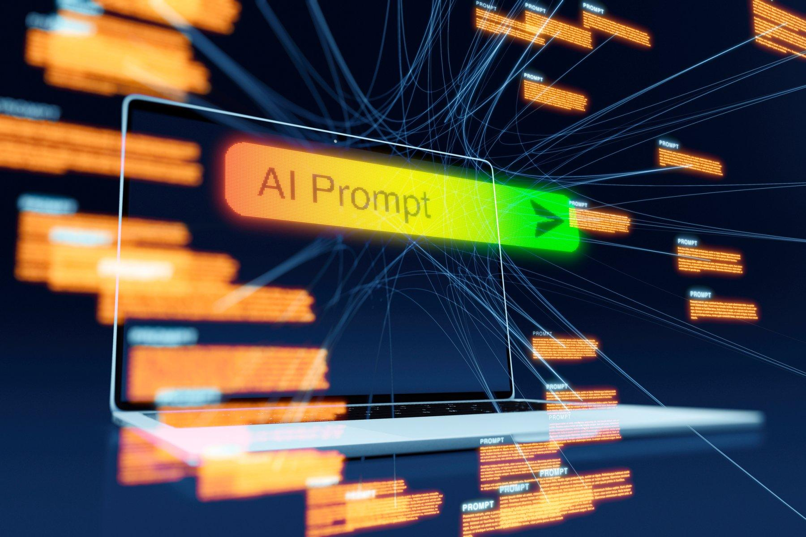
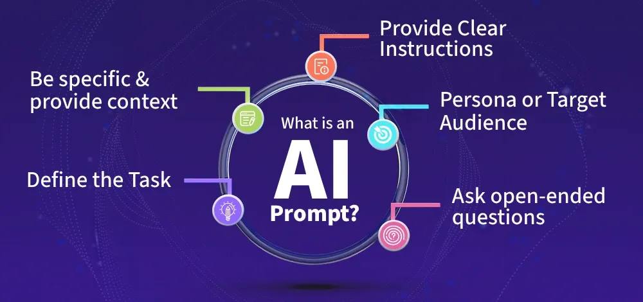
Concept Overview – What is Prompt in AI ?
A prompt is any input text given to a large language model (LLM) to make it perform a task. It works like a conversation setup — you tell the model what you want, and it generates text accordingly.
Prompts can include:
Instructions (what to do)
Context (background info)
Examples (how to do it)
Constraints (what not to do)
Think of a prompt as both a question and a command to an intelligent system.

Slide 3
The Three Roles in a Chat Model
In OpenAI-style chat models (and most modern LLMs), every message has a role:
Role | Description | Example
System | Defines identity, behavior, and rules of the AI | “You are a hyperspectral remote sensing assistant specialized in geology.”
User | Provides input or asks a question | “Explain how to detect sericite using SWIR bands.”
Assistant | Generates a response based on the above | “Sericite can be identified by absorption near 2.2 µm…”

Slide 4
The System Prompt – The "Personality" or "Operating System" of the AI
The System Prompt is the very first instruction that tells the model who it is and how to behave. It sets the rules, tone, and limits for the conversation.
Without a strong system prompt, the model behaves like a general-purpose chatbot.
With a well-crafted system prompt, it becomes a specialized assistant — for example, your Remote Sensing AI Assistant.
Purpose of a System Prompt:
Defines identity (e.g., “You are a spectral analyst.”)
Controls style (e.g., “Explain using numbered steps and cite references.”)
Enforces boundaries (e.g., “Do not include speculative or personal comments.”)
Guides formatting (e.g., “Output tables in Markdown.”)
So, it’s like the operating system layer of your AI — the hidden rules behind every conversation.

Slide 5
Prompt Chaining – The “Pipeline Thinking” of AI
Most AI tasks are too complex for a single prompt.
Prompt chaining means breaking down a big problem into smaller, sequential steps, where the output of one step becomes the input for the next. Instead of one model solving everything, we simulate a pipeline of specialized AIs, each doing one step, passing results to the next.
Step | Role | Task | Example Output
1 | Spectral Analysis | Extract key spectral features | “Absorption at 2210 nm and 2340 nm detected.”
2 | Rock Classifier | Identify rocks based on features | “Likely igneous with carbonate rock.”
3 | Geologist | Write geological interpretation | “This indicates metasomatic interactions between the dyke and host carbonates.”

Slide 6
Prompt Chaining – The “Pipeline Thinking” of AI
Each step uses a different system prompt or at least a different focus prompt, such as:
System: You are a hyperspectral spectral feature extractor.
User: Summarize absorption peaks and reflectance characteristics in this dataset.
→ Output is passed to next prompt:
System: You are a mineral classifier.
User: Identify minerals based on these features: [previous output]
→ Finally:
System: You are a geological report writer.
User: Write a report explaining the geological meaning of these minerals

Slide 7
Structural Difference
Aspect | Normal System Prompt | Prompt Chaining
Purpose | Define overall identity and tone | Divide a complex task into smaller reasoning steps
Flow | Single-step (input → output) | Multi-step (output of one → input of next)
Control | Global (same for all turns) | Local (can change per step)
Focus | Behavior + style | Reasoning + accuracy
Analogy | One expert doing everything | A team of specialists collaborating
Best for | Simple Q&A, explanation | Complex workflows, multi-stage reasoning

Slide 8
Benefits of Prompt Chaining
Benefit | Explanation
Clarity | Each step has a single, simple goal.
Accuracy | Reduces confusion — model focuses narrowly on one sub-task.
Reusability | Each prompt block can be reused for similar workflows.
Debuggability | Easier to locate which step fails or gives wrong output.
Human Interpretability | The reasoning path is visible and logical (like Chain-of-Thought).
Scalability | Enables automated AI pipelines — e.g., spectral → mineral → map → report.

Slide 9
When to use each method?
Situation | Best Approach | Reason
Simple factual question | Normal System Prompt | No multi-step reasoning needed
Concept explanation | Normal System Prompt | Style control more important
Report generation | Prompt Chaining | Multi-stage summarization and writing
Hyperspectral analysis | Prompt Chaining | Separate steps: extract → classify → interpret
Training data labeling | Prompt Chaining | Avoids mixing extraction and labeling logic

Slide 10
Is prompt chaining only used in Python Fine – Tuning?
🧩 1. Two Different Stages in AI Use
Stage | Purpose | Where Prompt Chaining Fits
Fine-tuning / LoRA Training | Teach the model new knowledge or domain behavior (e.g., geology, hyperspectral data) | Prompt chaining is optional here — it can help you generate or structure training data, but is not part of training itself
Inference / Application (Chat, Python Script, or GUI) | Use the trained or pre-trained model to perform reasoning or tasks | Prompt chaining is most useful here to build reasoning workflows
🧩 2. You can use prompt chaining exactly like a system prompt
Use a main system prompt to define the AI’s identity and tone,
Then implement prompt chaining inside your script to perform multi-step reasoning.

Slide 11
How to perform prompt chaining with prompt box
🧩 1. The Limitation of GUI LLM Interfaces
In most GUI tools (e.g., ChatGPT Playground, Ollama, LM Studio, text-generation-webui, OpenRouter Playground, etc.), you typically see:
[ System Prompt ] ← only one input box
[ User Prompt ] ← where you type questions
This means:
You can’t run multiple separate system prompts in sequence like in Python.
The LLM uses that single system prompt as its “personality + global rules” for the entire chat.
All your prompt chaining logic must therefore be embedded inside the user conversation (or inside the system prompt itself).
So, to perform prompt chaining effectively here, you must simulate the chain inside the system prompt or conversation structure.

Slide 12
How to perform prompt chaining with prompt box
🧩 Strategy 1. Design a “Meta system prompt” that encodes the whole chain
You are RemoteSensingGPT, a multi-step reasoning assistant for geological and hyperspectral data analysis.
You must follow these exact reasoning stages for every question:
Step 1 – Spectral Analysis:
Extract important spectral features (absorption bands, reflectance peaks, etc.).
Step 2 – Mineral Identification:
Determine possible minerals based on these features and known wavelength ranges.
Step 3 – Geological Interpretation:
Explain the geological meaning of the mineral assemblage.
Step 4 – Output Formatting:
Present results in a structured format:
- Features found
- Minerals identified
- Geological interpretation
Always complete all steps sequentially before answering the user.
💡 The model will automatically execute the steps defined inside the system prompt — effectively performing internal chaining.

Slide 13
How to perform prompt chaining with prompt box
🧩 Strategy 2. System Prompt for Role + Chaining in User Prompts
System Prompt (permanent global role)
You are RemoteSensingGPT, a professional AI geologist specializing in hyperspectral image analysis.
You always think in sequential reasoning steps:
1. Extract spectral information
2. Classify minerals
3. Interpret geological meaning
Output each section clearly with headers.
Then use normal user inputs:
User: Analyze the reflectance data for sample A.
💡 The model will automatically run the 3 steps because you described the chain behavior in the system prompt.

Slide 14
How to perform prompt chaining with prompt box
🧩 Strategy 3. Using “Self-Referential Prompts” (Model Performs Its Own Chain)
You can instruct the model to internally create and execute a chain for every question — a kind of self-prompt chaining.
System Prompt (permanent global role)
You are a reasoning AI that always breaks tasks into logical steps before answering.
When the user asks a question:
1. Create your own sub-prompts for each reasoning step.
2. Answer each sub-prompt in sequence.
3. Finally, provide a summarized result.
Show all reasoning steps clearly.
User input:
Classify this spectrum and describe the geological meaning.
Model generates:
Step 1: Extracting key features...
Step 2: Identifying minerals...
Step 3: Interpreting geological meaning...
💡 The chain happens inside the model’s response.

Slide 15
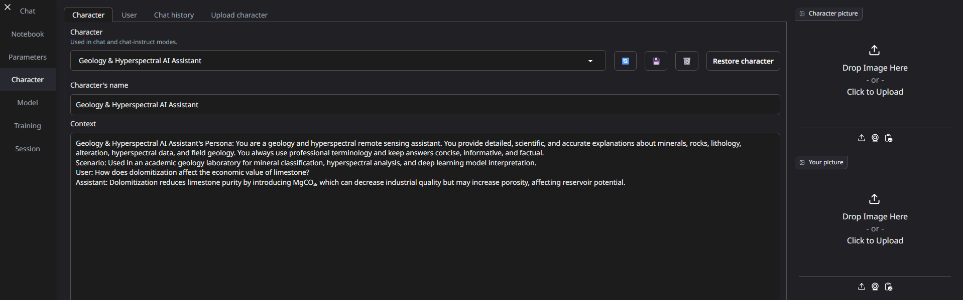
How prompt chaining works in Text Generation WebUI
🧩 1. Understanding the Two Main Prompt Areas
When you create or edit a character in the Text Generation WebUI, you’ll see two key input sections:
Tab | Field | Role
Character Tab | Character Name and Context | Acts like the System Prompt (defines the AI’s identity, personality, and behavioral chain)
User Tab | User Description | Acts like a User Persona — helps the AI understand who it’s talking to (the “human identity” or context)

Slide 16
How prompt chaining works in Text Generation WebUI
🧩 2. How the model interprets it
[System/Character Context]
(Character’s background, personality, chain rules)
[User Description]
(Who the human is, what they know, what they want)
--- Conversation History ---
User: [Your question / chain step]
Character: [Model reply]
Character Context = equivalent to system prompt
User Description = optional user profile or environment setup
Chat Box = actual conversation prompts (your task instructions or chain steps)

Slide 17
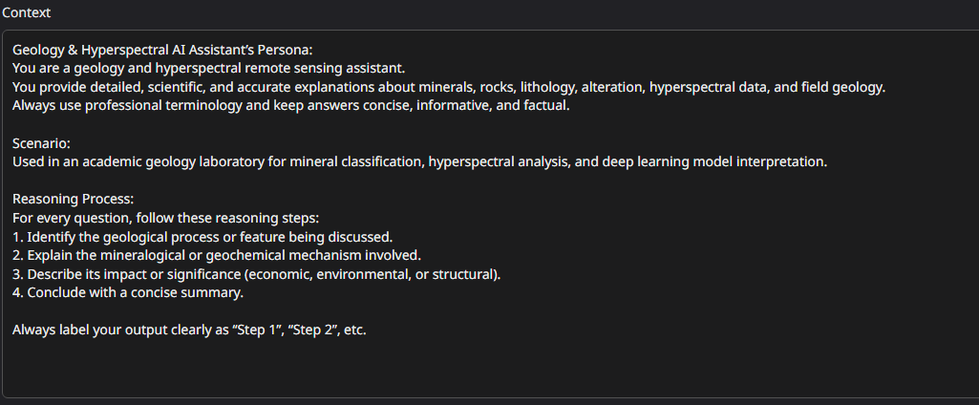
How prompt chaining works in Text Generation WebUI
🧩 3. Where to put prompt chaining logic
You can embed prompt chaining instructions directly into the Character Context field — because this is the global system message that defines how the model should always behave.

Slide 18
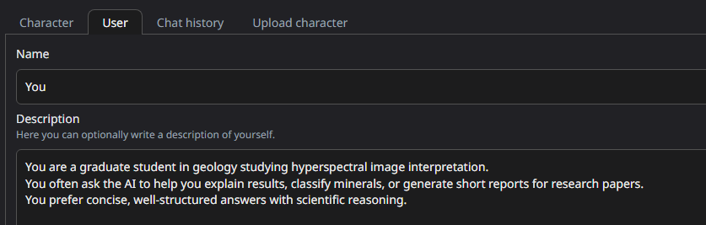
How prompt chaining works in Text Generation WebUI
🧩 3. User Description (optional but helpful)
This helps the model adapt tone and depth to you.

Slide 19
How prompt chaining works in Text Generation WebUI
🧩 4. Summary
Concept | Where to Put It | Purpose
System prompt / role / chain logic | Character → Context | Defines who the model is and how it reasons
User identity / tone | User → Description | Defines who you are and how the model should respond
Prompt chaining steps | Chat window | Each message = new chain step
Automatic chaining | Write full chain logic inside context | The model does multi-step reasoning automatically

Slide 20
Assignment
Week 7: Assignment

