Slide 1
ADVANCED DATA MANIPULATION AND INTEGRATION
LAB 4

Slide 2
MAIN GOAL
By the end of this lecture, you will be able to:
Learn how to turn existing image processing scripts into a simple GUI.
Learn threading to avoid GUI freezing during long operations.
Learn to add a progress bar showing real-time progress (%).
Use tkinter to create all GUIs.

Slide 3
WHy THREADING MATTERS?
1.1. Freezing Problems
In a single-threaded Tkinter application, a long-running process (e.g., heavy computation, file I/O) blocks the main thread, causing the GUI to become unresponsive (frozen) until the task is completed. A frozen GUI leads to poor user experience, as users may think the app has crashed.
1.2. Threading benefits
Keeps UI Responsive: The main thread handles rendering, while a worker thread performs the heavy task.
Progress or Status Updates: Display the user what’s happening in real-time.
Better Overall UX: Users can interact with other parts of the interface while tasks run in the back.

Slide 4
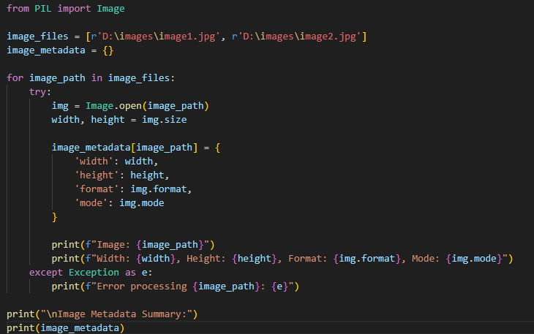
Ex1: exporting metadata

Slide 5
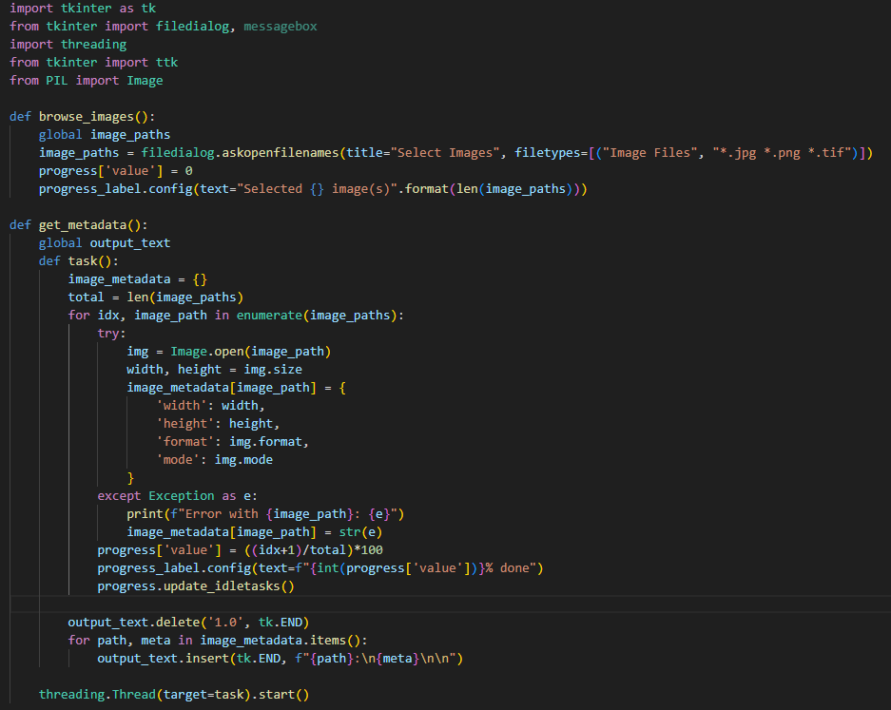
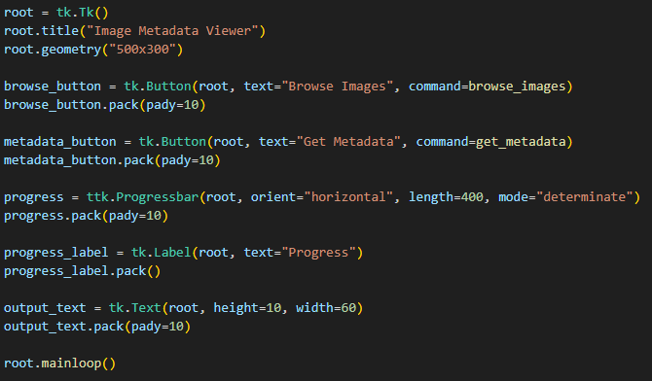

Slide 6
Important note 1
Command | Meaning
Filedialog.askopenfilenames() | Open a file browser window to select multiple files.
Title=“Select Images” | The title text at the top of the browse window.
Filetypes=[(“Image Files”, “*.jpg *.png *.tif”)] | Only show png, jpg, or tif files in the selection window.
.format(len(image_paths)) | The number of images the user selected.

Slide 7
Important note 2
Command | Meaning
Idx (just a variable name) | The index number (0, 1, 2, 3, …)
Enumerate(image_paths) | Automatically counts while looping
Idx +1 | Current number of image being processed
((Idx+1)/total)*100 | Progress percentage

Slide 8
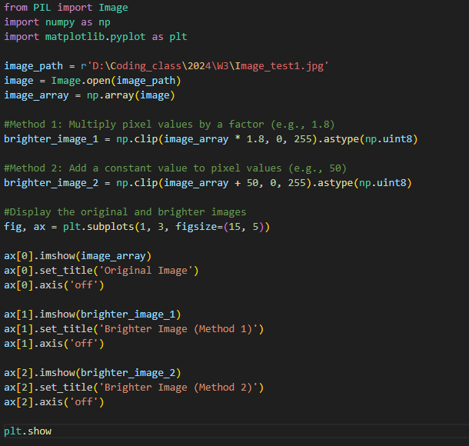
Ex2: intro to threading (non-blocking)

Slide 9
What we want to achieve?
Browse an image.
Let the user input a brightness value (e.g., 1.5x, 2x).
Show original and enhanced images side-by-side.
Progress bar + threading

Slide 10
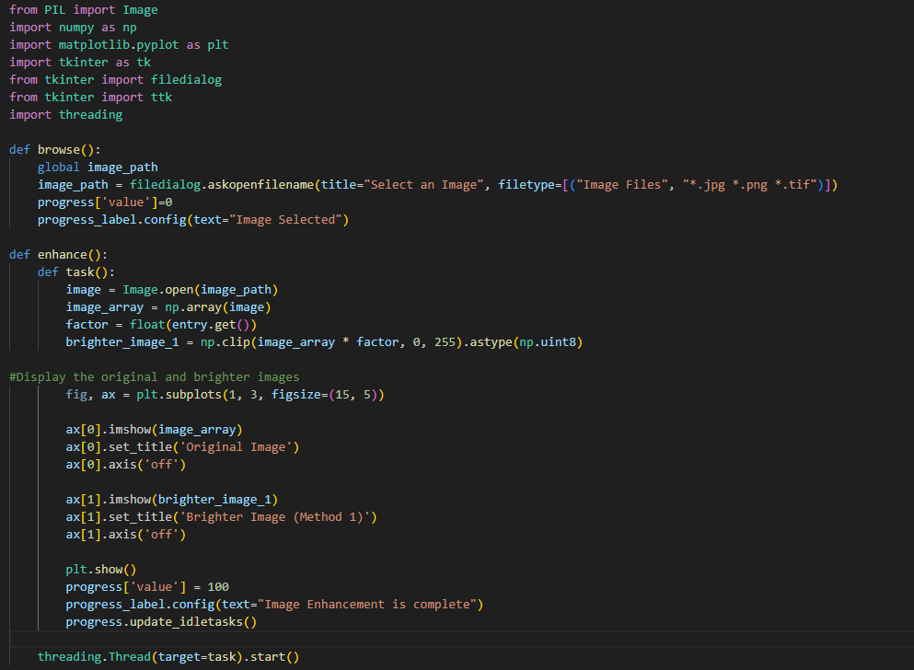
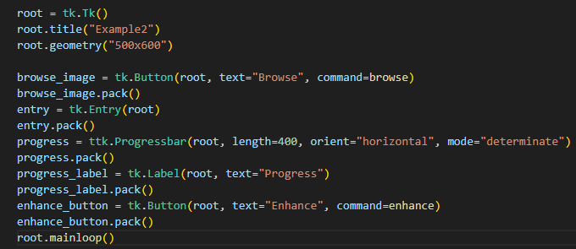

Slide 11
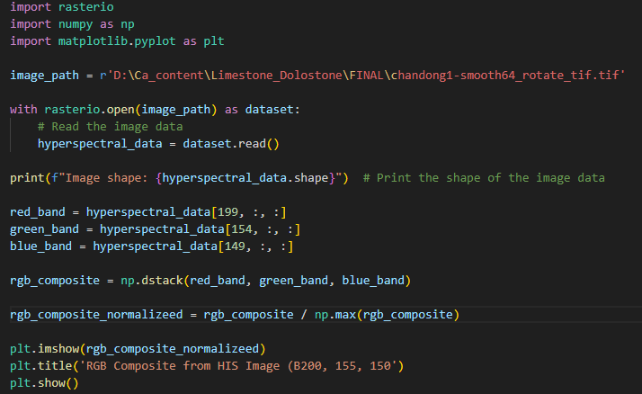
Ex3: work with hyperspectral image

Slide 12
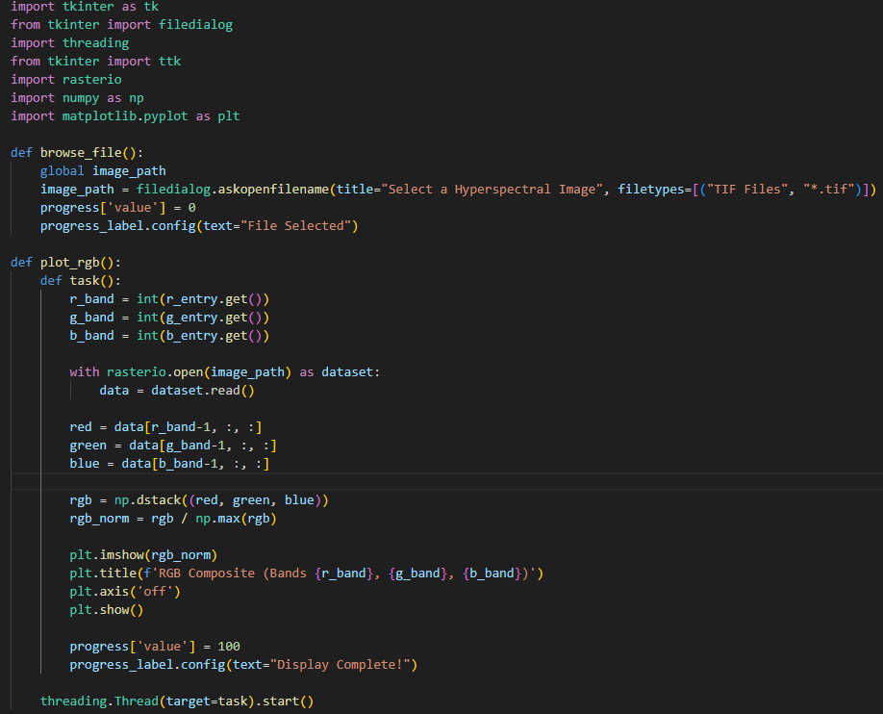
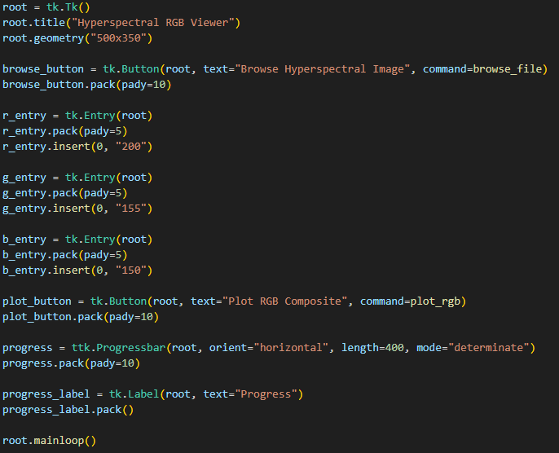

Slide 13
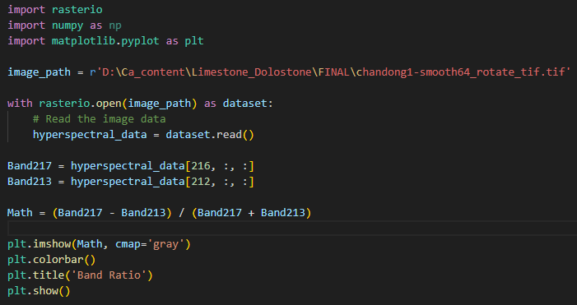
Ex4: BASIC OPERATION WITH HYPERSPECTRAL

Slide 14
WHAT WE WANT TO ACHIEVE
Browse a hyperspectral file.
Perform a simple band math operation (Band Ratio).
Display result in grayscale.
Threading + Progress bar.

Slide 15
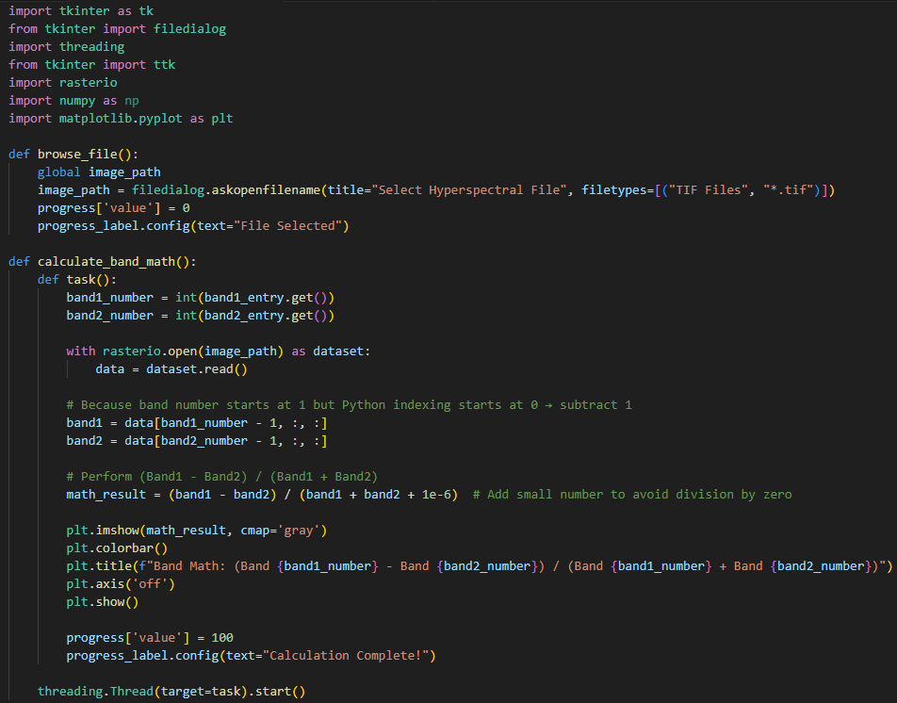
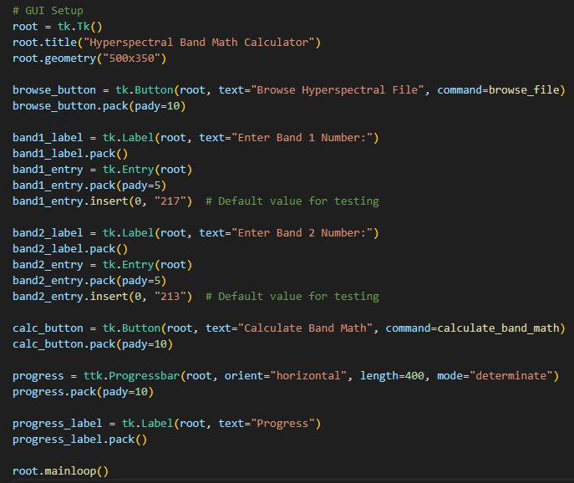

Slide 16
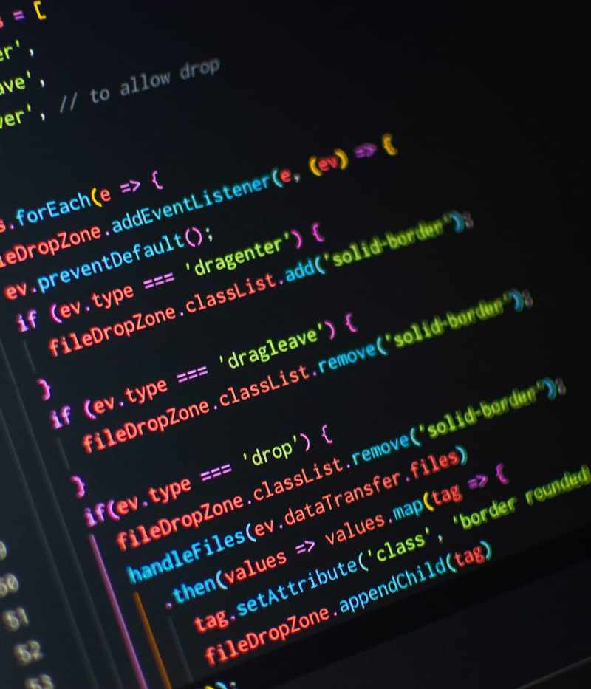
ASSIGNMENT
Goal: In addition to Start and Stop buttons, add two more buttons: Pause and Resume
Pause:
Temporarily halts the task but keeps the thread alive.
Disables itself and enables Resume.
Resume:
Continues the task from where it paused.
Disables itself and re-enables Pause.
Use pause flags (e.g., pause_thread = True/False) inside your task loop so that when Pause is clicked, the thread waits until Resume is clicked. Remember to update button states with button.config(state=tk.DISABLED) or tk.NORMAL appropriately.
while pause_thread and not stop_thread:
time.sleep(0.1)

