Slide 1
WELCOME
Coffee Management
GROUP: L.D.Hoa, N.T.D.Huong, V.D.Nguyen, N.H.Ly

Slide 2
Problem definition
At present, information technology is considered a key industry of the country. Information explosion and the strong development of technology, to develop, need to apply information technology in different industries. Current software increasingly supports users to conveniently use, fast processing time. Therefore, when designing software, it not only requires accuracy and handling of many things, but also meets the speed, friendly interface and realistic simulation on the computer for users to use conveniently and accustomed belonging, high security, ... Software helps save and time of human efforts, increase accuracy and efficiency at work. As in managing a cafe. If not supported by computer software, the management needs to be quite a lot of people and divided into several stages to be able to manage the store such as managing employees (employees in shifts or all day), managing invoices , search, statistics and information adjustment, etc. These jobs require time and effort but the accuracy and efficiency are not high when doing manual work without using software. In addition, it will make the storage difficult, to consume large space, easy to lose and expensive. Meanwhile solving with 1 software is simpler.
Therefore, it is necessary to develop a cafe management program.

Slide 3
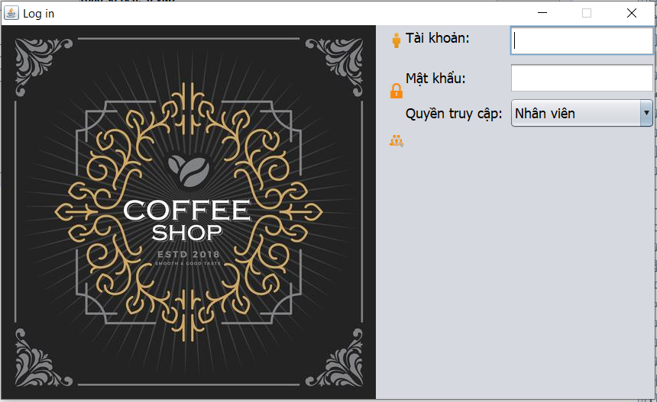
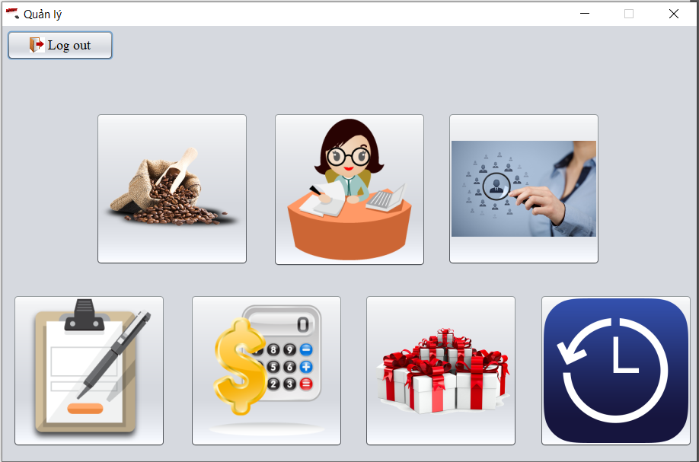
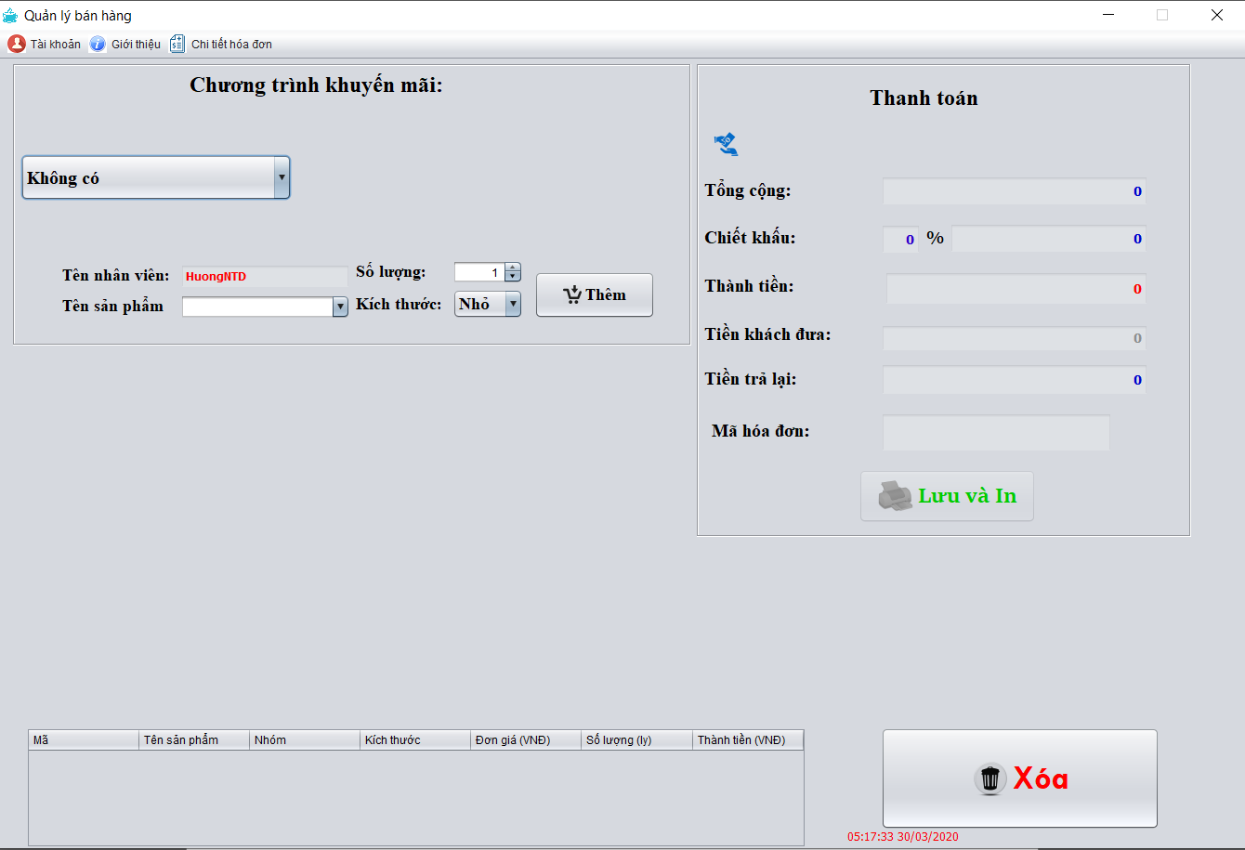
The functions of the application
Login – Hòa
"select * from Employee where UsernameEmp=? COLLATE SQL_Latin1_General_CP1_CS_AS and Password=? COLLATE SQL_Latin1_General_CP1_CS_AS";

Slide 4
The functions of the application
Login – Hòa
To avoid hacking that answer entirely, the only real difference is the sort order for some characters differs between the two collations. Character representation does not appear to differ.
Latin1_General_CS_AS is the default collation for any other English locale, such as English (United Kingdom).
"select * from Employee where UsernameEmp=? COLLATE SQL_Latin1_General_CP1_CS_AS and Password=? COLLATE SQL_Latin1_General_CP1_CS_AS";

Slide 5
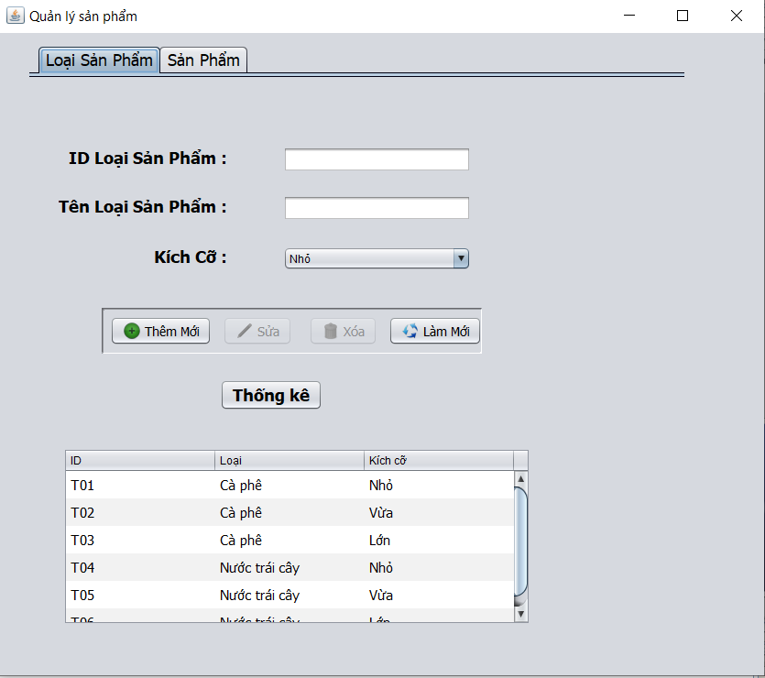
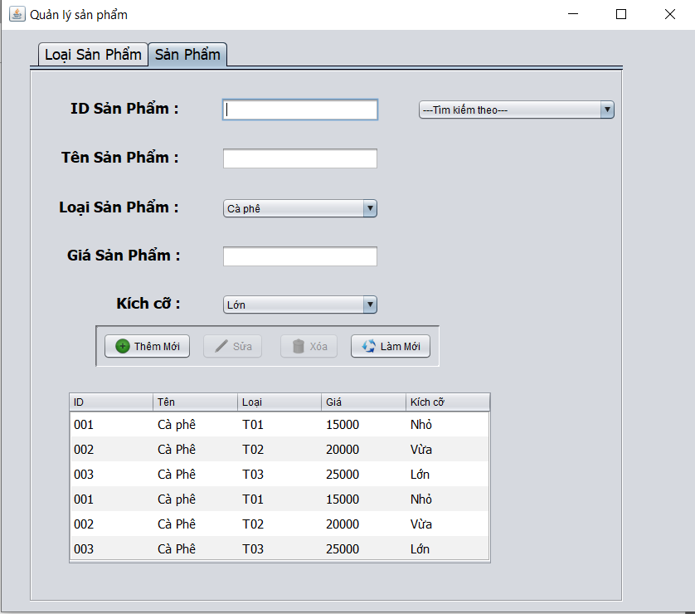
The functions of the application
2.Product Management - Hương

Slide 6
The functions of the application
2.Product Management - Hương
Check Product Exist: "select * from ProductType where TypeName=? and Size=?“
Load Type Product: "select * from ProductType“
Load all product: "select * from Product inner join ProductType on Product.IDType=ProductType.IDType";
Add product: "insert into Product values(?,?,?,?)“
Uppdate: "update Product set ProductName=?, IDType=?, Price=? where IDProduct=?“
Deleted: "select * from OrderDetails where IDProduct=?“
"Delete Product where IDProduct=?“

Slide 7
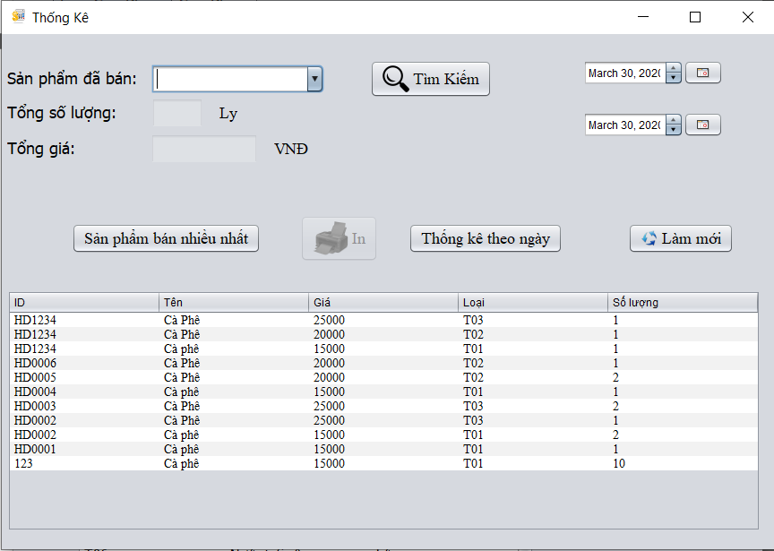
The functions of the application
2. Statistical- Nguyên

Slide 8
The functions of the application
2. Statistical- Nguyên
"select o.IDProduct, p.Price,p.ProductName,p.IDType,a.DateOrder"
+ " from OrderDetails o join Product p on o.IDProduct=p.IDProduct"
+ " join [Order] a on a.IDOrder=o.IDOrder"
+ " where convert(varchar, TRY_PARSE(DateOrder as date using 'vi-vn'), 111) >= '" + start + "'"
+ " and convert(varchar, TRY_PARSE(DateOrder as date using 'vi-vn'), 111) <= '" + end + "' order by convert(varchar, TRY_PARSE(DateOrder as date using 'vi-vn'), 111) DESC");

Slide 9
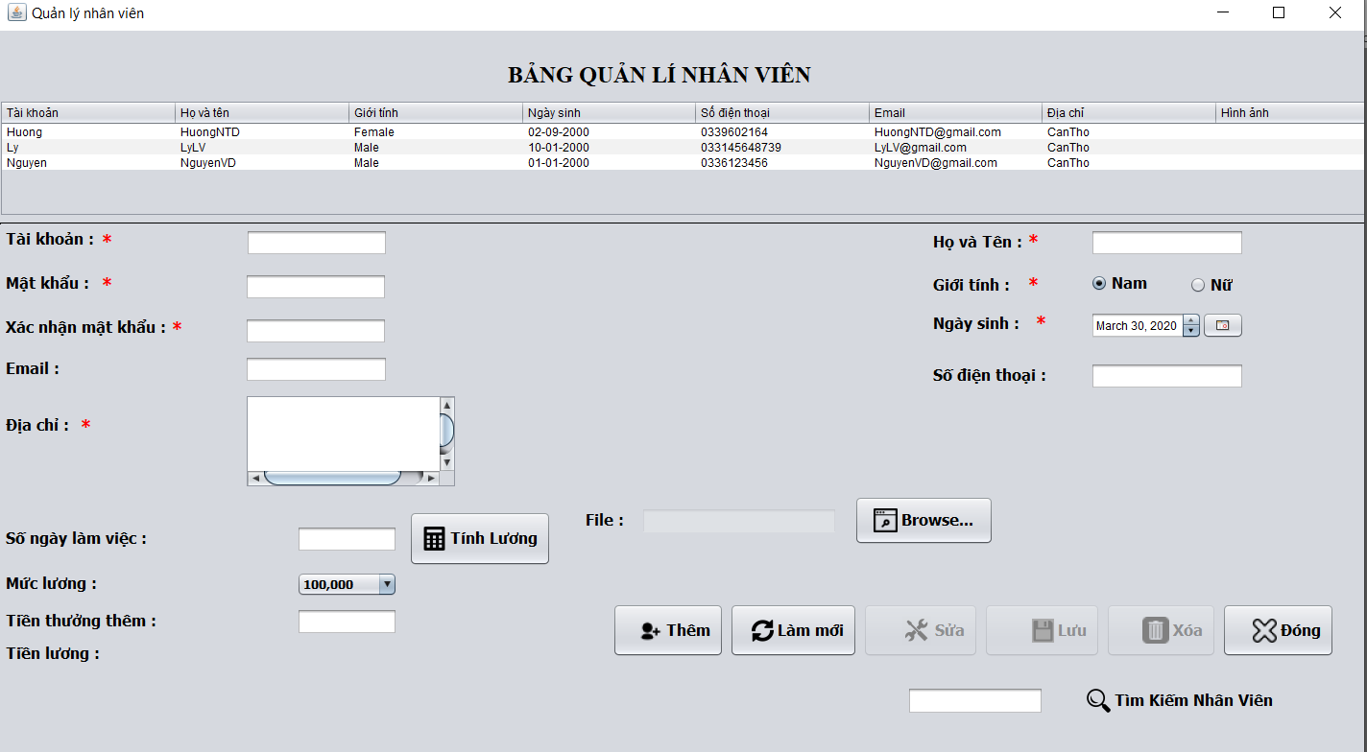
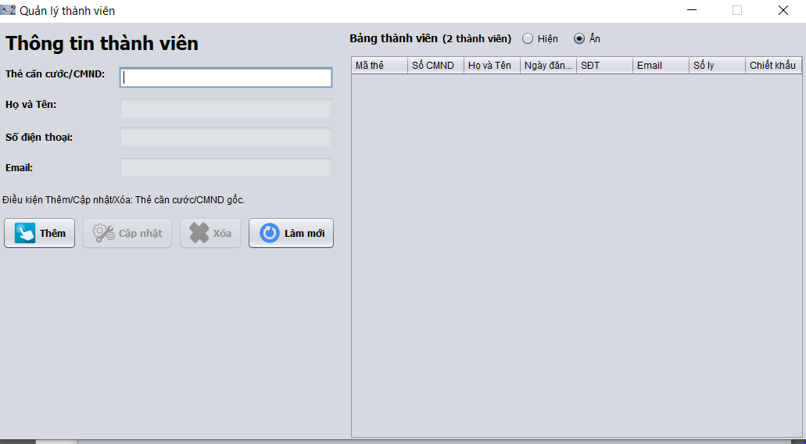
The functions of the application
2. Employee Management - Lý

Slide 10
The functions of the application
2. Employee Management - Lý
Search: "Select * from Employee where UsernameEmp like ?“
Delete: "Delete from Employee where UsernameEmp=?“
Add new Employee: Insert into Employee values(?,?,?,?,?,?,?,?,?)

Slide 11
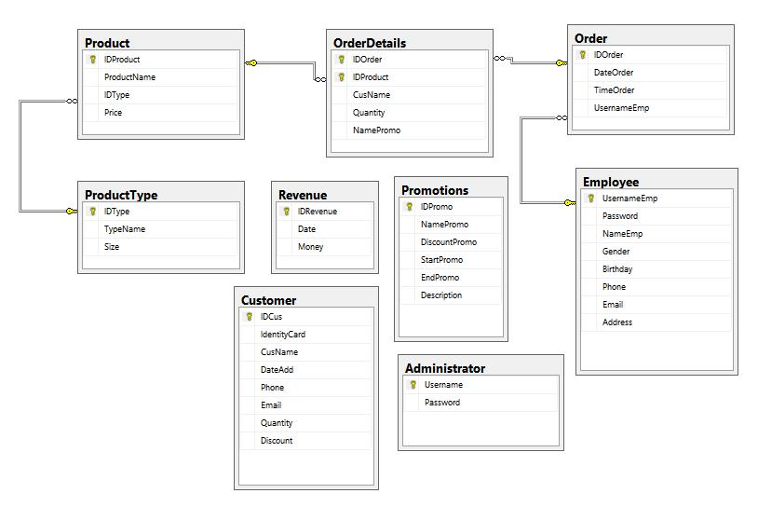
CLASS DIAGRAM

Slide 12
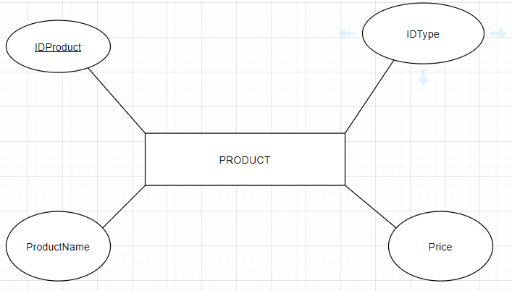
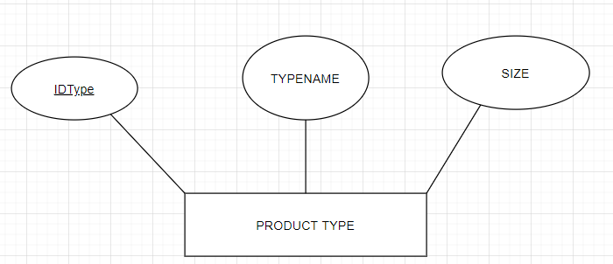
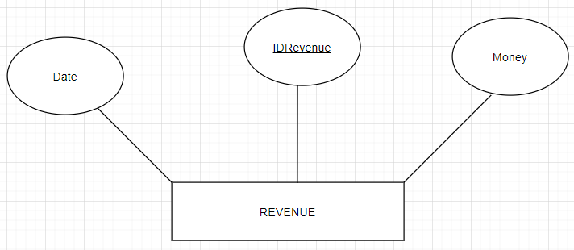
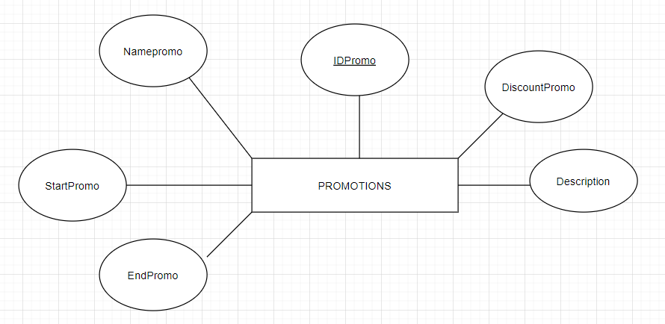
SƠ ĐỒ THUỘC TÍNH

Slide 13
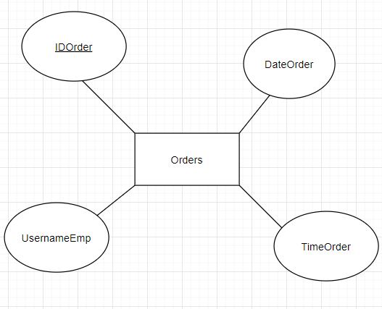
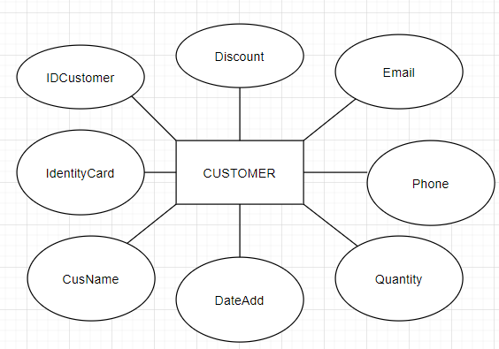
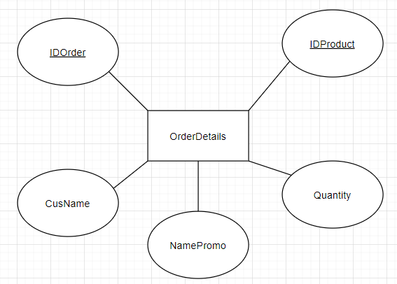
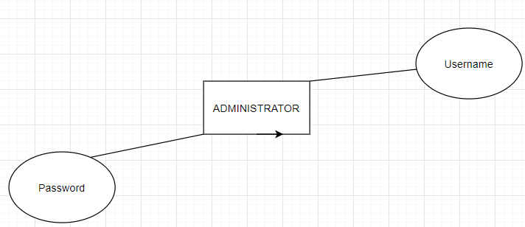

Slide 14
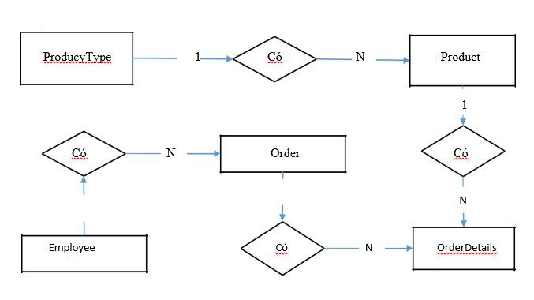
Sơ Đồ Quan Hệ Thực Thể

Slide 15
DEMO CODE

Slide 16
THANK FOR WATCHING AND LISTENING

