Slide 1
WELCOME
Coffee Management
GROUP …
Le Duc Hoa – Nguyen Thi Diem Huong – Vuong Dinh Nguyen – Nguyen Huu Ly

Slide 2
Problem definition
At present, information technology is considered a key industry of the country. Information explosion and the strong development of technology, to develop, need to apply information technology in different industries. Current software increasingly supports users to conveniently use, fast processing time. Therefore, when designing software, it not only requires accuracy and handling of many things, but also meets the speed, friendly interface and realistic simulation on the computer for users to use conveniently and accustomed belonging, high security, ... Software helps save and time of human efforts, increase accuracy and efficiency at work. As in managing a cafe. If not supported by computer software, the management needs to be quite a lot of people and divided into several stages to be able to manage the store such as managing employees (employees in shifts or all day), managing invoices , search, statistics and information adjustment, etc. These jobs require time and effort but the accuracy and efficiency are not high when doing manual work without using software. In addition, it will make the storage difficult, to consume large space, easy to lose and expensive. Meanwhile solving with 1 software is simpler.
Therefore, it is necessary to develop a cafe management program.
Group 4: Coffee Management

Slide 3
Task
Hương:
About us
Change password
Product
Information
Nguyên:
Customer
Revenue
Thống kê
Class Diagrams
Hòa:
Adminform
Billform
Combolistener
Loginform
Document
Lý:
Employee management
Order
Pomotion
SetImage
Design Database

Slide 4
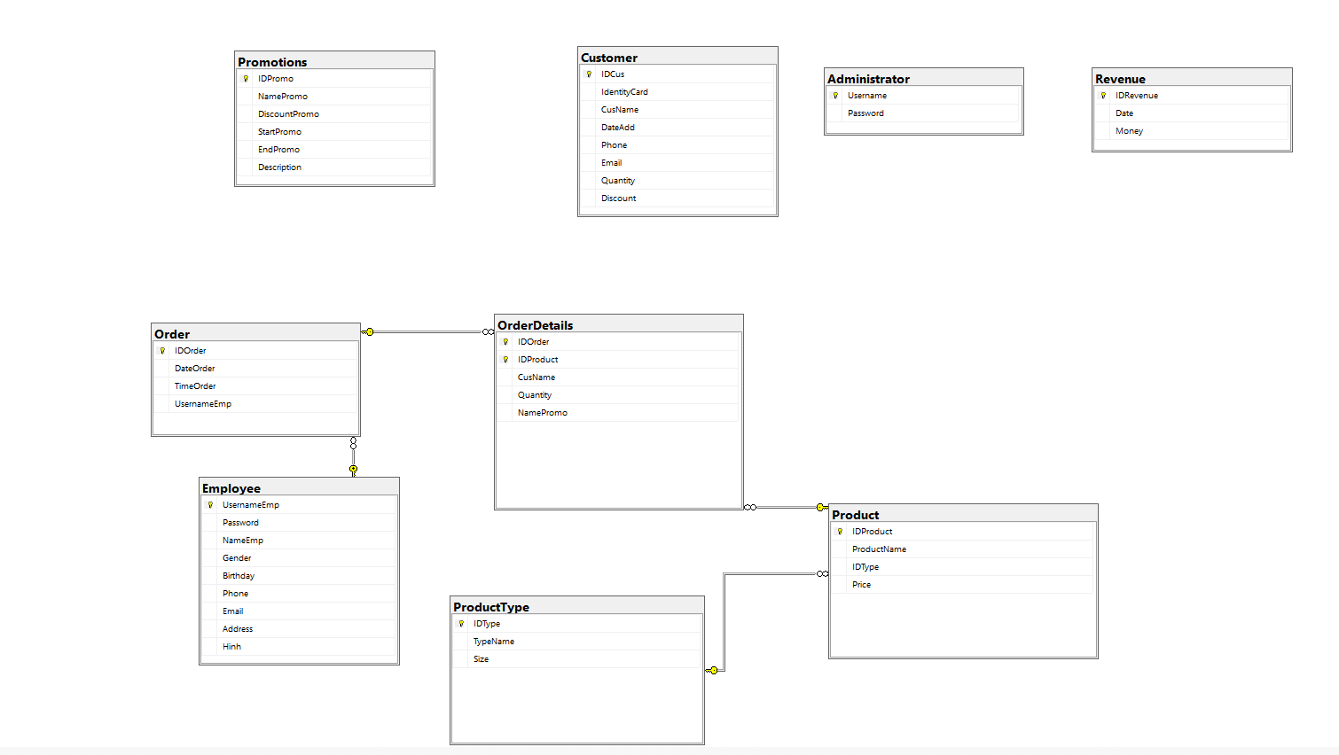
Database diagrams

Slide 5
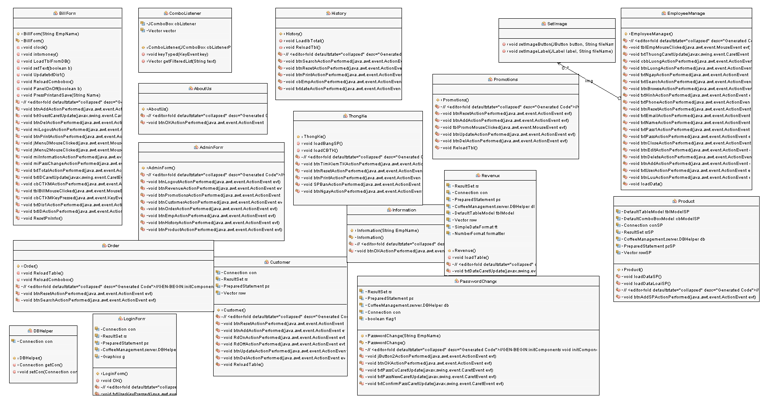
Class Diagram

Slide 6
DEMO CODE

Slide 7
THANK FOR WATCHING AND LISTENING

