Slide 1







CAPSTONE PRESENTATION
Future Skill Requirements In Information Technology Fields.
BY HOA LE
JUNE 05, 2023

Slide 2



OUTLINE
Executive Summary
Introduction
Methodology
Results
Visualization – Charts
Dashboard
Discussion
Findings & Implications
Conclusion
Appendix

Slide 3

EXECUTIVE SUMMARY
Current technologies and future trends
Methodology using to collect and present data
Data Wrangling
Data Visualization
Build dashboard using IBM Cognos
The demand in languages and database change every year
Gender gap in the IT workplace
Analyze the top 10 high demand of languages and databases to catch up with the change of technology

Slide 4

INTRODUCTION
Analyze the trend of technologies are using in Information Technology fields.
Identify skills that need in IT fields
The most demand programming languages
The top 10 high demand database skills
Gender gap concerns in IT workplace

Slide 5

METHODOLOGY
Collect data from various source using APIs, Web Scrapping.
Data Wrangling:
Finding Missing Values
Determine Missing Values
Finding Duplicates and remove
Normalizing data
Data Visualization
Using IBM Cognos Dashboard
Python visualizations

Slide 6
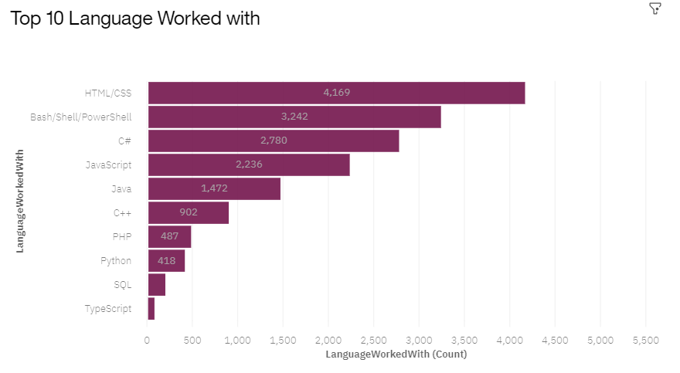
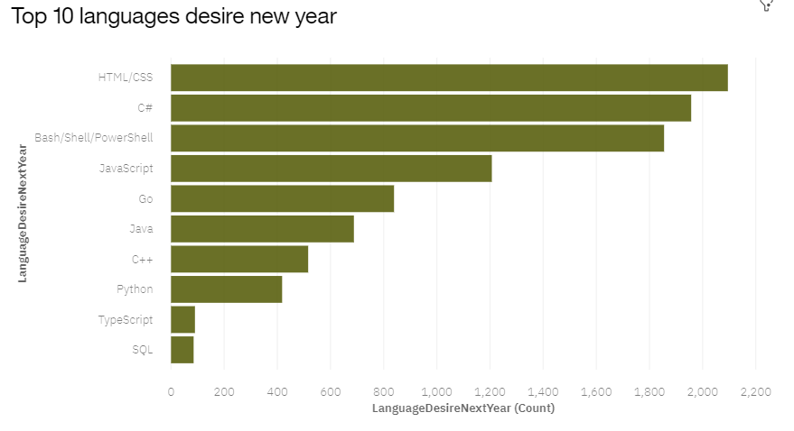
PROGRAMMING LANGUAGE TRENDS
Current Year
Next Year

Slide 7
PROGRAMMING LANGUAGE TRENDS - FINDINGS & IMPLICATIONS
Findings
HTML/CSS, Bash/Shell/PowerShell, C#, and JavaScript are the top four programming languages.
C# is becoming a more popular programming language next year.
Bash/Shell/PowerShell is less popular next year.
Implications
These languages are widely used and in high demand among developers. They are likely the most commonly used languages for web development and scripting tasks.
The data suggests that C# is experiencing increased popularity and adoption. This could be due to several factors such as its usage in game development (Unity), Microsoft's .NET framework, or its application in enterprise software development.
These scripting languages are often used for automation, system administration, and command-line tasks. The decrease in popularity could be due to the rise of alternative languages or tools for similar purposes.

Slide 8
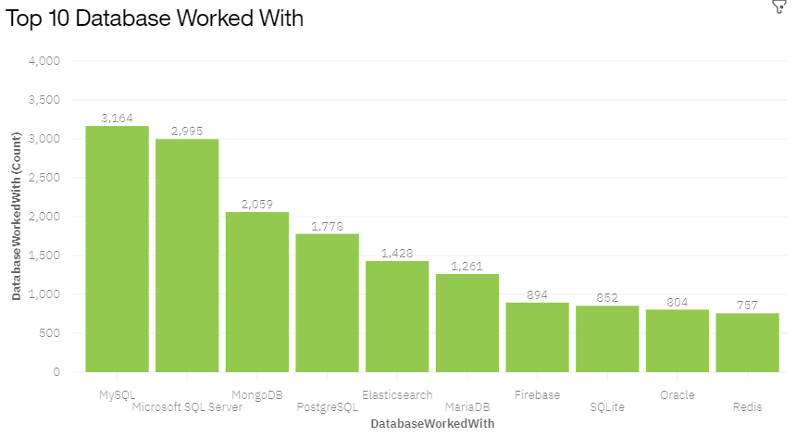
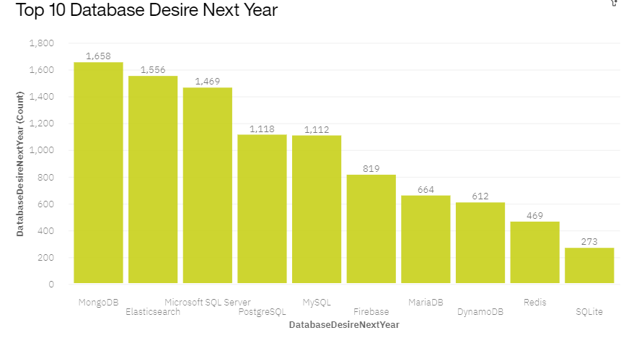
DATABASE TRENDS
Current Year
Next Year

Slide 9
DATABASE TRENDS - FINDINGS & IMPLICATIONS
Findings
MongoDB was claimed as the top database used by developers next year.
Oracle dropped out of the top 10 databases used by developers.
Elasticsearch surpassed MySQL to become the second most popular database used by developers.
Implications
Developers are increasingly favoring MongoDB for their database needs, potentially due to its suitability for modern application development and data-intensive projects.
Developers are shifting away from Oracle for various reasons, such as cost, complexity, or the emergence of alternative database technologies
Growing demand for real-time analytics and search capabilities among developers. It may indicate a shift towards more advanced data processing and analysis requirements in modern applications.

Slide 10

DASHBOARD
https://dataplatform.cloud.ibm.com/dashboards/45975089-e694-487e-afdf-e983d936977d/view/7507e3036eea0bf577d0b1e407ca2e507d612559b1bb875587d67b4959657497a86945c4c87d1a53da475732f5ed470cc9

Slide 11
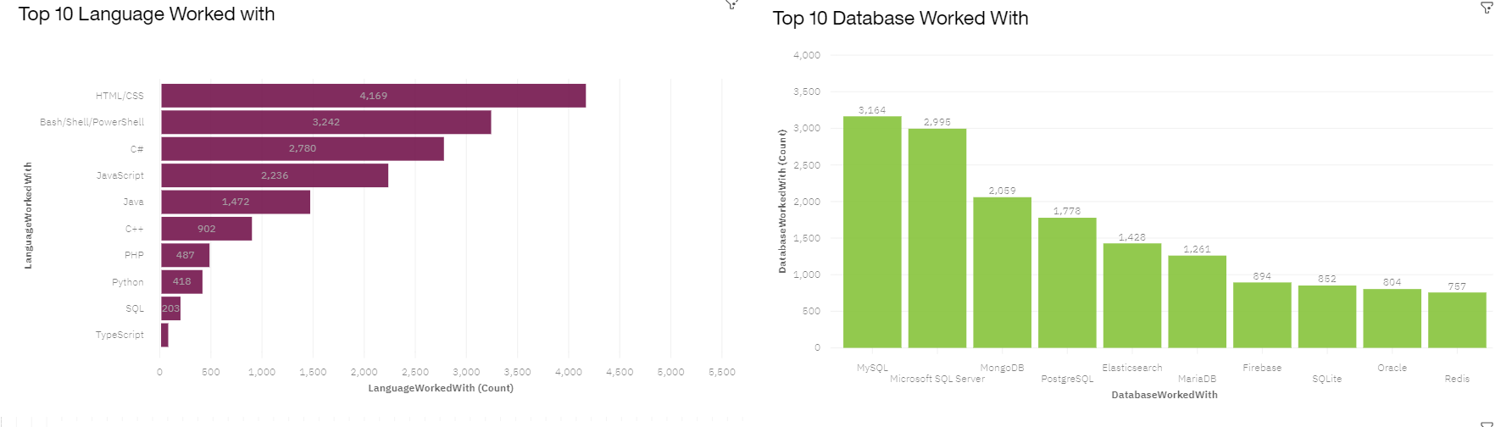
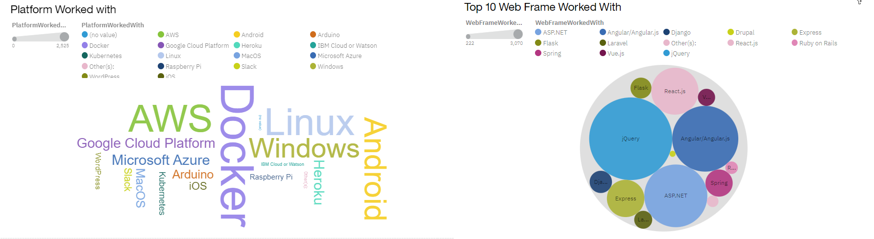
DASHBOARD TAB 1

Slide 12
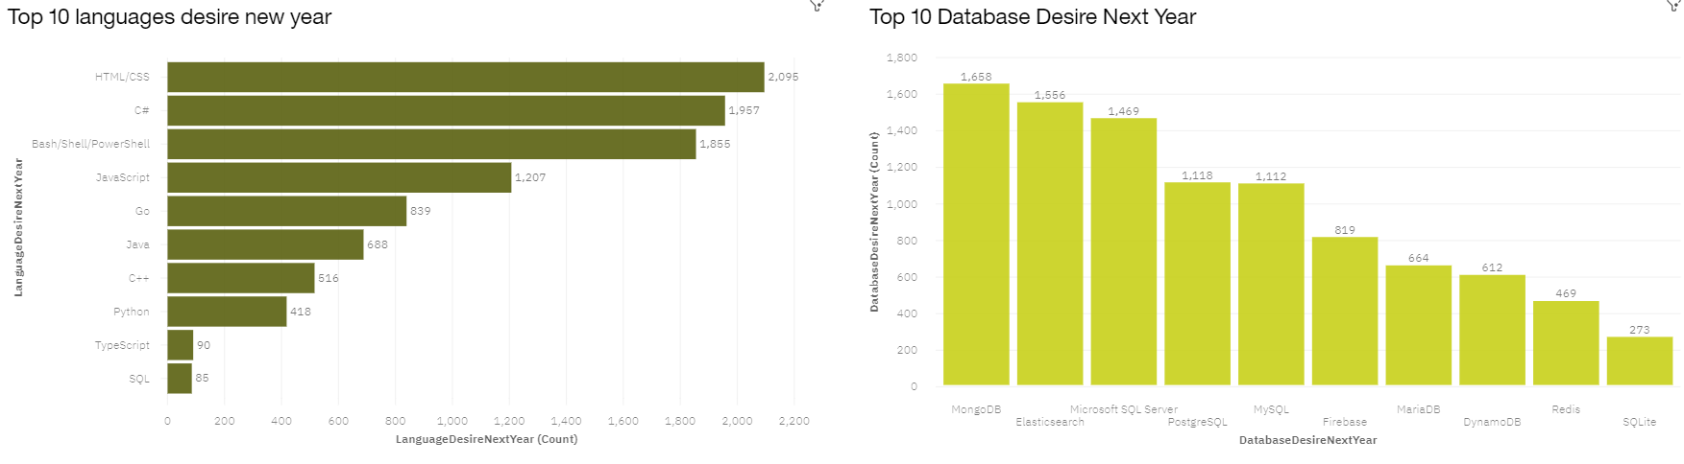
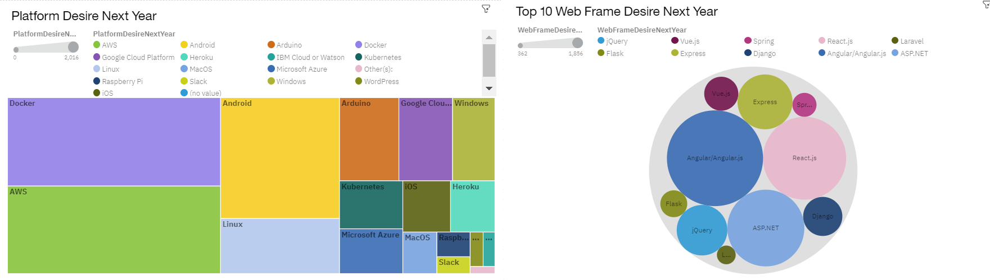
DASHBOARD TAB 2

Slide 13
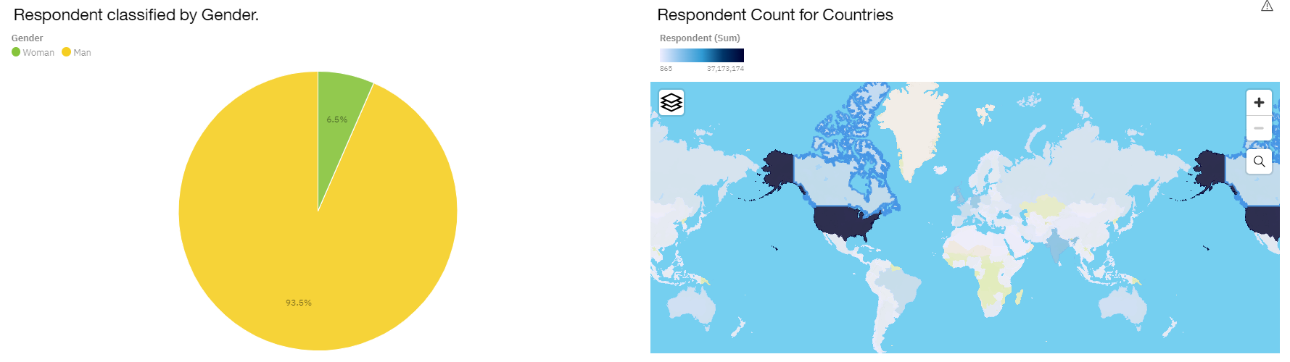
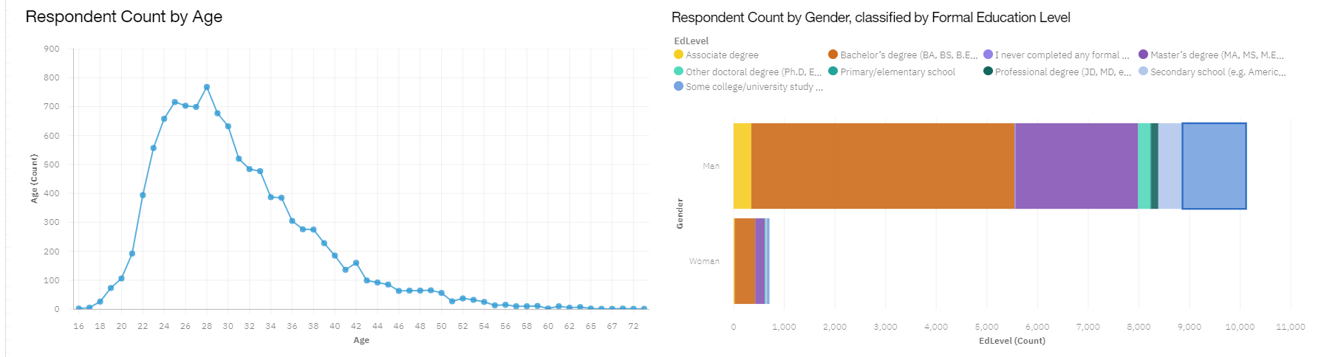
DASHBOARD TAB 3

Slide 14
DISCUSSION
Males account for the majority (93.5%) of people working in IT.
Current technologies and future trends are important factors to consider.
The peak age group that responded to the survey is 28 years old.
A bachelor's degree is dominant among people working in IT fields.

Slide 15
OVERALL FINDINGS & IMPLICATIONS
Findings
Technology in the IT field is rapidly changing from year to year.
The gender gap in IT is becoming a growing concern.
A bachelor's degree is the main requirement to work in IT.
Platforms like Docker, AWS, Linux, and Windows continue to experience steady growth.
Implications
Companies need to make regular adjustments to adapt to changing requirements.
The hiring process should encourage more females to join the IT workplace.
There is a need to diversify the requirements for degrees when hiring employees.
The deployment of cloud services is rapidly increasing in the future.

Slide 16

CONCLUSION
HTML and CSS still play a vital role in the jobs of developers.
NoSQL has become a prominent database used in the IT industry.
AWS, Docker, Linux, and Windows are the main platforms that developers interact with.
There is a significant gender gap in the IT workplace between males and females.
A bachelor's degree accounts for the majority of the workforce in the IT industry.

Slide 17
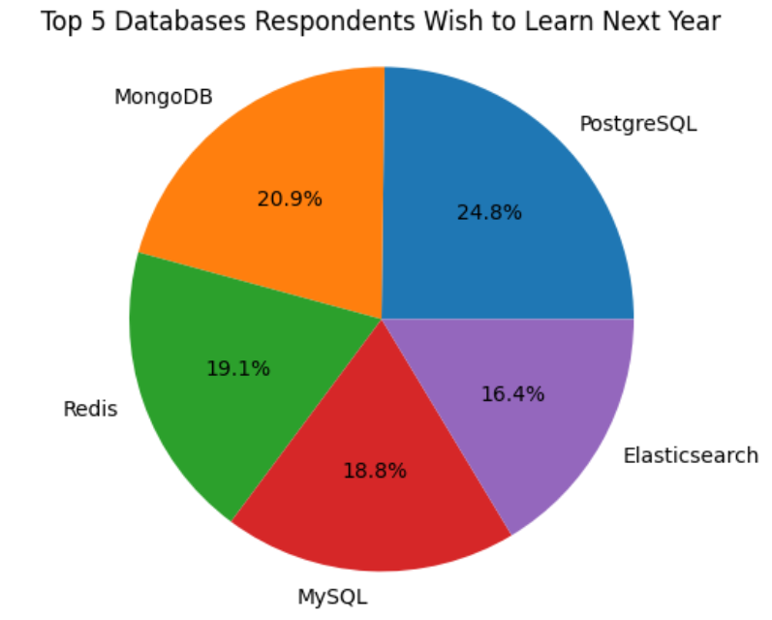

APPENDIX

Slide 18
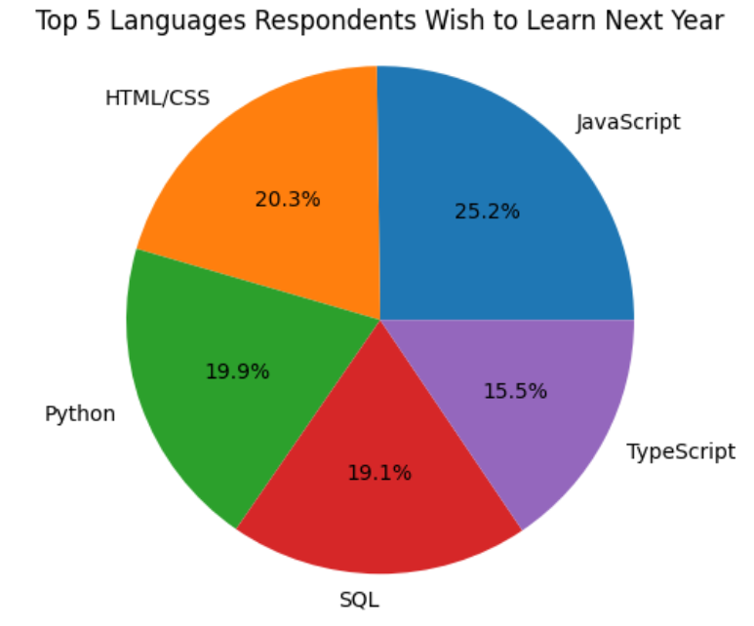
APPENDIX

Slide 19
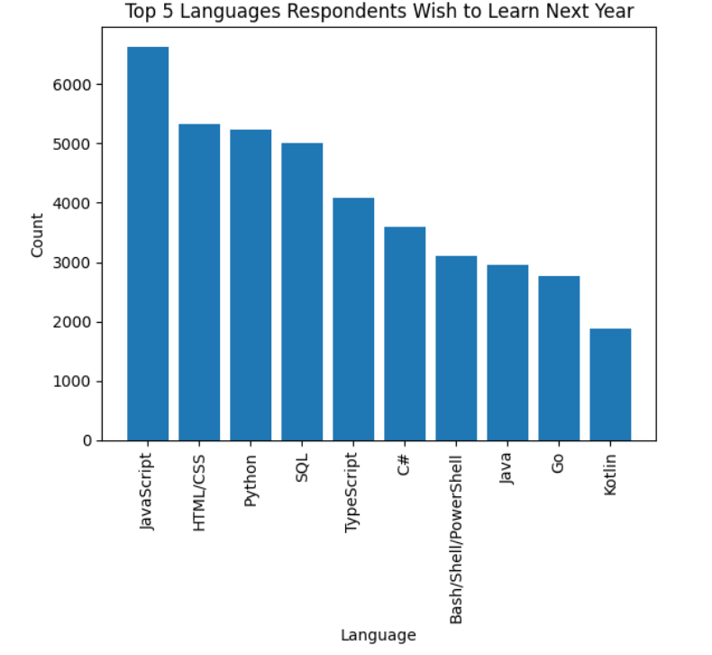
APPENDIX

Slide 20
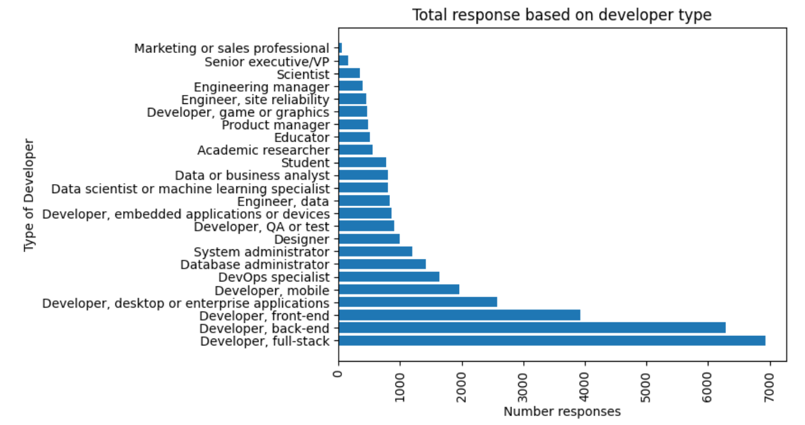
APPENDIX

Slide 21
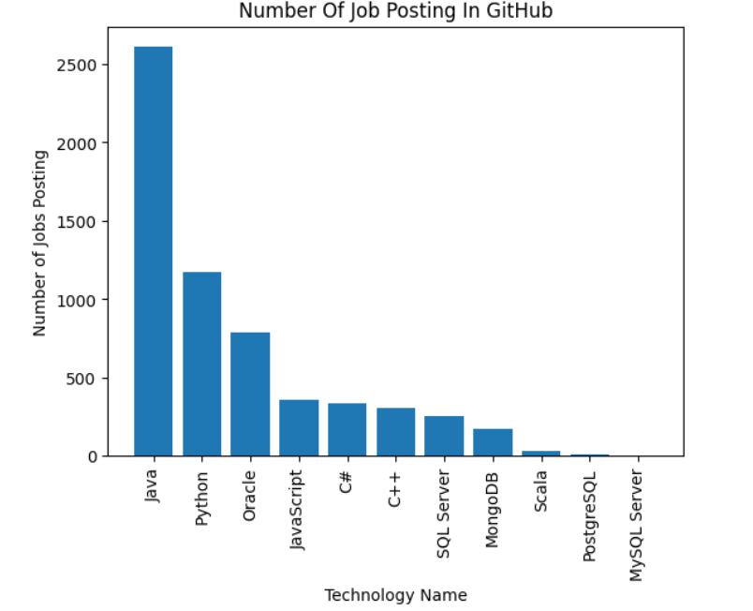
JOB POSTINGS

Slide 22
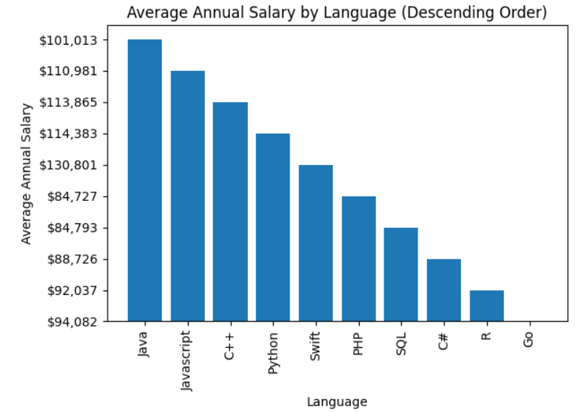
POPULAR LANGUAGES

