Slide 1
3
Data
Storage
3.<number>
© Cengage Learning

Slide 2
Objectives
After studying this chapter, the student should be able to:
List five different data types used in a computer.
Describe how different data is stored inside a computer.
Describe how integers are stored in a computer.
Describe how reals are stored in a computer.
Describe how text is stored in a computer using one of the
various encoding systems.
Describe how audio is stored in a computer using sampling,
quantization, and encoding.
Describe how images are stored in a computer using raster
and vector graphics schemes.
Describe how video is stored in a computer as a
representation of images changing in time.
3.<number>

Slide 3
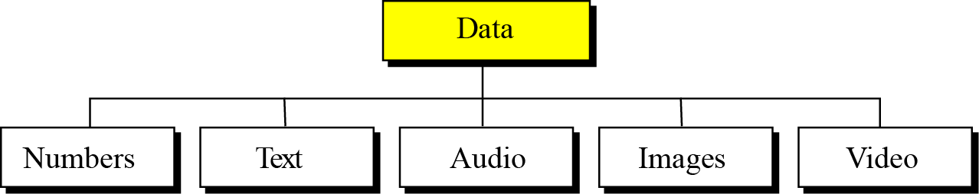
3-1 INTRODUCTION
Data today come in different forms including numbers, text, audio, image, and video (Figure 3.1).
Figure 3.1 Different types of data
3.<number>
Notes:
Các dạng dữ liệu trên máy tính

Slide 4

i
The computer industry uses the term “multimedia” to
define information that contains numbers,
text, images, audio, and video.
3.<number>

Slide 5
3.1.1 Data inside the computer
All data types are transformed into a uniform representation when they are stored in a computer and transformed back to their original form when retrieved. This universal representation is called a bit pattern.
Figure 3.2 A bit pattern
3.<number>
Notes:
Dữ liệu trong máy tính được biểu diễn dưới dạng bit

Slide 6
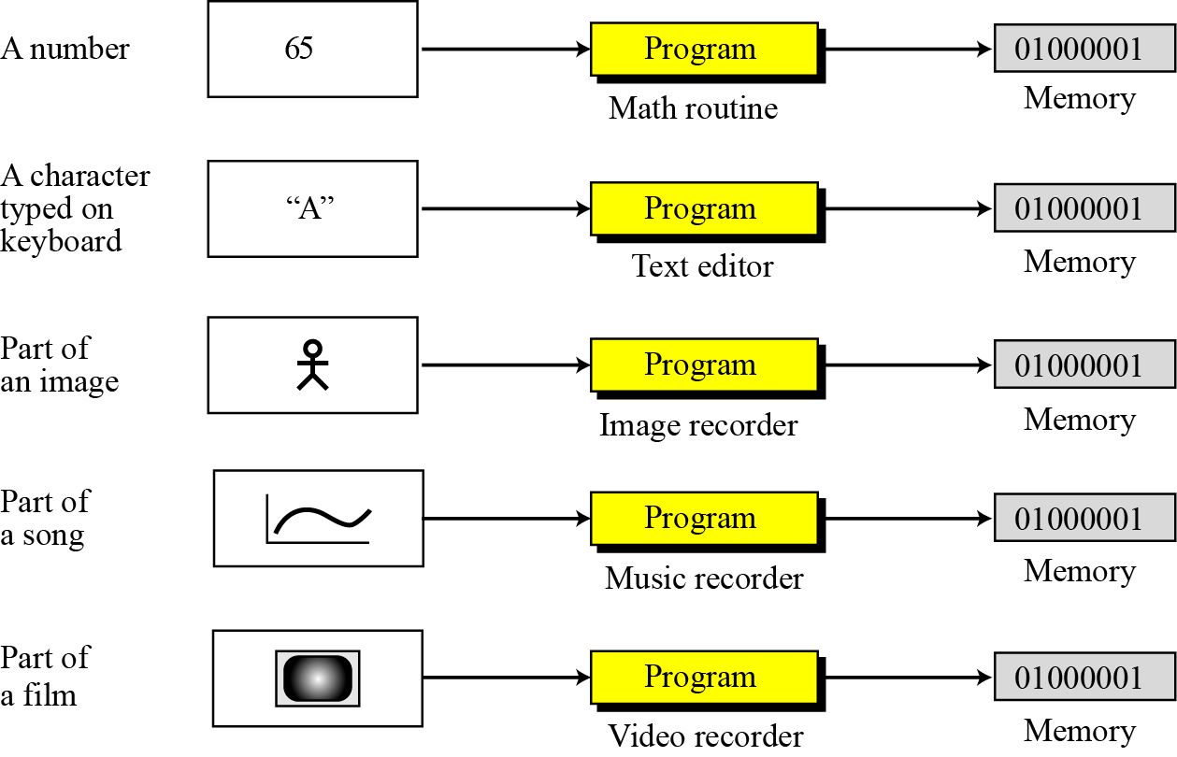
Figure 3.3 Storage of different data types
3.<number>

Slide 7
3.1.2 Data compression
To occupy less memory space, data is normally compressed before being stored in the computer. Data compression is a very broad and involved subject, so we have dedicated the whole of Chapter 15 to this subject.
i
Data compression is discussed in Chapter 15.
3.<number>

Slide 8
3.1.3 Error detection and correction
Another issue related to data is the detection and correction of errors during transmission or storage. We discuss this issue briefly in Appendix H.
i
Error detection and correction is discussed
in Appendix H.
3.<number>

Slide 9
3-2 STORING NUMBERS
A number is changed to the binary system before being stored in the computer memory, as described in Chapter 2. However, there are still two issues that need to be handled:
How to store the sign of the number.
How to show the decimal point.
3.<number>

Slide 10
3.2.1 Storing integers
Integers are whole numbers (numbers without a fractional part). For example, 134 and −125 are integers, whereas 134.23 and −0.235 are not. An integer can be thought of as a number in which the position of the decimal point is fixed: the decimal point is to the right of the least significant (rightmost) bit. For this reason, fixed-point representation is used to store an integer, as shown in Figure 3.4. In this representation the decimal point is assumed but not stored.
3.<number>

Slide 11
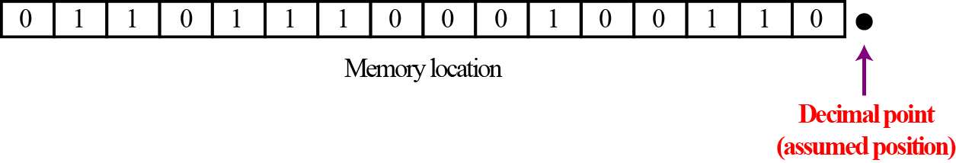
Figure 3.4 Fixed point representation of integers
i
An integer is normally stored in memory using
fixed-point representation.
3.<number>

Slide 12
Unsigned representation
An unsigned integer is an integer that can never be negative and can take only 0 or positive values. Its range is between 0 and positive infinity.
An input device stores an unsigned integer using the following steps:
The integer is changed to binary.
If the number of bits is less than n, 0s are added to the left.
3.<number>

Slide 13
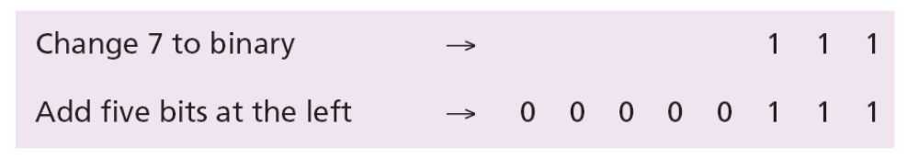
Example 3.1
Store 7 in an 8-bit memory location using unsigned representation.
Solution
First change the integer to binary, (111)2. Add five 0s to make a total of eight bits, (00000111)2. The integer is stored in the memory location. Note that the subscript 2 is used to emphasize that the integer is binary, but the subscript is not stored in the computer.
3.<number>

Slide 14
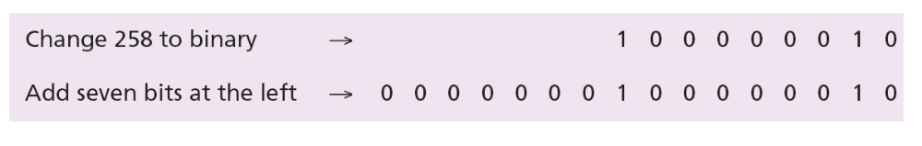
Example 3.2
Store 258 in a 16-bit memory location.
Solution
First change the integer to binary (100000010)₂. Add seven 0s to make a total of sixteen bits, (0000000100000010)₂. The integer is stored in the memory location.
3.<number>

Slide 15
Example 3.3
What is returned from an output device when it retrieves the bit string 00101011 stored in memory as an unsigned integer.
Solution
Using the procedure shown in Chapter 2, the binary integer is converted to the unsigned integer 43.
3.<number>

Slide 16
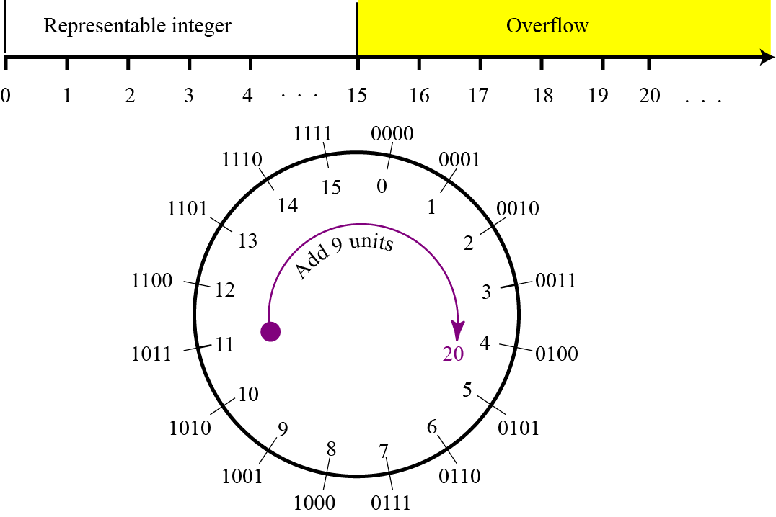
Figure 3.5 shows what happens if we try to store an integer that is larger than 2⁴ − 1 = 15 in a memory location that can only hold four bits.
Figure 3.5 Overflow in unsigned integers
3.<number>

Slide 17
Sign-and-magnitude representation
In this method, the available range for unsigned integers (0 to 2^{n} − 1) is divided into two equal sub-ranges. The first half represents positive integers, the second half, negative integers.
Figure 3.6 Sign-and-magnitude representation
i
In sign-and-magnitude representation, the leftmost bit defines the sign of the integer. If it is 0, the integer is positive. If it is 1, the integer is negative.
3.<number>

Slide 18
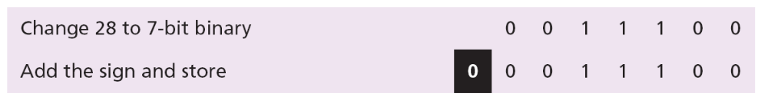
Example 3.4
Store +28 in an 8-bit memory location using sign-and-magnitude representation.
Solution
The integer is changed to 7-bit binary. The leftmost bit is set to 0. The 8-bit number is stored.
3.<number>

Slide 19
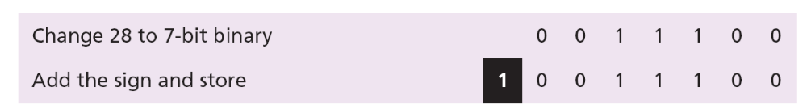
Example 3.5
Store −28 in an 8-bit memory location using sign-and-magnitude representation.
Solution
The integer is changed to 7-bit binary. The leftmost bit is set to 1. The 8-bit number is stored.
3.<number>

Slide 20
Example 3.6
Retrieve the integer that is stored as 01001101 in sign-and-magnitude representation.
Solution
Since the leftmost bit is 0, the sign is positive. The rest of the bits (1001101) are changed to decimal as 77. After adding the sign, the integer is +77.
3.<number>

Slide 21
Example 3.7
Retrieve the integer that is stored as 10100001 in sign-and-magnitude representation.
Solution
Since the leftmost bit is 1, the sign is negative. The rest of the bits (0100001) are changed to decimal as 33. After adding the sign, the integer is −33.
3.<number>

Slide 22
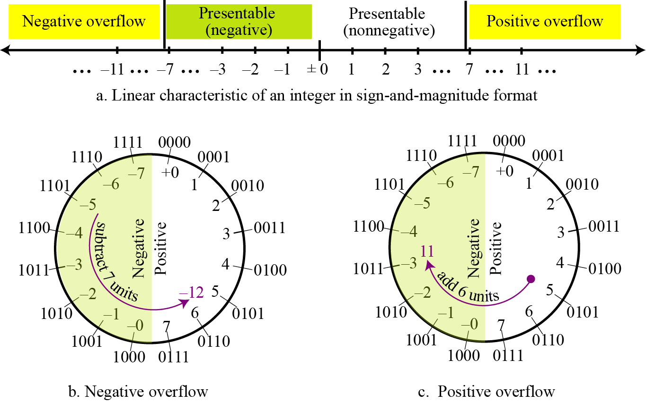
Figure 3.7 shows both positive and negative overflow when storing an integer in sign-and-magnitude representation using a 4-bit memory location.
Figure 3.7 Overflow in sign-and-magnitude representation

Slide 23
Two’s complement representation
Almost all computers use two’s complement representation to store a signed integer in an n-bit memory location. In this method, the available range for an unsigned integer of (0 to 2n − 1) is divided into two equal sub-ranges. The first sub-range is used to represent nonnegative integers, the second half to represent negative integers. The bit patterns are then assigned to negative and nonnegative (zero and positive) integers as shown in Figure 3.8.
3.<number>

Slide 24
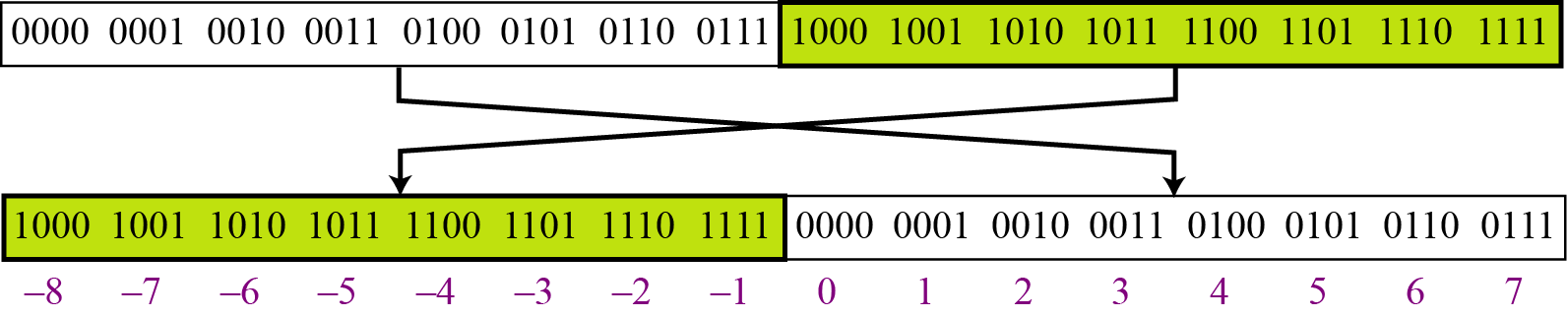
Figure 3.8 Two’s complement representation
i
In two’s complement representation, the leftmost bit defines the sign of the integer. If it is 0, the integer is positive. If it is 1, the integer is negative.
3.<number>

Slide 25
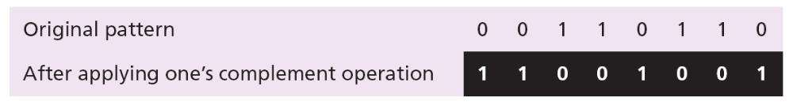
One’s Complementing
Before we discuss this representation further, we need to introduce two operations. The first is called one’s completing or taking the one’s complement of an integer. The operation can be applied to any integer, positive or negative. This operation simply reverses (flips) each bit. A 0-bit is changed to a 1-bit, a 1-bit is changed to a 0-bit.
Example 3.8
The following shows how we take the one’s complement of the integer 00110110.
3.<number>
Notes:
Nguyên tắc bù 1

Slide 26
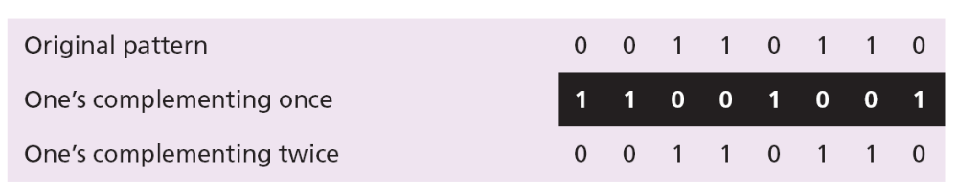
Example 3.9
The following shows that we get the original integer if we apply the one’s complement operations twice.
3.<number>

Slide 27
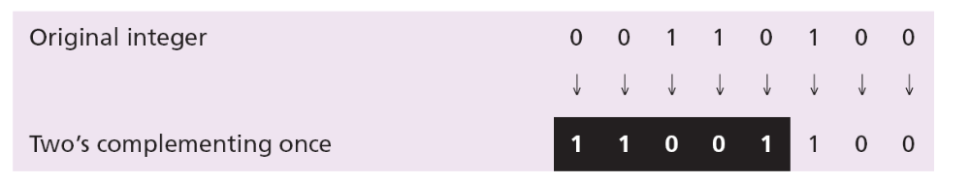
Two’s Complementing
The second operation is called two’s completing or taking the two’s complement of an integer in binary. This operation is done in two steps. First, we copy bits from the right until a 1 is copied; then, we flip the rest of the bits.
Example 3.10
The following shows how we take the two’s complement of the integer 00110100.
3.<number>
Notes:
Nguyên tắc tìm số đối của 1 số nhị phân (Nguyên tắc bù 2):
Từ bên phải sang trái viết lại các bit bthg đến khi gặp số 1. Khi đó đảo các bit tiếp theo cho đến hết

Slide 28
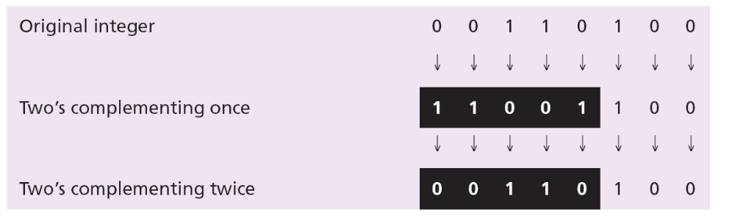
Example 3.11
The following shows that we always get the original integer if we apply the two’s complement operation twice.
i
An alternative way to take the two’s complement of an integer is to first take the one’s complement and then add 1 to the result.
3.<number>

Slide 29
Example 3.12
Store the integer 28 in an 8-bit memory location using two’s complement representation.
Solution
The integer is positive (no sign means positive), so after decimal to binary transformation no more action is needed. Note that five extra 0s are added to the left of the integer to make it eight bits.
3.<number>

Slide 30
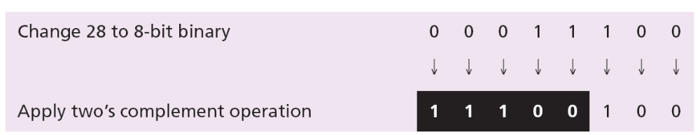
1 |0000 | 0000
Example 3.13
Store −28 in an 8-bit memory location using two’s complement representation.
Solution
The integer is negative, so after changing to binary, the computer applies the two’s complement operation on the integer.
3.<number>

Slide 31
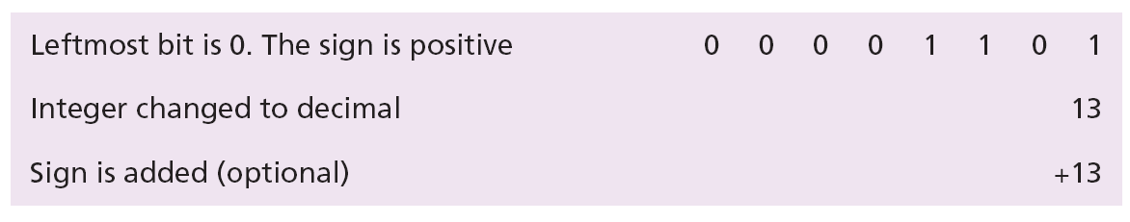
Example 3.14
Retrieve the integer that is stored as 00001101 in memory in two’s complement format.
Solution
The leftmost bit is 0, so the sign is positive. The integer is changed to decimal and the sign is added.
3.<number>

Slide 32
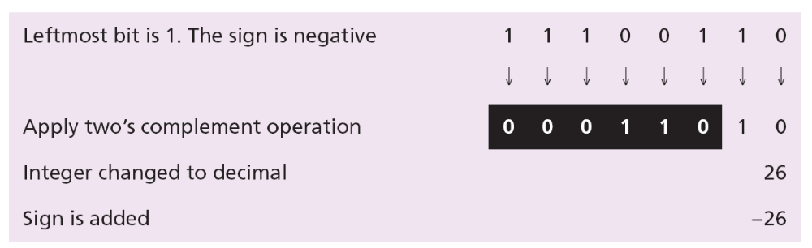
Example 3.15
Retrieve the integer that is stored as 11100110 in memory using two’s complement format.
Solution
The leftmost bit is 1, so the integer is negative. The integer needs to be two’s complemented before changing to decimal.
3.<number>
Notes:
Đổi số âm từ hệ 2 sang hệ 10:
-sử dụng phép bù 2 đưa choỗi nhị phân âm đó về choỗi nhị phân dương
-đổi choỗi nhị phân đó về hệ thập phân
-thêm dấu âm vào
Đối với choỗi nhị phân có bit bên trái ngoài cùng bằng không -> đổi về hệ thập phân (không cần sử dụng phép bù 2)

Slide 33
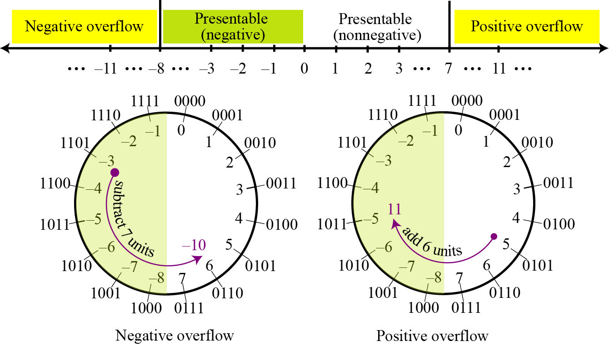
i
There is only one zero in two’s complement notation.
Figure 3.9 Overflow in two’s complement representation

Slide 34
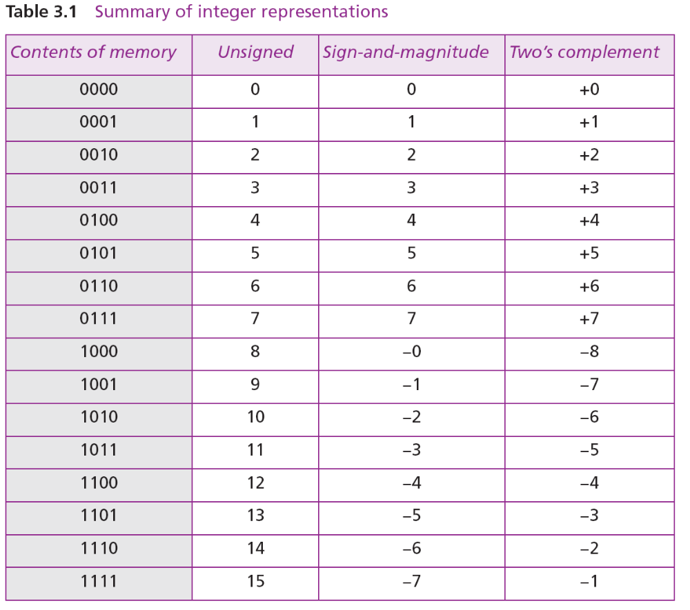
3.2.2 Comparison of the three systems
3.<number>

Slide 35
Storing reals
A real is a number with an integral part and a fractional part. For example, 23.7 is a real number—the integral part is 27 and the fractional part is 7/10. Although a fixed-point representation can be used to represent a real number, the result may not be accurate or it may not have the required precision. The next two examples explain why.
i
Real numbers with very large integral parts or very small fractional parts should not be stored in fixed-point representation.
3.<number>

Slide 36
Example 3.16
In the decimal system, assume that we use a fixed-point representation with two digits at the right of the decimal point and fourteen digits at the left of the decimal point, for a total of sixteen digits. The precision of a real number in this system is lost if we try to represent a decimal number such as 1.00234: the system stores the number as 1.00.
Example 3.17
In the decimal system, assume that we use a fixed-point representation with six digits to the right of the decimal point and ten digits for the left of the decimal point, for a total of sixteen digits. The accuracy of a real number in this system is lost if we try to represent a decimal number such as 236154302345.00. The system stores the number as 6154302345.00: the integral part is much smaller than it should be.
3.<number>

Slide 37
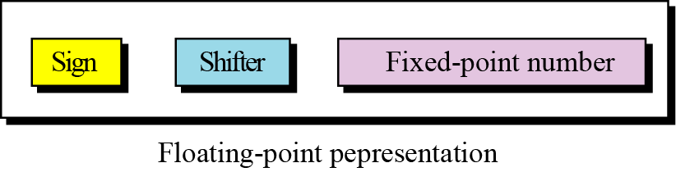
Floating-point representation
The solution for maintaining accuracy or precision is to used floating-point representation.
Figure 3.10 The three parts of a real number in floating-point
i
A floating point representation of a number is made up of three parts: a sign, a shifter, and a fixed-point number.
3.<number>

Slide 38
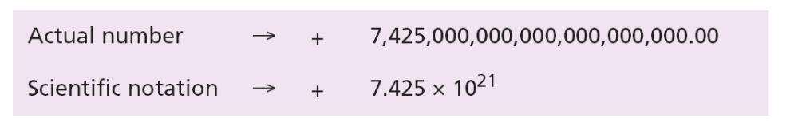
Example 3.18
The following shows the decimal number
7,452,000,000,000,000,000,000.00
in scientific notation (floating-point representation).
The three sections are the sign (+), the shifter (21), and the fixed-point part (7.425). Note that the shifter is the exponent.
3.<number>

Slide 39
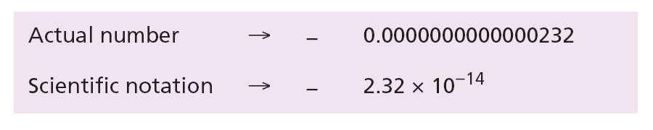
Example 3.19
Show the number
−0.0000000000000232
in scientific notation (floating-point representation).
Solution
We use the same approach as in the previous example—we move the decimal point after the digit 2, as shown below:
The three sections are the sign (−), the shifter (−14), and the fixed-point part (2.32). Note that the shifter is the exponent.
3.<number>

Slide 40
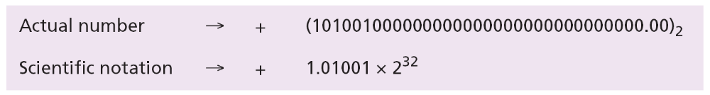
Example 3.20
Show the number
(101001000000000000000000000000000.00)₂
in floating-point representation.
Solution
We use the same idea, keeping only one digit to the left of the decimal point.
3.<number>

Slide 41
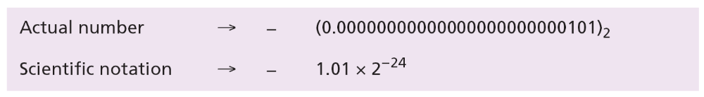
Example 3.21
Show the number
−(0.00000000000000000000000101)₂
in floating-point representation.
Solution
We use the same idea, keeping only one digit to the left of the decimal point.
3.<number>

Slide 42
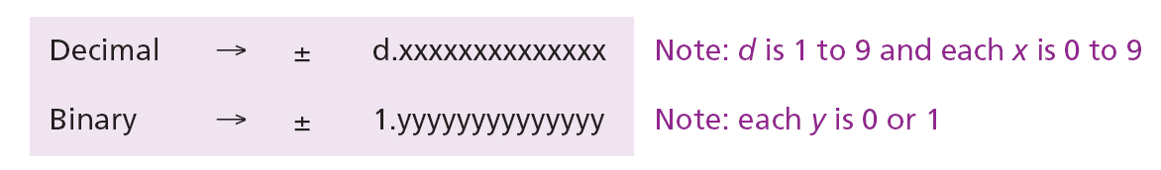
Normalization
To make the fixed part of the representation uniform, both the scientific method (for the decimal system) and the floating-point method (for the binary system) use only one non-zero digit on the left of the decimal point. This is called normalization. In the decimal system this digit can be 1 to 9, while in the binary system it can only be 1. In the following, d is a non-zero digit, x is a digit, and y is either 0 or 1.
3.<number>

Slide 43
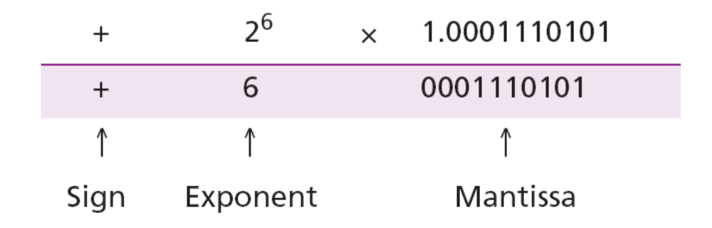
i
Note that the point and the bit 1 to the left of the fixed-point section are not stored—they are implicit.
i
The mantissa is a fractional part that, together with the sign, is treated like an integer stored in sign-and-magnitude representation.
3.<number>

Slide 44
Excess System
The exponent, the power that shows how many bits the decimal point should be moved to the left or right, is a signed number. Although this could have been stored using two’s complement representation, a new representation, called the Excess system, is used instead. In the Excess system, both positive and negative integers are stored as unsigned integers. To represent a positive or negative integer, a positive integer (called a bias) is added to each number to shift them uniformly to the non-negative side. The value of this bias is 2^{m−1} − 1, where m is the size of the memory location to store the exponent.
3.<number>

Slide 45
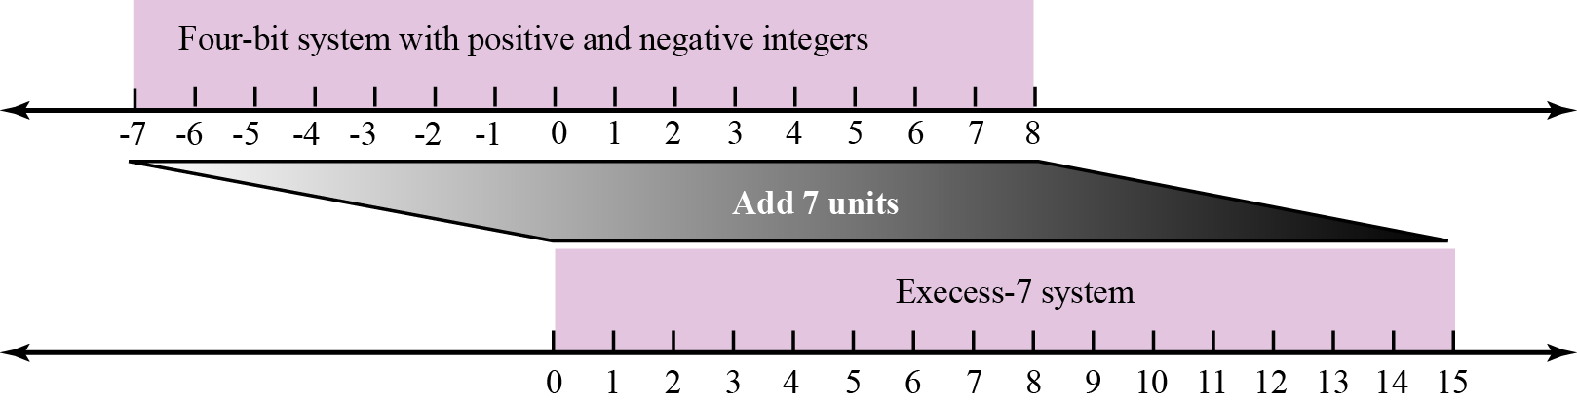
Example 3.22
We can express sixteen integers in a number system with 4-bit allocation. By adding seven units to each integer in this range, we can uniformly translate all integers to the right and make all of them positive without changing the relative position of the integers with respect to each other, as shown in the figure. The new system is referred to as Excess-7, or biased representation with biasing value of 7.
Figure 3.11 Shifting in Excess representation

Slide 46
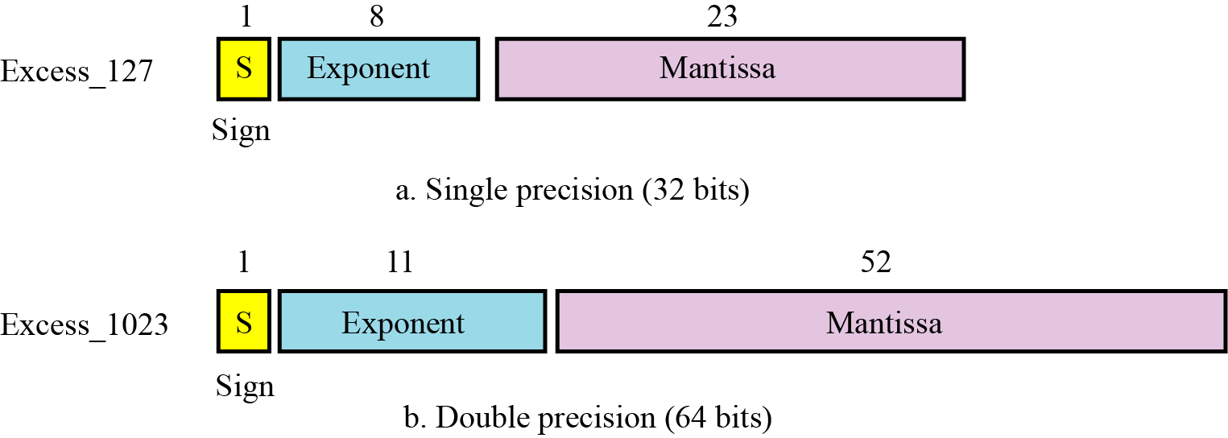
IEEE Standard
Figure 3.12 IEEE standards for floating-point representation
3.<number>

Slide 47
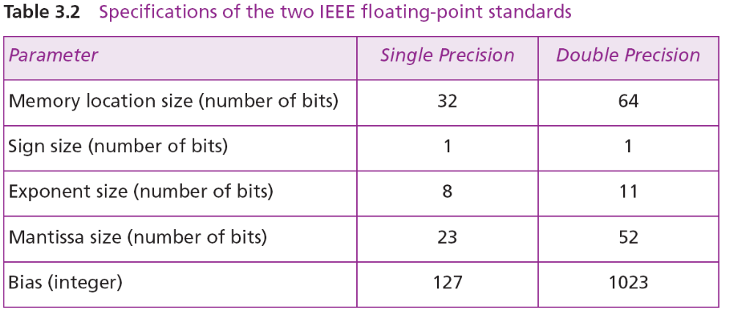
IEEE Specifications
3.<number>

Slide 48
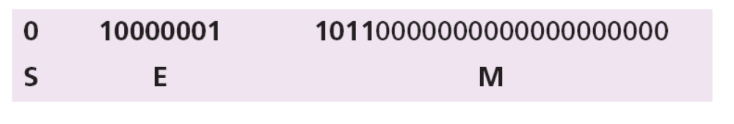
Example 3.23
Show the Excess_127 (single precision) representation of the decimal number5.75.
Solution
The sign is positive, so S = 0.
Decimal to binary transformation: 5.75 = (101.11)₂.
Normalization: (101.11)₂ = (1.1011)₂ × 2².
E = 2 + 127 = 129 = (10000001)₂, M = 1011. We need to add nineteen zeros at the right of M to make it 23 bits.
The presentation is shown below:
The number is stored in the computer as
01000000110110000000000000000000
3.<number>

Slide 49
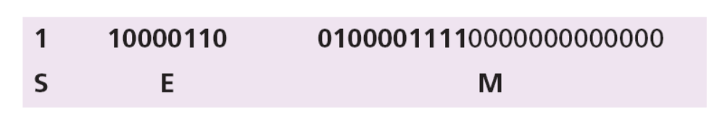
Example 3.24
Show the Excess_127 (single precision) representation of the decimal number –161.875.
Solution
The sign is negative, so S = 1.
Decimal to binary transformation: 161.875= (10100001.111)₂.
Normalization: (10100001.111)₂ = (1.0100001111)₂ × 2⁷.
E = 7 + 127 = 134 = (10000110)₂ and M = (0100001111)₂.
Representation:
The number is stored in the computer as
11000011010000111100000000000000
3.<number>

Slide 50
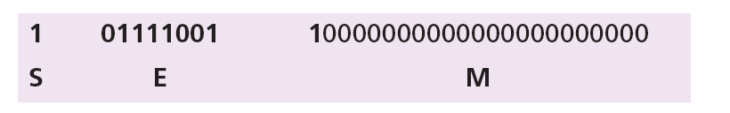
Example 3.25
Show the Excess_127 (single precision) representation of the decimal number –0.0234375.
Solution
S = 1 (the number is negative).
Decimal to binary transformation: 0.0234375 = (0.0000011)₂.
Normalization: (0.0000011)₂ = (1.1)₂ × 2⁻⁶.
E = –6 + 127 = 121 = (01111001)₂ and M = (1)₂.
Representation:
The number is stored in the computer as
10111100110000000000000000000000
3.<number>

Slide 51
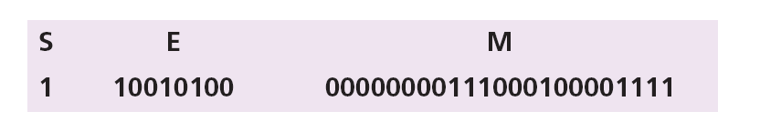
Example 3.26
The bit pattern (11001010000000000111000100001111)₂ is stored in Excess_127 format. Show the value in decimal.
Solution
The first bit represents S, the next eight bits, E and the remaining 23 bits, M.
The sign is negative.
The shifter = E − 127 = 148 − 127 = 21.
This gives us (1.00000000111000100001111)₂ × 2²¹.
The binary number is (1000000001110001000011.11)₂.
The absolute value is 2,104,378.75.
The number is −2,104,378.75.
3.<number>

Slide 52
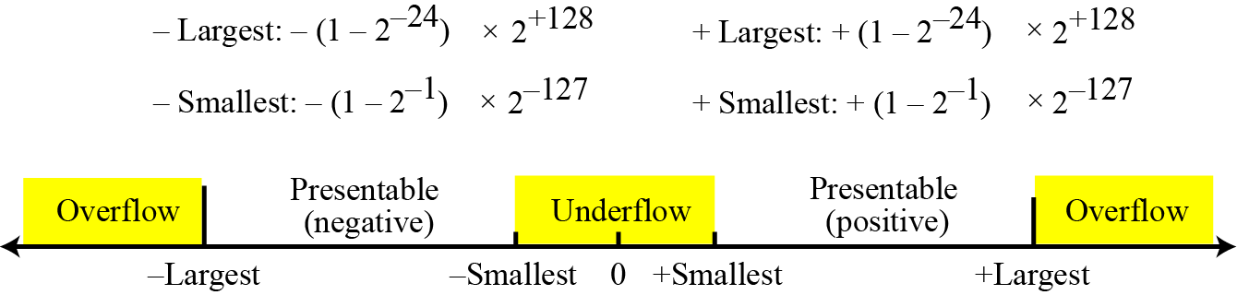
Overflow and Underflow
Figure 3.13 Overflow and underflow in reals
Storing Zero
A real number with an integral part and the fractional part set to zero, that is, 0.0, cannot be stored using the steps discussed above. To handle this special case, it is agreed that in this case the sign, exponent, and the mantissa are set to 0s.
3.<number>

Slide 53
3-3 STORING TEXT
A section of text in any language is a sequence of symbols used to represent an idea in that language. For example, the English language uses 26 symbols (A, B, C,…, Z) to represent uppercase letters, 26 symbols (a, b, c, …, z) to represent lowercase letters, nine symbols (0, 1, 2, …, 9) to represent numeric characters and symbols (., ?, :, ; , …, !) to represent punctuation. Other symbols such as blank, newline, and tab are used for text alignment and readability.
3.<number>

Slide 54
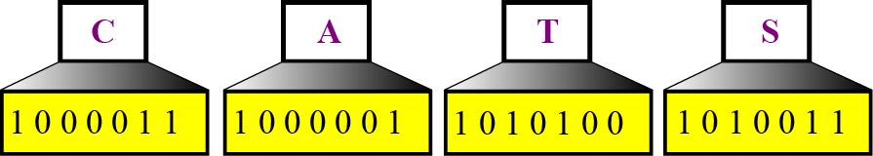
We can represent each symbol with a bit pattern. In other words, text such as “CATS”, which is made up from four symbols, can be represented as four n-bit patterns, each pattern defining a single symbol (Figure 3.14).
Figure 3.14 Representing symbols using bit patterns
3.<number>

Slide 55
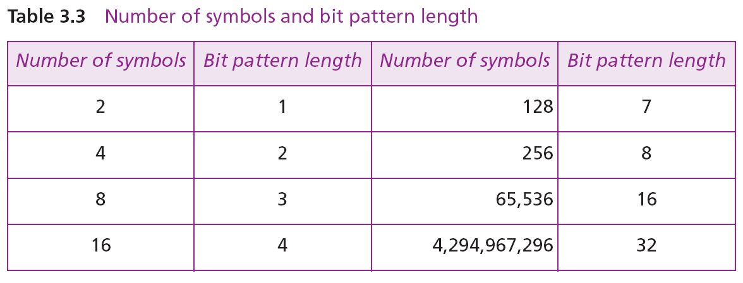
3.<number>

Slide 56
Codes
ASCII
Unicode
Other Codes
i
See Appendix A
3.<number>

Slide 57
3-4 STORING AUDIO
Audio is a representation of sound or music. Audio, by nature, is different than the numbers or text we have discussed so far. Text is composed of countable entities (characters): we can count the number of characters in text. Text is an example of digital data. In contrast, audio is not countable. Audio is an example of analog data. Even if we are able to measure all its values in a period of time, we cannot store these in the computer’s memory, as we would need infinite number of memory locations. Figure 3.15 shows the nature of an analog signal, such as audio, that varies with time.

Slide 58
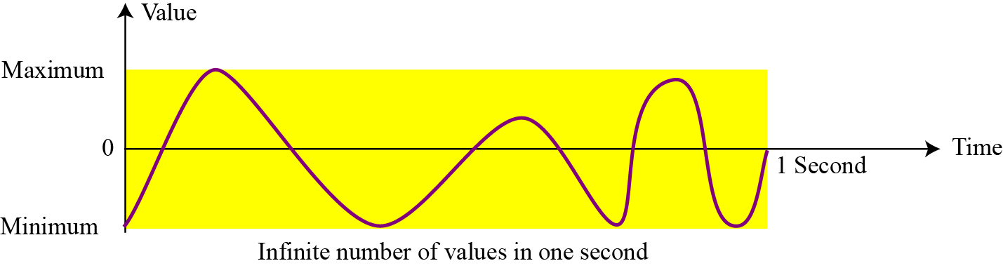
Figure 3.15 An audio signal
3.<number>
Notes:
Âm thanh được lưu trữ dưới dạng hình sin

Slide 59
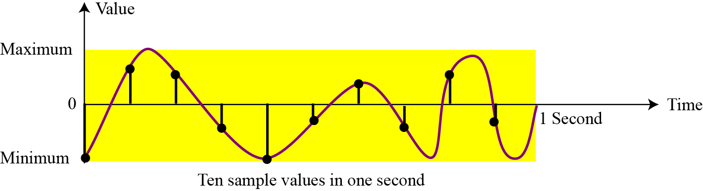
3.4.1 Sampling
If we cannot record all the values of a an audio signal over an interval, we can record some of them. Sampling means that we select only a finite number of points on the analog signal, measure their values, and record them.
Figure 3.16 Sampling an audio signal

Slide 60
3.4.2 Quantization
The value measured for each sample is a real number. This means that we can store 40,000 real values for each one second sample. However, it is simpler to use an unsigned integer (a bit pattern) for each sample. Quantization refers to a process that rounds the value of a sample to the closest integer value. For example, if the real value is 17.2, it can be rounded down to 17: if the value is 17.7, it can be rounded up to 18.
3.<number>

Slide 61
3.4.2 Encoding
The quantized sample values need to be encoded as bit patterns. Some systems assign positive and negative values to samples, some just shift the curve to the positive part and assign only positive values.
If we call the bit depth or number of bits per sample B, the number of samples per second, S, we need to store S × B bits for each second of audio. This product is sometimes refer to as bit rate, R. For example, if we use 40,000 samples per second and 16 bits per each sample, the bit rate is
R = 40,000 × 16 = 640,000 bits per second
3.<number>

Slide 62
3.4.4 Standards for sound encoding
Today the dominant standard for storing audio is MP3 (short for MPEG Layer 3). This standard is a modification of the MPEG (Motion Picture Experts Group) compression method used for video. It uses 44100 samples per second and 16 bits per sample. The result is a signal with a bit rate of 705,600 bits per second, which is compressed using a compression method that discard information that cannot be detected by the human ear. This is called lossy compression, as opposed to lossless compression: see Chapter 15.
3.<number>

Slide 63
3-5 STORING IMAGES
Images are stored in computers using two different techniques: raster graphics and vector graphics.
3.5.1 Raster graphics
Raster graphics (or bitmap graphics) is used when we need to store an analog image such as a photograph. A photograph consists of analog data, similarly to audio information: the difference is that the intensity (color) of data varies in space instead of in time. This means that data must be sampled. However, sampling in this case is normally called scanning. The samples are called pixels (picture elements).
3.<number>

Slide 64
Resolution
Just like audio sampling, in image scanning we need to decide how many pixels we need to record for each square or linear inch. The scanning rate in image processing is called resolution. If the resolution is sufficiently high, the human eye cannot recognize the discontinuity in reproduced images.
Color depth
The number of bits used to represent a pixel, its color depth, depends on how the pixel’s color is handled by different encoding techniques. The perception of color is how our eyes respond to a beam of light. Our eyes have different types of photoreceptor cells: some respond to the three primary colors red, green, and blue (often called RGB), while others merely respond to the intensity of light.
3.<number>

Slide 65
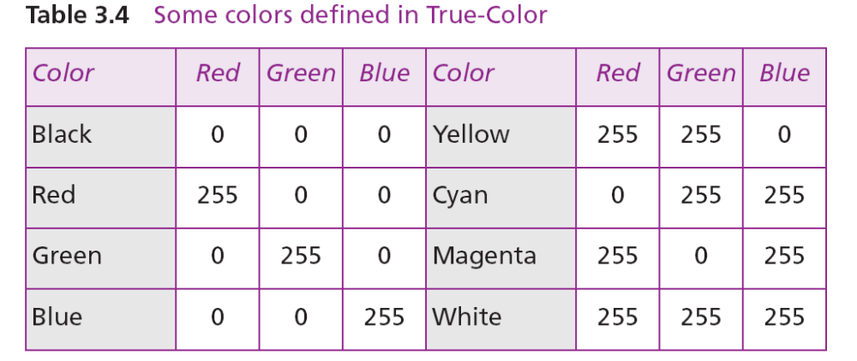
True-Color
One of the techniques used to encode a pixel is called True-Color, which uses 24 bits to encode a pixel.
3.<number>

Slide 66
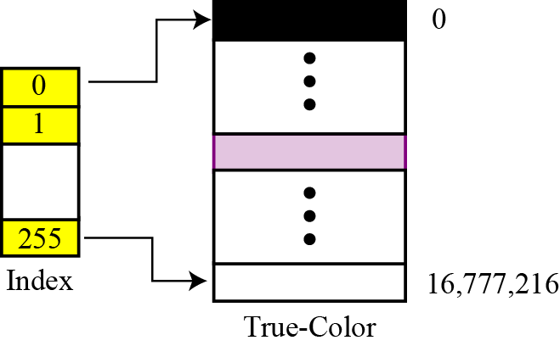
Indexed color
The indexed color—or palette color—scheme uses only a portion of these colors.
Figure 3.17 Relationship of the indexed color to the True-Color

Slide 67
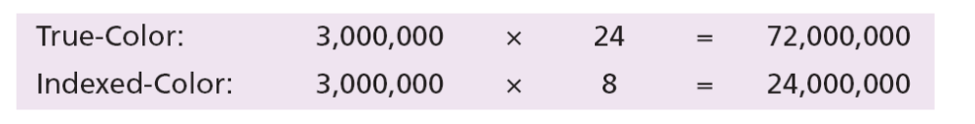
For example, a high-quality digital camera uses almost three million pixels for a 3 × 5 inch photo. The following shows the number of bits that need to be stored using each scheme:
3.<number>

Slide 68
Standards for image encoding
Several de facto standards for image encoding are in use. JPEG (Joint Photographic Experts Group) uses the True-Color scheme, but compresses the image to reduce the number of bits (see Chapter 15). GIF (Graphic Interchange Format), on the other hand, uses the indexed color scheme.
3.<number>

Slide 69
3.5.2 Vector graphics
Raster graphics has two disadvantages: the file size is big and rescaling is troublesome. To enlarge a raster graphics image means enlarging the pixels., so the image looks ragged when it is enlarged. The vector graphic image encoding method, however, does not store the bit patterns for each pixel. An image is decomposed into a combination of geometrical shapes such as lines, squares, or circles.
For example, consider a circle of radius r. The main pieces of information a program needs to draw this circle are:
1. The radius r and equation of a circle.
2. The location of the center point of the circle.
3. The stroke line style and color.
4. The fill style and color.
3.<number>

Slide 70
3-6 STORING VIDEO
Video is a representation of images (called frames) over time. A movie consists of a series of frames shown one after another. In other words, video is the representation of information that changes in space and in time. So, if we know how to store an image inside a computer, we also know how to store video: each image or frame is transformed into a set of bit patterns and stored. The combination of the images then represents the video.
i
See Chapter 15 for video compression.
3.<number>

