Slide 1
Team 4
Madhav
Hoa
Brian
Clayton
Kairos
The Right Time
Your personal scheduling companion

Slide 2
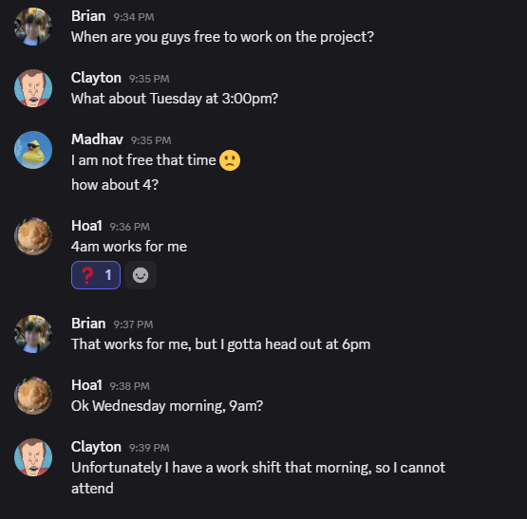
Notes:
[BRIAN]
Existing tools don’t always provide smart insights or flexible collaboration.
A collaborative scheduling platform that simplifies availability sharing, optimizes meeting times, and reduces scheduling conflicts.
Focused on ease of use, smart suggestions, and data-driven insights

Slide 3
Team 4
Why Kairos?
Kairos
Scheduling events is disorganized, time-consuming, and tedious.
Different availability complicates scheduling.
Create an event and invite your friends.
Input your availability.
Obtain a visual of everyone’s availabilities to easily decide a date.

Slide 4
Team 4
Tech Stack and Software Design
Kairos
Backend
Django - Model View Template (MVT)
SQLite + Django ORM
Frontend
Alpine JS
Tailwind CSS

Slide 5
Team 4
Kairos Demo
Kairos
1.
Signup/Login
2.
Event showcase
3.
Creating an event
4.
Joining an event
5.
Event Participation
6.
Notifications
Notes:
While explaining don’t forget to highlight how the application fulfills the projects objectives and requirements

Slide 6
Team 4
Difficult Code Implementation
Kairos
Calendar Schedule API
Calendar API compatibility issues making codebase complex
Resolved with pair programming & shifting tasks

Slide 7
Team 4
Kairos
Challenges and Lessons Learned
Differing project vision + scope
Conflicting code

Slide 8
Team 4
Kairos
Differing Project Vision
Differing ideas of what MVP should look like
Different views on how event scheduling should look
Planning meetings and visuals
Importance of planning and outlining prior to development

Slide 9
Team 4
Kairos
Conflicting Code
Merge conflicts
Clear communication and teamwork
Helped to deal with blockers
Importance of mutually exclusive tasks during sprint planning

Slide 10
Thank you
Any Questions?

