Slide 1
Environment Setup
Professor Jianqing (Fisher) Wu

Slide 2
Overview
Install software
Node.js
Ionic
Cordova
MS Visual Studio Code
Create your first app
Change your first app

Slide 3
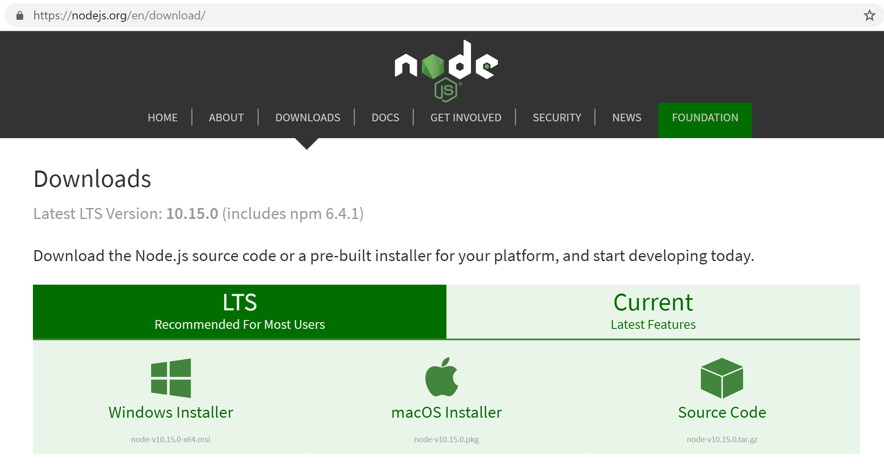
Install NodeJS
Download NodeJS at https://nodejs.org/en/download/

Slide 4
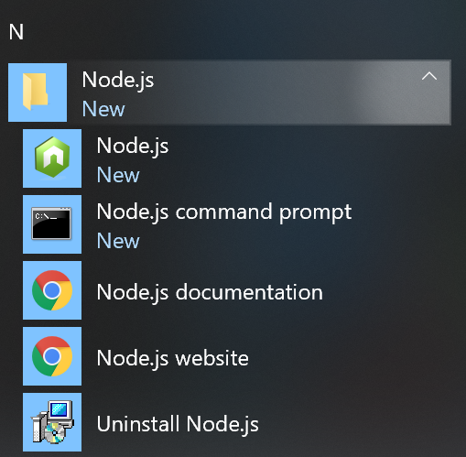
Install NodeJS
Find and open “Node.js command prompt” in Start Menu.

Slide 5
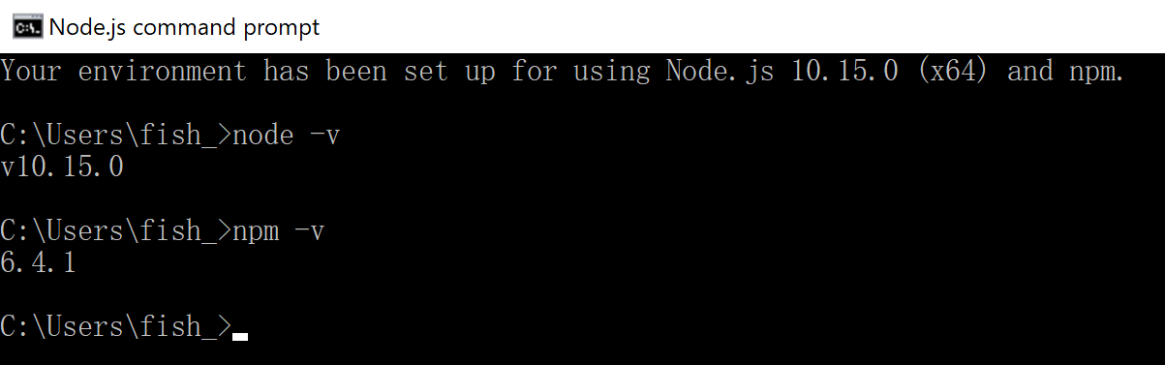
Install NodeJS
Run “node –v” command to check whether the installation is successful.
You can also run “npm –v” command to check the version of npm (nodejs package manager).

Slide 6
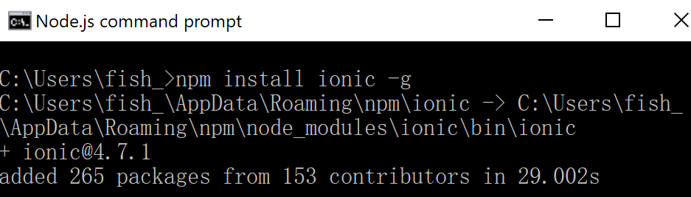
Install Ionic
Run “npm install ionic -g” command to install Ionic.
Mac users probably need to use “sudo npm install ionic -g” command instead, and enter your laptop password.

Slide 7
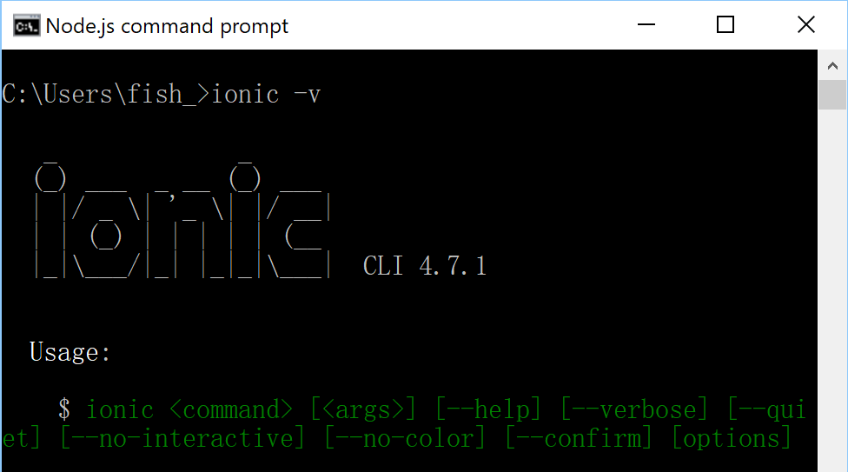
Install Ionic
Run “ionic –v” commend to check whether the installation is successful.

Slide 8
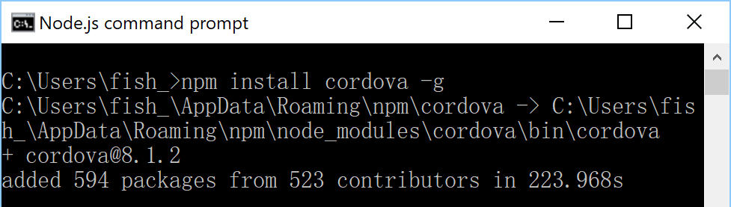
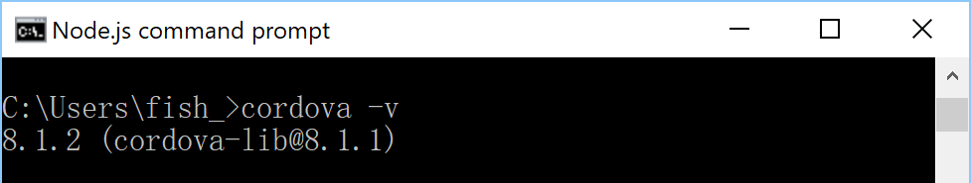
Install Cordova
Run “npm install cordova -g” command to install Cordova.
Run “cordova –v” commend to check whether the installation is successful.

Slide 9
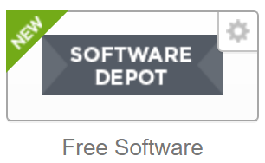
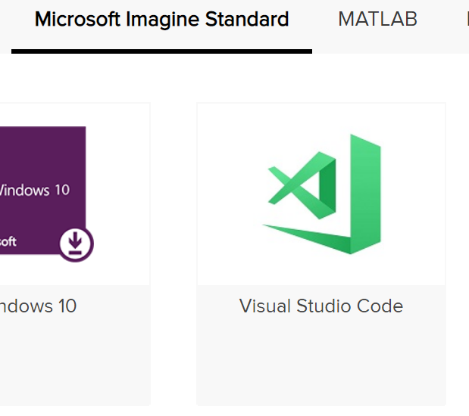
Install Visual Studio Code as editor
Open “Free Software” in Student Center
Download and install Visual Studio Code

Slide 10
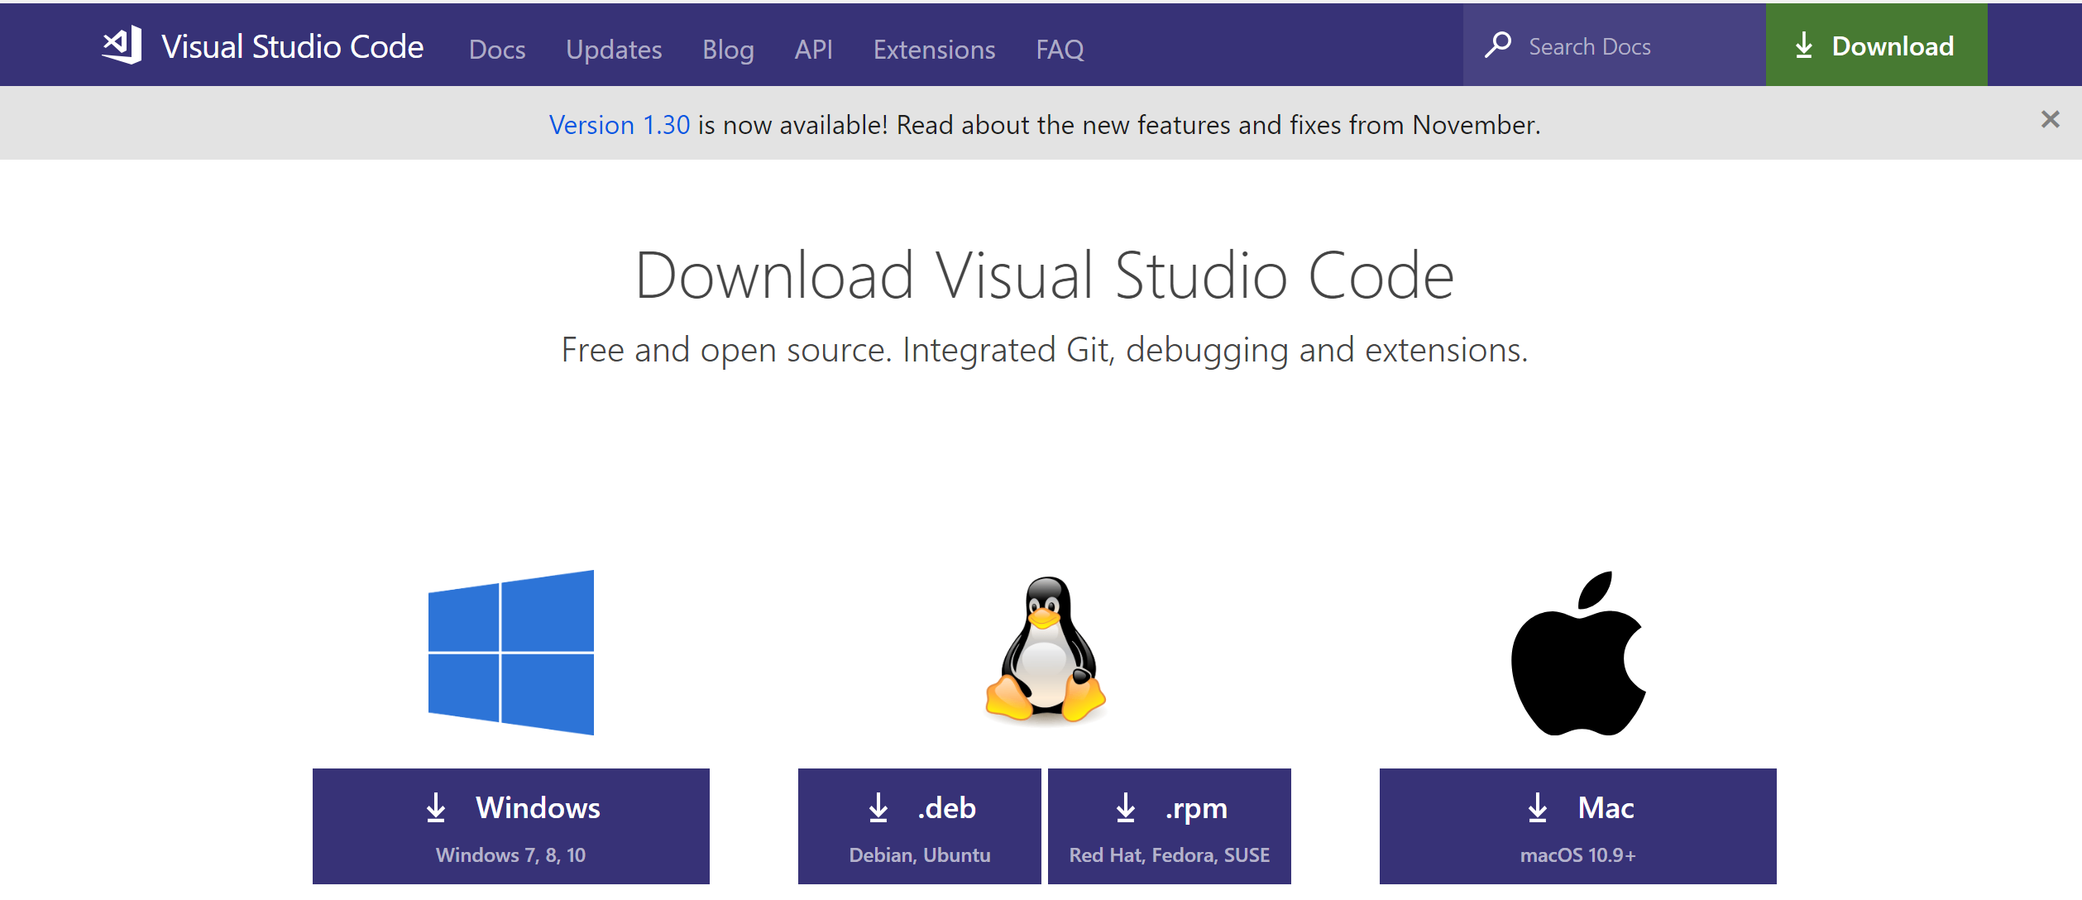
Install Visual Studio Code as editor
Order Visual Studio Code for free.
Choose the version to download and install according to your own operation system (Windows or Mac).

Slide 11
Install Visual Studio Code (VSC) Plugins
Install the following plugins after installing VSC.
Angular Language Service
Angular v7 Snippets
TypeScript TSLint Plugin

Slide 12
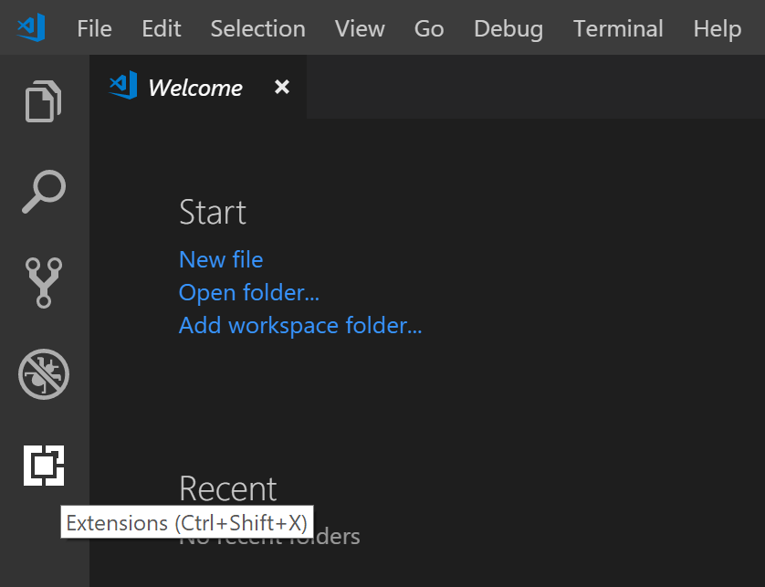
Install Visual Studio Code (VSC) Plugins
Click Extensions Icon in VSC

Slide 13
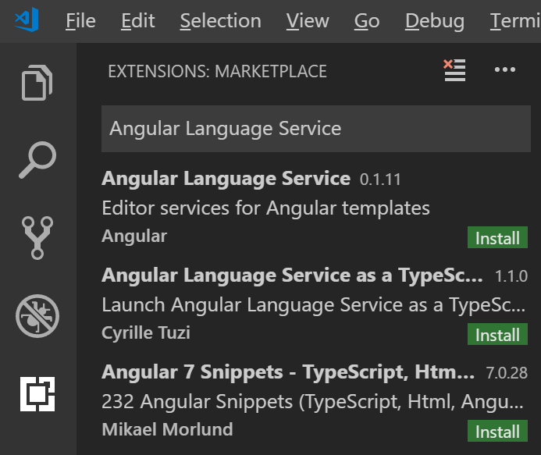
Install Visual Studio Code (VSC) Plugins
Type “Angular Language Service” in Search Bar and click “Install” Button
Repeat the same procedure for the other two plugins.

Slide 14
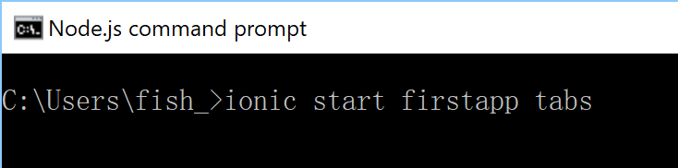
Create Your First App
Use “ionic start firstapp tabs” command to create your first app!
Install the free Ionic Appflow SDK and connect your app? n

Slide 15
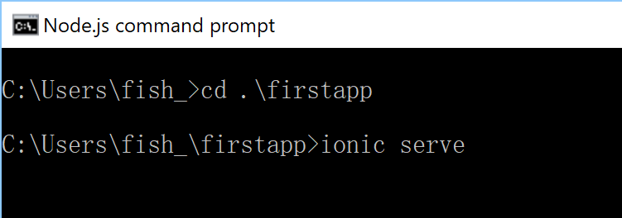
Create Your First App
Run the following two commands to see your first app
cd .\firstapp
Ionic serve
Now you can open http://localhost:8100/ in your web-browser (strongly recommend to use Chrome) to see your first app.

Slide 16
Create Your First App
Change to Developer mode to see how your app looks like in a cell phone or in a tablet
On Mac - ⌘ + Shift + C.
On Windows / Linux - Ctrl + Shift + C OR F12.

Slide 17
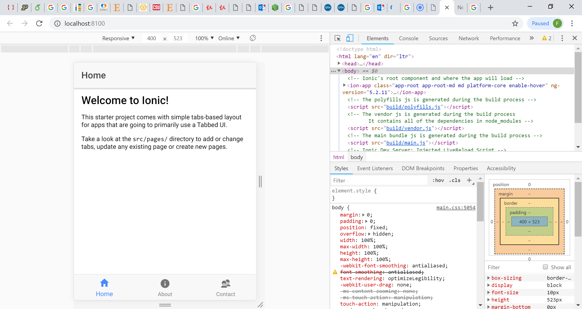
Creating your First App

Slide 18
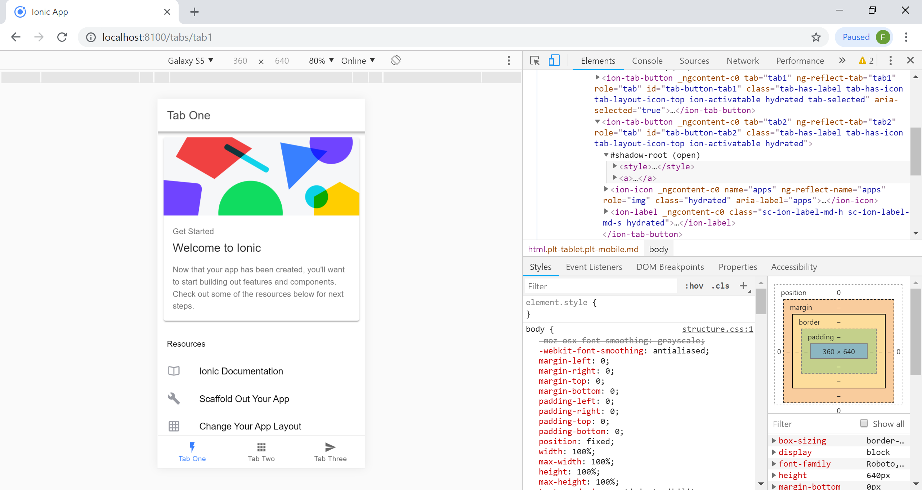
Create Your First App

Slide 19
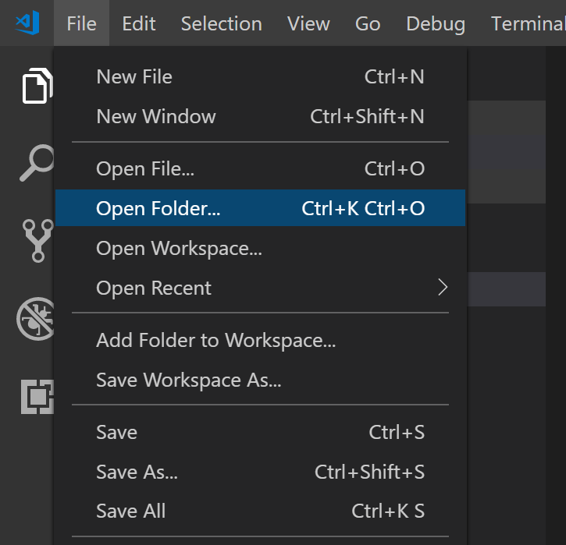

Change Your First App
Open your project in Visual Studio Code
Your folder:

Slide 20
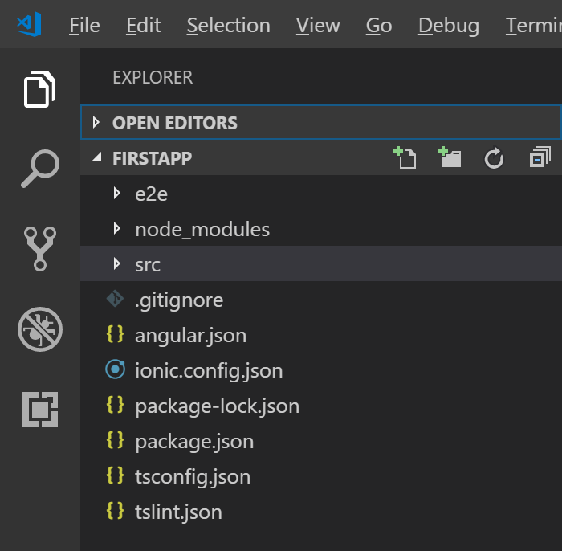
Change Your First App
Open your project in Visual Studio Code

Slide 21
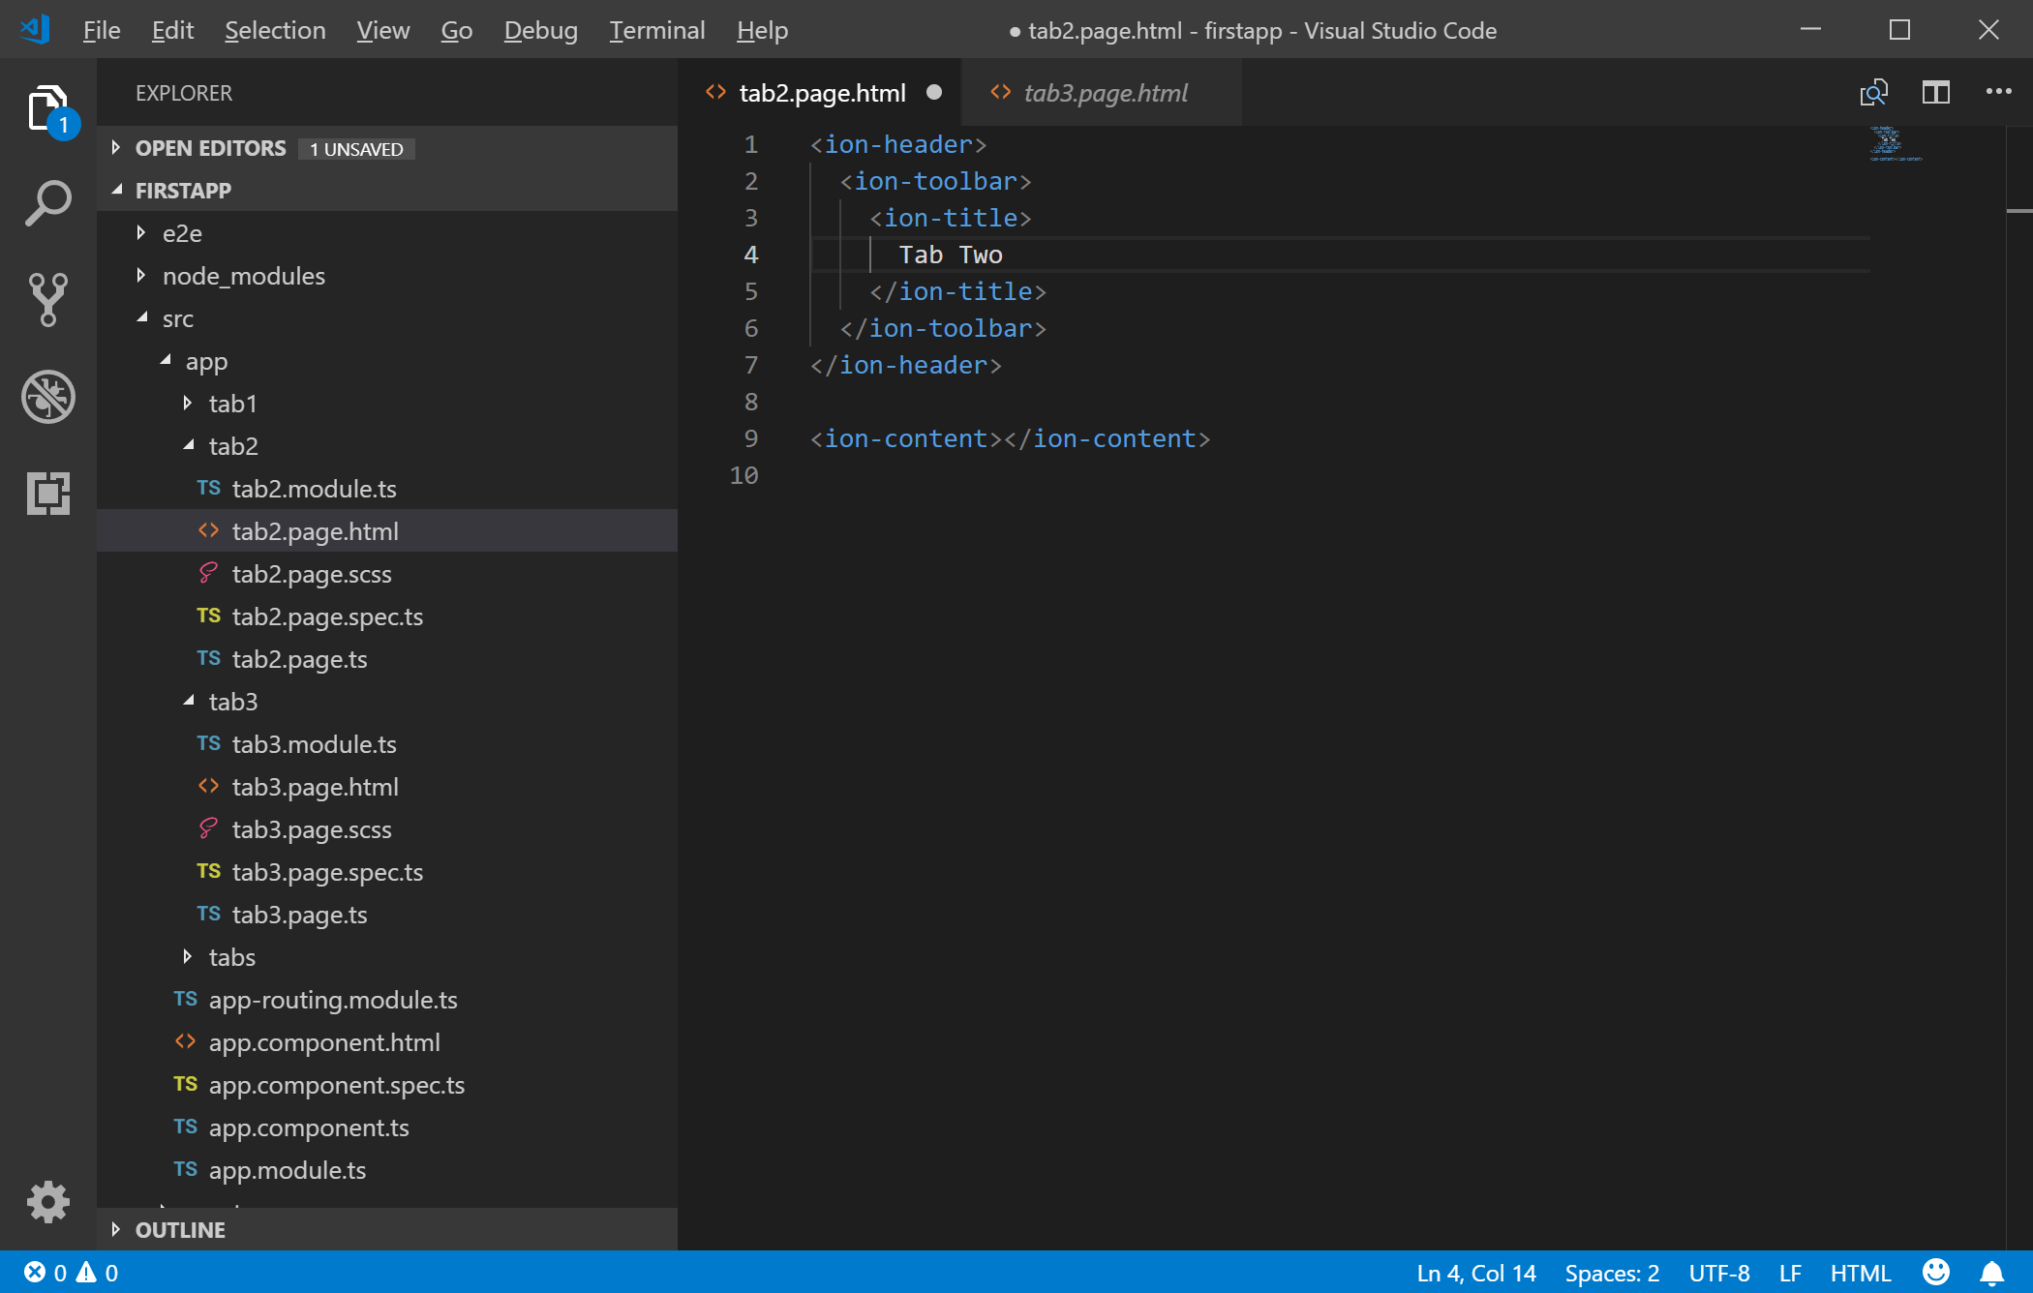
Change Your First App
Click FIRSTAPP=>SRC=>tab2=>tab2.page.html

Slide 22
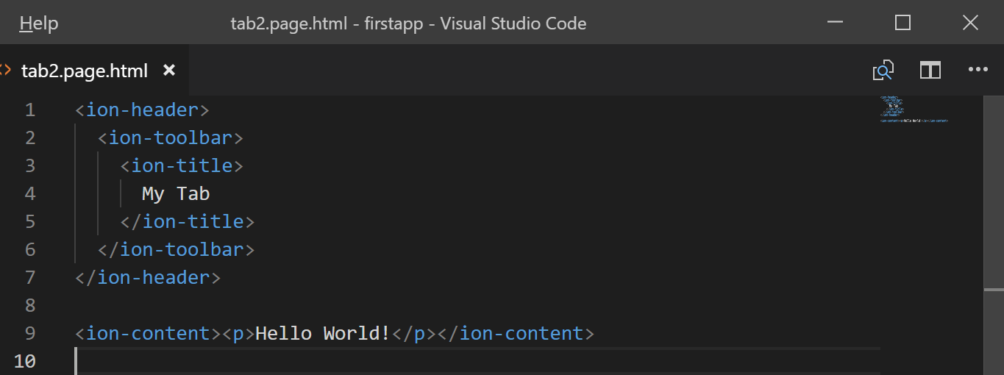
Change Your First App
Change title to “My Tab”
Change <ion-content></ion-content> to <ion-content><p>Hello World!</p></ion-content>
Save your page

Slide 23
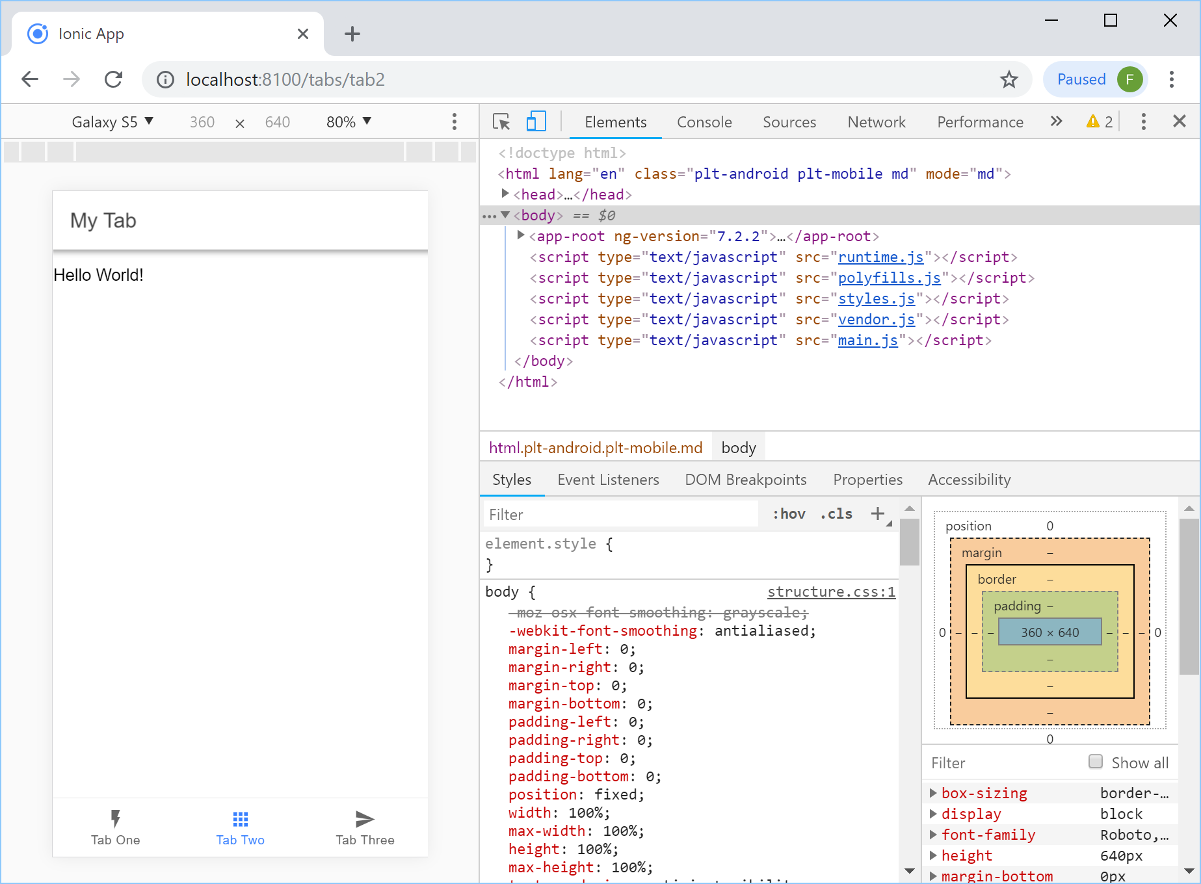
Change Your First App
Click “Tab Two” in Chrome, you will see the page you changed.

