Slide 1


MANUFACTURING PERFORMANCE OVERVIEW
MPO
Machine Data → Performance → Action
Centralized production reporting for management, engineering, and maintenance.
LNB • SFTP • Node-RED • PostgreSQL • ASP.NET Core • Docker
PROJECT PROCESS & DESIGN OVERVIEW
PANASONIC • 01
Notes:
MPO is a web-based manufacturing performance reporting system that turns raw LNB machine data into dashboards and reports for daily operations.

Slide 2
EXECUTIVE SUMMARY
MPO Turns Machine Data into Action
One automated flow unifies output, quality, and downtime—from .u01 files to the management dashboard.
01
02
03
Centralize
Analyze
Act
One unified reporting source for LNB machine data.
Drill down by line, lane, machine, model, part, feeder, and nozzle.
Identify at-risk equipment, investigate root causes, and export data.
Outcome: raw data becomes evidence for daily operations.
MPO | Manufacturing Performance Overview
PANASONIC • 02
Notes:
The dashboard highlights areas that need attention; detailed reports provide evidence for investigation.

Slide 3
BUSINESS VALUE
Four Direct Operational Benefits
01
02
One Data Source
Reduce Manual Work
Centralize production, quality, and downtime.
Eliminate multiple consolidation and file-reconciliation steps.
03
04
Faster Root-Cause Analysis
Flexible Sharing
Trace issues from line to feeder, nozzle, or part.
Export filtered results in an Excel-compatible format.
MPO | Manufacturing Performance Overview
PANASONIC • 03

Slide 4
SYSTEM AT A GLANCE
One Architecture, One Data Flow
01
02
03
04
05
LNB
SFTP
Node-RED
PostgreSQL
Web MPO
.u01 raw data
Secure transfer
Parse + delta
Store + state
Dashboard + export
AUTOMATED
No manual file handling is needed after data enters PostgreSQL.
MPO | Manufacturing Performance Overview
PANASONIC • 04
Notes:
Overall flow: LNB raw data, SFTP, incoming folder, Node-RED Watch, parsing and delta calculation, PostgreSQL, ASP.NET Core, and the web frontend in Docker.

Slide 5
01
DATA PIPELINE
How MPO ingests, standardizes, and preserves cumulative counter meaning.
From Raw Data to Operational Decisions
MPO | Manufacturing Performance Overview
PANASONIC • 05

Slide 6
END-TO-END FLOW
Automated Data Flow in 8 Steps
01
LNB Generates File
02
SFTP Transfers File
03
Watch Detects File
04
Parse Content
.u01 counters
incoming folder
filter valid files
machine + report
05
Calculate Delta
06
Write to Database
07
Restore State
08
Display on Web
count + time
stored procedure
after restart
dashboard + export
Critical control: delta counters + state persistence.
MPO | Manufacturing Performance Overview
PANASONIC • 06
Notes:
The entire process is automated, from raw files to reports. After data is stored in PostgreSQL, users work directly through the web dashboard.

Slide 7
INGESTION & PARSING
Node-RED Standardizes .u01 Files
01
02
03
Machine identity
Production context
Operational counters
Line • machine • lane • stage • type • version
MJS ID • lot • product • report date • output
Cycle time • production • downtime • error counters
MountPickupFeeder
→ feeder list by part, address, reel, and miss counters
MountPickupNozzle
→ nozzle list by head, address, name, and miss counters
MPO | Manufacturing Performance Overview
PANASONIC • 07

Slide 8
CORE PROCESSING LOGIC
Delta Counters Preserve Actual Output
First Reading
Delta = Current
DELTA
No previous state
= Current counter − Previous counter
Normal
Delta = Current − Previous
Applied to
Record only the increment
Production • Time • Feeder • Nozzle
Counter reset
Delta = Current
Current < Previous
Prevent double counting • Handle machine resets • Maintain period accuracy
MPO | Manufacturing Performance Overview
PANASONIC • 08
Notes:
This is the most important point in the flow. Machines send cumulative values, while the system needs the actual increment for each period. Delta calculation prevents double counting and handles counter resets.

Slide 9
EQUIPMENT-LEVEL DATA
Equipment Details Also Use Delta
F
N
Feeder delta
Nozzle delta
Pickup, mount, and miss groups by feeder / slot / part.
Pickup, mount, and miss groups by nozzle / head.
Unified JSON payload → report_data + feeder_data + nozzle_data + raw_state
MPO | Manufacturing Performance Overview
PANASONIC • 09

Slide 10
STATE RECOVERY
Restart Does Not Lose Delta Context
RUN
STATE
RESTORE
machine_counter_state stores the latest raw counters plus feeder_state and nozzle_state JSONB.
Node-RED starts → loads state into flow context → continues accurate delta calculation.
MPO | Manufacturing Performance Overview
PANASONIC • 10
Notes:
When Node-RED starts, the flow queries machine_counter_state and reloads the counters for each machine, feeder, and nozzle into the flow context.

Slide 11
02
DATA FOUNDATION
PostgreSQL combines relational schemas and JSONB for speed and flexibility.
From Raw Data to Operational Decisions
MPO | Manufacturing Performance Overview
PANASONIC • 11

Slide 12
POSTGRESQL DATA MODEL
Four Tables Form the Data Backbone
DETAIL
FACT
1 : N
feeder_logs
production_reports
Feeder details by report
MASTER
1 : N
master_machines
Central report history
Standardized machine catalog
1 : N
DETAIL
nozzle_logs
1 : 1
Nozzle details by report
STATE
machine_counter_state
Latest raw state
MPO | Manufacturing Performance Overview
PANASONIC • 12
Notes:
The database separates master data, report history, feeder/nozzle details, and technical state. Clear relationships support fast reporting while preserving delta recovery after restart.

Slide 13
CENTRAL FACT TABLE
production_reports: Historical Data
OUTPUT
TIME
output_qty • board • module • pickup • mount
power on • production • stop • wait • error
QUALITY
CYCLE
pickup miss • mount miss • recognition • trouble
cycle_time_1 • cycle_time_2 • cycle_time_3
Analysis dimensions: machine • report date • MJS • product • lot • file
MPO | Manufacturing Performance Overview
PANASONIC • 13

Slide 14
DETAIL TABLES
Feeder and Nozzle Enable Root-Cause Analysis
feeder_logs
nozzle_logs
Block code / serial / part / reel
Head number / nozzle name
Feeder & sub-feeder address
Nozzle & component address
Pickup, mount, and miss counters
Pickup, mount, and miss counters
Multiple feeders per report
Multiple nozzles per report
Outcome: prioritize the exact feeder, slot, reel, part, nozzle, or head to inspect.
MPO | Manufacturing Performance Overview
PANASONIC • 14

Slide 15
HYBRID STORAGE
Relational + JSONB: Fast and Flexible
SQL
JSON
Relational columns
JSONB fields
+
Core fields support stable filtering, joins, indexes, and reporting.
Rare time stats, count stats, feeder state, and nozzle state remain flexible.
Foreign keys preserve relationships
ON DELETE CASCADE for details
Indexes by date, machine, MJS, lot, report, and address
MPO | Manufacturing Performance Overview
PANASONIC • 15

Slide 16
STORED PROCEDURE
One Centralized Write Point
CALL
insert_full_production_report(payload JSONB)
01
02
03
04
05
Upsert Machine
Insert report
Insert feeders
Insert nozzles
Update counter state
Node-RED standardizes data; PostgreSQL handles relationships, writes, and state updates.
MPO | Manufacturing Performance Overview
PANASONIC • 16
Notes:
The stored procedure is the centralized write point: read machine_id, upsert master data, insert the report, process feeders/nozzles, and update machine_counter_state.

Slide 17
03
REPORTING APP
The application turns PostgreSQL data into dashboards, drill-downs, and exports.
From Raw Data to Operational Decisions
MPO | Manufacturing Performance Overview
PANASONIC • 17

Slide 18
APPLICATION ARCHITECTURE
Tech Stack Optimized for Web Reporting
COLLECT
STORE
BACKEND
SFTP + Node-RED
PostgreSQL
.NET 9 + ASP.NET Core MVC
DATA
FRONTEND
DEPLOY
EF Core + Npgsql
Razor + Bootstrap + Chart.js
Docker containers
PostgreSQL → report services → MVC controllers → Razor pages → dashboard / table / export
MPO | Manufacturing Performance Overview
PANASONIC • 18

Slide 19
REPORT PORTFOLIO
Nine Views of the Same Data
01
Overall Dashboard
02
Board Count
03
Production Report
04
By Part
05
By Feeder
06
By Nozzle
07
Cycle Time
08
Downtime
09
Total Pickup / Placement
Dashboard for direction → detailed reports for evidence and action.
MPO | Manufacturing Performance Overview
PANASONIC • 19

Slide 20
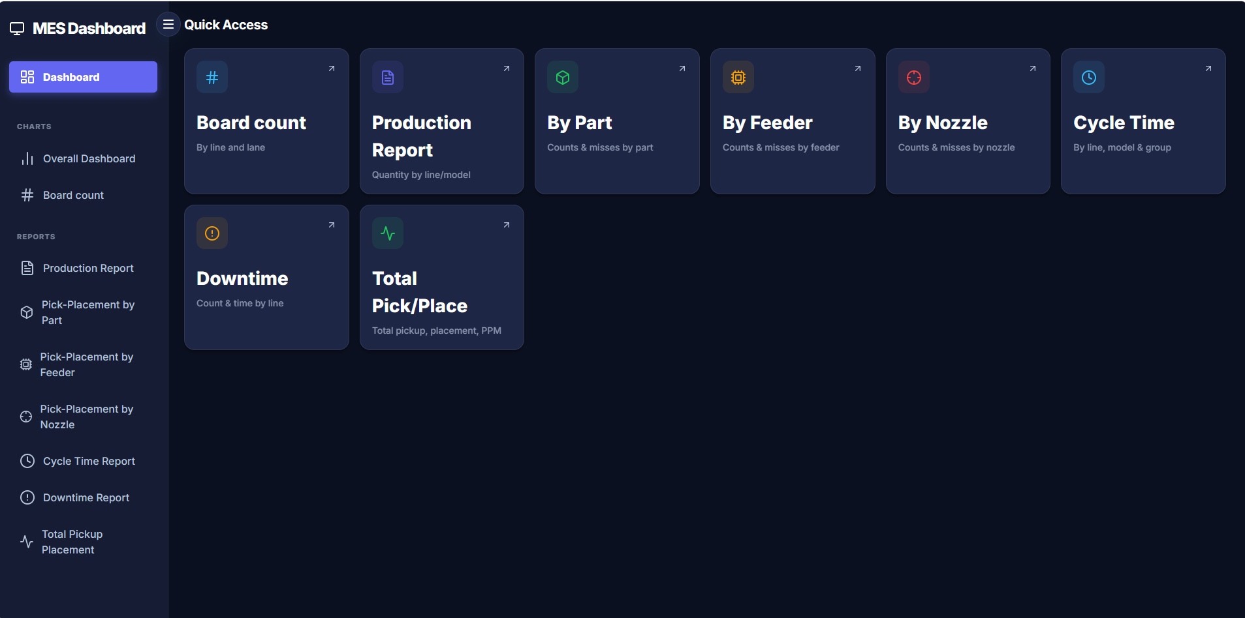
REAL APPLICATION • QUICK ACCESS
SCREEN 01 / 10
One-click access to the complete MPO reporting suite.
Notes:
QUICK ACCESS: One-click access to the complete MPO reporting suite. Use this screen as evidence of the implemented workflow and explain the visible filters, results and export actions.

Slide 21
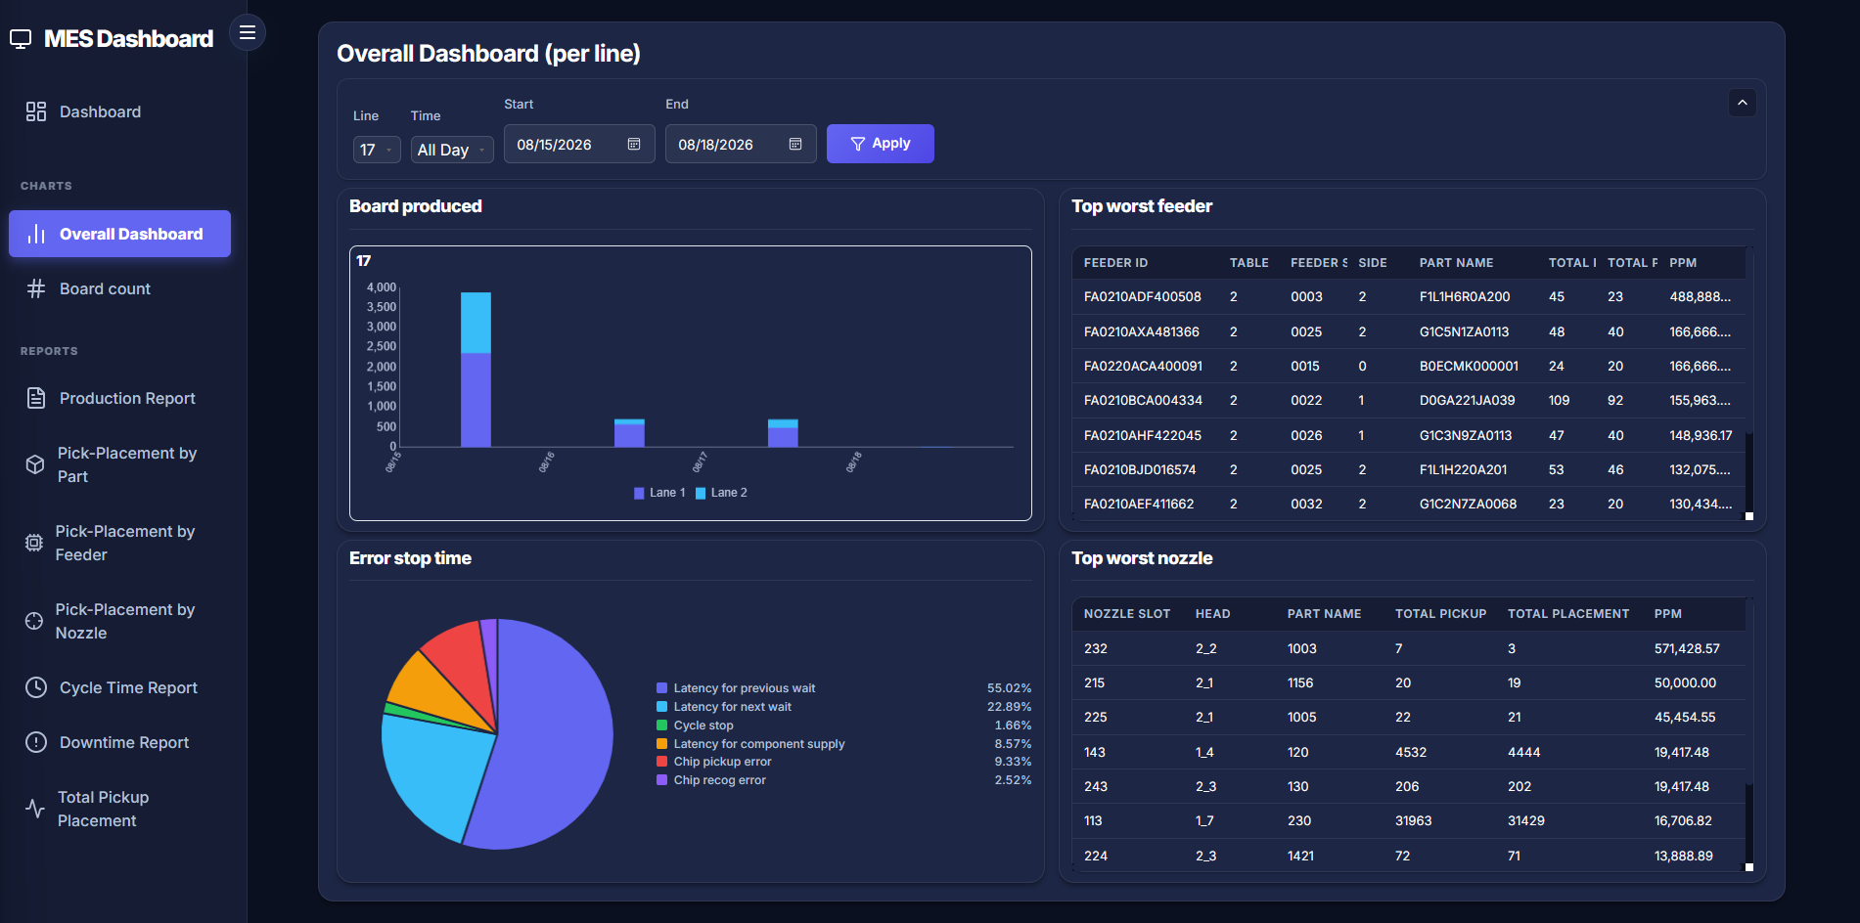
REAL APPLICATION • OVERALL DASHBOARD
SCREEN 02 / 10
Management view combining output, equipment risk and downtime.
Notes:
OVERALL DASHBOARD: Management view combining output, equipment risk and downtime. Use this screen as evidence of the implemented workflow and explain the visible filters, results and export actions.

Slide 22
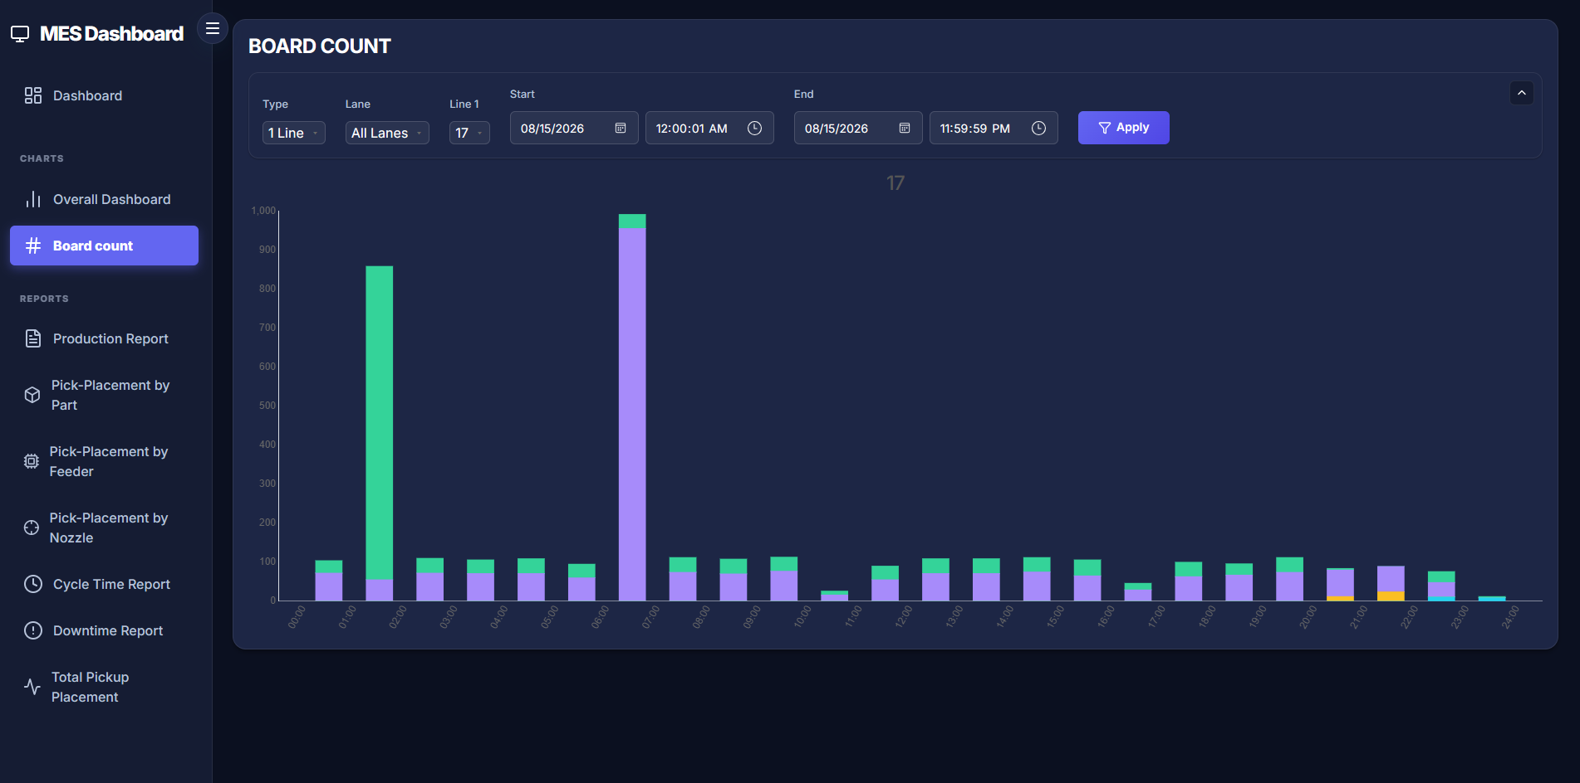
REAL APPLICATION • BOARD COUNT
SCREEN 03 / 10
Hourly output comparison by line and lane.
Notes:
BOARD COUNT: Hourly output comparison by line and lane. Use this screen as evidence of the implemented workflow and explain the visible filters, results and export actions.

Slide 23
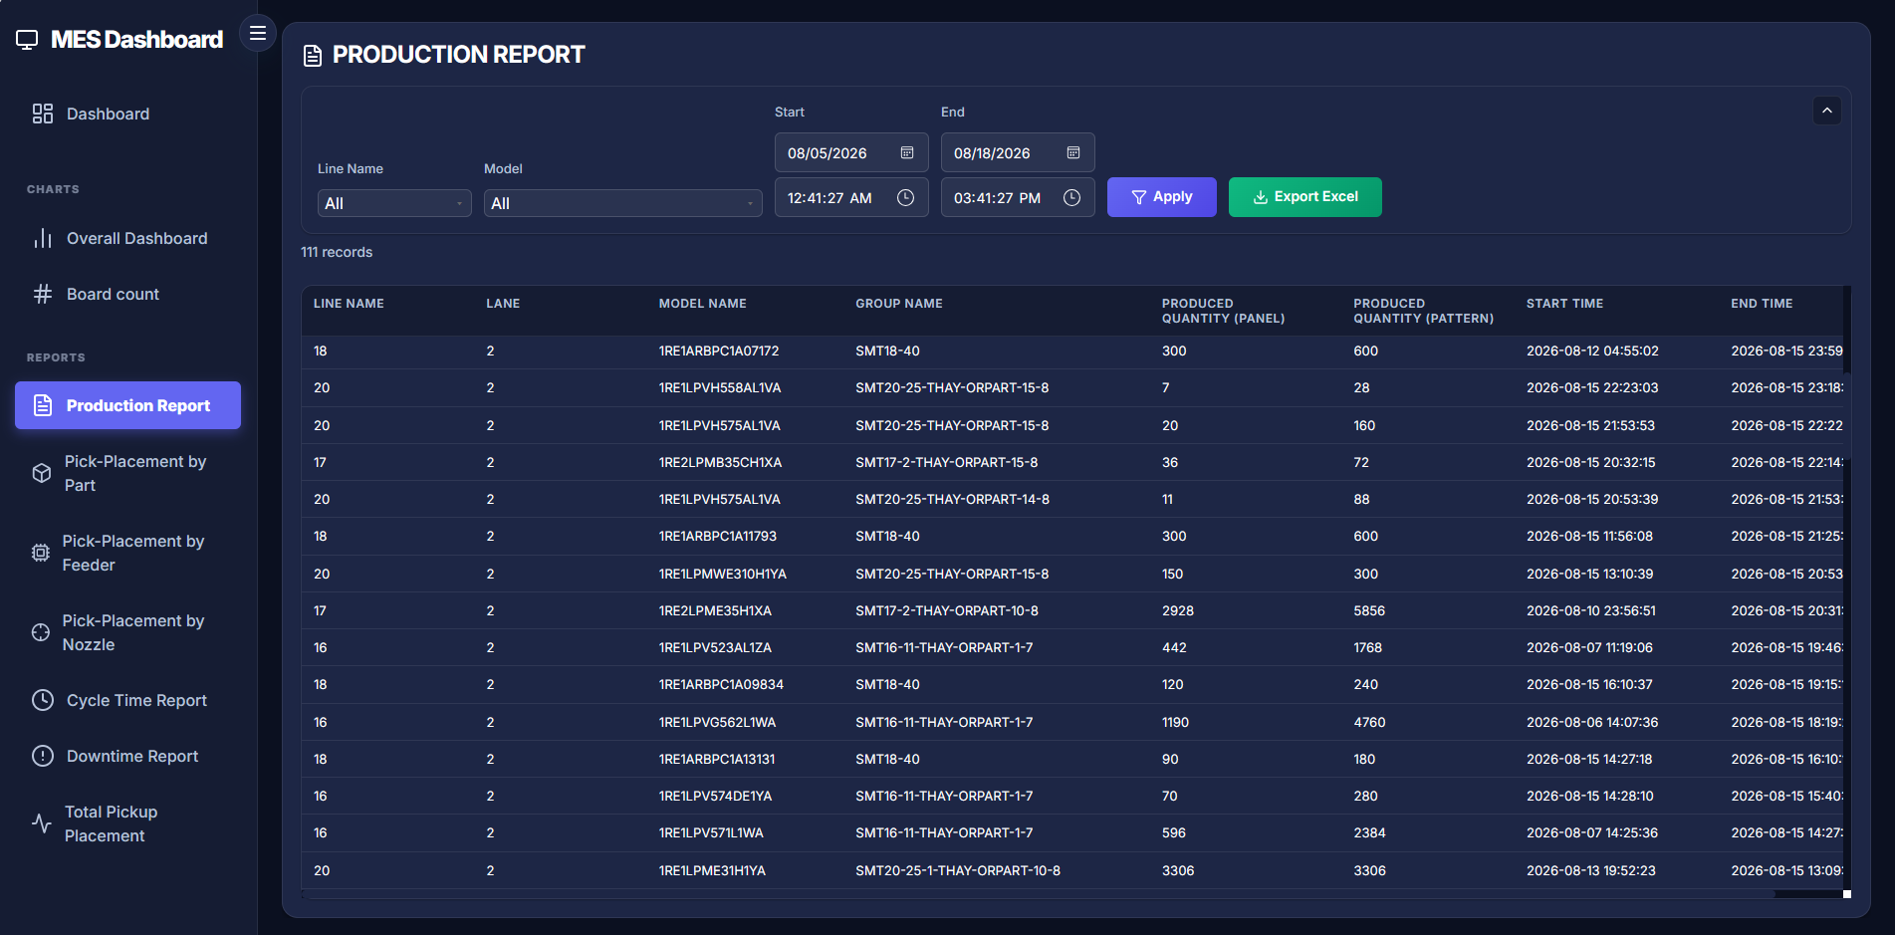
REAL APPLICATION • PRODUCTION REPORT
SCREEN 04 / 10
Filtered production history with Excel export.
Notes:
PRODUCTION REPORT: Filtered production history with Excel export. Use this screen as evidence of the implemented workflow and explain the visible filters, results and export actions.

Slide 24
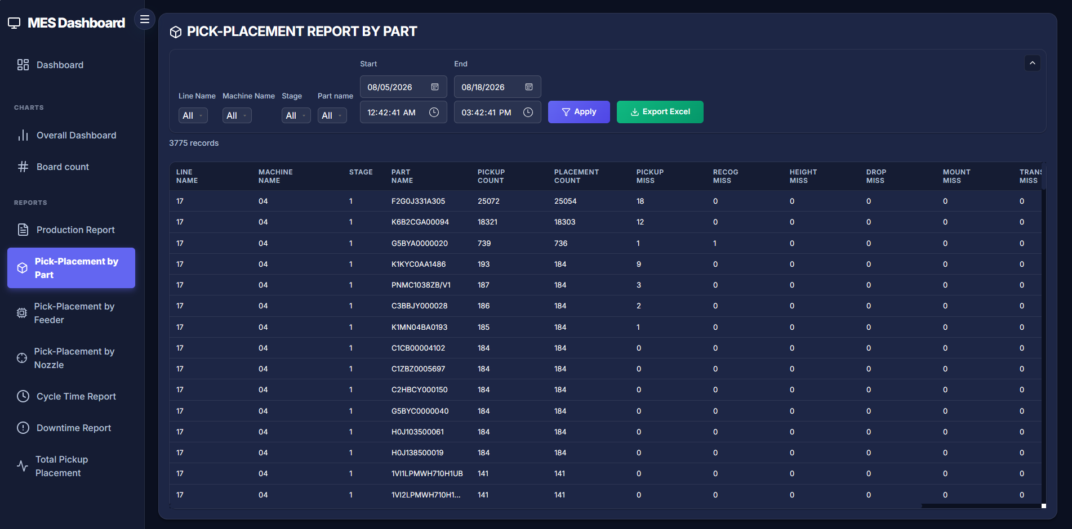
REAL APPLICATION • PICK-PLACEMENT BY PART
SCREEN 05 / 10
Trace misses and placement quality to part level.
Notes:
PICK-PLACEMENT BY PART: Trace misses and placement quality to part level. Use this screen as evidence of the implemented workflow and explain the visible filters, results and export actions.

Slide 25
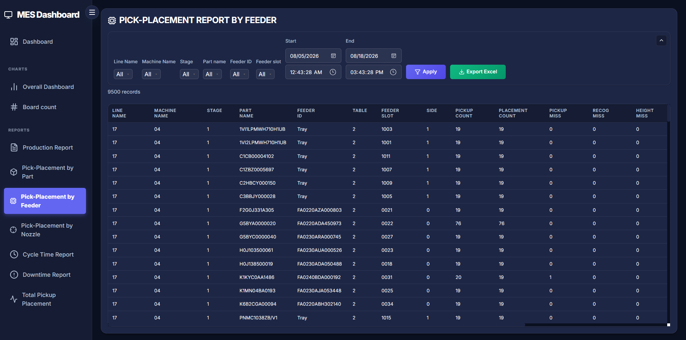
REAL APPLICATION • PICK-PLACEMENT BY FEEDER
SCREEN 06 / 10
Identify feeder, slot and material-related losses.
Notes:
PICK-PLACEMENT BY FEEDER: Identify feeder, slot and material-related losses. Use this screen as evidence of the implemented workflow and explain the visible filters, results and export actions.

Slide 26
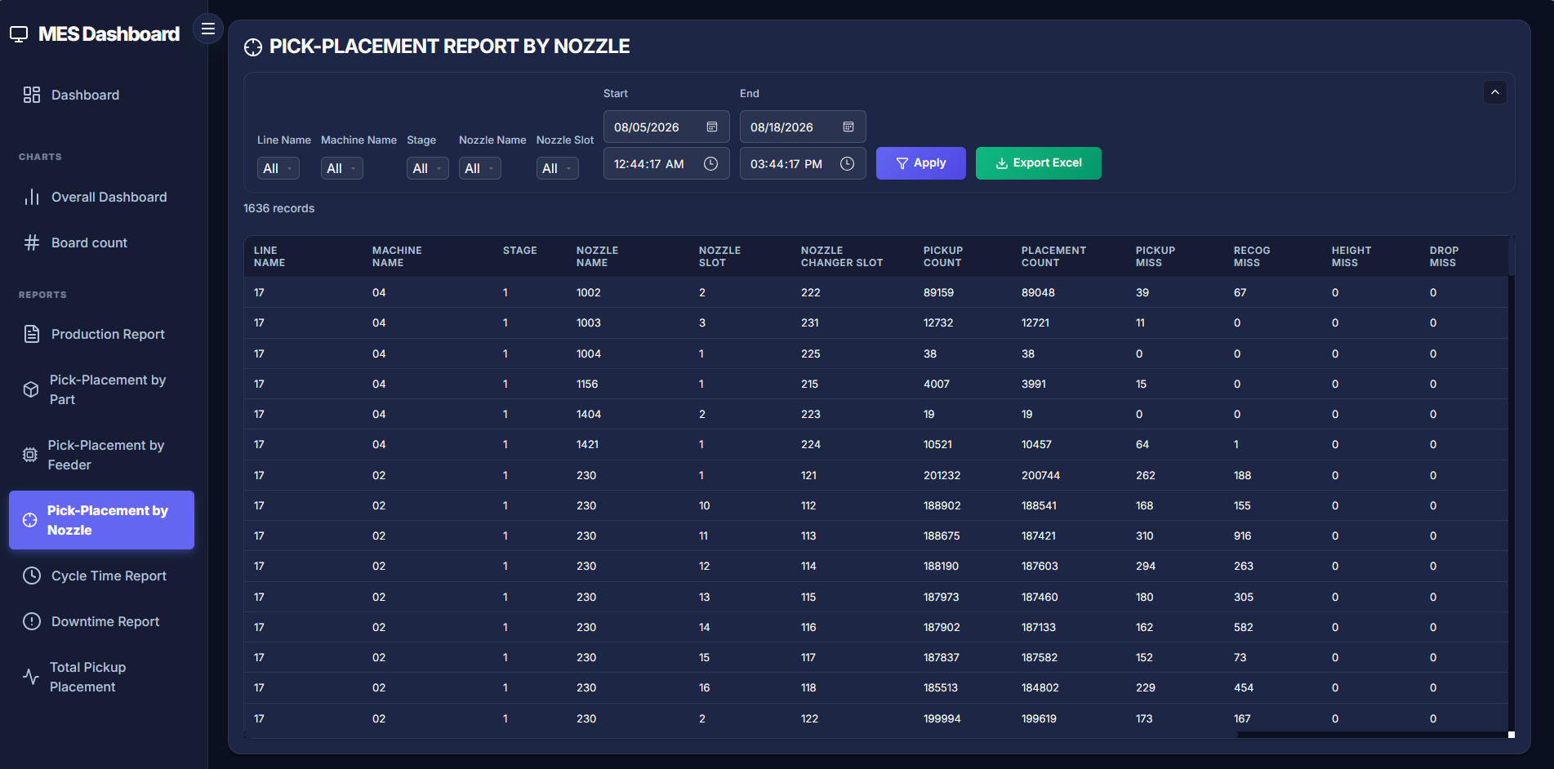
REAL APPLICATION • PICK-PLACEMENT BY NOZZLE
SCREEN 07 / 10
Prioritize nozzle and head maintenance from evidence.
Notes:
PICK-PLACEMENT BY NOZZLE: Prioritize nozzle and head maintenance from evidence. Use this screen as evidence of the implemented workflow and explain the visible filters, results and export actions.

Slide 27
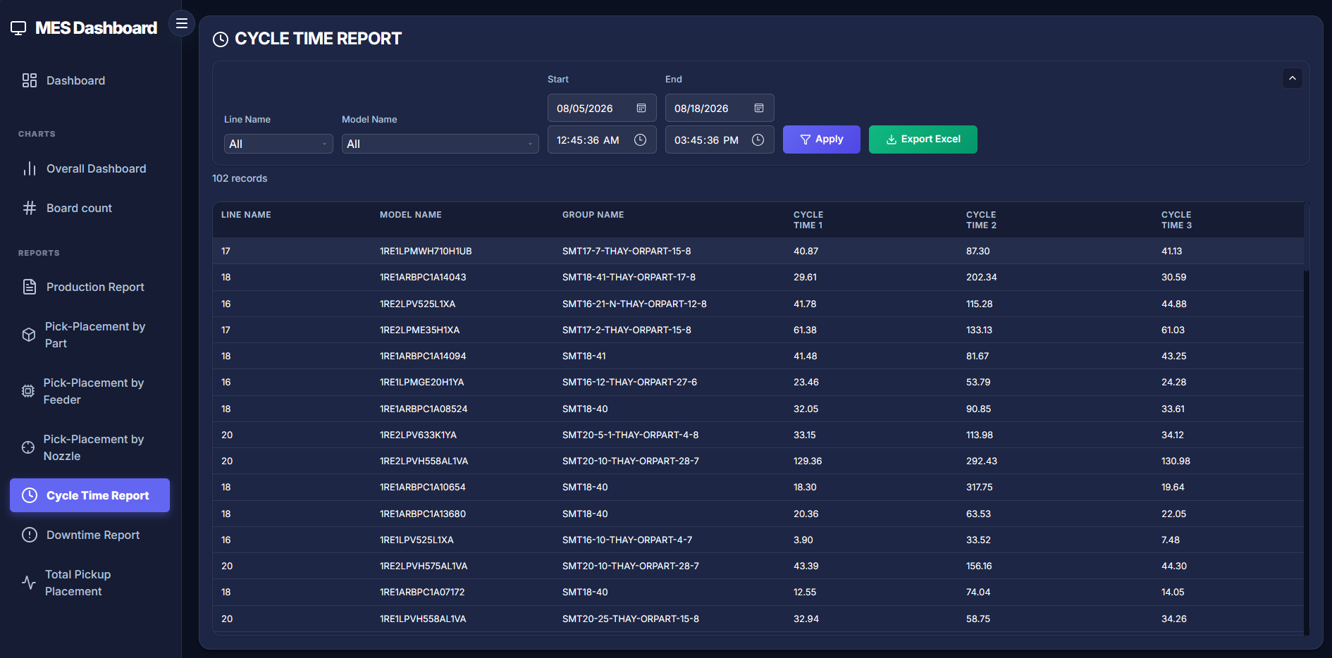
REAL APPLICATION • CYCLE TIME REPORT
SCREEN 08 / 10
Compare cycle time by line, model and group.
Notes:
CYCLE TIME REPORT: Compare cycle time by line, model and group. Use this screen as evidence of the implemented workflow and explain the visible filters, results and export actions.

Slide 28
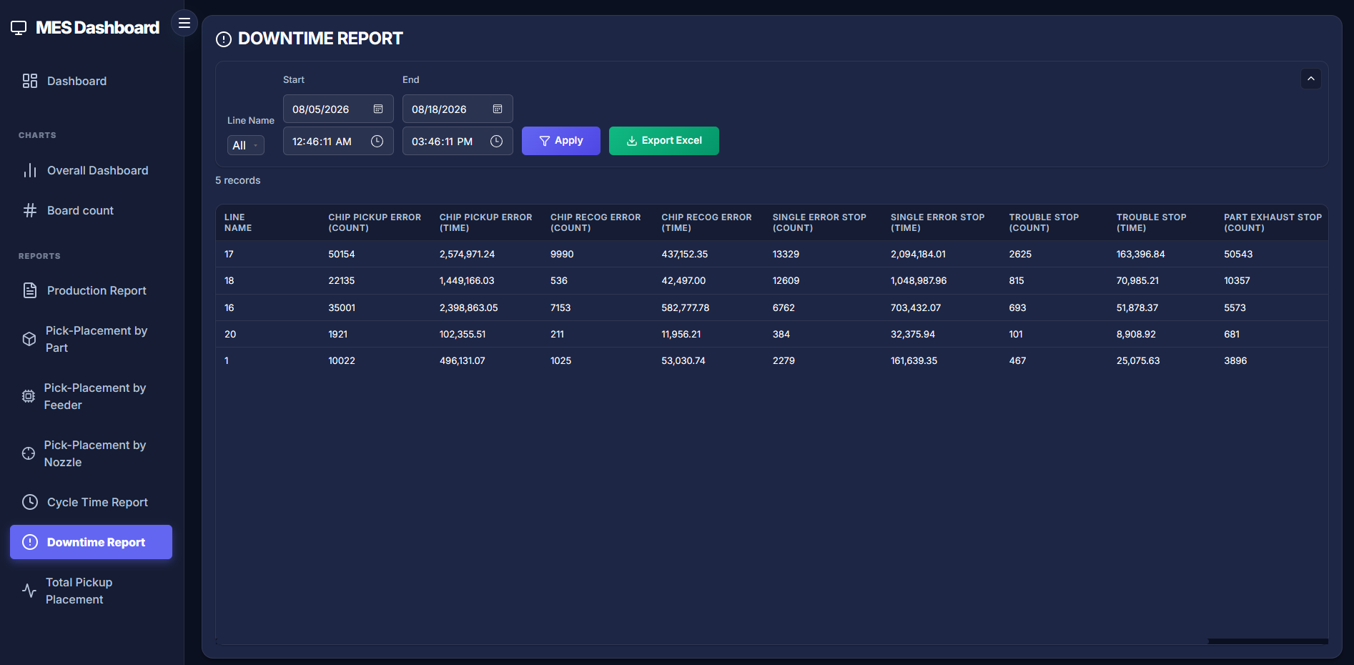
REAL APPLICATION • DOWNTIME REPORT
SCREEN 09 / 10
Measure error count and stop duration by line.
Notes:
DOWNTIME REPORT: Measure error count and stop duration by line. Use this screen as evidence of the implemented workflow and explain the visible filters, results and export actions.

Slide 29
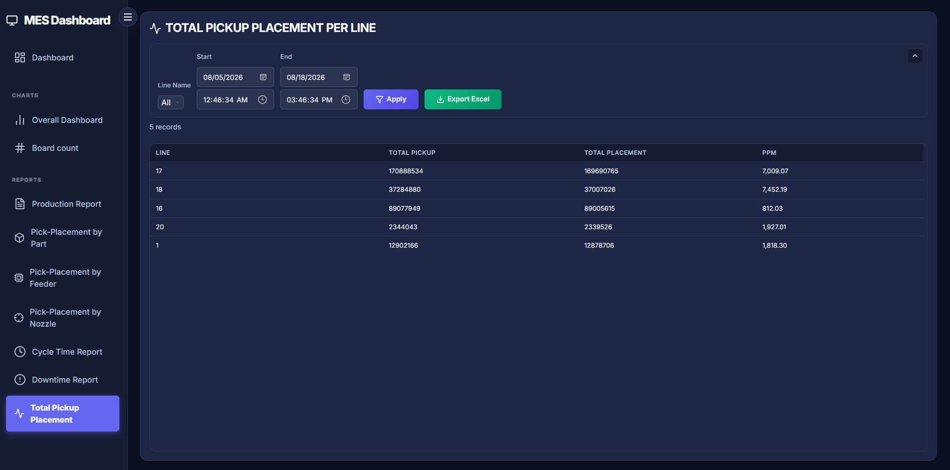
REAL APPLICATION • TOTAL PICKUP / PLACEMENT
SCREEN 10 / 10
Compare pickup, placement and PPM across lines.
Notes:
TOTAL PICKUP / PLACEMENT: Compare pickup, placement and PPM across lines. Use this screen as evidence of the implemented workflow and explain the visible filters, results and export actions.

Slide 30
OVERALL DASHBOARD
Dashboard Prioritizes What Matters
—
—
—
ACTION LISTS
BOARD PRODUCED
PPM
ERROR STOP
Worst feeder
Output by line
Relative quality
Error-stop duration
Worst nozzle
Pickup / Placement
Compare by line and time range
Stop category
Focus on top worst feeder / nozzle
Track pickup, placement, PPM, and stop time
KPI placeholder — actual values depend on filters.
MPO | Manufacturing Performance Overview
PANASONIC • 30
Notes:
The dashboard combines board produced, top worst feeder/nozzle, total pickup/placement, PPM, and error-stop time by line.

Slide 31
PRODUCTION ANALYTICS
Three Reports Track Productivity
01
02
03
Board Count
Production Report
Cycle Time
Output trends by line, lane, time, and model.
Panel / pattern output by line, lane, model, and group.
Evaluate cycle performance by line, model, and group.
Trend
Output comparison
Cycle distribution
MPO | Manufacturing Performance Overview
PANASONIC • 31

Slide 32
QUALITY ROOT-CAUSE
From Symptoms to the Source
PART
FEEDER
NOZZLE
At-risk part / scrap ratio
Table • slot • side • reel
Head • nozzle • miss
Pickup + Placement + Miss groups + Scrap ratio
Same KPI logic, different analysis level.
MPO | Manufacturing Performance Overview
PANASONIC • 32

Slide 33
LOSS ANALYSIS
Downtime and PPM Guide Improvement
DOWNTIME GROUPS
PPM
Pickup error
= Quality misses × 1,000,000
Recognition error
Total pickup / placement
Single error stop
Compare across lines
Trouble stop
Prioritize the largest losses
Part exhaust
Measure count and time
Bars illustrate layout only; they are not actual data.
MPO | Manufacturing Performance Overview
PANASONIC • 33

Slide 34
FILTER • TABLE • EXPORT
A Repeatable Analysis Experience
01
02
03
04
FILTER
REVIEW
REFINE
EXPORT
Date • shift • line • model • part
Detailed chart + table under the same criteria
Pagination + adjustable column widths
All filtered results → Excel-compatible
Same filters → same evidence → faster sharing.
MPO | Manufacturing Performance Overview
PANASONIC • 34

Slide 35
04
DEMO & SCOPE
A demonstration journey from overview to detailed evidence.
From Raw Data to Operational Decisions
MPO | Manufacturing Performance Overview
PANASONIC • 35

Slide 36
8-STEP DEMO
Demo Along the Decision Journey
01
Open Dashboard
02
Select Time
03
Board Produced
04
Worst equipment
Overview of output, quality, and downtime
Date range + shift → Apply
Compare output by line / lane
Prioritize at-risk feeders and nozzles
05
Error Stop
06
Downtime Report
07
Drill-down
08
Export Excel
Identify the largest stop category
View count + time for each error
Filter feeder / nozzle by line and part
Share the exact filtered dataset
Core message: from “what happened?” to “where should we inspect?”
MPO | Manufacturing Performance Overview
PANASONIC • 36
Notes:
Demo journey: dashboard, time selection, Board Produced, top worst feeder/nozzle, Error Stop Time, Downtime Report, equipment drill-down, and Excel export.

Slide 37
CURRENT SCOPE
Current Scope Confirmed
IN SCOPE
NOT VERIFIED
Overall Dashboard + 8 detailed report groups
Login / role-based access
Report filters, pagination, and adjustable column widths
Not included in the verified implementation.
Excel-compatible export of filtered results
PostgreSQL retry, timeout, and cancellation handling
The current user flow opens directly to the dashboard.
Antiforgery validation for unsafe MVC forms
MPO | Manufacturing Performance Overview
PANASONIC • 37

Slide 38
MANAGEMENT TAKEAWAYS
Three Management Takeaways
01
02
03
One Source of Truth
From KPIs to Root Causes
Operationally Ready
MPO centralizes machine, quality, and downtime data.
The dashboard guides; detailed reports verify.
Automated pipeline, restored state, and flexible export.
Raw machine data → operational evidence → focused action
MPO | Manufacturing Performance Overview
PANASONIC • 38

Slide 39
THANK YOU
Q&A
Manufacturing Performance Overview
LNB → SFTP → Node-RED → PostgreSQL → Docker Web Portal
Accurate Data • Faster Analysis • Focused Action
MPO | Manufacturing Performance Overview
PANASONIC • 39

