Slide 1

TERRA NT
NT self-drive
trip planning
AI-assisted route planning for travellers
across the Northern Territory
A research-informed prototype for bringing route evidence, traveller constraints and human review into one workflow.
PRT691 project presentation
Darwin and External 06
Notes:
Lead: Max Hoang · 0:30
We are developing Terra NT, a trip-planning prototype for self-drive travel in the Northern Territory. We will show how our research shaped the design, what the current system can do, and what still needs validation.
Visual note: the bundled full_nt.jpg is illustrative artwork, not a documentary photograph of a named place. Confirm usage rights before submission.
Source: A2 cover and project scope, pp. 1 and 5.

Slide 2
01 · THE PROBLEM
02
Planning a remote trip means reconciling changing evidence
Terra NT is an advisory planner. The traveller still makes the final decision.
A route decision depends on more than a map.
Travellers combine information from different owners, with different update cycles and different levels of authority.
REVIEWABLE ITINERARY
traveller
constraints
Route-relevant evidence
+ vehicle, dates and experience
+ clear uncertainty
ROAD
PARK
PERMIT
FUEL
WEATHER
OPERATOR
AI helps assemble and explain. It does not verify a road, closure or permit in real time.
TERRA NT · PRT691
Notes:
Lead: Ahanaf Alvi · 0:55
Our problem is not a lack of travel information. It is that the information comes from different owners and changes at different rates. The planner should help travellers bring relevant information together while making the source and uncertainty clear.
Primary user: the self-drive traveller. Other affected stakeholders include visitor-centre staff, small tourism operators, Aboriginal communities and responsible authorities.
Source: A2, pp. 5–6 and 8–9.

Slide 3
02 · RESEARCH
03
Stakeholder evidence made trust a product requirement
Eight coded response sets show why freshness, source authority and route feasibility lead the design.
INTERVIEW THEME PRESENCE
FINDING → DESIGN DECISION
Freshness / outdated information
8
Source transparency and trust
8
Multiple sources
One route-specific workflow while keeping source ownership visible.
Fragmented planning information
7
Vehicle and route suitability
7
Authority + freshness
Show source type and last-checked context as core evidence.
Fuel and remote-area safety
7
Alternative routes / disruption
7
Permit / access clarity
5
Vehicle suitability
Capture 2WD, 4WD and towing constraints before route advice.
Human/local knowledge remains relevant
5
Different user constraints
3
Local operator accuracy
1
Road, park, permit, fuel, weather and operator records are partial observations of changing conditions, not guarantees of current reality.
Data context
Response sets containing the theme (n = 8)
TERRA NT · A2 FIGURE 1 + TABLE 1
Notes:
Lead: Shaobin Chen · 1:05
The report coded eight supplied response sets. Freshness or outdated information and source transparency and trust appeared in all eight. Fragmented planning information, vehicle and route suitability, fuel and remote-area safety, and alternative routes or disruption appeared in seven.
Those findings changed the design priorities: one route-specific workflow, visible source type and last-checked context, and vehicle-aware constraints before route advice.
Source: A2 report Figure 1 and Table 1, p. 6; Table 2, p. 8. The chart is recreated as editable slide content from the report values.

Slide 4
03 · EVOLUTION
04
The concept narrowed to evidence-grounded advice
Current components are separated from target controls that are still planned.
A1
A2
NOW
TARGET
broad self-drive
trip planning
corridor-specific
decision support
Flutter app +
file-based RAG + Gemini
retrieve → check →
explain a reviewed route
CURRENT IMPLEMENTATION
Authoritative and advisory sources
→
curated place records
→
Gemini planner service
→
structured itinerary
→
traveller review
WORKSHOP-ALIGNED APPROACH FIT
RAG + rules + constrained wording
General LLM travel planner
Train / fine-tune a model
4.50 / 5
2.76 / 5
2.12 / 5
TERRA NT · A2 TABLE 4B + SYSTEM DESIGN
Notes:
Lead: Max Hoang · 1:05
We moved from a broad itinerary generator idea toward evidence-grounded decision support. The target architecture separates retrieval, deterministic checks and explanation.
The report also compared three approaches using a weighted project-fit score. RAG plus deterministic rules and constrained wording scored 4.50 out of 5, ahead of a general LLM travel planner at 2.76 and training or fine-tuning at 2.12. This is decision evidence, not a performance benchmark.
The current knowledge-base retrieval is file-based and region-filtered. Live road and access feeds and the general deterministic rules layer remain planned.
Evidence: A2, pp. 10–13, Table 4B, p. 11; current tools/plan_server documentation.

Slide 5
04 · LECTURE → PROJECT
05
Data lineage and app structure keep the AI system traceable
The lecture themes map to a concrete flow: source evidence enters the system, gets curated and retrieved, then reaches a reviewable mobile workflow.
DATA SOURCES
NT Road Report
road status / access
CURATE
RETRIEVE
EXPLAIN
Parks Australia + NT Parks
park rules / closures
place records
source authority
URL + checked date
region + tags
select records
by region
include context
in planner prompt
Gemini structured
output → Flutter
screens → human
review
NLC permits
authority / access
BOM + operators
weather / local context
WHAT THE DATA DOES NOT DO
LECTURE COVERAGE
The current records are curated context, not live road, closure, weather, fuel, permit or booking status. A checked date shows when a person reviewed the source, not a guarantee that conditions remain current.
W01 + W06
Stakeholders → requirements
W02 + W03
Data context + human-centred design
W04 + W05 + W09 + W12
Responsible AI, readiness, privacy and traceability
W07 + W08 + W10 + W11
Evaluation, iteration, refinement and presentation
TERRA NT · DATA LINEAGE + COURSE COVERAGE
Notes:
Lead: Max Hoang · 0:55
This slide makes the data and app structure explicit. Our source categories include NT Road Report, Parks Australia and NT Parks, Northern Land Council permit information, BOM forecasts and operator context. We curate place records with source authority, URLs, checked dates, region and tags.
The current planner retrieves file-based records by region and includes them in the Gemini prompt. Gemini returns structured itinerary output, which the Flutter app presents for traveller review. The current data is not a live feed, so checked dates are evidence metadata rather than a promise of current conditions.
The project also applies the lecture sequence: stakeholders and discovery become requirements; data context and human-centred design shape the workflow; responsible AI, readiness, privacy and lifecycle traceability constrain the system; testing, iteration, refinement and presentation provide the evidence loop.
Evidence: A2 pp. 5–13, 14–17, 41–45; current tools/plan_server/README.md and rag/README.md.

Slide 6
05 · DATA SOURCES
06
Terra NT combines evidence owned by different organisations
Each source contributes a different kind of route context. The planner keeps the source name and checked date with the record.
SOURCE
WHAT IT CONTRIBUTES
HOW WE TREAT IT
NT Road Report
Road and access context
Advisory evidence. Confirm current closures and conditions with the official source.
Parks Australia + NT Parks
Park rules, closures and visitor context
Authority context. Do not infer that a site is open or accessible today.
Northern Land Council
Permit and access authority context
Permission boundary. The app must not invent cultural access approval.
BOM + local operators
Weather and local travel context
Supporting context. Keep the source and review date visible.
Every place record keeps
authority · URL · checked date · region · tags · evidence text
This makes the origin of an answer inspectable.
TERRA NT · SOURCE AUTHORITY + FRESHNESS
Notes:
Lead: Max Hoang · 0:35
Before explaining RAG, name the data. NT Road Report contributes road and access context. Parks Australia and NT Parks contribute park rules and closure context. Northern Land Council information contributes permit and authority context. BOM and local operators add weather and local context.
Each record keeps an authority, URL, checked date, region and tags. That metadata lets the team inspect where a recommendation came from. It does not make the record live. The audience should hear this distinction before we explain the AI layer.
Evidence: A2 pp. 8–13; current tools/plan_server/rag/README.md and places.py.

Slide 7
06 · DATA PROCESSING
07
Source material becomes route-ready evidence through a controlled preparation step
The system does not send an unstructured web search directly to the model.
1
COLLECT
2
NORMALISE
3
CURATE
4
FILTER
5
PASS CONTEXT
official pages
operator context
→
place name
region + tags
→
source + URL
checked date
→
match route
region + request
→
records enter
planner prompt
EXAMPLE RECORD
WHY THIS STEP MATTERS
Preparation reduces irrelevant context and preserves traceability. It also gives the team a place to detect missing, duplicated or stale records before generation.
Jabiru
region: Top End · tag: culture / nature · authority: park source
source URL + checked date travel with the text
TERRA NT · DATA PREPARATION
Notes:
Lead: Shaobin Chen · 0:35
This is the preparation layer. We collect source material, normalise the place name and region, curate authority and checked-date metadata, filter records for the requested corridor and pass only the relevant context into the planner prompt.
The example is a place record for Jabiru. The record carries the evidence text and its source metadata together. This step matters because it gives us a human-review point before the model generates anything.
Evidence: current tools/plan_server/rag/README.md and places.py; A2 pp. 10–13.

Slide 8
07 · RAG
08
RAG grounds the response in relevant records before Gemini writes the itinerary
Retrieval supplies context. It does not prove that a road, permit or closure is current.
TRAVELLER REQUEST
REGION FILTER
RETRIEVED CONTEXT
STRUCTURED PROMPT
ITINERARY JSON
→
→
→
→
dates, vehicle,
interests, corridor
select matching
place records
source-linked
records + caveats
constraints +
context + schema
stops, reasons,
checks and notes
RAG DOES
RAG DOES NOT
HUMAN CONTROL
Finds relevant records and carries their context into the prompt.
Guarantee current conditions or replace official checks.
The traveller reviews, edits and accepts the proposed route.
TERRA NT · FILE-BASED, REGION-FILTERED RAG
Notes:
Lead: Max Hoang · 0:40
RAG means retrieval-augmented generation. The traveller request includes dates, vehicle, interests and corridor. The current service filters the file-based place records by region, brings relevant source-linked records into the prompt, and asks Gemini for structured itinerary output.
The important boundary is that RAG improves relevance and traceability. It does not turn a checked record into a live road or permit feed. The human still reviews and edits the route. This is file-based, region-filtered retrieval, not a vector database and not an autonomous safety system.
Evidence: current tools/plan_server/rag/README.md, places.py and server.py; A2 Table 4B, p. 11.

Slide 9
08 · APP STRUCTURE
09
The app turns a structured plan into a reviewable traveller workflow
The app is the interface between the planner service and the person making the trip decision.
TRAVELLER
FLUTTER APP
PLANNER API
RAG + GEMINI
FLUTTER RESULT
enter route
constraints
→
form, map,
stops, edits
→
Firebase auth
+ request
→
retrieve context
+ return JSON
→
itinerary, map
+ stop detail
review and edit
The loop returns to the traveller. The user can inspect a stop, change the route, or reject the suggestion.
CURRENT LIMIT: the complete authenticated app-to-planner flow still needs verification on a connected device.
TERRA NT · FLUTTER + PLANNER SERVICE
Notes:
Lead: Tarik Bulut · 0:40
The app structure has five steps. The traveller enters a route and constraints in Flutter. The app sends an authenticated request to the planner API. The planner retrieves source context and asks Gemini for structured JSON. Flutter renders the itinerary, map and stop details. The user then reviews and edits the proposed route.
This is a review loop, not a one-way answer. The current limitation is that we still need to verify the complete authenticated app-to-planner flow on a connected device.
Evidence: current Flutter app, tools/plan_server/server.py and presentation tracker.

Slide 10
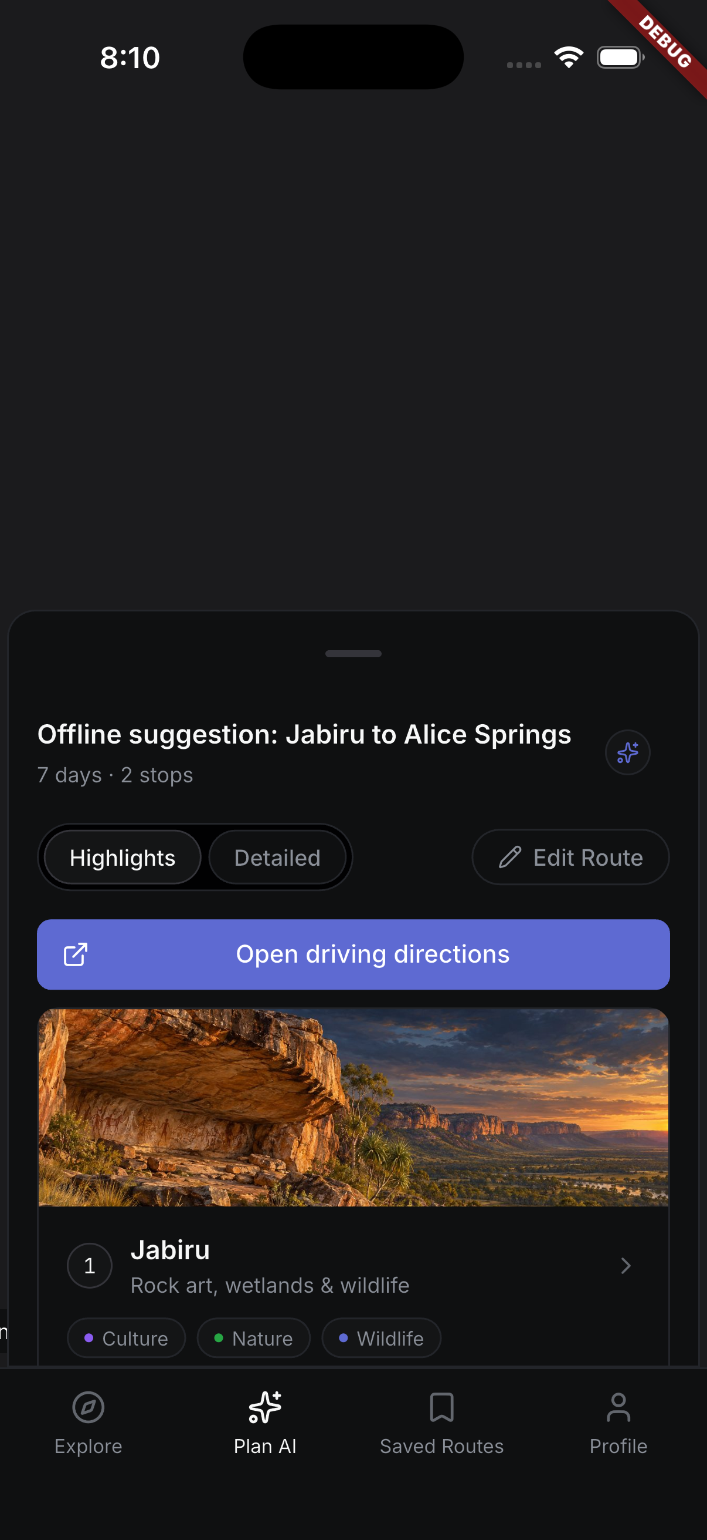
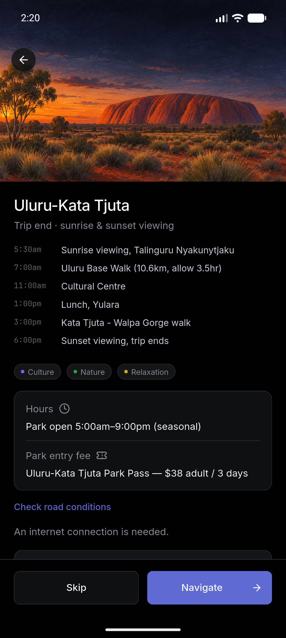
09 · CURRENT BUILD
10
The current app makes a route inspectable and editable
Implementation evidence comes from the Flutter mobile experience and the planner service, with clear limits.
WHAT EXISTS
Flutter app
Onboarding, interactive map, itinerary and stop views, with route controls.
Planner
Gemini structured-output backend with 12 source-linked place records.
Map
OpenFreeMap basemap and best-effort OSRM geometry. Straight connectors remain the fallback.
Current simulator output
Stop detail
Debug build · offline suggestion
Current capture · route content
CURRENT SIMULATOR CAPTURE · DEBUG BUILD · APP-TO-PLANNER FLOW STILL NEEDS VERIFICATION
TERRA NT · PRT691
Notes:
Lead: Tarik Bulut · 0:50
The mobile experience and the planner service are progressing as separate parts of the system. The current simulator capture shows a debug build with an offline suggestion from stored places. It is useful app evidence, but it is not proof of a live Gemini-generated route.
The service has returned structured Gemini output and uses curated place records, but the complete authenticated app-to-planner flow still needs verification on a connected device.
Ethical impact: the app keeps the traveller responsible for the final decision and avoids presenting stale context as current safety information. Scalability depends on adding governed, region-tagged records corridor by corridor and validating the rules and source quality before expansion.
Evidence: A2, pp. 10–13; current presentation tracker and planner documentation.

Slide 11
10 · RESPONSIBLE AI
11
The largest risk is a fluent answer built on stale evidence
Controls are shown with their current status so planned safeguards are not mistaken for completed ones.
RISK
CURRENT RESPONSE / REMAINING CONTROL
STATUS
Stale or incomplete road/access information
Point users to official live checks; no live road or closure feed yet.
PARTIAL
Incorrect permit or cultural-access claim
Do not infer permission. Rely on responsible authorities and show uncertainty.
IN PLACE
Fluent but unsafe recommendation
Deterministic hard checks remain a target requirement.
PLANNED
Privacy and account security
Keep planner authentication enabled; use de-identified research records.
IN PLACE
ETHICS
Authority, permits and cultural access stay visible.
IMPACT
More transparent planning and fewer repeated checks.
SCALABILITY
Expand corridor by corridor after validation.
TERRA NT · PRT691
Notes:
Lead: Shaobin Chen · 0:55
Our highest-impact risk is a confident recommendation based on stale or incomplete information. The knowledge base preserves source context, but this does not make the data current. A general rules engine is still outstanding, so Terra NT remains an advisory prototype and travellers must confirm live road, park and permit conditions.
Ethically, authority, permit and cultural-access boundaries must stay visible. The intended impact is more transparent planning and less repeated checking, but we should not claim safety improvement until the rules and user evaluation are complete. For scalability, a region-tagged data model can extend corridor by corridor, provided each new source set is governed, refreshed and tested.
Evidence: A2, pp. 14–15, Table 5 and Appendix D; current RAG dataset guidance.

Slide 12
11 · EVALUATION
12
The strongest result is narrow, and that is useful
9/9 functional checks passed for the browser prototype and curated snapshot on 11 September 2026.
4/4
2/2
3/3
9 / 9
personalisation
+ scheduling
safety / evidence
snapshot
human control
+ interaction
predefined functional checks passed
Chromium · 390 × 844 viewport
WHAT THIS RESULT MEANS
WHAT IT DOES NOT MEAN
Preliminary functional evidence for the browser prototype and curated snapshot.
It does not validate the Flutter app, Gemini/RAG retrieval accuracy, current NT conditions, field safety or real-user trust.
TERRA NT · BROWSER PROTOTYPE EVIDENCE
Notes:
Lead: Ahanaf Alvi · 0:55
We completed nine functional checks on the browser prototype. That result covers its curated demonstration behaviours only. It is not a test of the Flutter app or the newer Gemini/RAG service. Our next evaluation needs to test retrieval support, constraint handling and whether users can understand the evidence.
State the boundary clearly: “9/9” is not “100% accurate” and is not a safety benchmark.
Evidence: A2, pp. 16–17, especially Table 7 and Appendix E6.

Slide 13
12 · LIVE DEMO
13
The traveller reviews a route, then keeps control
Demo target: 2:35 · Start signed in · Say whether the result is live Gemini, fixture or seeded content.
01
Open or generate
Use the Darwin–Kakadu–Katherine / Top End corridor.
02
Inspect the route
Show stop order and route geometry. Explain the fallback.
03
Edit the plan
Open a stop, then reorder or remove/restore it.
04
Close responsibly
Remind the audience to check official live conditions.
Use the current stop-detail capture as visual support if the network or login blocks the live path.
Fallback: show the prepared local itinerary and name the unavailable step. Never call cached or seeded output a live AI generation.
TERRA NT · DEMO SCRIPT BUILT INTO NOTES
Notes:
Lead: Max Hoang, with brief hand-offs · 2:35
Demo objective: show how a traveller creates or opens an itinerary, understands the route and retains control.
Sequence:
1. Start already signed in.
2. Choose the Darwin–Kakadu–Katherine / Top End corridor so the demo matches the A2 research scope.
3. Generate or open the prepared itinerary and say whether it came from live Gemini, a fixture or a seeded route.
4. Show the route and stop order. Explain that OSRM geometry is visual route guidance and can fall back to straight connectors.
5. Open one stop, then reorder or remove/restore a stop.
6. Close with: “The map supports orientation, but current road and access conditions still need confirmation from official sources.”
Fallback: use the prepared local itinerary or the capture shown on the slide. Do not claim a live AI generation if the demo uses cached, fixture or seeded output.
Evidence: compulsory live demonstration within 10 minutes; current tracker and A2 pp. 10–13, 16–17.

Slide 14
13 · NEXT MILESTONE
14
Traceable recommendations are the next milestone
The workflow is together. The evidence model and live validation still need to catch up.
01
Verify the authenticated app-to-Gemini flow on a connected iPhone.
02
Retain source authority and freshness with each itinerary fact.
03
Add and evaluate deterministic checks for closures, access, permits and vehicle suitability.
04
Integrate live official data, then test stale and missing records with travellers and staff.
Terra NT brings the planning workflow together. The next milestone is proving that route recommendations remain traceable and useful when the underlying conditions change.
TERRA NT · QUESTIONS
Notes:
Lead: Tarik Bulut · 0:55
Our next work is to verify the authenticated app-to-Gemini flow on a connected iPhone, expand the evidence model so generated facts retain source authority and freshness, add deterministic checks for closures, access, permits and vehicle suitability, and evaluate the experience with travellers and relevant staff.
Closing line: “Terra NT brings the planning workflow together. The next milestone is proving that route recommendations remain traceable and useful when the underlying conditions change.”
Evidence: A2, pp. 5, 8–9, 14–17; current presentation tracker and RAG documentation.

