Slide 1
Chapter 2 Testing Throughout the Software Development Lifecycle
Author: PVANQUANG

Slide 2
Content
Software Development Lifecycle Models
Test Levels
Test Types
Maintenance Testing

Slide 3
2.1 Software Development Life Cycle Models

Slide 4
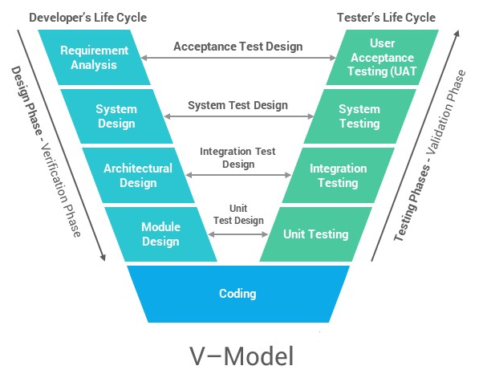
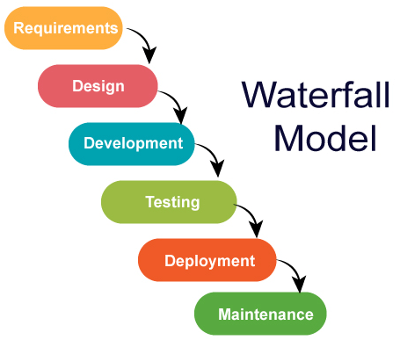
2.1 Software Development Life Cycle Models
Software Development Life Cycle Models (K2)
Sequential development models

Slide 5
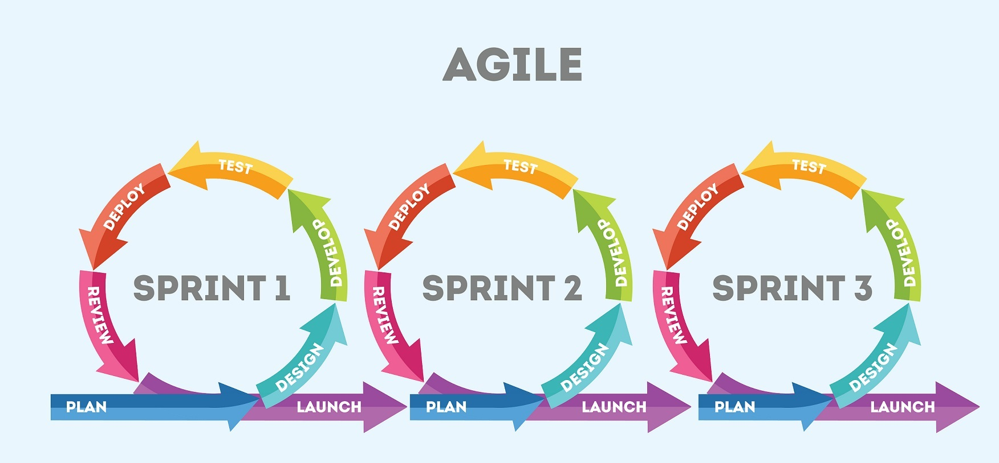
2.1 Software Development Lifecycle Models
Software Development Life Cycle Models (K2)
Iterative and incremental development models

Slide 6
2.1 Software Development Life Cycle Models
Software Development and Software Testing (K2)
In any software development lifecycle model, there are several characteristics of good testing:
For every development activity, there is a corresponding test activity
Each test level has test objectives specific to that level
Test analysis and design for a given test level begin during the corresponding development activity
Testers should be involved in reviewing documents as soon as drafts are available
Whichever SDLC is used, test activities should start in the early stages of the lifecycle, adhering to the testing principle of early testing.

Slide 7
2.2 Test Levels

Slide 8
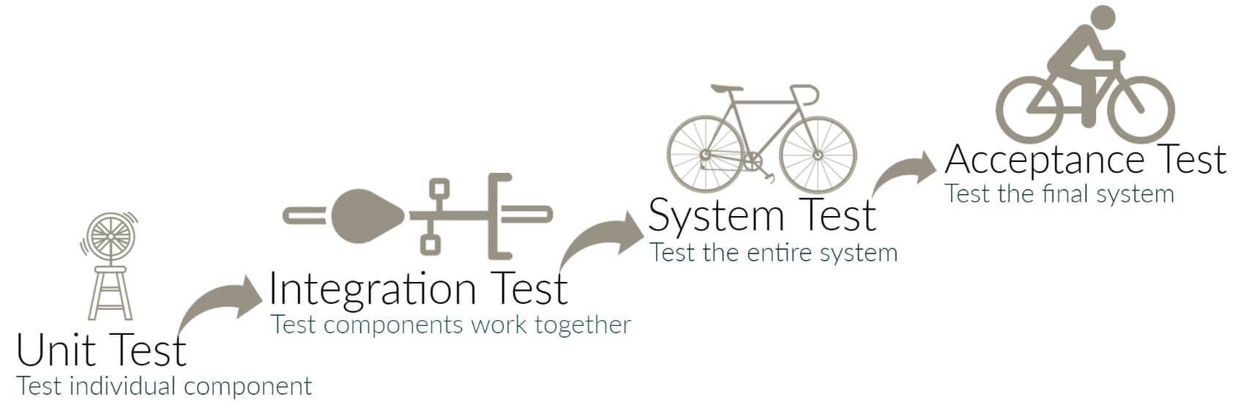
2.2 Test Levels
Introduction (K2)
Groups of test activities that are organized and managed together.

Slide 9
2.2 Test Levels
Introduction (K2)
Test levels are characterized by the following attributes
Objectives
Test basis (referenced to derive test cases)
Typical Test object (i.e., what is being tested)
Typical defects and failures
Approaches and responsibilities
For every test level, a suitable test environment is required.
Example: UT can done on local development environment, UAT should be done in a production environment

Slide 10
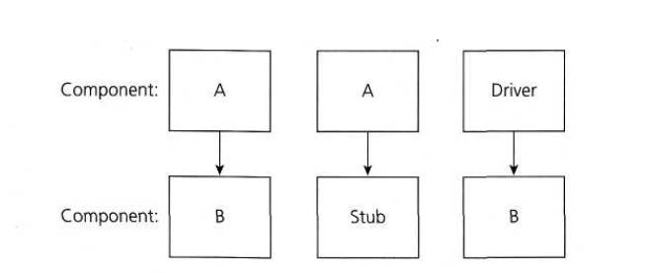
2.2 Test Levels
Component testing (unit testing/module testing/isolation testing) (K2) focuses on components that are separately testable
Objectives:
Reducing risk
Verifying whether the functional and non-functional behaviors of the component are as designed and specified
Building confidence in the component’s quality
Finding defects in the component
Preventing defects from escaping to higher test levels

Slide 11
2.2 Test Levels
Component testing (unit testing/module testing/isolation testing) (K2) focuses on components that are separately testable
Test basis:
Detailed design
Code
Data model
Component specifications
Type test objects:
Components, units or modules
Code and data structures
Classes
Database modules

Slide 12
2.2 Test Levels
Component testing (unit testing/module testing/isolation testing) (K2)
Typical defects and failures:
Incorrect functionality (e.g., not as described in design specifications)
Data flow problems
Incorrect code and logic
Approaches and responsibilities:
Usually performed by the developer who wrote the code
Tests can be written after the code
Test Driven Development (TDD): first write tests, then write code

Slide 13
2.2 Test Levels
Integration testing (K2)
Objectives:
Reducing risk
Verifying whether the functional and non-functional behaviors of the interfaces are as designed and specified
Building confidence in the quality of the interfaces
Finding defects in the interfaces, components, systems
Preventing defects from getting into higher test levels
There are multiple levels of integration testing:
Component Integration Testing
System Integration Testing

Slide 14
2.2 Test Levels
Integration testing (K2)
Test basis:
Software and system design
Sequence diagrams
Interface and communication protocol specifications
Use cases
Architecture at component or system level
Workflows
External interface definitions

Slide 15
2.2 Test Levels
Integration testing (K2)
Type test objects:
Subsystems
Databases
Infrastructure
Interfaces
APIs
Microservices

Slide 16
2.2 Test Levels
Integration testing (K2)
Typical defects and failures:
For component integration testing
Incorrect data, missing data, or incorrect data encoding
Incorrect sequencing or timing of interface calls
Interface mismatch
Failures in communication between components
Unhandled or improperly handled communication failures between components
Incorrect assumptions about the meaning, units, or boundaries of the data being passed between components

Slide 17
2.2 Test Levels
Integration testing (K2)
Typical defects and failures:
For system integration testing
Inconsistent message structures between systems
Incorrect data, missing data, or incorrect data encoding
Interface mismatch
Failures in communication between systems
Unhandled or improperly handled communication failures between systems
Incorrect assumptions about the meaning, units, or boundaries of the data being passed between systems
Failure to comply with mandatory security regulations

Slide 18
2.2 Test Levels
Integration testing (K2)
Approaches and responsibilities:
Component integration testing is often the responsibility of developers
System integration testing is generally the responsibility of testers
Systematic integration strategies may be based on the system architecture (e.g., top-down and bottom-up), functional tasks, transaction processing sequences...
Integration should normally be incremental (i.e., a small number of additional components or systems at a time) rather than “big bang” (i.e., integrating all components or systems in one single step)
Focus on risk analysis of the most complex interfaces
Continuous integration often includes automated regression testing, ideally at multiple test levels

Slide 19
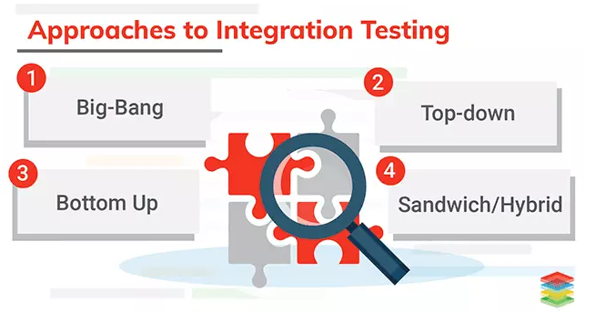
2.2 Test Levels
Integration testing (K2)
Approaches and responsibilities:

Slide 20
2.2 Test Levels
Integration testing (K2)
Approaches and responsibilities:
Bottom up:
Big-bang:
Top down:
A
Test A
Layer I
Test B
B
C
D
Layer II
Test C
Test
A, B, C, D,
E, F, G
E
F
G
Test D
Layer III
Test E
Test F
Test G
Test E
Test B, E, F
Test
A, B, C, D,
E, F, G
Test A
Test A, B, C, D
Test F
Test C
Test
A, B, C, D,
E, F, G
Layer I
Layer I II
All Layers
Test D,G
Test G

Slide 21
2.2 Test Levels
System Testing (K2) focuses on the behavior and capabilities of a whole system or product, often considering the end-to-end tasks the system can perform and the non-functional behaviors it exhibits while performing those tasks
Objectives:
Reducing risk
Verifying whether the functional and non-functional behaviors of the system are as designed and specified
Validating that the system is complete and will work as expected
Building confidence in the quality of the system as a whole
Finding defects
Preventing defects from escaping to higher test levels
Verifying data quality

Slide 22
2.2 Test Levels
System Testing (K2)
Test basis:
System and software requirement specifications
Risk analysis reports
Use cases
Epics and user stories
Models of system behavior
State diagrams
System and user manuals
Test objects:
Applications
Hardware/software systems
Operating systems
System under test
System configuration and configuration data

Slide 23
2.2 Test Levels
System Testing (K2)
Typical defects and failures:
Incorrect calculations
Incorrect or unexpected system functional or non-functional behavior
Incorrect control and/or data flows within the system
Failure to properly and completely carry out end-to-end functional tasks
Failure of the system to work properly in the system environment(s)
Failure of the system to work as described in system and user manuals

Slide 24
2.2 Test Levels
System Testing (K2)
Approaches and responsibilities:
Should focus on the overall, end-to-end behavior of the system as a whole, both functional and non-functional
System testing is typically carried out by independent testers who rely heavily on specifications
Can be tested using black box or white box.

Slide 25

2.2 Test Levels
Acceptance testing (K2) focuses on the behavior and capabilities of a whole system or product
Different type acceptance tests are:
User acceptance testing (UAT): Building confidence that the users can us the system with minimum difficulty, cost and risk
Operational acceptance testing (OAT): Building confidence that the system administrator can keep the system working in production
Contract and regulation acceptance testing Building confidence that the contractual or regulatory compliance has been achieved

Slide 26
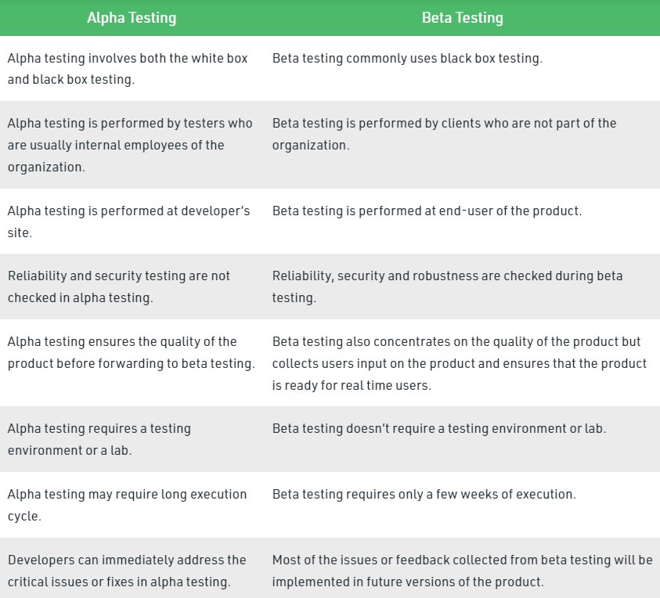
2.2 Test Levels
Acceptance testing (K2): Different type acceptance tests are:

Slide 27
2.2 Test Levels
Acceptance testing (K2)
Objectives:
Establishing confidence in the quality of the system as a whole
Validating that the system is complete and will work as expected
Verifying that functional and non-functional behaviors of the system are as specified
Acceptance testing may produce information to assess the system’s readiness for deployment and use by the customer (end-user)
Defects may be found during acceptance testing, but finding defects is often not an objective, and finding a significant number of defects during acceptance testing may in some cases be considered a major project risk
May also satisfy legal or regulatory requirements or standards

Slide 28
2.2 Test Levels
Acceptance testing (K2)
Test Basis:
Business processes
User or business requirements
Regulations, legal contracts and standards
Use cases and/or user stories
System requirements
System or user documentation
Installation procedures
Risk analysis reports

Slide 29
2.2 Test Levels
Acceptance testing (K2)
Test Objects:
System under test
System configuration and configuration data
Business processes for a fully integrated system
Recovery systems and hot sites (for business continuity and disaster recovery testing)
Operational and maintenance processes
Forms
Reports
Existing and converted production data

Slide 30
2.2 Test Levels
Acceptance testing (K2)
Typical defects and failures:
System workflows do not meet business or user requirements
Business rules are not implemented correctly
System does not satisfy contractual or regulatory requirements
Non-functional failures such as security vulnerabilities, inadequate performance efficiency under high loads, or improper operation on a supported platform
Specific approaches and responsibilities:
Acceptance testing is often the responsibility of the customers, business users, product owners, or operators of a system, and other stakeholders may be involved as well
Acceptance testing is often thought of as the last test level in a sequential development lifecycle, but it may also occur at other times

Slide 31
2.3 Test Types

Slide 32
2.3 Test Types
Introduction (K2)
A test type is a group of test activities aimed at testing specific characteristics of a software system, or a part of a system, based on specific test objectives
Objectives:
Evaluating functional quality characteristics, such as completeness, correctness, and appropriateness
Evaluating non-functional quality characteristics, such as reliability, performance efficiency, security, compatibility, and usability
Evaluating whether the structure or architecture of the component or system is correct, complete, and as specified
Evaluating the effects of changes, such as confirming that defects have been fixed (retest/confirmation testing) and looking for unintended changes in behavior resulting from software or environment changes (regression testing)

Slide 33
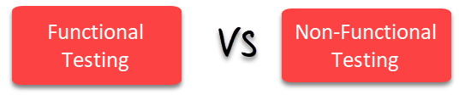
2.3 Test Types

Slide 34
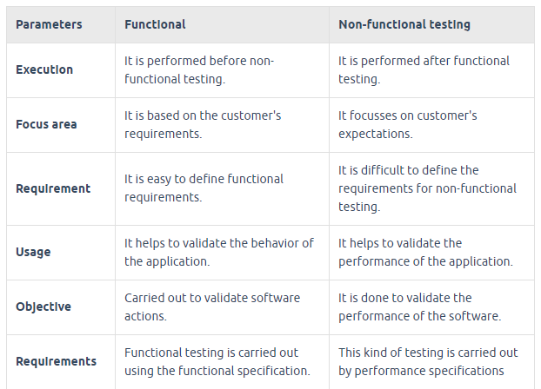
2.3 Test Types

Slide 35
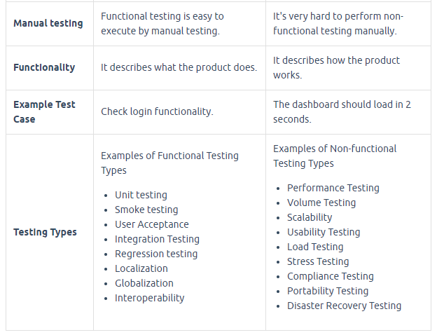
2.3 Test Types

Slide 36
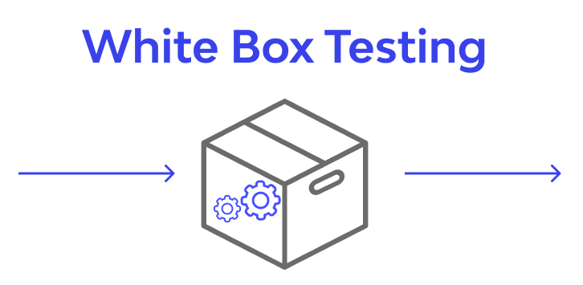
2.3 Test Types

Slide 37
2.3 Test Types
White-box Testing (K2)
Derives tests based on the system’s internal structure or implementation
At the component testing level, code coverage is based on the percentage of component code that has been tested
The thoroughness of white-box testing can be measured through structural coverage.
White-box test design and execution may involve special skills or knowledge, such as the way the code is built, how data is stored, and how to use coverage tools and to correctly interpret their results

Slide 38
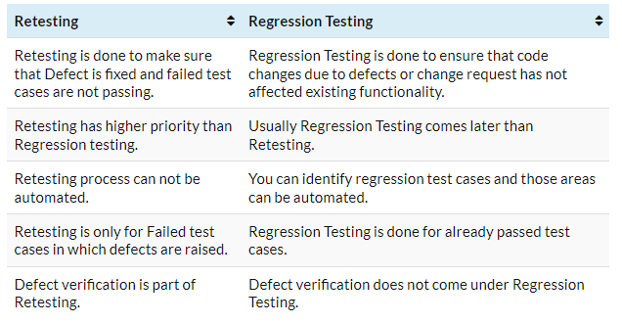
2.3 Test Types
Change-related Testing (K2)

Slide 39
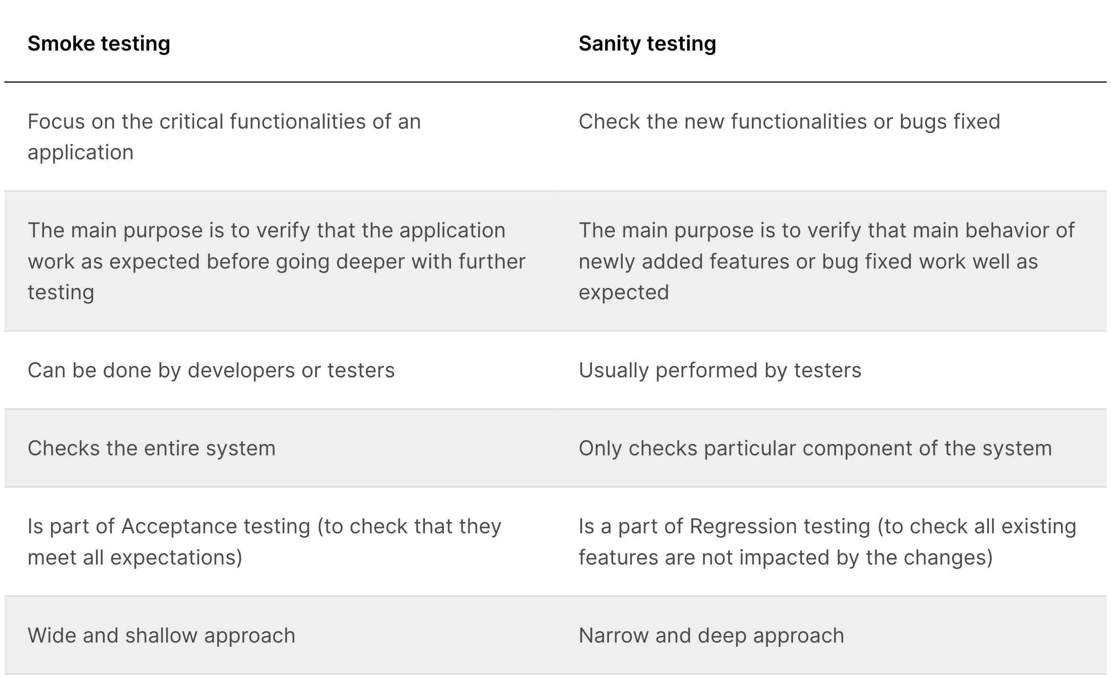
2.3 Test Types
Change-related Testing (K2)

Slide 40
2.4 Maintenance Testing

Slide 41
2.4 Maintenance Testing
Introduction (K2)
Once deployed to production environments, software and systems need to be maintained
Changes of various sorts are almost inevitable in delivered software and systems:
Fix defects discovered in operational use
Add new functionality
Delete or alter already-delivered functionality
Maintenance is also needed to preserve or improve non-functional quality characteristics of the component or system over its lifetime, especially performance efficiency, compatibility, reliability, security, , and portability
When any changes are made as part of maintenance, maintenance testing should be performed
Maintenance can involve planned releases and unplanned releases (hot fixes)
A maintenance release may require maintenance testing at multiple test levels, using various test types, based on its scope

Slide 42
2.4 Maintenance Testing
Triggers for Maintenance (K2): Maintenace testing is done on an existing operational system, and is triggered by modifications, migration, or retirement of the software or system
Modification, such as planned enhancements (e.g., release-based), corrective and emergency changes, changes of the operational environment (such as planned operating system or database upgrades), upgrades of COTS software, and patches for defects and vulnerabilities
Migration, such as from one platform to another, which can require operational tests of the new environment as well as of the changed software, or tests of data conversion when data from another application will be migrated into the system being maintained
For Internet of Things systems, maintenance testing may be triggered by the introduction of completely new or modified things, such as hardware devices and software services, into the overall system.
The maintenance testing for such systems places particular emphasis on integration testing at different levels (e.g., network level, application level) and on security aspects, in particular those relating to personal data

Slide 43
2.4 Maintenance Testing
Impact Analysis for Maintenance (K2)
Evaluates the changes that were made for a maintenance release to identify the intended consequences as well as expected and possible side effects of a change, and to identify the areas in the system that will be affected by the change
Can also help to identify the impact of a change on existing tests. The side effects and affected areas in the system need to be tested for regressions, possibly after updating any existing tests affected by the change.
May be done before a change is made, to help decide if the change should be made, based on the potential consequences in other areas of the system
Impact analysis can be difficult if:
Specifications (e.g., business requirements, user stories, architecture) are out of date or missing
Test cases are not documented or are out of date
Bi-directional traceability between tests and the test basis has not been maintained
Tool support is weak or non-existent
The people involved do not have domain and/or system knowledge
Insufficient attention has been paid to the software's maintainability during development

Slide 44


