Slide 1
Chapter 3 Static Testing
Author: PVANQUANG

Slide 2
Content
Static Testing Basics
Review Process

Slide 3
3.1 Static Testing Basics

Slide 4
3.1 Static Testing Basics
Static testing (K1)
Testing a component or system at specification or implementation level without executing the software
Relies on the manual examination of work products (i.e., reviews)
Or tool-driven evaluation of the code
Or other work products (i.e., static analysis)
Static analysis can be applied to any work product with a formal structure (typically code or models) for which an appropriate static analysis tool exists
Static analysis can even be applied with tools that evaluate work products written in natural language such as requirements (e.g., checking for spelling, grammar, and readability)

Slide 5
3.1 Static Testing Basics
Work Products that Can Be Examined by Static Testing (K1)
Static can be used on almost any work product such as:
Specifications
Epics, user stories, and acceptance criteria
Architecture and design specifications
Code
Testware
User guides
Web pages
Contracts, project plans, schedules, and budget planning
Configuration set up and infrastructure set up
Models, such as activity diagrams, which may be used for Model-Based testing

Slide 6
3.1 Static Testing Basics
Benefits of Static Testing (K2)
Some benefits of static testing include:
Detecting and correcting defects more efficiently, and prior to dynamic test execution
Identifying defects which are not easily found by dynamic testing
Preventing defects in design or coding
Increasing development productivity
Reducing development cost and time
Reducing testing cost and time
Reducing total cost of quality due to fewer failures later in the lifecycle or after delivery into operation
Improving communication between team members

Slide 7
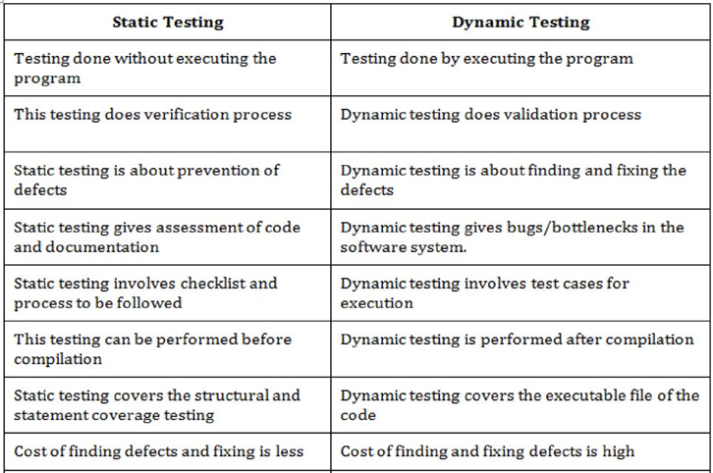
3.1 Static Testing Basics

Slide 8
3.2 Review Process

Slide 9
3.2 Review Process
Review process – Introduction (K2)
Range from informal to formal:
Informal reviews are NOT documented and DON’T follow a defined process
Formal reviews follow a formal process include documentation are characterized by:
+ Team participation
+ Documented results
+ Documented review procedures
Formality depends on:
SDLC model
Maturity of the development process
Complexity of the work product to be reviewed
Legal or regulatory requirements
Need for an audit trail
Focus depends on the agreed objective of review:

Slide 10
3.2 Review Process
Work Product Review Process (K2)
The formal review process comprise the following main activities:
Planning
Initiate review
Individual review /Individual preparation
Issue communication and analysis
Fixing and reporting

Slide 11
3.2 Review Process
Work Product Review Process - Planning (K2)
Defining the scope, which includes the purpose of the review, what documents or parts of documents to review, and the quality characteristics to be evaluated
Estimating effort and timeframe
Identifying review characteristics such as the review type with roles, activities, and checklists
Selecting the people to participate in the review and allocating roles
Defining the entry and exit criteria for more formal review types (e.g., inspections)
Checking that entry criteria are met (for more formal review types)
Work Product Review Process - Initiate review (K2)
Distributing the work product (physically or by electronic means) and other material, such as issue log forms, checklists, and related work products
Explaining the scope, objectives, process, roles, and work products to the participants
Answering any questions that participants may have about the review

Slide 12
3.2 Review Process
Work Product Review Process - Individual review (K2)
Reviewing all or part of the work product
Noting potential defects, recommendations, and questions
Work Product Review Process - Issue communication and analysis (K2)
Communicating identified potential defects (e.g., in a review meeting)
Analyzing potential defects, assigning ownership and status to them
Evaluating and documenting quality characteristics
Evaluating the review findings against the exit criteria to make a review decision (reject; major changes needed; accept, possibly with minor changes)

Slide 13
3.2 Review Process
Work Product Review Process - Fixing and reporting (K2)
Creating defect reports for those findings that require changes to a work product
Fixing defects found (typically done by the author) in the work product reviewed
Communicating defects to the appropriate person or team (when found in a work product related to the work product reviewed)
Recording updated status of defects (in formal reviews), potentially including the agreement of the comment originator
Gathering metrics (for more formal review types)
Checking that exit criteria are met (for more formal review types)
Accepting the work product when the exit criteria are reached

Slide 14
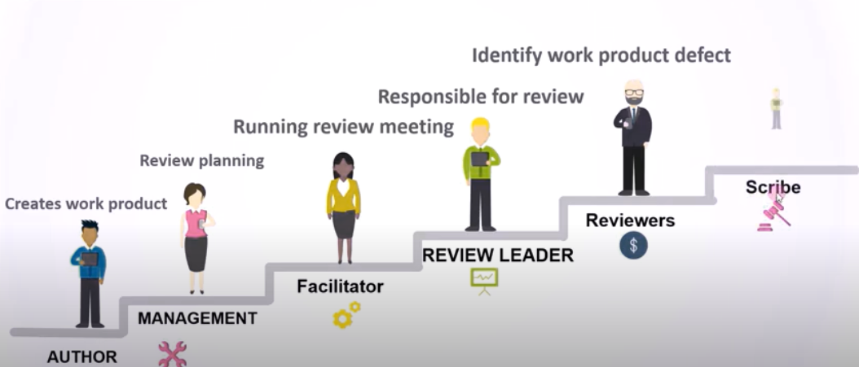
3.2 Review Process
Roles and responsibilities in a formal review (K2)

Slide 15
3.2 Review Process
Roles and responsibilities in a formal review (K2)
Author
Creates the work product under review
Fixes defects in the work product under review (if necessary)
Management
Is responsible for review planning
Decides on the execution of reviews
Assigns staff, budget, and time
Monitors ongoing cost-effectiveness
Executes control decisions in the event of inadequate outcomes
Facilitator (often called moderator)
Ensures effective running of review meetings (when held)
Mediates, if necessary, between the various points of view
Is often the person upon whom the success of the review depends

Slide 16
3.2 Review Process
Roles and responsibilities in a formal review (K2)
Review leader
Takes overall responsibility for the review
Decides who will be involved and organizes when and where it will take place
Reviewers
May be subject matter experts, persons working on the project, stakeholders with an interest in the work product, and/or individuals with specific technical or business backgrounds
Identify potential defects in the work product under review
May represent different perspectives (e.g., tester, developer, user, operator, business analyst, usability expert, etc.)
Scribe (or recorder)
Collates potential defects found during the individual review activity
Records new potential defects, open points, and decisions from the review meeting (when held)

Slide 17
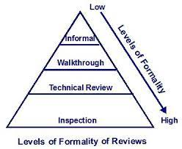
3.2 Review Process
Review Types (K2)

Slide 18
3.2 Review Process
Review Types - Informal review (buddy check, pairing, pair review) (K2)
Main purpose | Detecting potential defects
Possible additional purposes | Generating new ideas or solutions, quickly solving minor problems
Characteristics | Not based on a formal (documented) process May not involve a review meeting May be performed by a colleague of the author or by more people Results may be documented Varies in usefulness depending on the reviewers Use of checklists is optional Very commonly used in Agile development

Slide 19
3.2 Review Process
Review Types - Walkthrough(K2)
Main purpose | Find defects, improve the software product, consider alternative implementations, evaluate conformance to standards and specifications
Possible additional purposes | Exchanging ideas about techniques or style variations, training of participants, achieving consensus
Characteristics | Individual preparation before the review meeting is optional Review meeting is typically led by the author of the work product Scribe is mandatory Use of checklists is optional May take the form of scenarios, dry runs, or simulations Potential defect logs and review reports are produced May vary in practice from quite informal to very formal

Slide 20
3.2 Review Process
Review Types - Technical review (K2)
Main purpose | Gaining consensus, detecting potential defects
Possible additional purposes | Evaluating quality and building confidence in the work product, generating new ideas, motivating and enabling authors to improve future work products, considering alternative implementations
Characteristics | Reviewers should be technical peers of the author, and technical experts in the same or other disciplines Individual preparation before the review meeting is required Review meeting is optional, ideally led by a trained facilitator (typically not the author) Scribe is mandatory, ideally not the author Use of checklists is optional Potential defect logs and review reports are produced

Slide 21
3.2 Review Process
Review Types - Inspection (K2)
Main purpose | Detecting potential defects, evaluating quality and building confidence in the work product, preventing future similar defects through author learning and root cause analysis
Possible additional purposes | Motivating and enabling authors to improve future work products and the software development process, achieving consensus
Characteristics (1) | Follows a defined process with formal documented outputs, based on rules and checklists Uses clearly defined roles, and may include a dedicated reader (who reads the work product aloud often paraphrase, i.e. describes it in own words, during the review meeting) Individual preparation before the review meeting is required Reviewers are either peers of the author or experts in other disciplines that are relevant to the work product

Slide 22
3.2 Review Process
Review Types - Inspection (K2)
Main purpose | Detecting potential defects, evaluating quality and building confidence in the work product, preventing future similar defects through author learning and root cause analysis
Possible additional purposes | Motivating and enabling authors to improve future work products and the software development process, achieving consensus
Characteristics (2) | Specified entry and exit criteria are used Scribe is mandatory Review meeting is led by a trained facilitator (not the author) Author cannot act as the review leader, reader, or scribe Potential defect logs and review report are produced Metrics are collected and used to improve the entire software development process, including the inspection process

Slide 23
3.2 Review Process
Applying Review Techniques (K3)
Review techniques can be applied in the individual review activity
Can be used across all the review types described
Effectiveness of any technique depends on the types of review used
Review techniques can be:
Ad hoc
Checklist – based
Scenarios and dry runs
Role- based
Perspective - based

Slide 24
3.2 Review Process
Applying Review Techniques – Ad hoc (K3)
Reviewers are provided with little or no guidance on how this task should be performed
Reviewers often read the work product sequentially, identifying and documenting issues as they encounter them
Commonly used technique needing little preparation
Highly dependent on reviewer skills and may lead to many duplicate issues being reported by different reviewers

Slide 25
3.2 Review Process
Applying Review Techniques – Checklist – based (K3)
Is a systematic technique, where by the reviewers detect issues based on checklists that are distributed at review initiation (e.g., by the facilitator)
A review checklist consists of a set of questions based on potential defects, which may be derived from experience
Checklists should be specific to the type of work product under review and should be maintained regularly to cover issue types missed in previous reviews
The main advantage of the checklist-based technique is a systematic coverage of typical defect types
Care should be taken not to simply follow the checklist in individual reviewing, but also to look for defects outside the checklist

Slide 26
3.2 Review Process
Applying Review Techniques – Scenarios and dry runs (K3)
In a scenario-based review, reviewers are provided with structured guidelines on how to read through the work product
A scenario-based review supports reviewers in performing “dry runs” on the work product based on expected usage of the work product (if the work product is documented in a suitable format such as use cases)
These scenarios provide reviewers with better guidelines on how to identify specific defect types than simple checklist entries
As with checklist-based reviews, in order not to miss other defect types (e.g., missing features), reviewers should not be constrained to the documented scenarios
Applying Review Techniques – Role-based (K3)
A role-based review is a technique in which the reviewers evaluate the work product from the perspective of individual stakeholder roles
Typical roles include specific end user types (experienced, inexperienced, senior, child, etc.), and specific roles in the organization (user administrator, system administrator, performance tester, etc.)
The same principles apply as in perspective-based reading because the roles are similar

Slide 27
3.2 Review Process
Applying Review Techniques – Perspective-based (K3)
In perspective-based reading, similar to a role-based review, reviewers take on different stakeholder viewpoints in individual reviewing
Typical stakeholder viewpoints include end user, marketing, designer, tester, or operations
Using different stakeholder viewpoints leads to more depth in individual reviewing with less duplication of issues across reviewers
In addition, perspective-based reading also requires the reviewers to attempt to use the work product under review to generate the product they would derive from it
Further, in perspective-based reading, checklists are expected to be used
Empirical studies have shown perspective-based reading to be the most effective general technique for reviewing requirements and technical work products
A key success factor is including and weighing different stakeholder viewpoints appropriately, based on risks

Slide 28
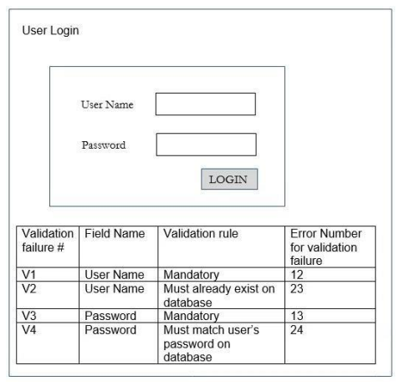
3.2 Review Process
Applying Review Techniques – Example (K3)
Q: You are performing a review of your colleague’s test cases based on the following test basis document:
The Test Cases are as follows:
TC1. PASS – valid ‘User Name’ and ‘Password’; Customer Menu displayed
TC2. FAIL – ‘User Name’ field has blank entry; Error Number 12 displayed
TC3. FAIL – ‘User Id’ entered does not exist on database (i.e. unregistered user); Error Number 23 displayed
TC4. FAIL – ‘Password’ entered does not match user’s password on database; Error Number 24 displayed
You are guided by the following checklist in your review:
C1. There must be one test case to cover success
C2. There must be one test case for each error path (e.g. validation failure)
C3. Each test case must use terminology consistent with the test basis document (field names, error numbering, etc.)
Record a separate defect for each missing test case (checklist items C1 and C2) and for each test case that does not meet checklist item C3.
How many defects should you record?
A. 1.
B. 2.
C. 3.
D. 4

Slide 29
3.2 Review Process
Success Factors for Reviews - Organizational success factors (K2)
Each review has clear objectives, defined during review planning, and used as measurable exit criteria
Review types are applied which are suitable to achieve the objectives and are appropriate to the type and level of software work products and participants
Any review techniques used, such as checklist-based or role-based reviewing, are suitable for effective defect identification in the work product to be reviewed
Any checklists used address the main risks and are up to date
Large documents are written and reviewed in small chunks, so that quality control is exercised by providing authors early and frequent feedback on defects
Participants have adequate time to prepare
Reviews are scheduled with adequate notice
Management supports the review process (e.g., by incorporating adequate time for review activities in project schedules)
Reviews are integrated in the company's quality and/or test policies

Slide 30
3.2 Review Process
Success Factors for Reviews - People-related success factors (K2)
The right people are involved to meet the review objectives, for example, people with different skill sets or perspectives, who may use the document as a work input
Testers are seen as valued reviewers who contribute to the review and learn about the work product, which enables them to prepare more effective tests, and to prepare those tests earlier
Participants dedicate adequate time and attention to detail
Reviews are conducted on small chunks, so that reviewers do not lose concentration during individual review and/or the review meeting (when held)
Defects found are acknowledged, appreciated, and handled objectively
The meeting is well-managed, so that participants consider it a valuable use of their time
The review is conducted in an atmosphere of trust; the outcome will not be used for the evaluation of the participants
Participants avoid body language and behaviors that might indicate boredom, exasperation, or hostility to other participants
Adequate training is provided, especially for more formal review types such as inspections
A culture of learning and process improvement is promoted

Slide 31


