Slide 1


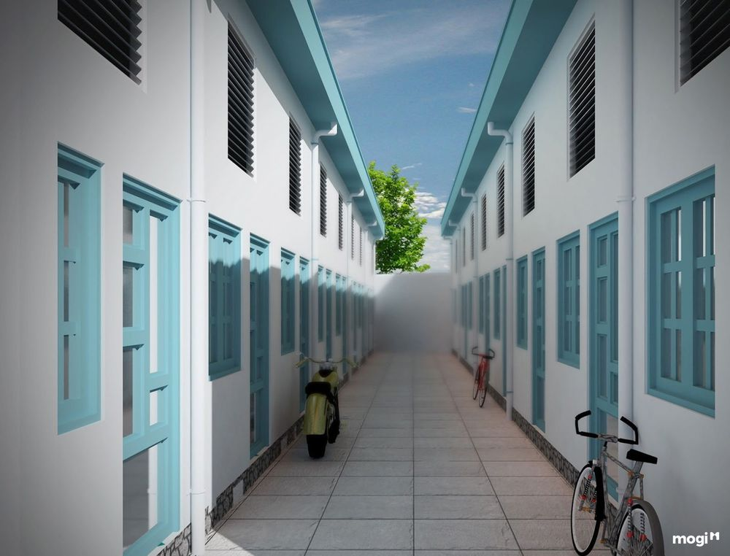
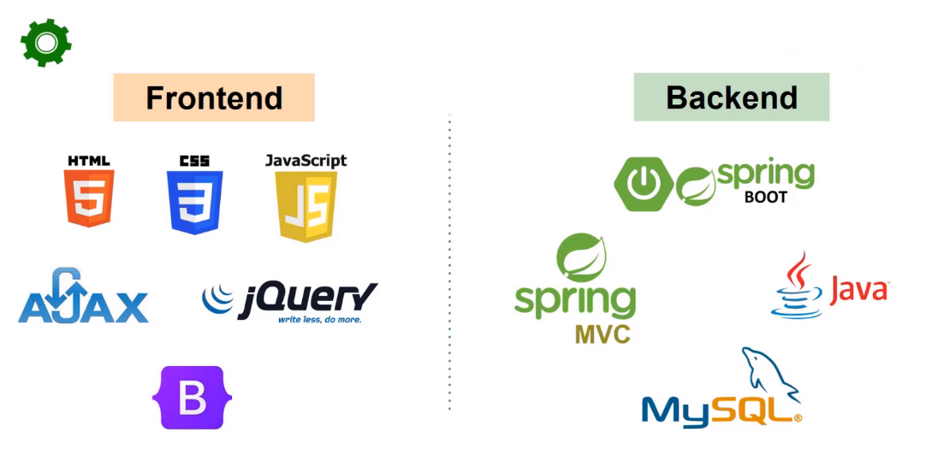
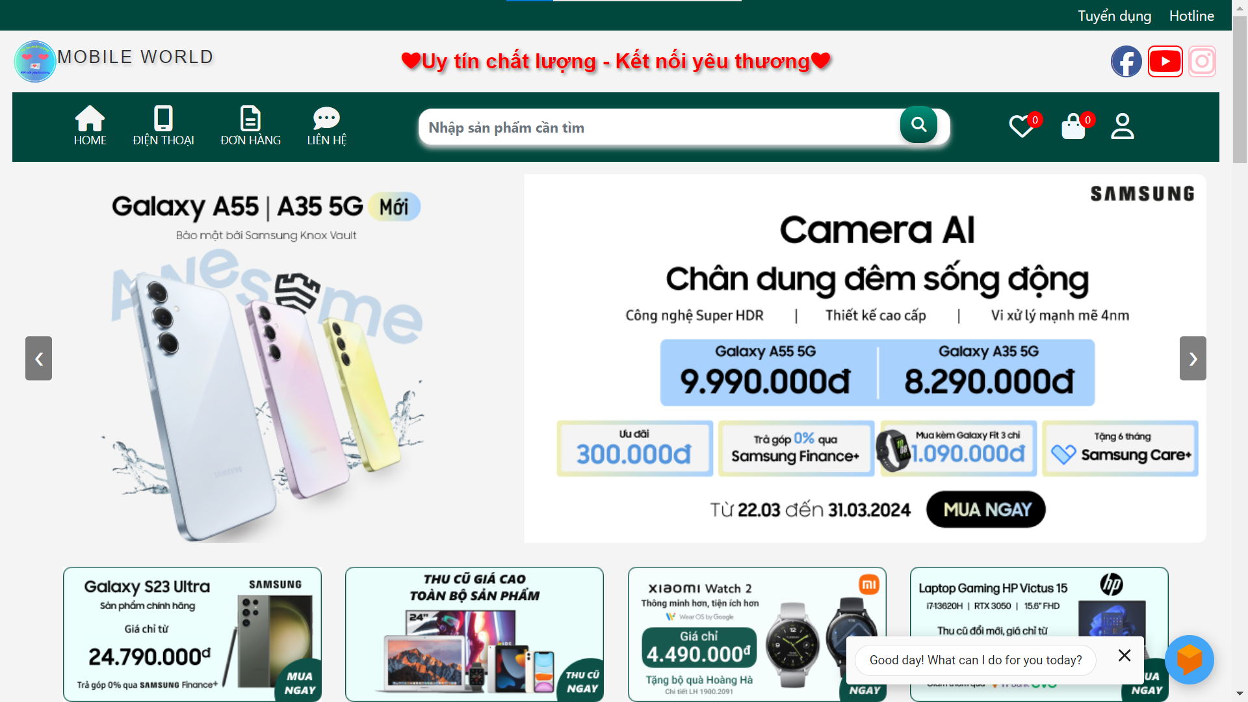
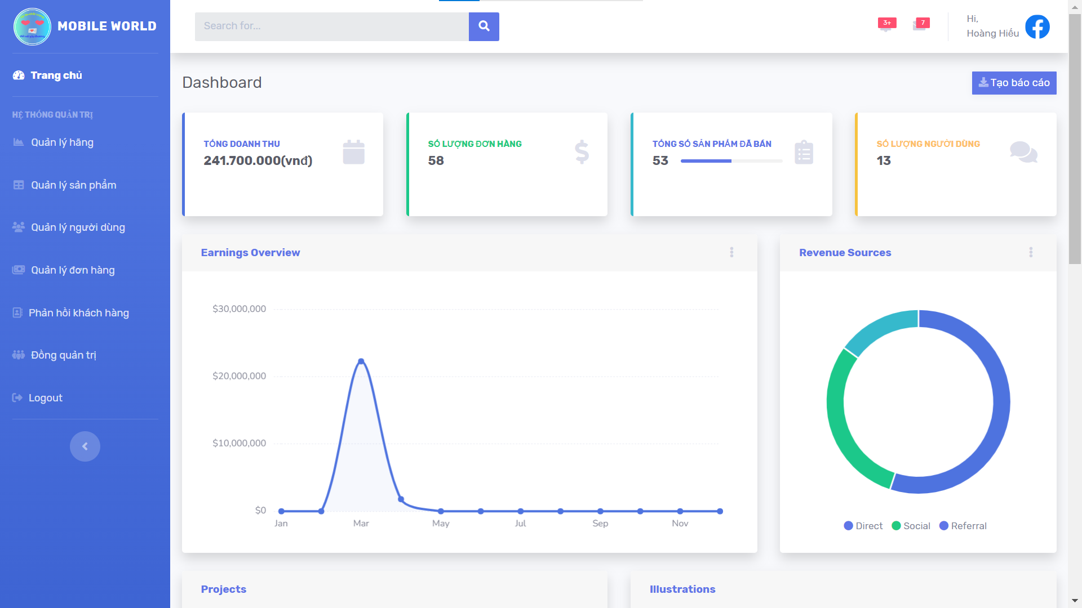
Build a web application based on Java Spring Boot
Nguyen Hoang Hieu
INTRODUCTION
MATERIALS AND METHOD
In an era of rapid technological advancement and increasing digital connectivity, the need for efficient e-commerce solutions has become essential. This project aims to address this necessity by developing a comprehensive web application specifically tailored for the sale of mobile phones. The application will provide a seamless shopping experience, allowing users to browse, compare, and purchase the latest mobile phones with ease.
FUNCTIONS
CUSTOMER
Register and log in
View details, search for products
Filter products by brand, price
Update shopping cart
Make orders
ADMIN
Firm management
Product Management
Account management
Order management
Ask chatbox for information
RESULTS
© 2024 Hoang Hieu. All rights reserved.

